Slide 1
Hezbollah:Counterterrorism Efforts
By: Abrar Mohamedali

Slide 2
Introduction
Hezbollah transformed from a revolutionary terrorist organization to a hybrid entity with political tools
There has been global efforts by countries like the U.S. and Israel to counter Hezbollah's presence.
U.S. focused on crippling Hezbollah's finances; Israel engaged in direct military actions with U.S. support.
This presentation delve on the importance of understanding counterterrorism efforts for regional stability and global security.

Slide 3
US COUNTERTERRORISM STRATEGY
U.S. strategy based on global intelligence campaigns, partnering with countries
Legislative measures, like the Antiterrorism Act, criminalizing support for Hezbollah
Financial measures targeting Hezbollah's finances through intelligence operations
Evaluation of the effectiveness of U.S. strategy against the dynamic nature of Hezbollah's activities.
Implications of U.S. strategies on global counterterrorism efforts and international relations.

Slide 4
Historical Context: Israel's Military Response
Israel's military responded to Hezbollah's 1980s kidnappings and hijackings with a military invasion of Lebanon.
Initial success followed by challenges with local Shi'ite collaboration.
The 2006 Hezbollah attack and IDF offensive failed to achieve their goals.
This raised doubts about counterterrorism strategy in the face of Hezbollah's tenacity and developing tactics
Past conflicts and decisions continue to shape the Middle East's political alignments, power relationships, and security issues.
The 2006 Hezbollah attack and IDF offensive continue to affect regional dynamics, emphasizing the need of historical context in geopolitical analysis.

Slide 5
Critique of Israeli Counterterrorism Policies
Criticism of Israel's counterterrorism policies for lacking coherence and evidentiary basis Failures attributed to hasty decision-making
Examination of specific instances where policy incoherence hindered success.
Lessons learned for the development of effective counterterrorism strategies.
U.S. Involvement and Challenges: U.S. Role and Challenges
U.S. involvement initiated post-Israel's 1982 invasion
Challenges faced, including Hezbollah's unconventional tactics
Examination of challenges in U.S. coordination with allies and adaptation to evolving terrorist strategies.
Impact of U.S. involvement on diplomatic relations in the region.

Slide 6
Hezbollah: Non-Violent Political Activities
By: Jake Waldman

Slide 7
The Hezbollah Social Service Section
The Jihad al-Binna Development Group (JBDG)
The Martyrs Foundation
The Woman’s Association
The Islamic Health Organization (IHO)
The Educational division
Imam al-Mahdi Scouts

Slide 8
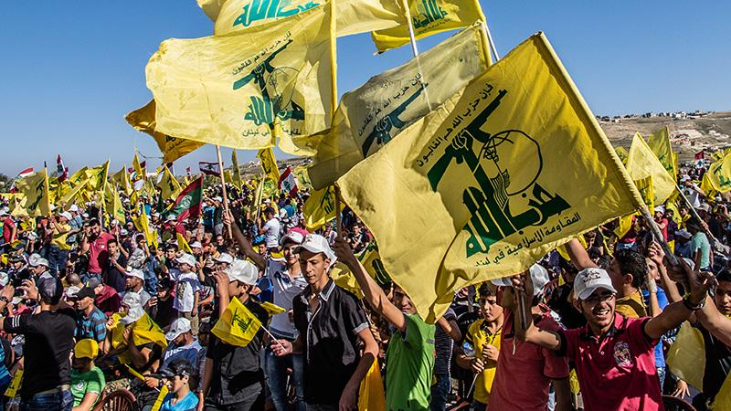
Hezbollah as a Political Party
Participated in elections since 1992
Has increased its parliamentary bloc from 12 to 57 seats from 2000 to 2009.
Corruption among Hezbollah party officials is widespread

Slide 9
Benefits to Hezbollah
Many of these institutions were created to enable Hezbollah to prosper as an organization and political party
The Imam al-Mahdi Scouts are a tool for indoctrination.
Through these services, Hezbollah has built and maintained its basis for ideological support, expanded its voting bloc, and boosted its influence within the Lebanese government.

