Slide 1
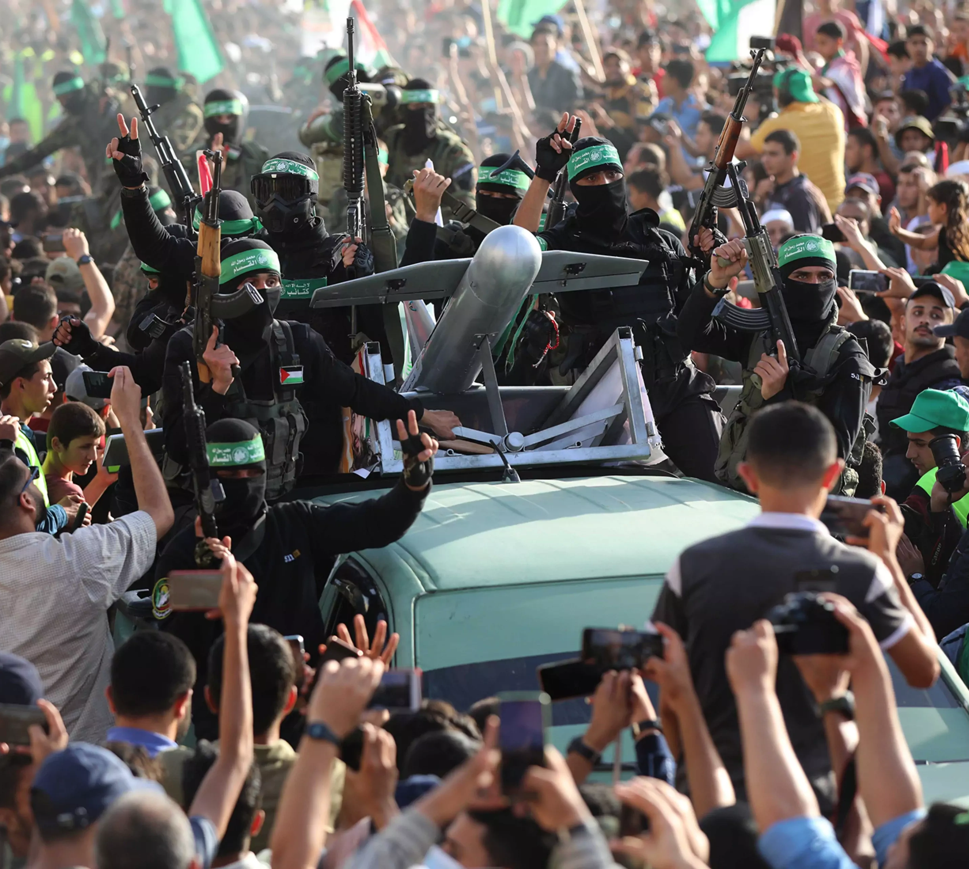
Hamas
Support
Recruitment
Funds
by Alyssa Santoro-Adajian
Amra, Ashraf. (2021). A parade for the Izz ad-Din al-Qassam Brigades, Hamas’s militant arm, is held in Gaza.

Slide 2
Funding - charities
POLITICAL WING
SOCIAL WING
MILITARY WING
HAMAS
Capitalization on foreign sympathy for Palestinians
Misleading of donors
Separation of popular support arm
Locations: Persian Gulf States, US, Great Britain, Germany, etc.

Slide 3
Supporters: States & fellow terrorist organizations
Iran
Hezbollah
Other nations
Ended in 2011, resumed in 2017
Other nearby countries
Iraq
Saudi Arabia
Help with smuggling weapons
Educational help – bombing
$3-50 million per year provided
Incentive-based
Weapons, etc.
Amro, A. (2022). Members of Lebanon’s Hezbollah take part in Ashura commemorations in a southern Beirut suburb [Online image]. Getty Images. https://cdn.cfr.org/sites/default/files/styles/immersive_image_3_2_desktop_2x/public/image/2020/01/Hezbollah.jpg.webp
Amro, Anwar. (2022). Members of Lebanon’s Hezbollah take part in Ashura commemorations in a southern Beirut suburb

Slide 4
Recruiting tactics & locations
Mosques
Universities
The internet
Frequent attenders - disposition
Preach martyrdom, family compensation and support
Arab universities – Syria, Yemen, Sudan
Recruitment websites
Honor suicide bombers
Childrens’ magazine

Slide 5
Future of hamas
Continued support
Repairing relations
Syria
Iran
Hezbollah
Supporters
Recruitment tactics

