Slide 1
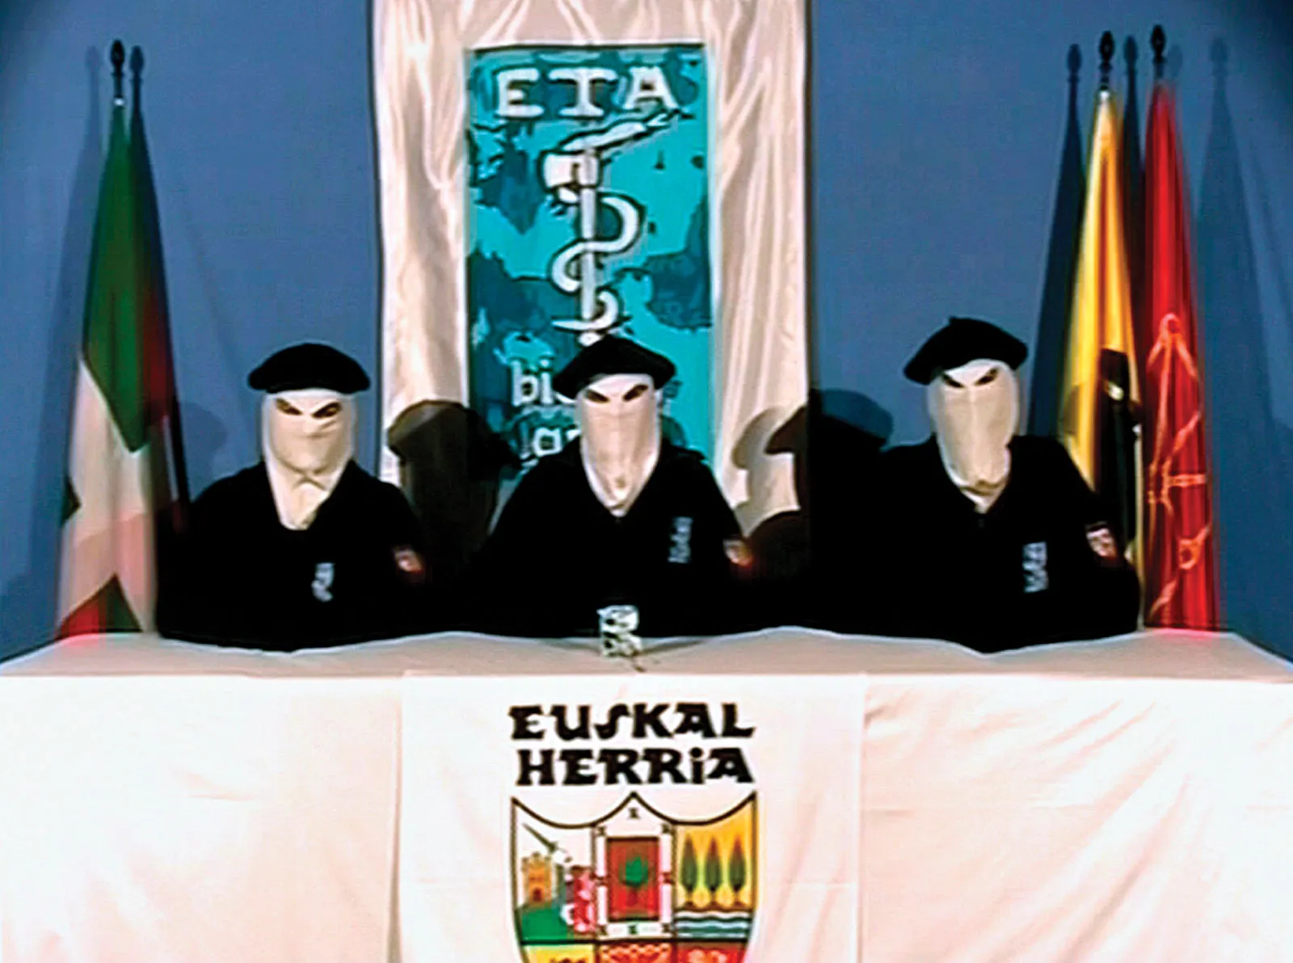
Euskadi ta Askatasuna - Methods of Operation

Slide 2
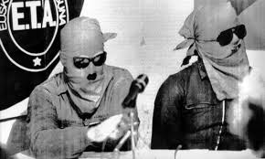
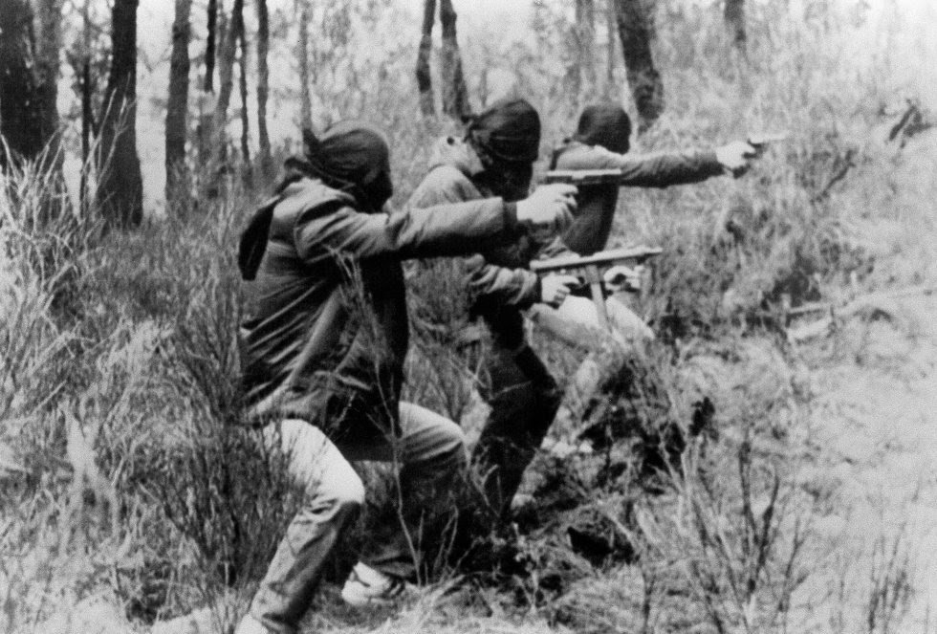
Methods
Non violence and violence
Violence gained attention from government
Negotiations

Slide 3
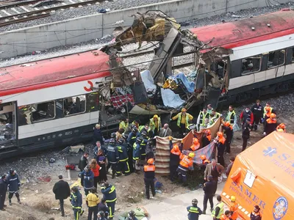
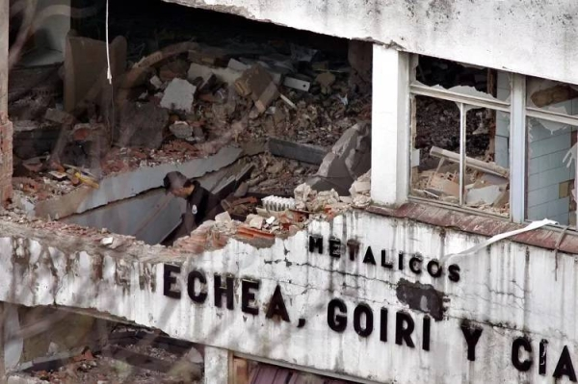
Tactics
Assassinations
Bombing buildings/cars
Intimidation
Physical damage over casualties

Slide 4
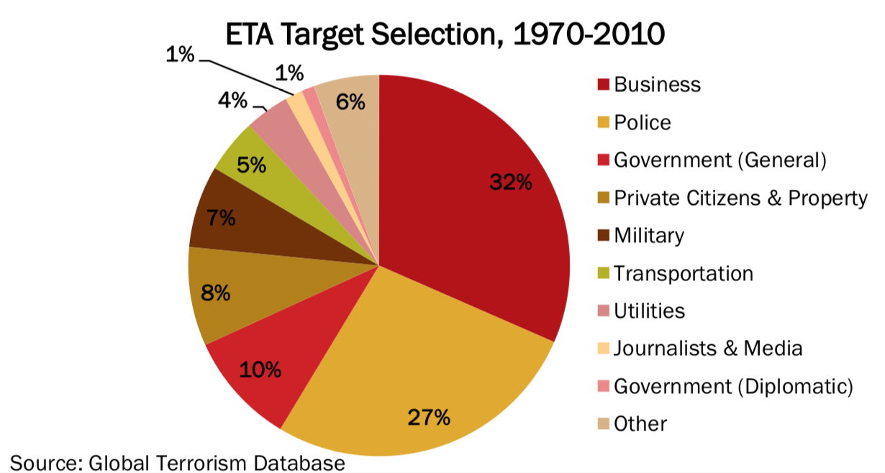
Targets
Politicians
Non- nationalists
Law Enforcement

Slide 5
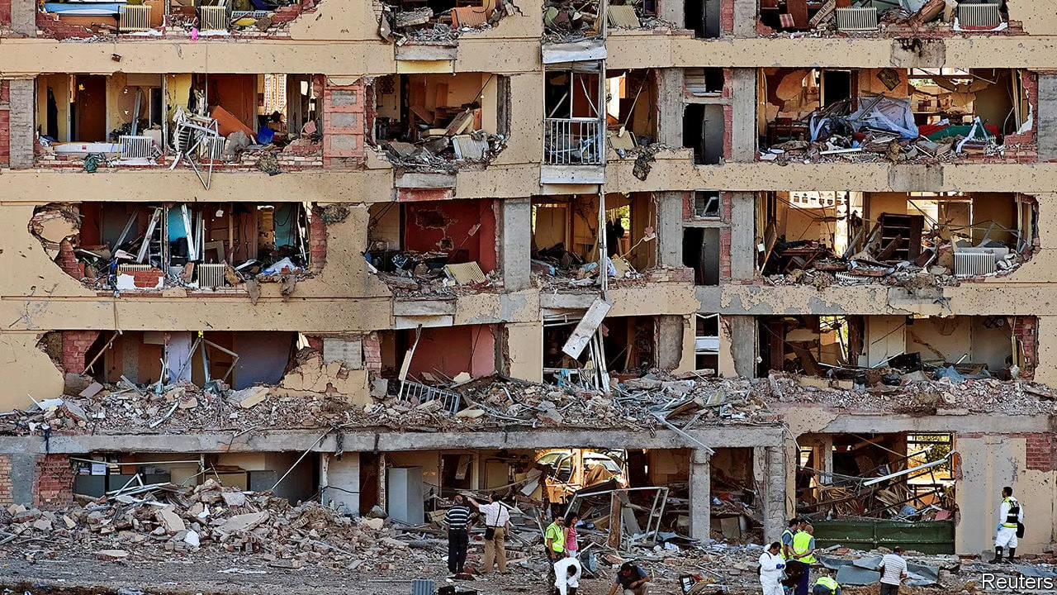
Disbandment
Decimation of ranks
Lack of public support

