Slide 1
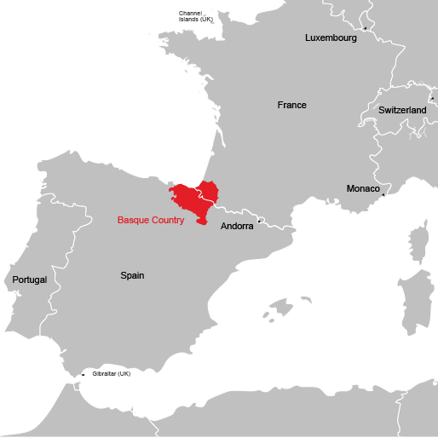
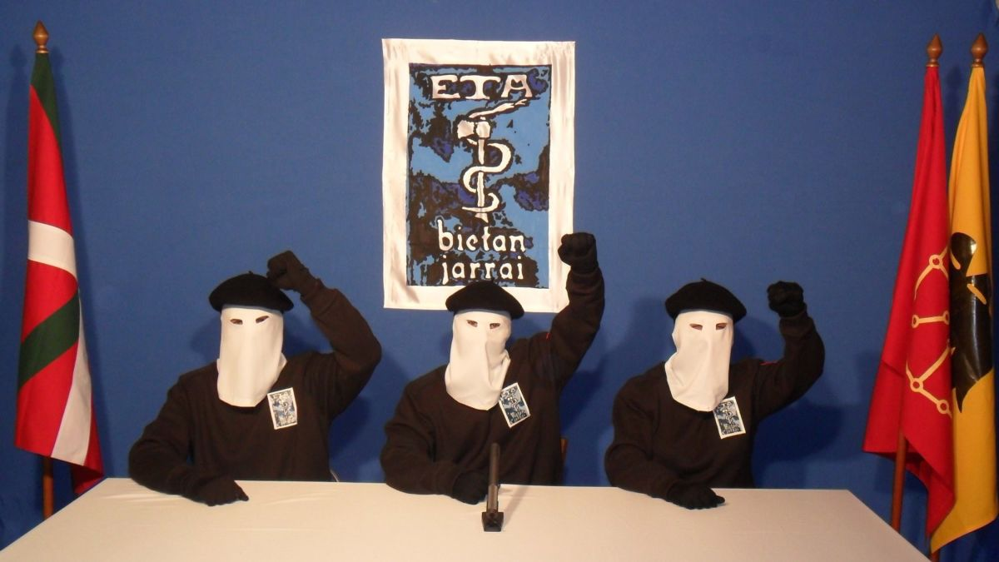
Origins, Objectives, and Doctrines: Euskadi Ta Askatasuna (ETA)

Slide 2
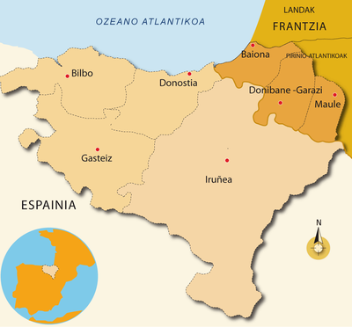
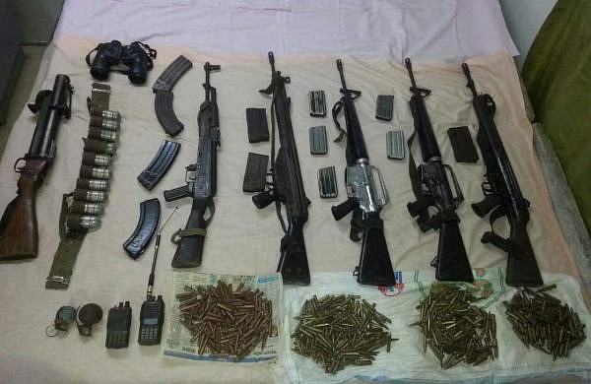
Doctrines and Objectives
Ethno-nationalism
Religiosity, later Marxism
“Bietan jarrai”
Armed Struggle + Politics
Attack → Response → Mobilization
Independent Basque nation-state
7 administrative regions of “Basque Country”

Slide 3
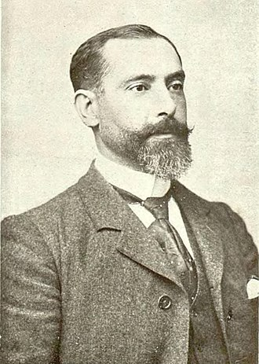
Origins: Basque Separatism
Culturally distinct Basque people.
Basque conflicts with Spanish crown over regional autonomy.
Industrialization → Migration → Fear of culture erasure.
1895: Sabino Arana y Goiri forms Basque Nationalist Party.
Advocates for independence.

Slide 4
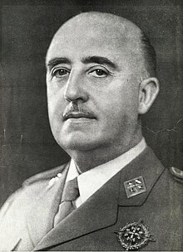
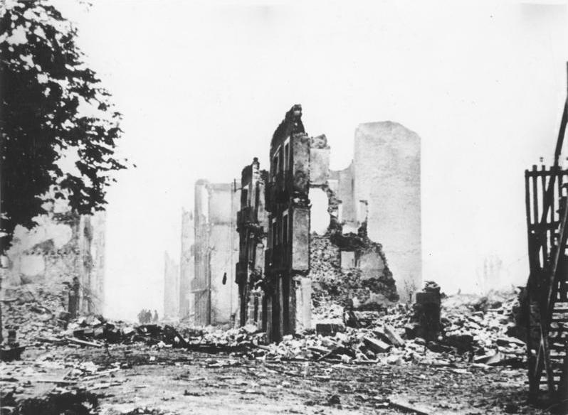
Origins: ETA
Oppression of Basque language and culture under Franco.
Basque Nationalist Party’s lack of armed resistance.
Assemblies held in France to determine ideology.
Repression of Trade Unions by the Franco regime.
General opposition to fascism.

Slide 5
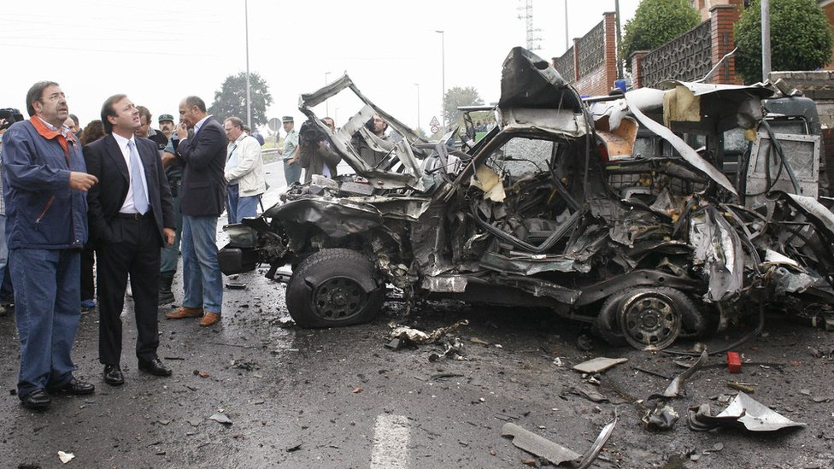
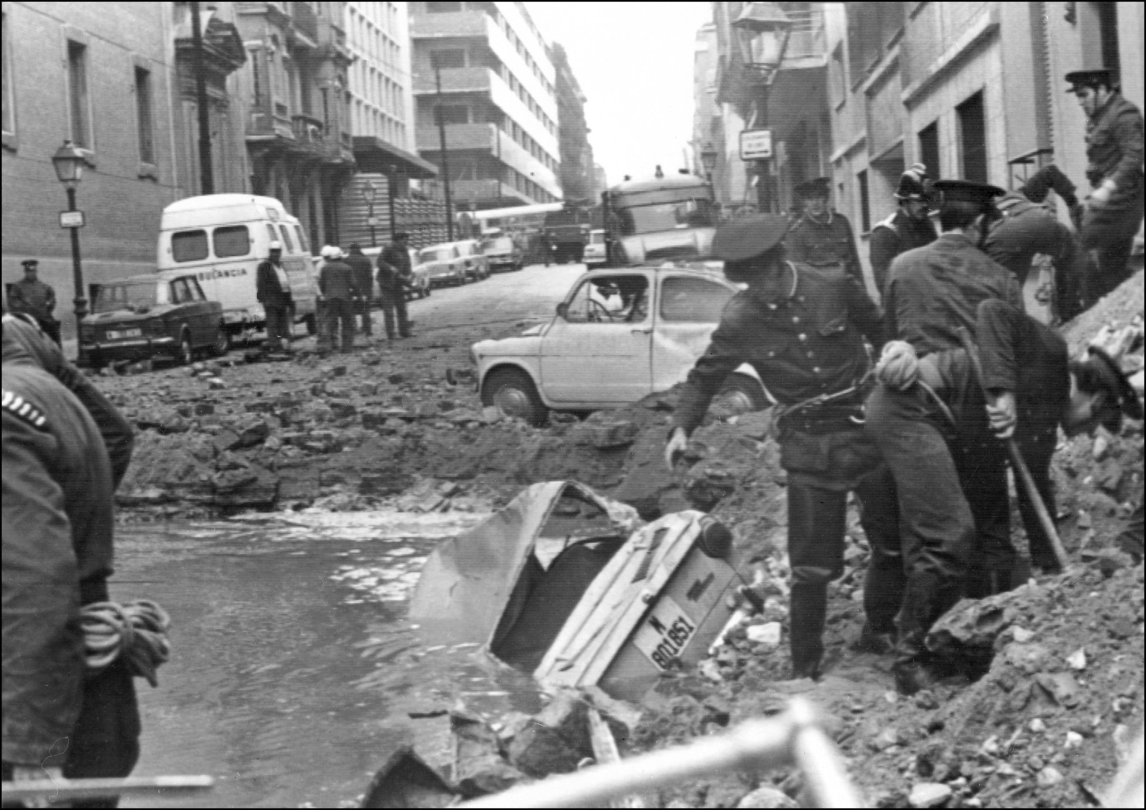
ETA as a Terrorist Organization
1959: Formation
1968: Txabi Etxebarrieta
1975: Death of Franco
2011 Final Ceasefire
2018: Dissolution

