Slide 1
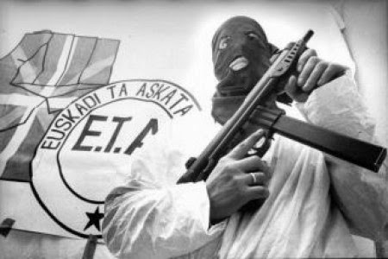
The leadership and leadership structure: The Euskadi ta Askatasuna (ETA)

Slide 2
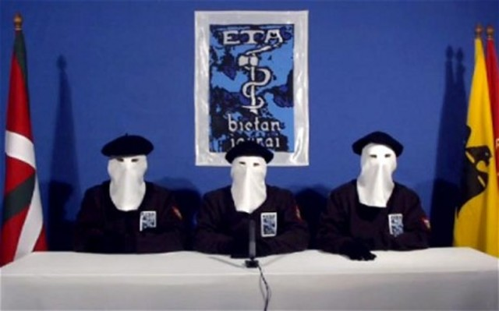
ETA Leaders: Who are they and what do we know?
Secretive
Basque Nationalism Ideology
Leadership Committee (Imposing decisions)
Hierarchical approach

Slide 3
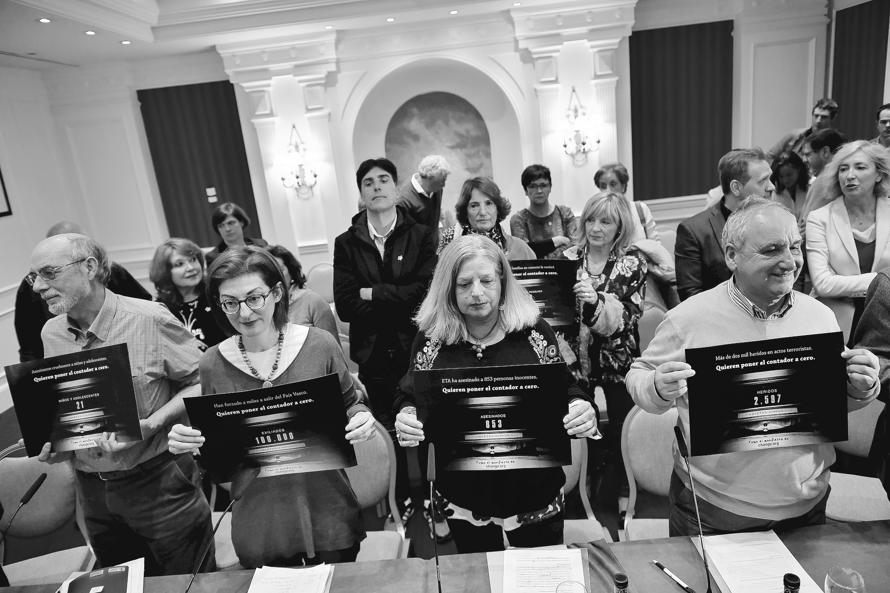
Imposing and Presenting Leadership Structure:
Decentralization
Network of Cells
Spanish Transition
Subcommittees
Politics vs. Violence

Slide 4
Leadership and Structure Stability: The Disputes
Separation
Politics vs. Violence
Moderate Regionalist vs. Radical Nationalist

Slide 5
The ETA’s Demise:
Weakened leadership and leadership structure
Higher demands
Reliance on Decentralization
Arrests of possible leaders
May 2008: Francisco Javier Lopez Pena
November 2008: Miguel de Garikoitz Aspiazu Rubina

