Slide 1


Boko Haram Operations
By – Devin Housman

Slide 2

Funding and External Aid
Primarily fund themselves through criminal activities including robbery and donations
01
Assert their control by exploiting resources and populations
02
Sell women into slavery
03

Slide 3

Affiliations
An alliance between Boko Haram and al- Qaeda began in 2009
This alliance was created in order to create a transnational organization and an Islamic State

Slide 4
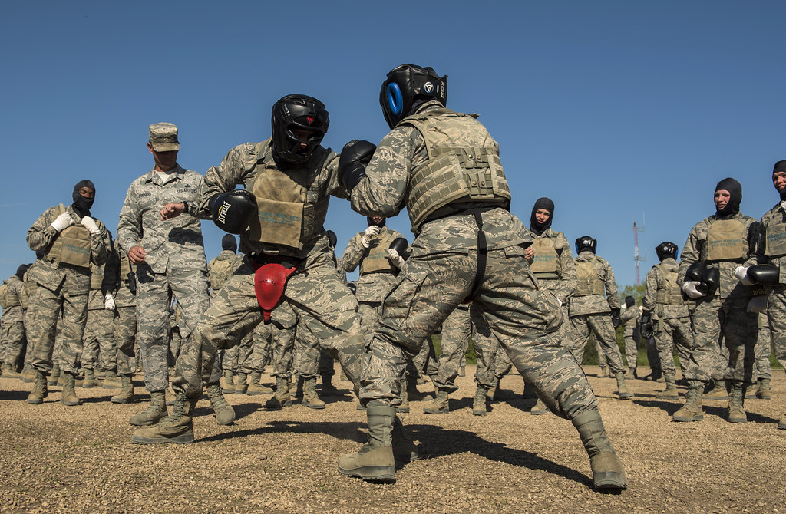
Training
Abdelmalek Droukdel – the leader of AQIM declared his support for Boko Haram
AQIM helped train individuals within Boko Haram
This Photo by Unknown Author is licensed under CC BY-NC

Slide 5

Recruitment
Child obductions for immediate use
Women and children are recruited for suicide missions
Boko Haram constantly needs new members due to its recruitment practices
This Photo by Unknown Author is licensed under CC BY

