Slide 1
Abu Sayyaf Group: Support
Monica Rolf

Slide 2
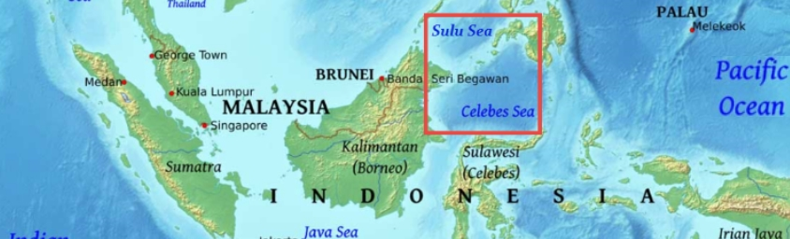
Funding
Kidnapping for ransom
90% of their funding
Piracy and Hijacking
Maritime operations to take over and rob commercial vessels
These tend to lead to kidnappings

Slide 3
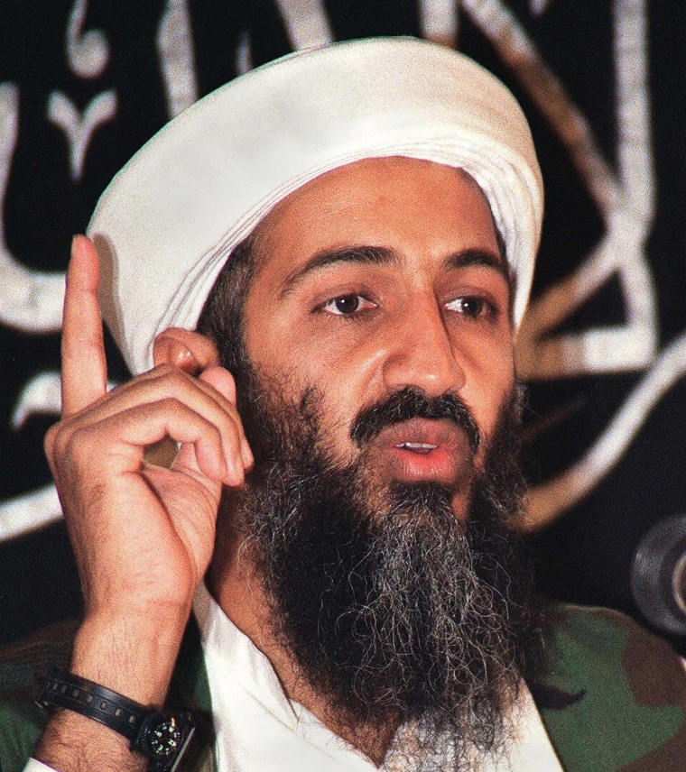
Allies
Foundational support from Al-Qaeda
Osama Bin-Laden and Ramzi Yousef
Funded training for recruits
Islamic State in the Philippines
Pledged allegiance to the IS
Supported the IS through kidnappings

Slide 4
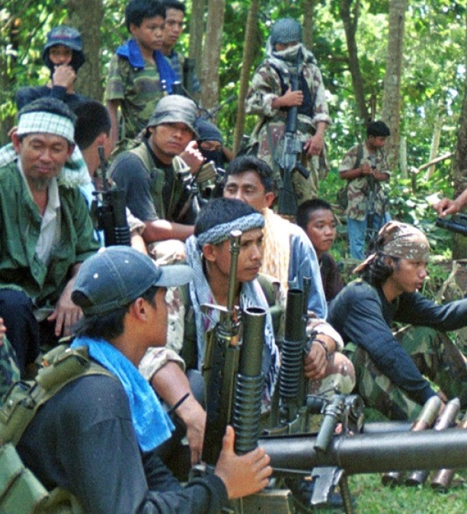
Recruitment
Financial benefits
Filipino economy is strong, Gini Coefficient is high
Social benefits
Sense of community, family, support
Fluctuation of membership & funds
High membership -> high kidnapping
Low membership -> terrorist attacks
Lack of leadership

Slide 5
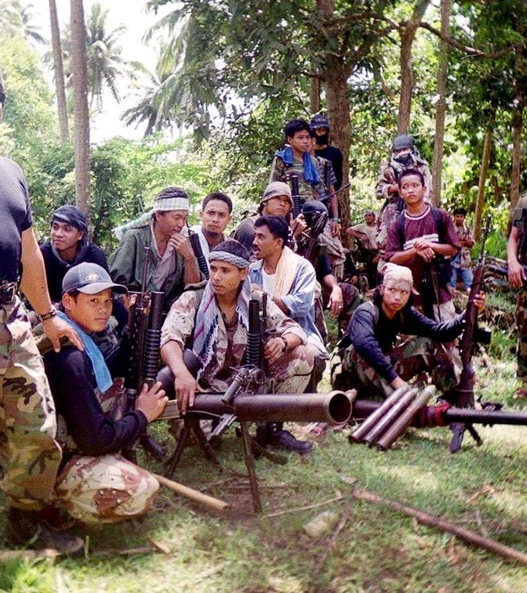
Effectiveness
Influence has diminished since 9/11
Banning of Ramzi Yousef
Death of Osama Bin Laden
Still in operation
Much smaller scale, no longer a large threat
Struggling to attract recruits
Women taking on operational role

