Slide 1
Strategy, Targets, and Methods of Operation of Abu Sayyaf
By: Caleb O’Brien

Slide 2
Strategy
Goal is an independent state encompassing Philippine Muslims.
Uses kidnapping, bombing, hostage, assassinations, beheadings, armed assaults, robbery, murder, and money extortion.
Avoidance of capture
This Photo by Unknown Author is licensed under CC BY-SA-NC

Slide 3
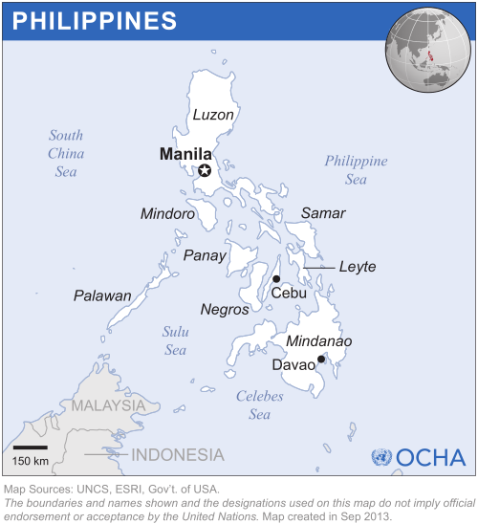
Targets
Philippine Christians
Rich Philippine members
Tourists
Occasionally target US citizens
This Photo by Unknown Author is licensed under CC BY

Slide 4
Methods of Operation
Terrorist attacks
Kidnapping for ransom
Connections to international terrorism
Extortion
This Photo by Unknown Author is licensed under CC BY-SA-NC

Slide 5
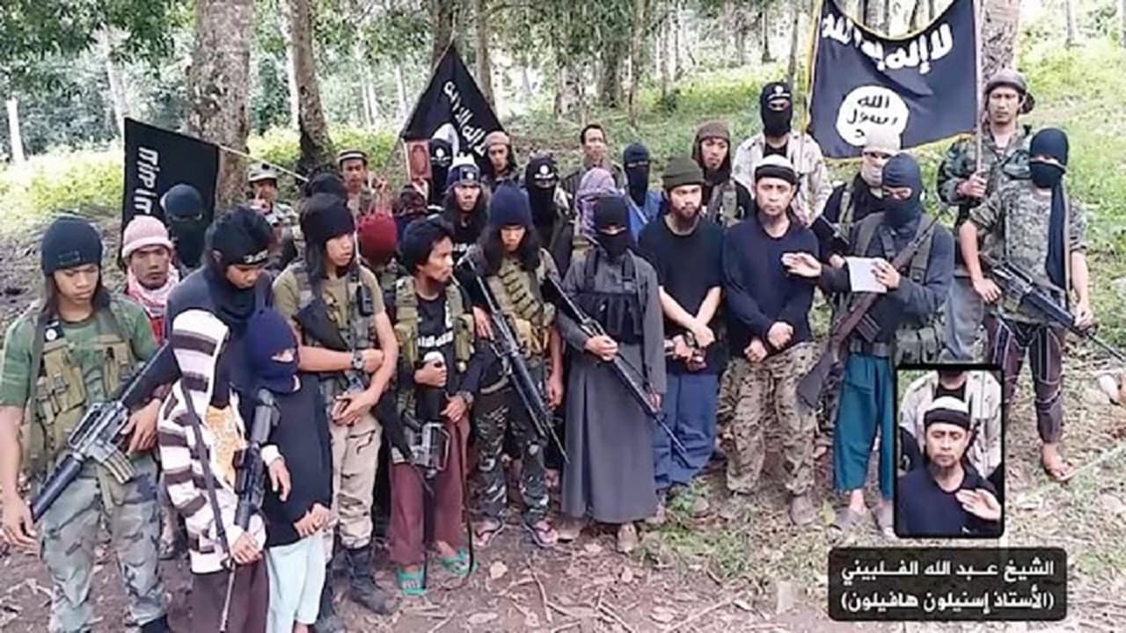
Conclusion
Their methods have partially worked over the years
Getting rid of Christians has not worked
Their ransom tactics have proven to work
Have made little or any progress towards becoming an independent Islamic state

