Slide 1
Origins of Abu Sayyaf
By Aidan Lyons

Slide 2


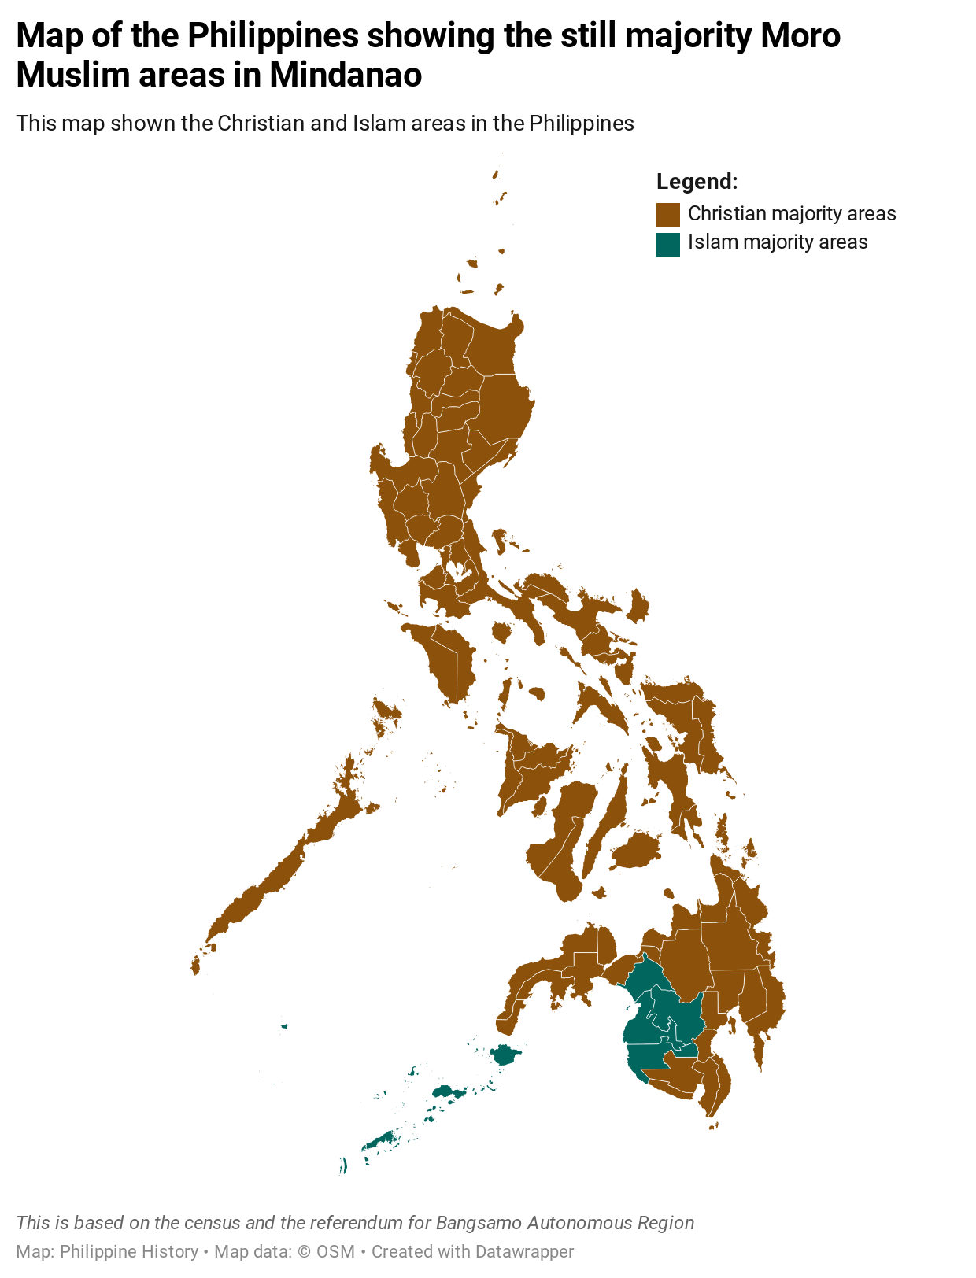

Islam in the Philippines
Christians always the large majority
The tiny Muslim population exists in the southern provinces
Constant conflicts between Muslims and Christians
Members of the 13 Muslim ethnicities: the Moro people
In 1972, the Moro National Liberation Front (MNLF) was founded
Engaged in armed conflicts and political affairs

Slide 3
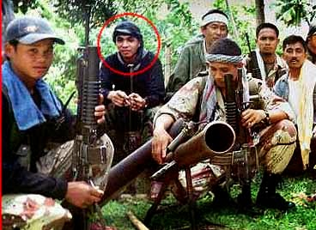
Abdurajak Abubakar Janjalani
Member of MNLF
1979 - Traveled to Afghanistan to fight against the Soviets
Osama bin Laden befriended him; saw his leadership potential
Bin Laden taught him militant tactics
Janjalani also studied Wahhabism and Jihad in Pakistan and Saudi Arabia

Slide 4
Founding ASG
Janjalani returned in 1988
Began forming a militant group in MNLF, named Mujahideen Commando Freedom Fighters
Recruited MNLF members frustrated with the recent cooperation with the government
Group received a large influx of members in 1991 and they separated from MNLF
Janjalani renamed the group Abu Sayyaf, the name he used in Afghanistan

Slide 5
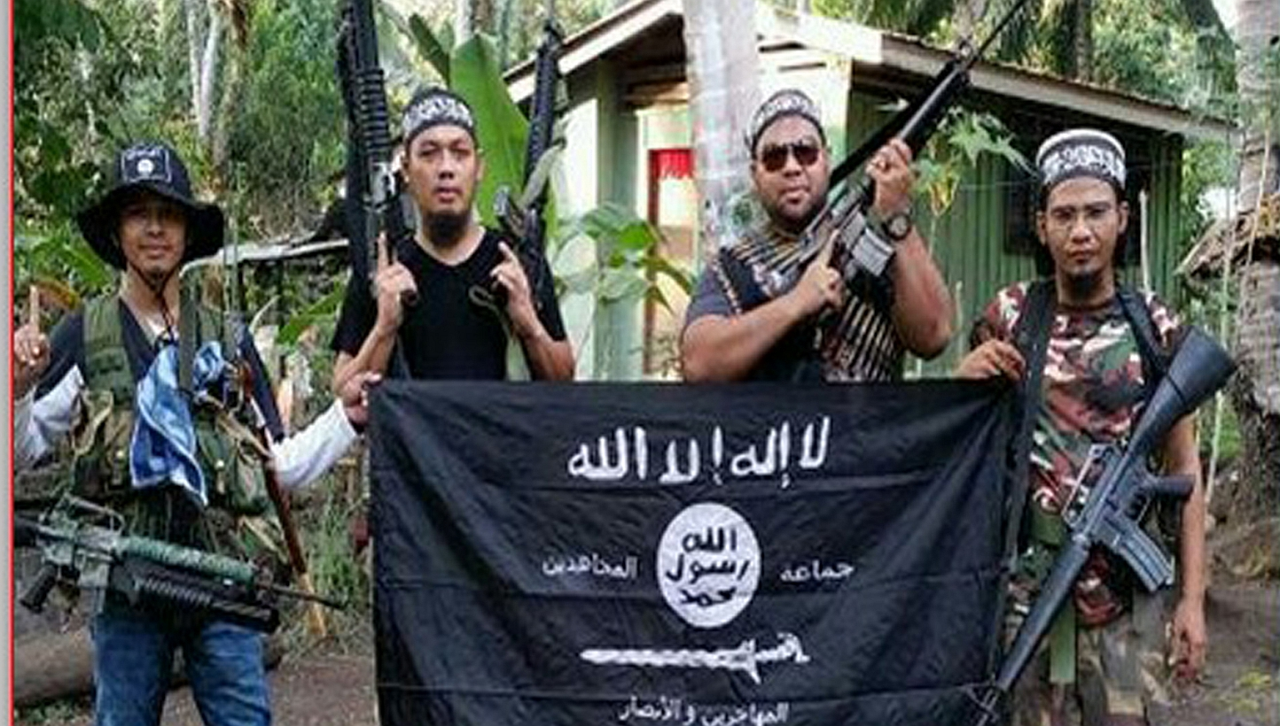
Doctrine and Ideology
ASG membership completely made up of Moro people
Followers of Wahhabism; reject other forms of Islam
Combination of ethnonationalist and religious-nationalist
Purely violent; rejects any cooperation with the government

Slide 6
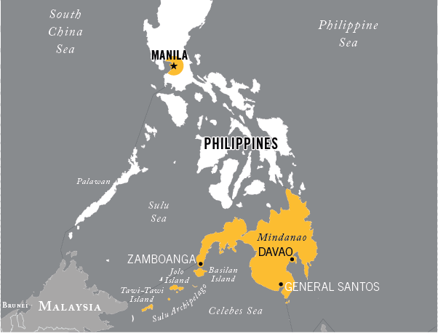
Objectives
Largely mirrors Al-Qaeda’s objectives in the Middle East
Take land for an independent Islamic State
Defend that land against Christian interference
Can they succeed? No.
Numbers are too low in 2023
Former President’s crackdown on terrorism

