Slide 1
Who: ASG What: Extremist group Where: Philippines When:1990’s Why: establish Islamic state

Slide 2
founder & objectives
Abdurajak Abubakar Janjalani
Fought in Afghan-soviet war
marginalization of Muslims
Possession of Islamic state

Slide 3
Evolution of leadership
Internal Struggles
Death of leader disorientation
Financial difficulties
Interpretation of religion
External Pressures
Military counterterrorism actions
Kidnapping Ransoms
Disruption of funding

Slide 4
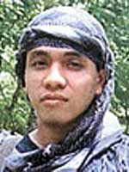
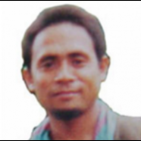
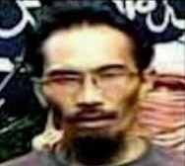

Slide 5
Current status
2014 last sighting
Hatib Hajan Sawadjaan
Unsuccessful in establishing Islamic state
Loss of control and power

