Slide 1
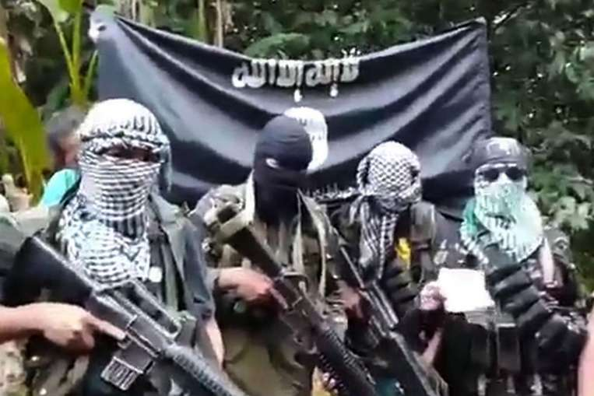
Abu Sayyaf Objectives
Why is Abu Sayyaf a significant threat?
A versatile, decentralized system
Participates in criminal activities
Abuses inaccessible areas
How does collaboration enhance counterterrorism efforts?
Multiple sources improve tracking
Strengthened capabilities
Coordinated, effective efforts

Slide 2
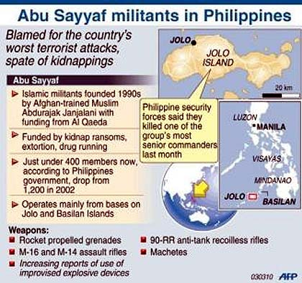
Strategies and tactics
Role of Operations
Law enforcement dismantles networks; military targets leaders
Disrupting Abu Sayyaf's operations requires both
The complexity of peace talks
Fragmented group structure causes problems
Criminal activity impedes discussions.

Slide 3
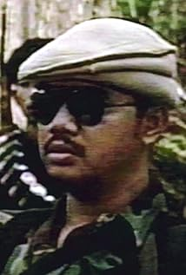
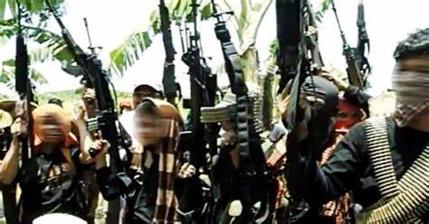
Achievements and Challenges
Challenges
Ability to adapt and recover from leadership losses
Limits group disruption.
Janjalani- 1998
Sabaya- 2002
Hapilon- 2017

Slide 4
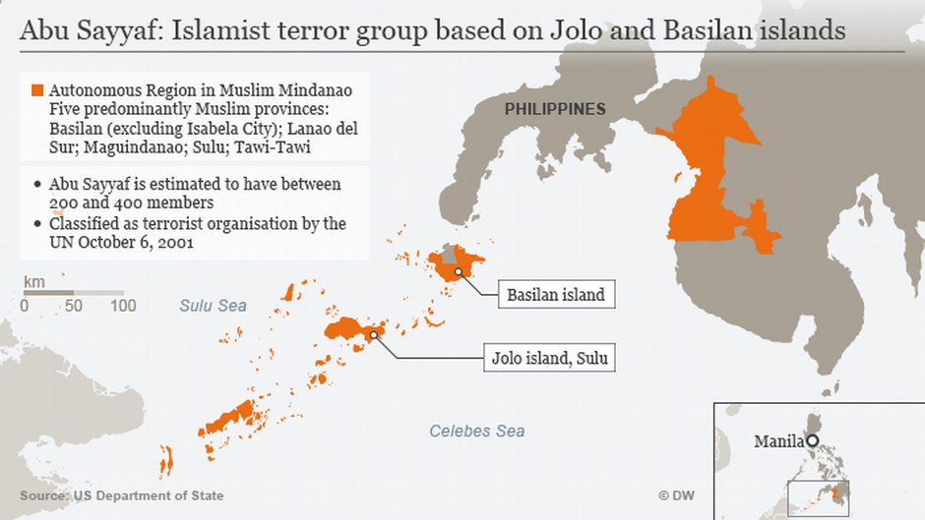
Regional Approaches to Counterterrorism
Differences in Approach
The Philippines places a strong emphasis on military force, whereas Malaysia and Indonesia prioritize cooperation and intelligence
Abu Sayyaf's adaptability threatens the Philippine strategy
Role of Intelligence-sharing
Improves regional Abu Sayyaf surveillance and counterterrorism cooperation
Critical for preventing group cross-border activity

Slide 5
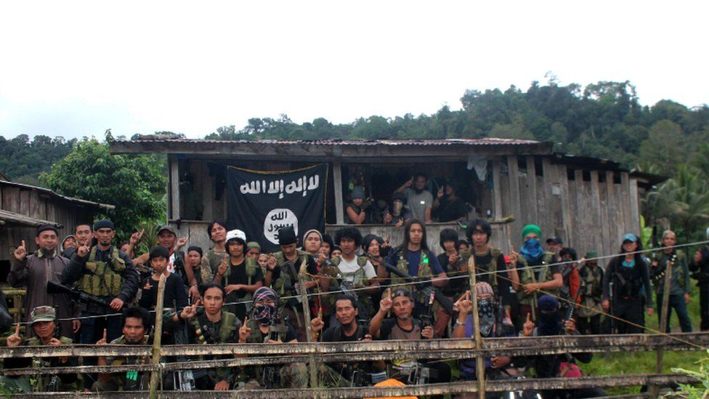
Future Strategies
Comprehensive Approach: Focus on overall strategy rather than military tactics.
Community Partnership: Take grassroots measures to stop radicalization and recruiting.
International Collaboration: Strengthen international and neighboring alliances.
Technology and Training: Increase situational awareness with modern surveillance equipment.
Proactive Measures: Enhance intelligence to predict and disrupt terrorist activities.

