Slide 1
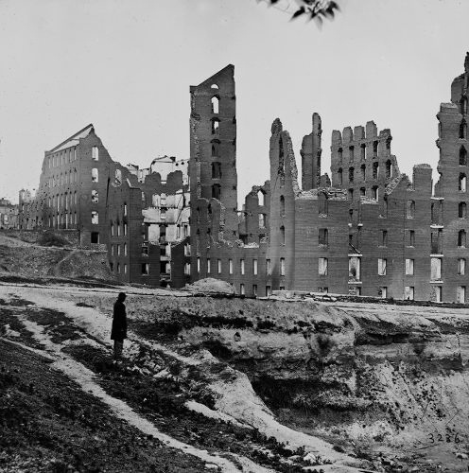
US Strategy to 1890s
Total War: Richmond 1865

Slide 2
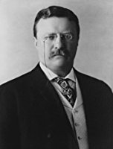
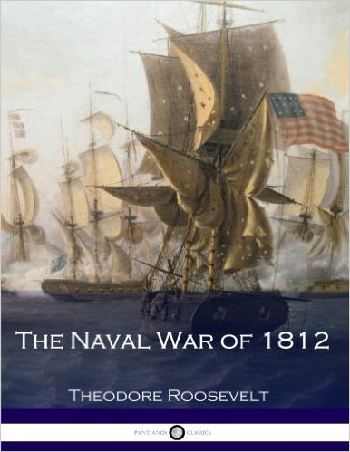
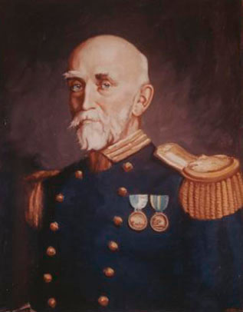
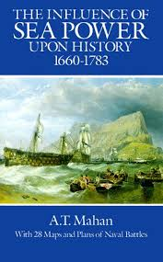
1890s: Naval Power
Theodore Roosevelt Alfred Thayer Mahan
(1858-1919) 1882 1st ed. (1840-1914) 1890 1st ed.

Slide 3
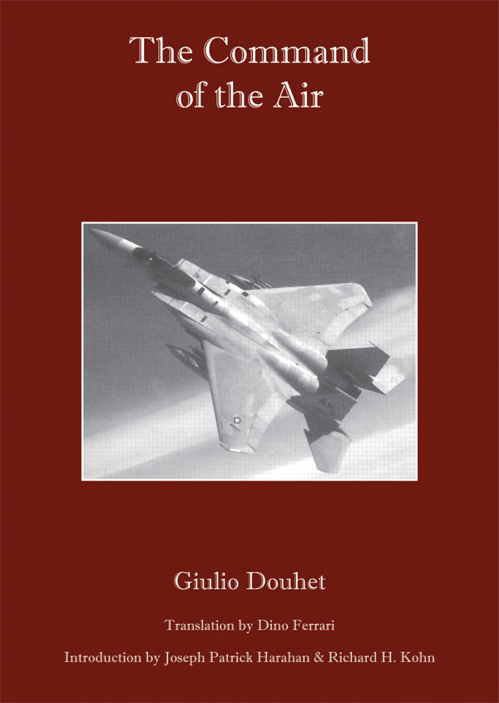
The Rise of Airpower: 20th century
Two Views
Airpower is a novelty
Airpower is decisive
Giulio Douhet (Italy)
William Mitchell (US)

Slide 4
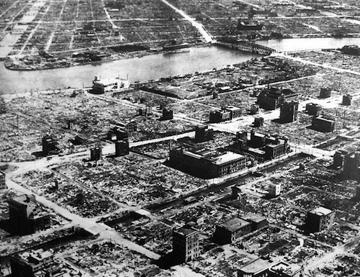
WW II Strategic Bombing
Tokyo May 9-19, 1945

Slide 5
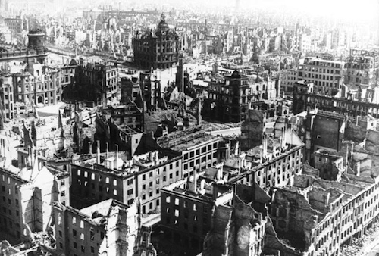
Dresden (1945)

Slide 6
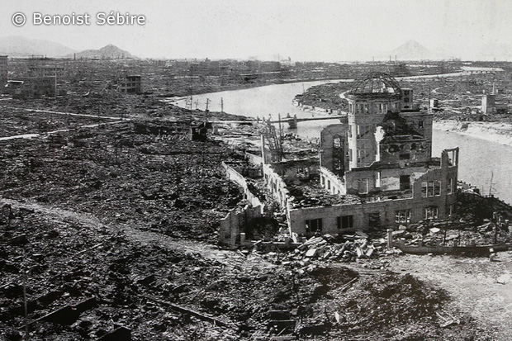
August 6, 1945 Hiroshima

Slide 7
Hiroshima
Before
After

Slide 8
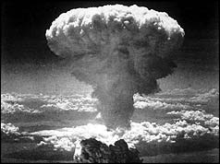
August 9, 1945 Nagasaki

Slide 9
Nagasaki: Before and After

Slide 10
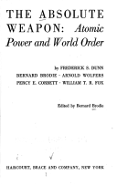
Is Strategy Over? Yes and No
Bernard Brodie,
The Absolute Weapon, 1946
Bernard Brodie,
Strategy in the Missile Age, 1959

