Slide 1
Russia and States of the Former Soviet Union

Slide 2
Russian Presidents
Boris Yeltsin
1991-1999
Vladimir Putin
1999-2008, 2012--

Slide 3
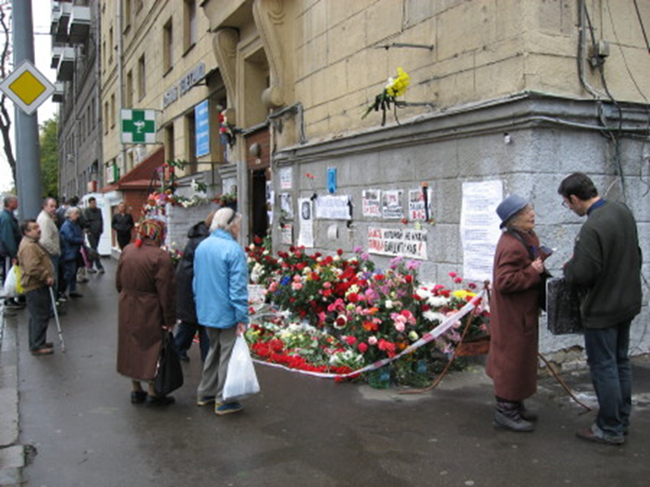
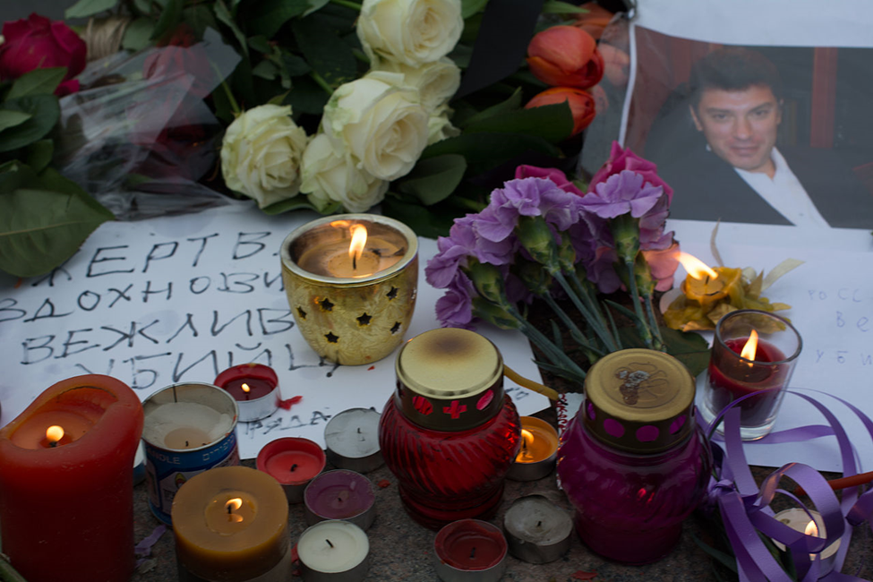
Putin’s Rule at Home
“Former Russian Spy Poisoned by Nerve Agent, British Police Say” –
NY Times
Anna Politkovskaya, Boris Nemstov,
October 2006 Feb. 2015

Slide 4
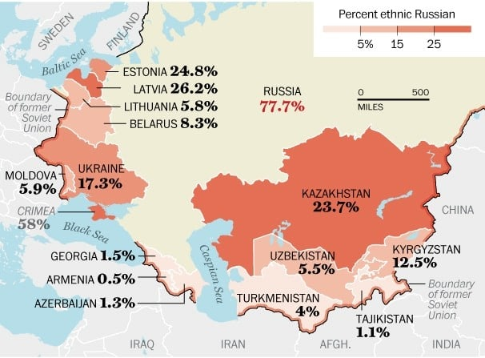
Putin Foreign Policy
Return to Great Power Status
Reclaim Sphere of Influence
Near Abroad
Weaken NATO
Undermine
Liberal Democracy

Slide 5
NATO Expansion

Slide 6
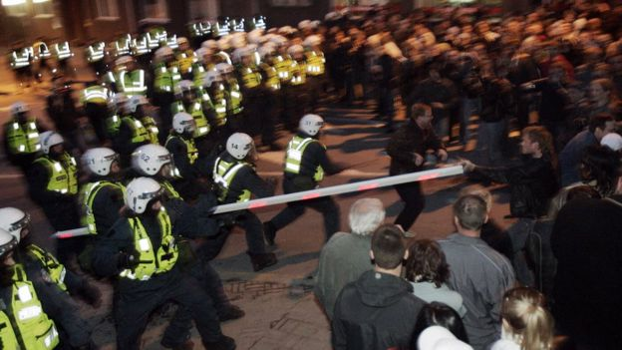
Hybrid Warfare
Mixture of Cyberattacks
Information Warfare
Media/social Media Disinformation Campaigns
Paramilitary Operations
Estonia 2007

Slide 7
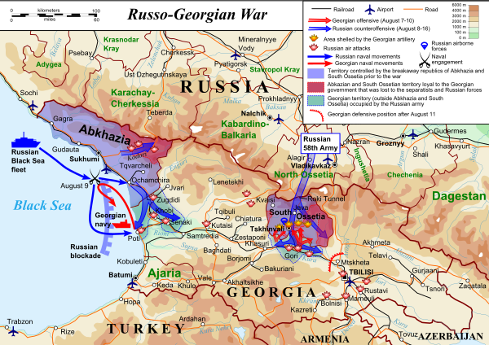
Russia vs. Georgia 2008
Abkhazia and South Ossetia

Slide 8
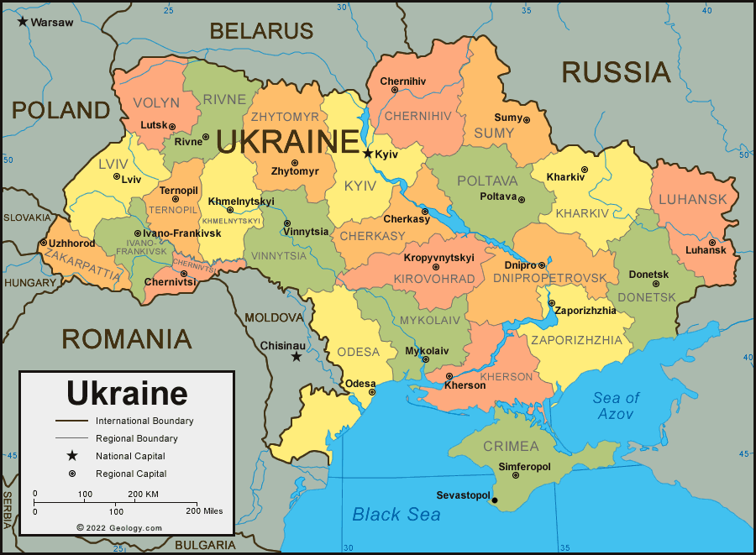
Independent Ukraine
Budapest Agreement December 1994

Slide 9
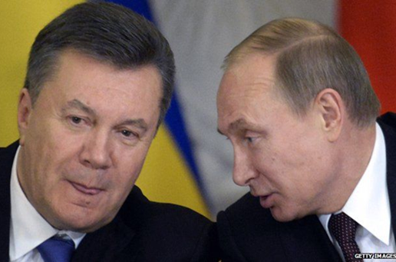
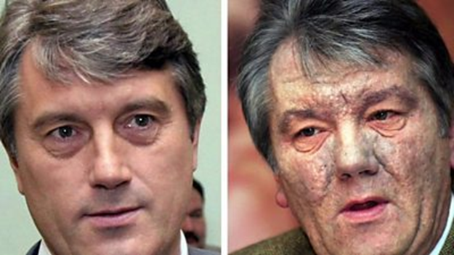
2004 Election
Viktor Yanukovych Viktor Yushchenko

Slide 10
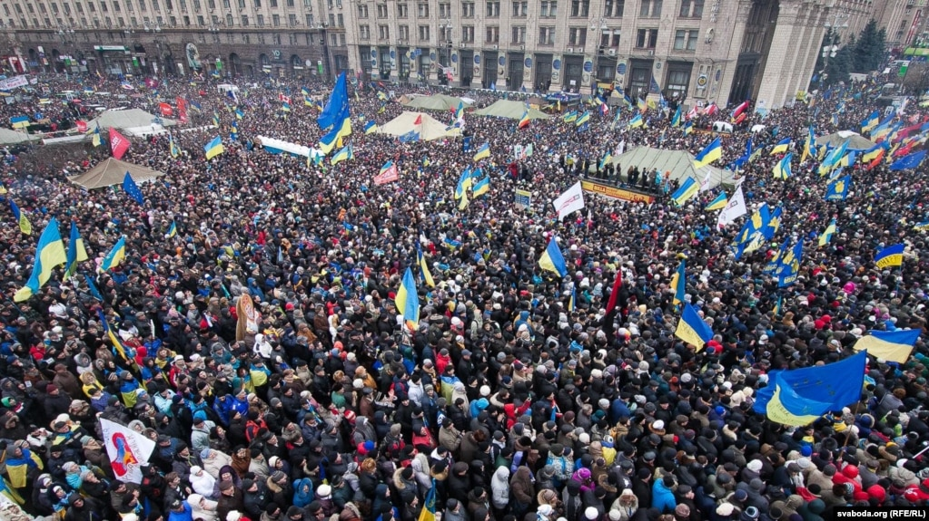
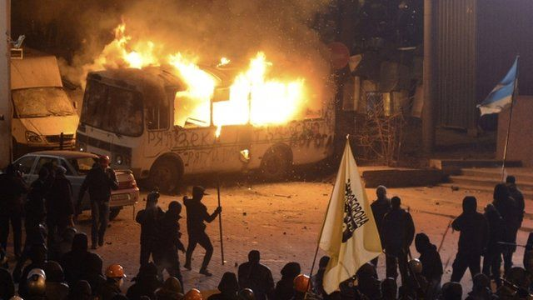
Ukraine Crisis November 2013--2014
Protests in Kyiv Jan-Feb 2014

Slide 11
Russian Response 2014
“Little Green Men”
Russia’s Sphere of Influence

Slide 12
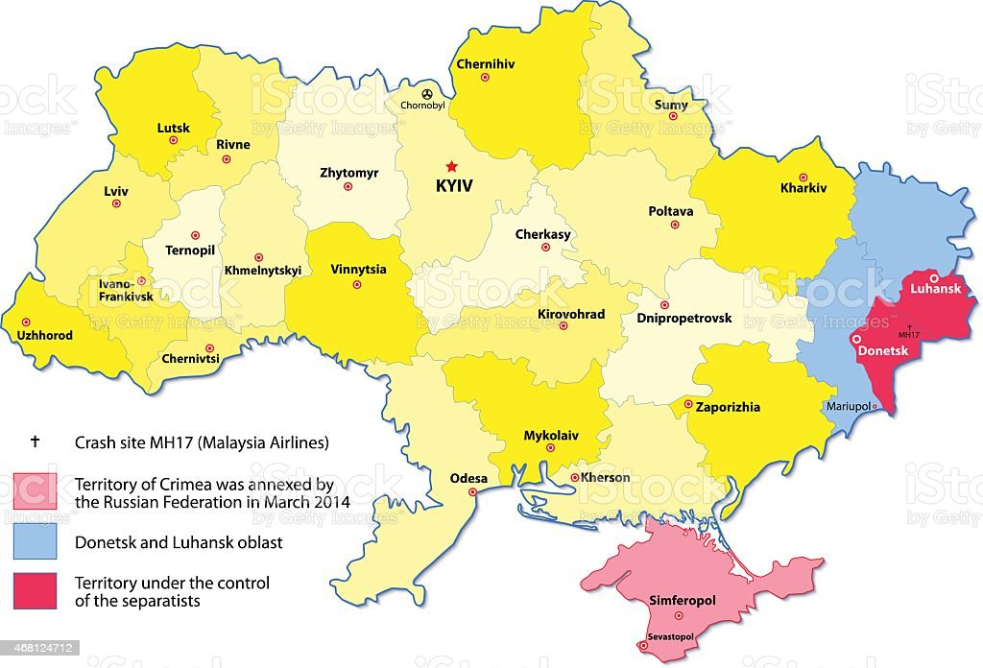
Ukraine After 2014
Minsk Protocol 2014

Slide 13
February 2022: Invasion

Slide 14
Why Invade?
Ukraine/Kyiv as heart of old Russia
Russian return to Great Power Status
(“Putin the Great”)
NATO expansion and Russian traditional insecurity
Not enough NATO expansion
Few punishments after 2014
US commitment to Europe/NATO uncertain

Slide 15
Big Picture I
European Response
“Germany to buy 35 Lockheed F-35 fighter jets from U.S. amid Ukraine crisis” Reuters
US response
Asian Response
“Japan PM Says World's Response to Russia Could Shape New Era Following Post-Cold War Period” US News
Russian Difficulties
Escalation

Slide 16
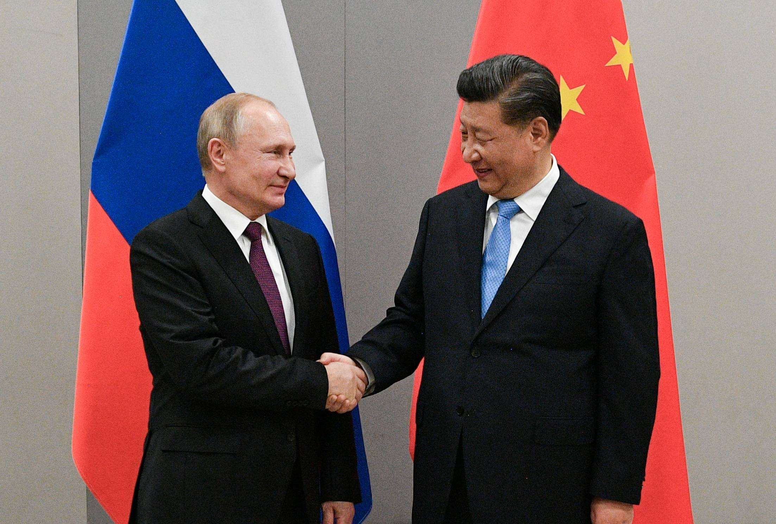
Big Picture II
Joint Statement of the Russian Federation and the People’s Republic of China on the International Relations Entering a New Era and the Global Sustainable Development, February 4, 2022 (Translation by US Air Force, Air University)
Putin and Xi
February 2022

Slide 17
Highlights of Joint Statement
Multipolarity
Redistribution of power in the world
Cultural Diversity and civilizational diversity of nations
Democracy is culturally defined
Non-interference in internal affairs of nation
All states must accept “diversity of their civilizational, cultural, and historical backgrounds…”
“Certain states” cause “instability” by acting unilaterally
“Certain states” impose their standards on others, and try to change other countries political systems

Slide 18
More Highlights of Joint Statement
Alliances are divisive (NATO expansion is bad)
Oppose “certain states” attempts to gain military superiority and “ideologized cold war approaches”
Russia-China friendships has no limits
Russia believes in one China and Taiwan is part of China
Calls for “new kind of relationships between world powers on the basis of mutual respect, peaceful coexistence, and mutually beneficial cooperation.”

Slide 19
Power Transition Theory Long Cycle Theory Hegemonic Stability Theory
Hegemonic War
Winner becomes Hegemon
Hegemon creates new rules for the system
Hegemon weakens; rules weaken
Challenger Rises
Notes:
19

Slide 20
STOP HERE MARCH 2022

Slide 21
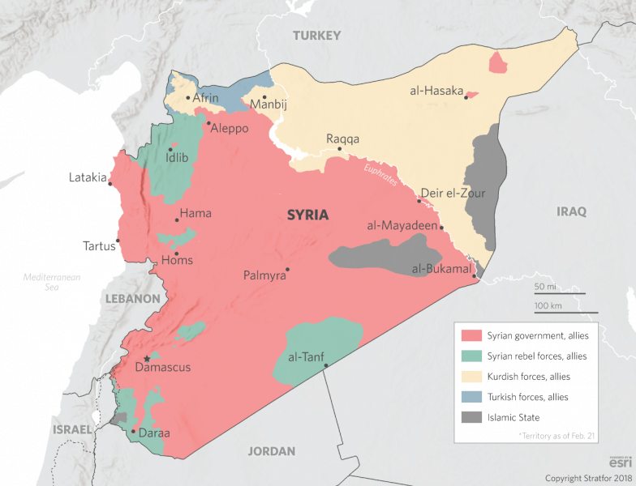
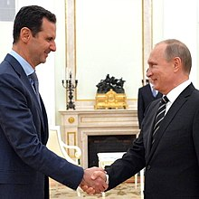
Syrian Civil War 2011--present
President Bashar al-Assad 2018 Map

Slide 22
UK Referendum 2016

Slide 23
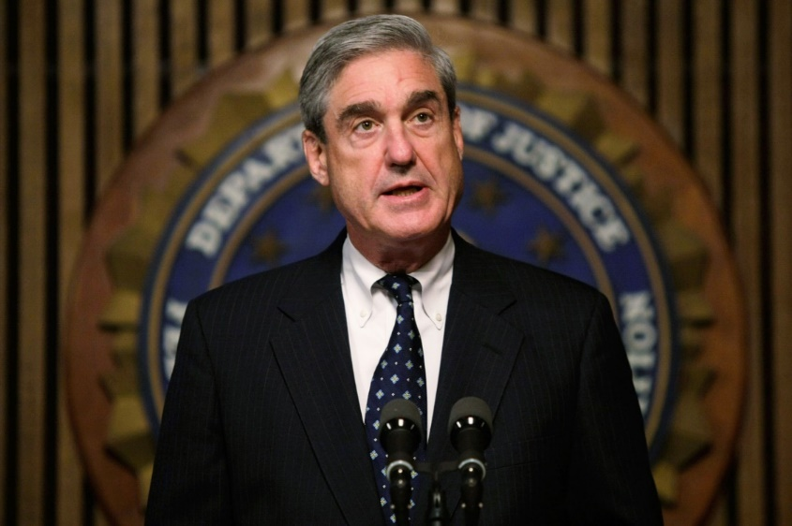
US Presidential Election 2016
DNI Report On Russian Activities During the 2016 Election, January 2017
US Senate Select Committee on Intelligence Report, July 2018
Mueller Indictments of Trump Campaign Aids, October 2017
Mueller February 18, 2018 Indictments
Mueller July 2018 Indictments
Special Counsel
Robert Mueller

Slide 24
From Senate Intelligence Committee Report
“Russian efforts to influence the 2016 U.S. presidential election represent the most recent expression of Moscow’s longstanding desire to undermine the U.S.-led liberal democratic order, but these activities demonstrated a significant escalation in directness, level of activity, and scope of effort compared to previous operations.”

Slide 25
Helsinki 2018

Slide 26
Russian Nuclear Capability

Slide 27
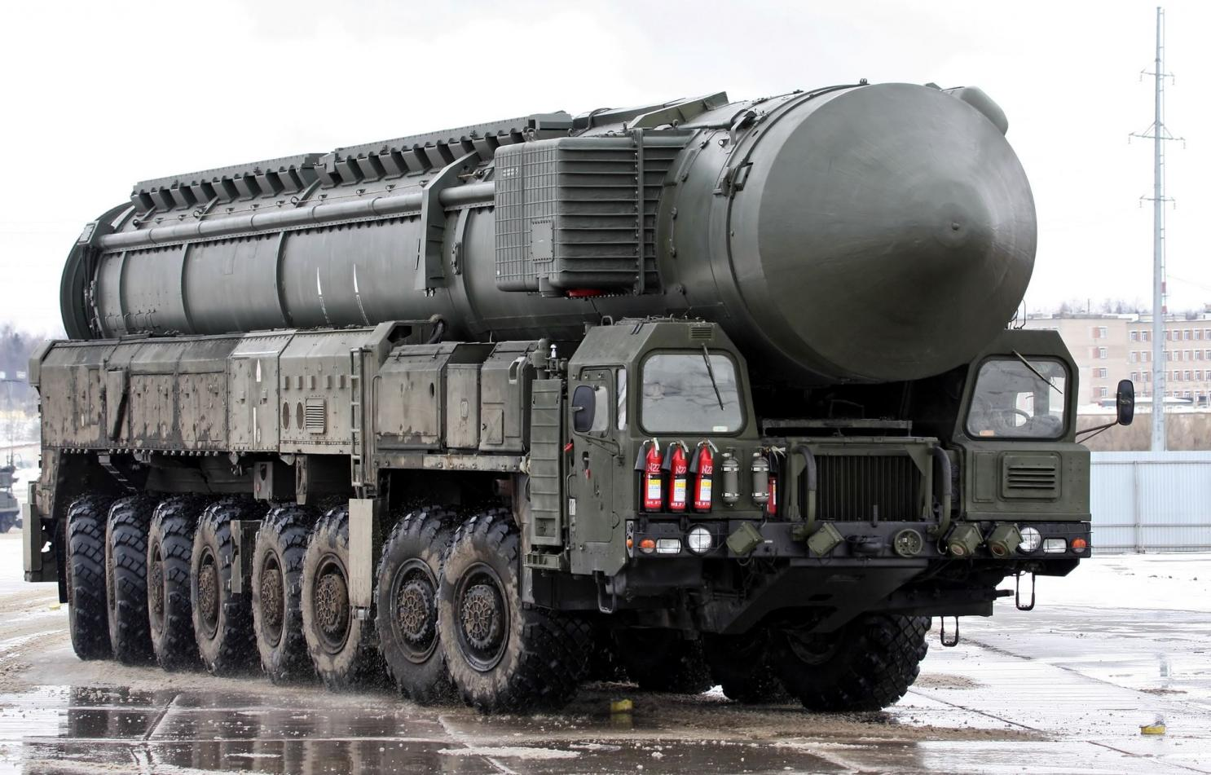
New Russian ICBMs
SS-27 Mod 2 SS-X-30 Satan 2
Topol MR (RS-24 Yars) (RS-28 Sarmat)

