Slide 1
US National Interests
What are the threats to the US?
What role should the US have in the world?
Who decides the answer?

Slide 2
Theories to Guide National Interest?
“Isolationism”
(regional power only)
vs.
Realists
Internationalism
Idealists (Liberalism)
(Wilsonianism)
vs.
Nationalism

Slide 3
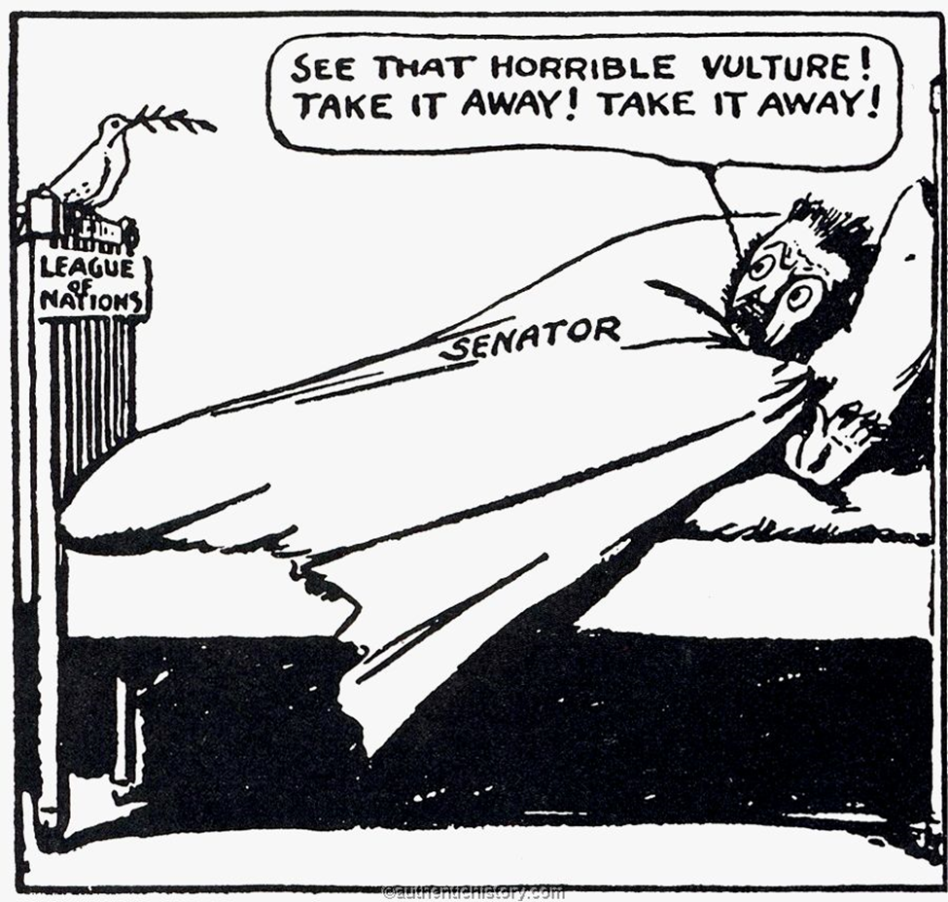
Pre-WW II Policies: US as a Regional Power
WW I
League of Nations decision
1919-1941
“isolationism”

Slide 4
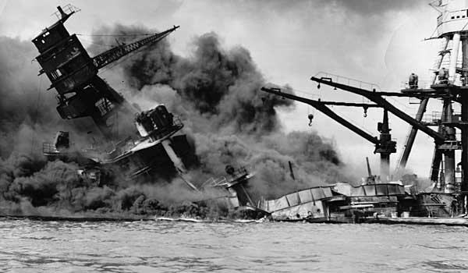
Pearl Harbor, December 7, 1941

Slide 5
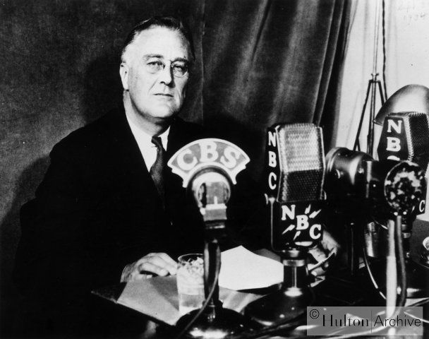
FDR

Slide 6
Post-WW II Choice
Regional Power
vs.
Global Power
Choice: Global (1947-1952)

Slide 7
The Question of Leadership
If we don’t make the rules, will someone else?
WW II: World run by Nazis?
Cold War: World run by Communist dictatorships?
Anarchy: No order?

Slide 8
Decision?
FDR, Truman, Eisenhower…
Create and lead a Liberal-Democratic Order
Today: “Rules-based international system”

