Slide 1
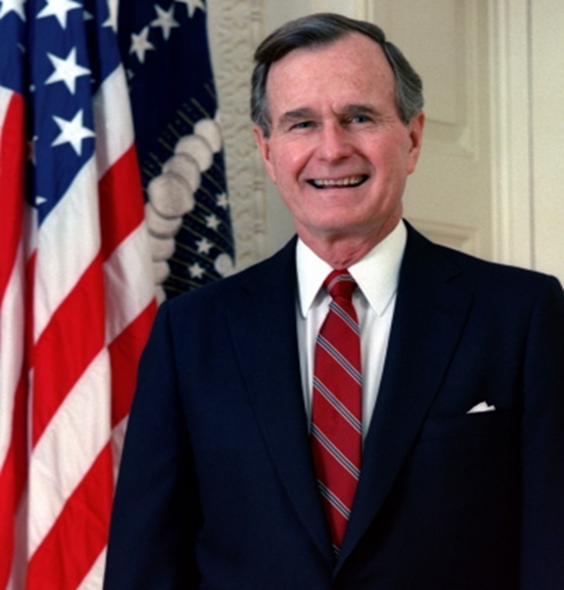
Cold War is Over What Replaces Truman Doctrine?
Bill Clinton (1993-2001)
George H. W. Bush (41)
1989-1993
Sounds Idealist, but Seems to be Realist
Definitely Idealist

Slide 2
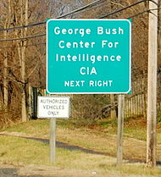
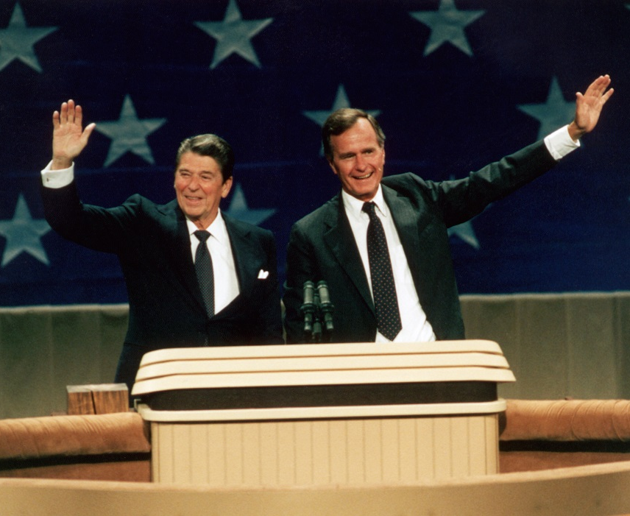
Bush Foreign Policy Positions
US Ambassador to the UN
Chief of US Liaison Mission to China
Director of Central Intelligence
Vice President (in charge of crisis management)

Slide 3
Bush’s Dilemma
What does a realist do if Great Power Competition is Over?
Think like a realist: Great Power Competition is Not Over
OR
An Idealist: Create New World Order: International Law

Slide 4
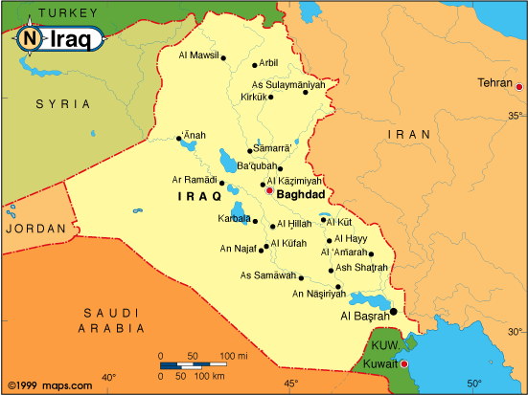
Iraq-Kuwait 1990

Slide 5
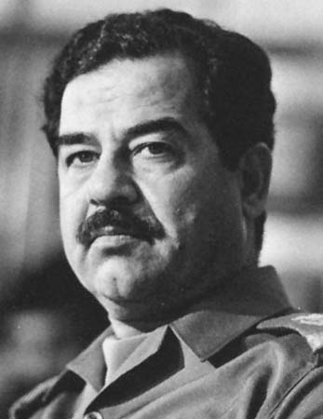
Saddam Hussein

Slide 6
Bush as Idealist: Collective Security and the UN
UNSC Resolution 660 (8/2/90)
UNSC Resolution 678 (11/29/90)
“New World Order” speech (9/11/90)

Slide 7
The War Ends 4/3/91
Elimination of Iraqi WMD
International Atomic Energy Agency –IAEA
UN Special Commission -- UNSCOM

Slide 8
Idealism?
But…
Economic issues
Multilateralism
Realism

Slide 9
Realism: Iraq as a Buffer

Slide 10
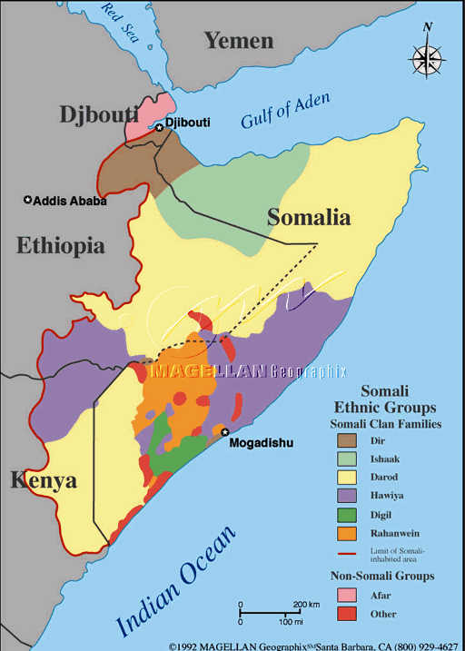
Idealism?
Somalia Civil War
December 9, 1992

Slide 11
Clinton’s Challenge
Replace the Truman Doctrine
Guidelines
Wilsonian Internationalism
Focus on Economics
How foreign economic policy can create US jobs

Slide 12
Clinton Doctrine?
Engagement and Enlargement:
“En-En” Strategy
A National Security Strategy of Engagement and Enlargement, February 1995
A National Security Strategy of Engagement and Enlargement, February 1996
A National Security Strategy for a New Century, May 1997
A National Security Strategy for a New Century, October 1998
A National Security Strategy for a New Century, December 1999
A National Security Strategy for a Global Age, December 2000.
Speeches by Clinton, Lake, and Albright. September 1993
Speeches by Christopher and Albright, November 1993

Slide 13
Liberal-Democratic Order
Strengthening the Core Group of Liberal-Democracies
Transitional States (former Communist)
Multilateralism
NATO UN

Slide 14
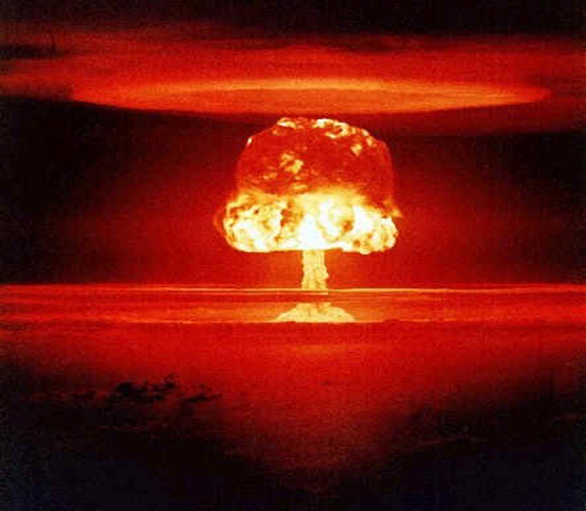
Challengers to the Rules
Human Rights
Rogue States
Weapons of Mass Destruction proliferation

Slide 15
Economic Opportunities (Globalization Accelerates)
7. Big Emerging Markets: BEM
China
India
Brazil
Indonesia
Poland
Russia
Venezuela

Slide 16
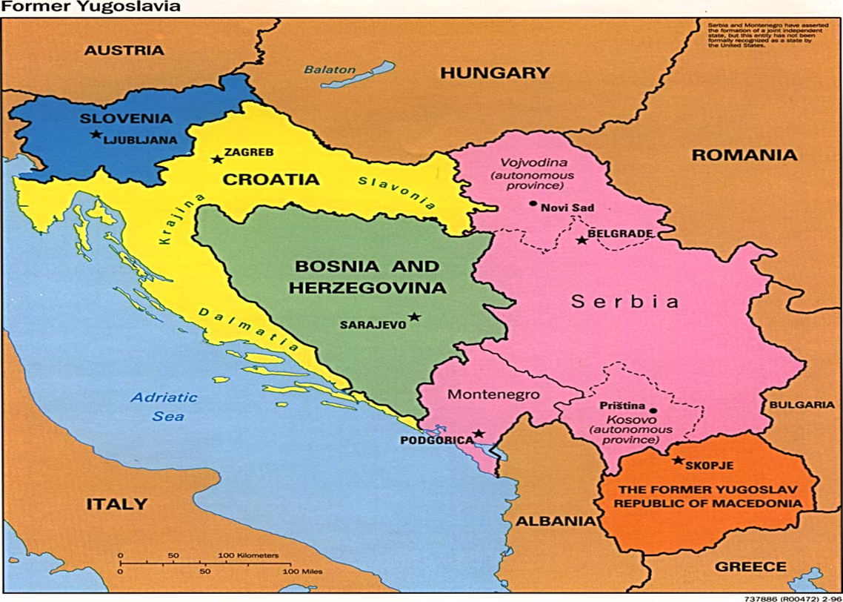
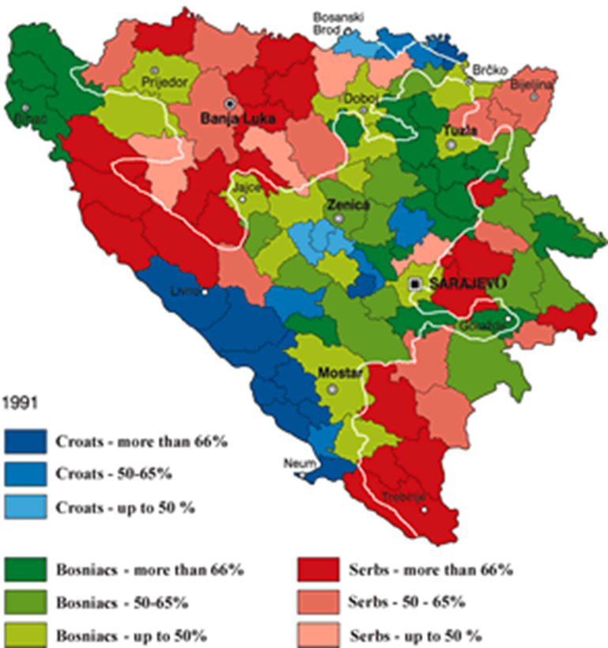
8. Humanitarian Crises
Yugoslavia/Bosnia
Somalia
Haiti

Slide 17
1. Economic Policy: Embracing and Accelerating Globalization
Economic Liberalism
(Free Trade)
Vs.
Economic Nationalism
(Protectionism)

Slide 18
Economic World Order Building
NAFTA: North American Free Trade Agreement
FTAA: Free Trade Area of the Americas
APEC: Asia-Pacific Economic Cooperation
WTO: World Trade Organization
JOBS

Slide 19
2. Peace Operations
Somalia 1993
Rwanda 1994
Bosnia 1995
Kosovo 1998/99
Reference
PRD-13 (1993)
PDD-25 (1994)

Slide 20
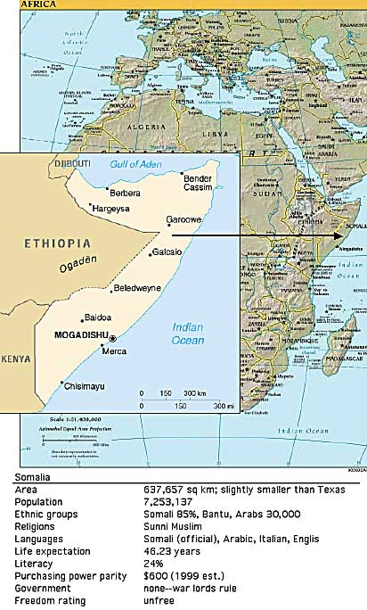
Somalia 1993
Humanitarian Military
Intervention
To stop a civil war
But…October 3, 1993

Slide 21
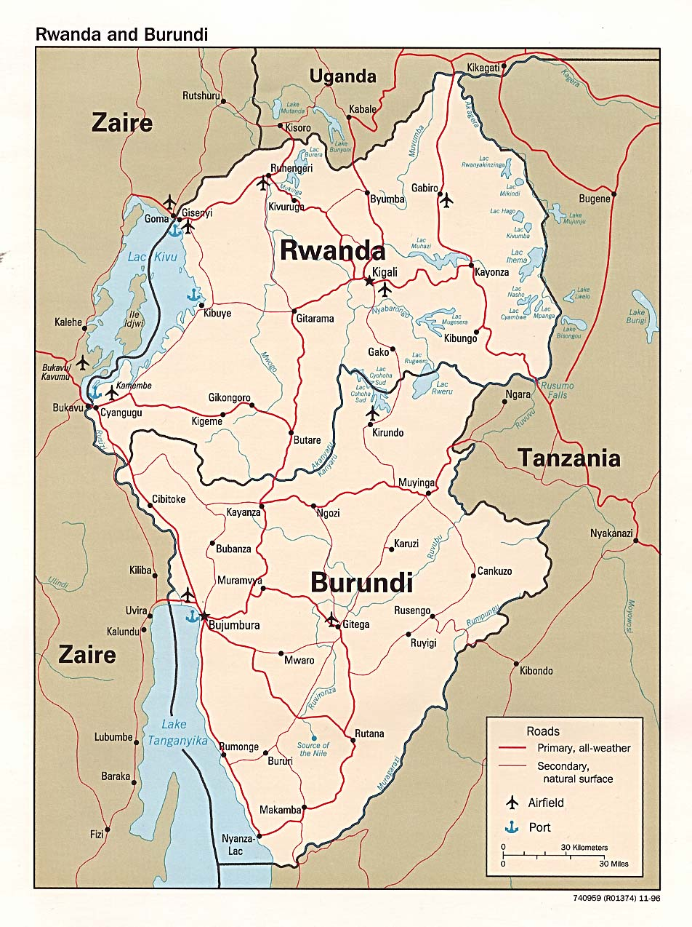
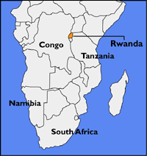
Rwanda Spring 1994
Hutu vs. Tutsi
No intervention

Slide 22
The Result
800,000 deaths in 100 Days
By 1996: 2 million refugees
Pre-crisis population: 6 million

Slide 23
Yugoslavia

Slide 24
Bosnia 1991 (map reference)
Civil War 1991-1995
Bosniaks
vs
Bosnian Croats
vs
Bosnian Serbs

Slide 25
To the Dayton Accords November 1995
Summer-Fall 1995
Bosniak-Croat truce
NATO Bombing
The Strategy
Local ground forces
US/NATO air power

