Slide 1
First Nuclear Age: 1945-1991

Slide 2
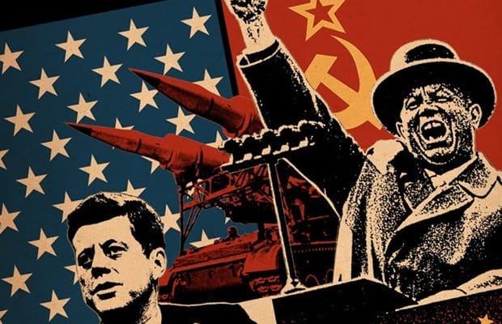
Characteristics
Bipolarity
Rationality
Balance of Power
Deterrence
Arms Control
to achieve stability

Slide 3
Atomic Weapons: Fission Bombs

Slide 4
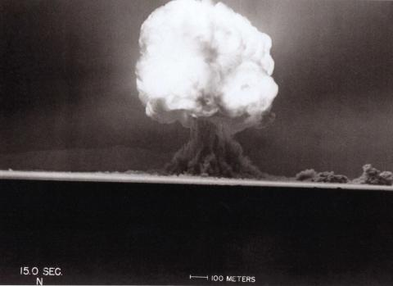
Manhattan Project (1942)
July 16, 1945
“Trinity”

Slide 5
US Use of Atomic Bombs in WW II (for reference)
Hiroshima
Nagasaki
August 6, 1945
“Gun-Type” device
“Little Boy”
Plane: Enola Gay
August 9, 1945
Implosion device
“Fat Man”
Plane: Bock’s Car

Slide 6
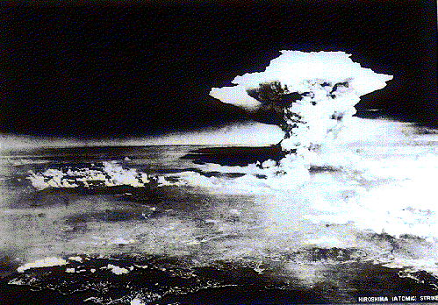
Hiroshima August 6, 1945

Slide 7
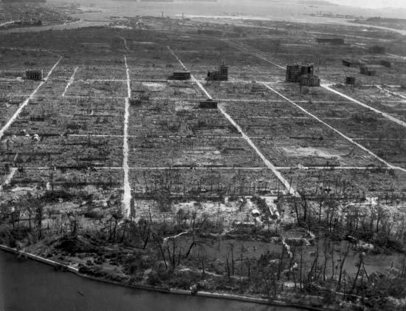
Hiroshima After the bomb

Slide 8
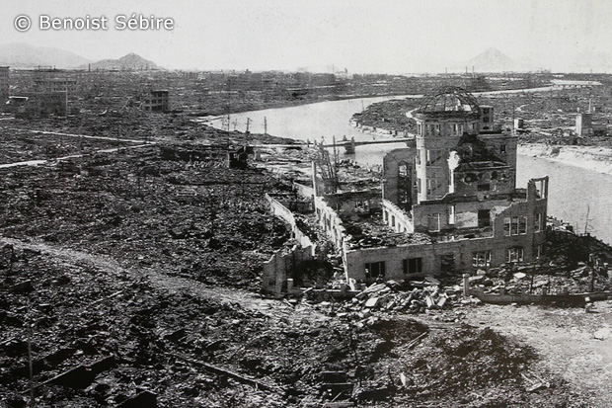
Hiroshima

Slide 9
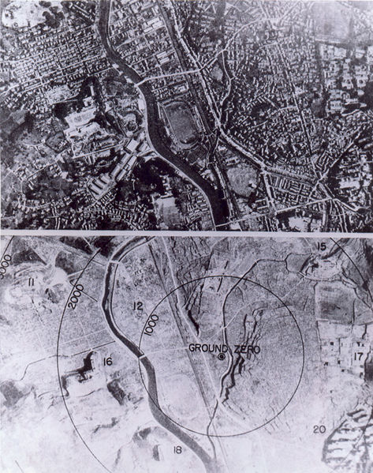
Nagasaki August 9, 1945

Slide 10
Nuclear or H-Bomb

Slide 11
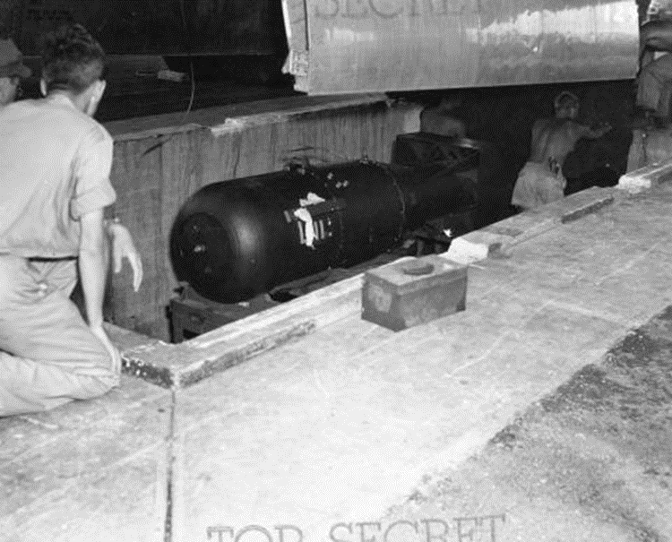
US Nuclear Triad
Strategic Bombers
ICBMs
SLBMs
“Little Boy” bomb being
loaded onto the Enola Gay,
August 1945

Slide 12
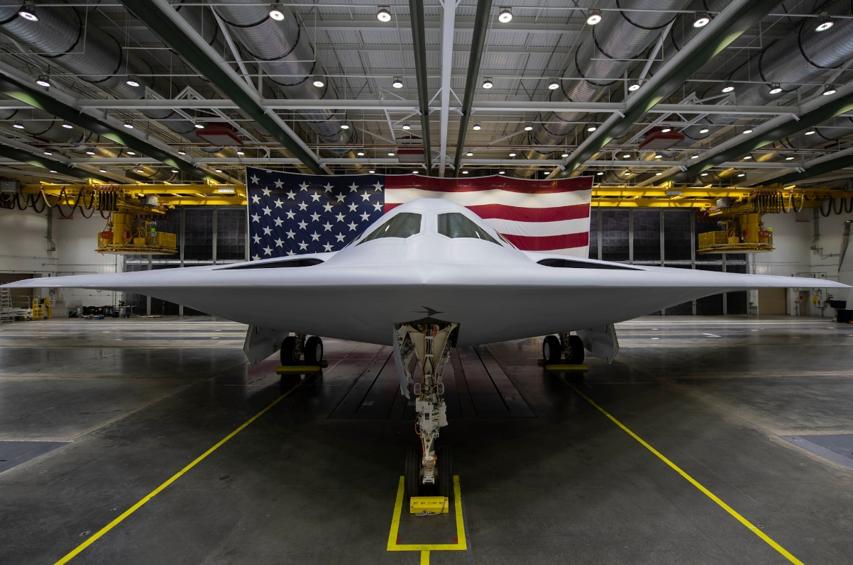
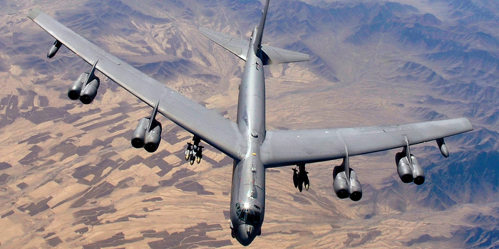
Strategic Bombers
B-52: Stratofortress (1961) B-21 Raider (~2027)

Slide 13
B-52 with ALCM

Slide 14
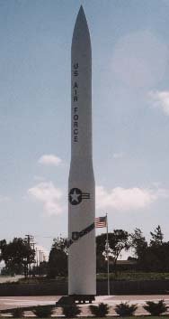
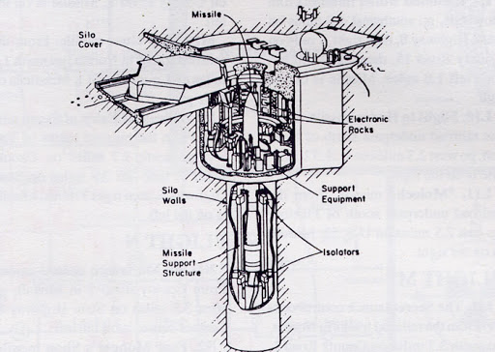
ICBM Intercontinental Ballistic Missile
Minuteman III (1970)
Test

Slide 15
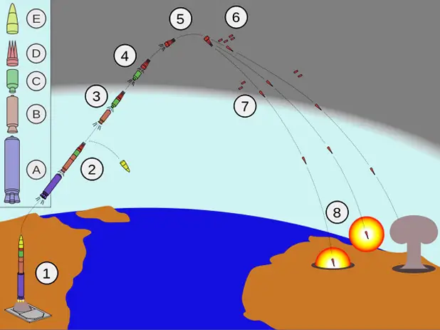
MIRVs: Multiple Independently-targeted Reentry Vehicles

Slide 16
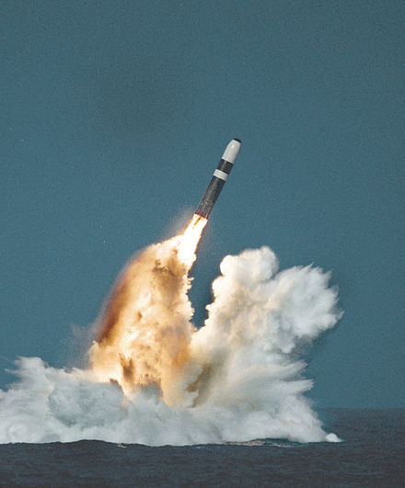
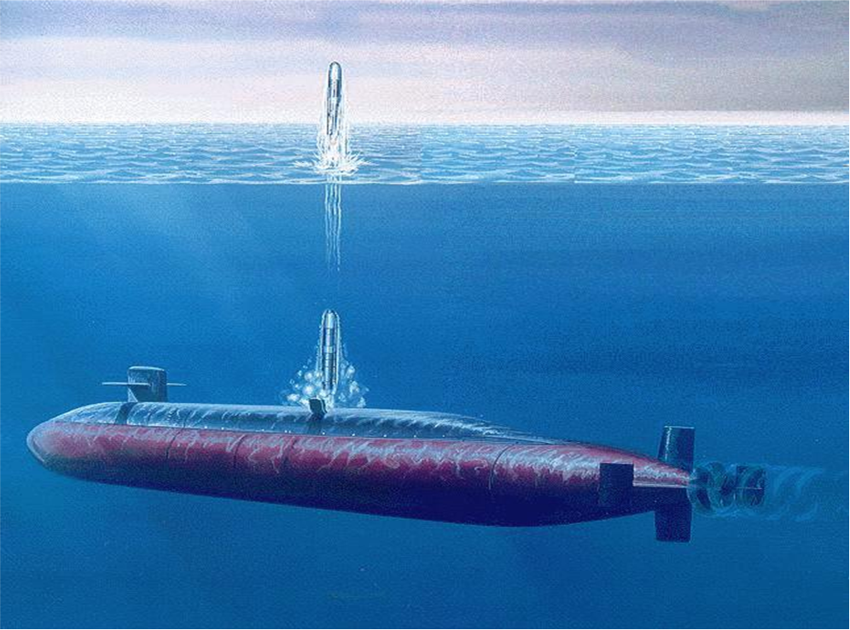
SLBM – Submarine-launched Ballistic Missile (Test)

Slide 17
Launch Tube Hatches on USS Alabama (Ohio Class)

Slide 18
US Strategic Nuclear Forces
ICBM SLBM Bombers
launchers/warheads launchers/warheads launchers/warheads
1950 | 0 | 0 | 0 | 0 | 462 | 330
1960 | 12 | 12 | 32 | 32 | 1515 | 3083
1970 | 1054 | 1244 | 656 | 1552 | 390 | 3339
1980 | 1054 | 2144 | 512 | 5056 | 376 | 3568
1990 | 1000 | 2440 | 608 | 5312 | 267 | 4648
2000 | 550 | 2000 | 432 | 3456 | 73 | 1376
2013 | 450 | 500 | 288 | 1152 | 60 | 300

Slide 19
USSR/Russian Strategic Nuclear Forces
ICBM SLBM Bombers
launchers/warheads launchers/warheads launchers/warheads
1956 | 0 | 0 | 0 | 0 | 40 | 120
1960 | 2 | 2 | 30 | 30 | 121 | 354
1970 | 1472 | 1472 | 317 | 287 | 157 | 568
1980 | 1338 | 5362 | 990 | 1558 | 157 | 568
1990 | 1297 | 6857 | 908 | 2900 | 127 | 1402
2000 | 756 | 3540 | 348 | 1576 | 112 | 790
2013 | 326 | 1050 | 160 | 624 | 72 | 810

Slide 20
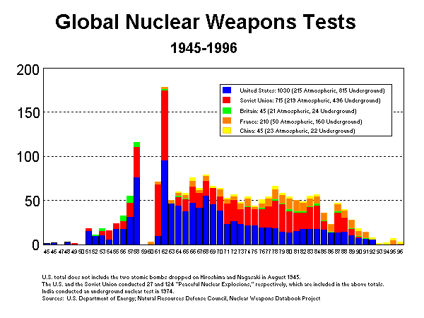
Nuclear tests

Slide 21
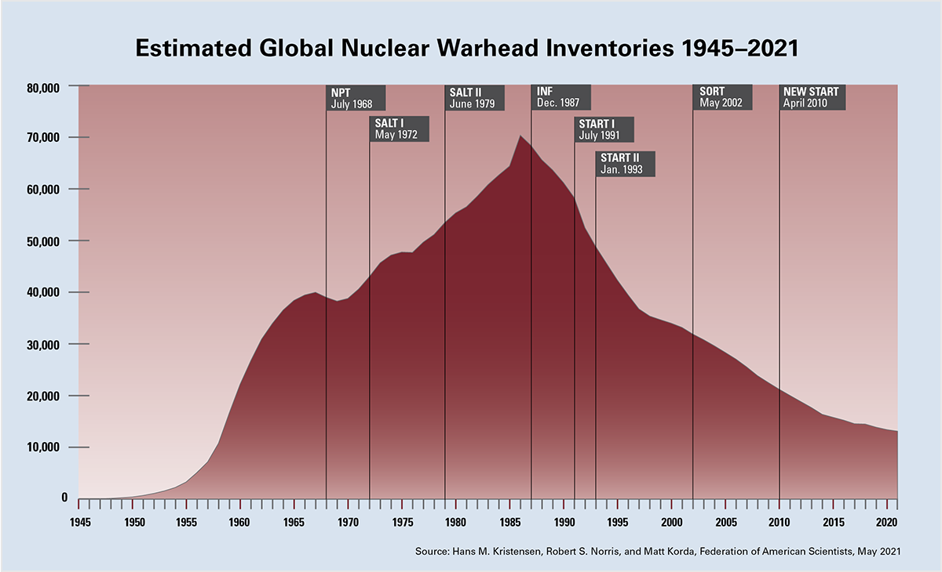
Numbers of Nuclear Weapons (From Federation of American Scientists)

Slide 22
Why so many Weapons? Deterrence
Soviet First Strike
If successful…
US Second USSR “wins”
strike
US
USSR

Slide 23
US Second Strike Capability
Scenario: Everyone Dies:
Successful deterrence (through punishment)
Assured Destruction
US Second strike
Soviet First Strike
US
USSR

Slide 24
Effects of Nuclear War Sidney D. Drell and Frank von Hippel. Limited Nuclear War. Scientific American 235, no. 5 (November 1976): 34.

