Slide 1

US-Chinese Relations
Big Bang to Normalization (1970s)

Slide 2
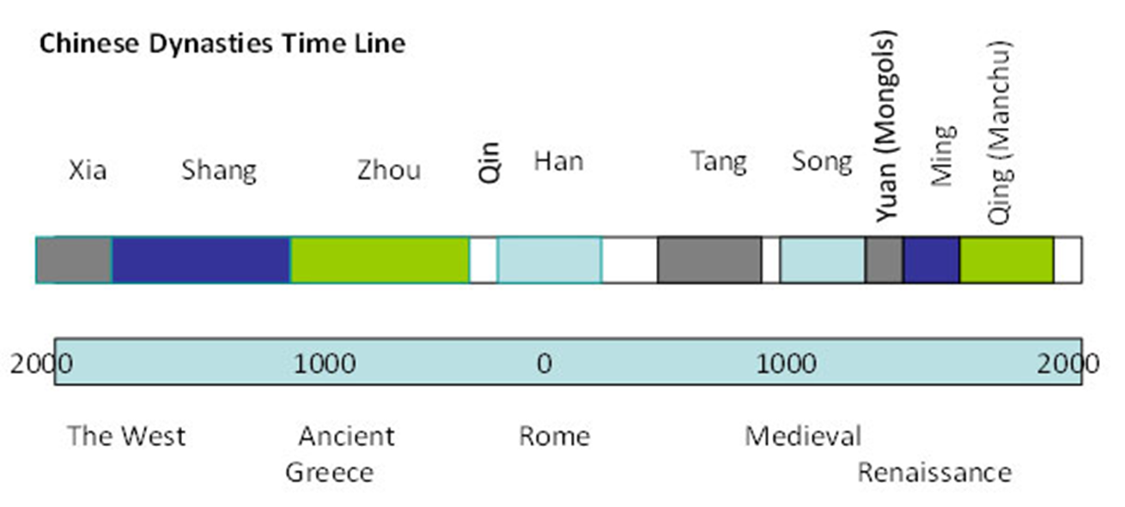
History
American Revolution

Slide 3
Eras
Pre-WW II
WW II and Chinese Civil War
Cold War: Isolation 1949-1969
Cold War: Engagement 1969-1980s
Chinese Reform Begins 1978
Tiananmen Square 1989

Slide 4
1. Pre-WW II

Slide 5
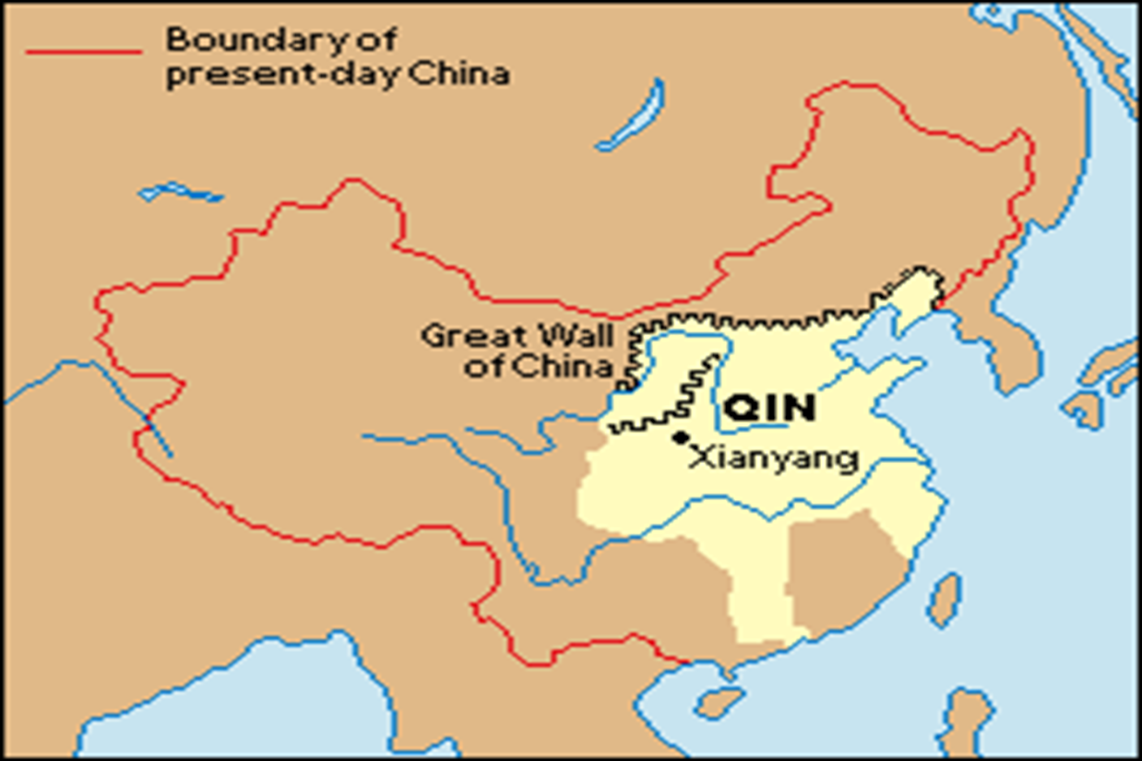
Foreign Policy of Chinese Dynasties

Slide 6
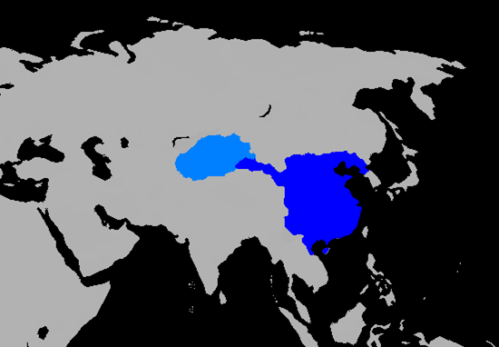
Han Dynasty 206 BCE-220 AD

Slide 7
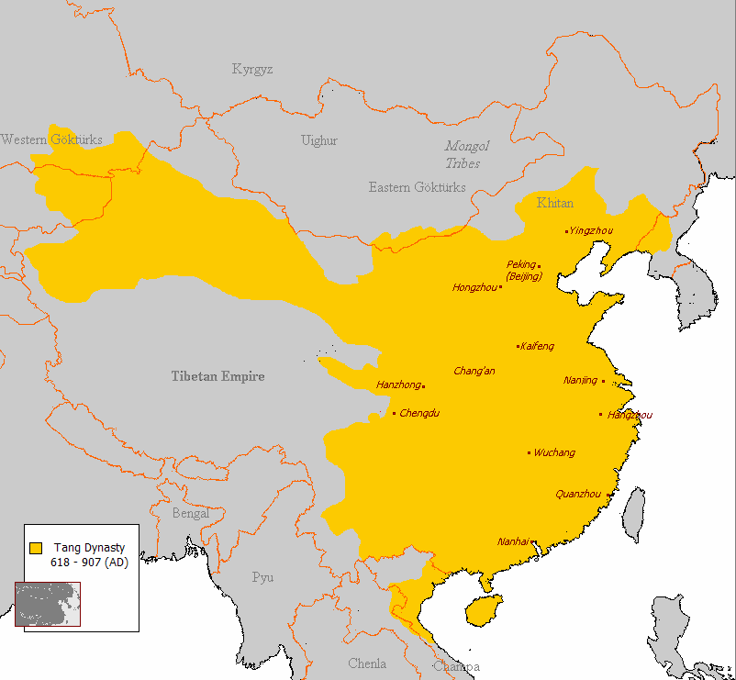
Tang Dynasty 618-906

Slide 8
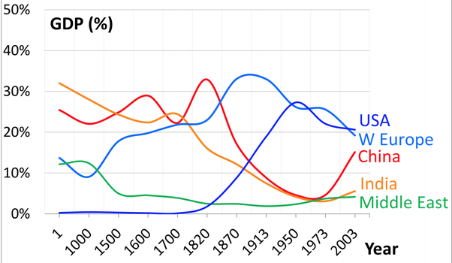
Wealth and Power

Slide 9
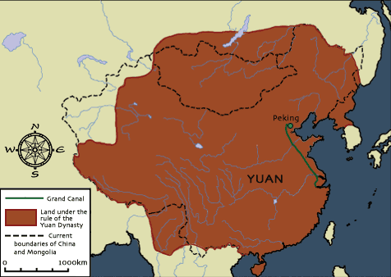
Foreign Rule: Mongols
Yuan Dynasty, 1279-1368

Slide 10
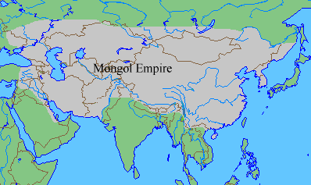

Slide 11
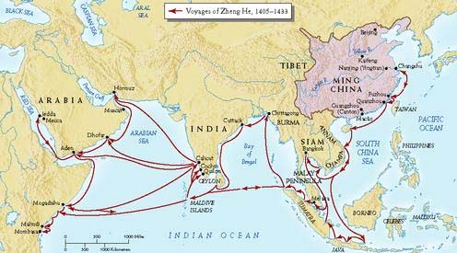
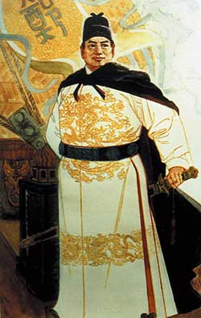
Admiral Zheng He’s Voyages
1405-1433 (Ming Dynasty 1368-1644)

Slide 12
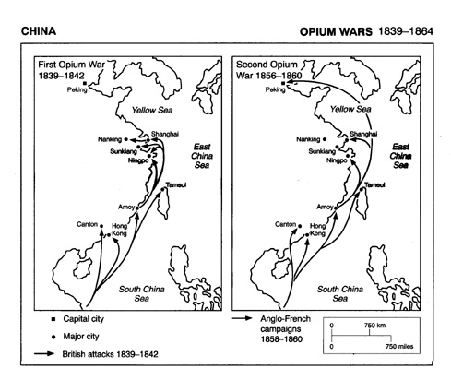
British Colonialism: Opium Wars
Treaty of Nanking, 1842
Map from: http://iao.ish-lyon.cnrs.fr/Henriot/AKQWeb/Mapjpeg/MpOpiWar.jpeg

Slide 13
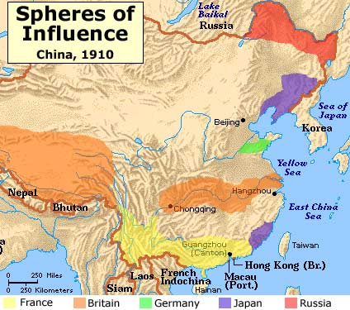
“Carving Up China like a Ripe melon”
“100 Years of Humiliation” 1842-1949

Slide 14
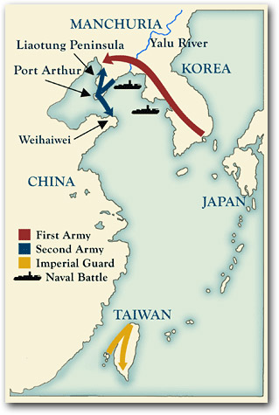
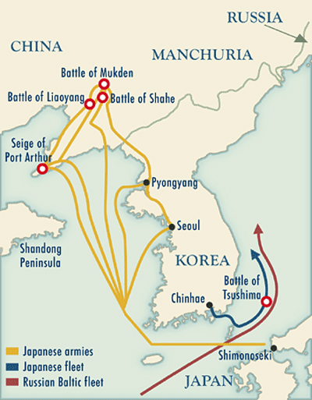
Japanese Threat
Sino-Japanese War 1894-5
Treaty Of Shimonoseki
Russo-Japanese War 1904-5
Treaty of Portsmouth

Slide 15
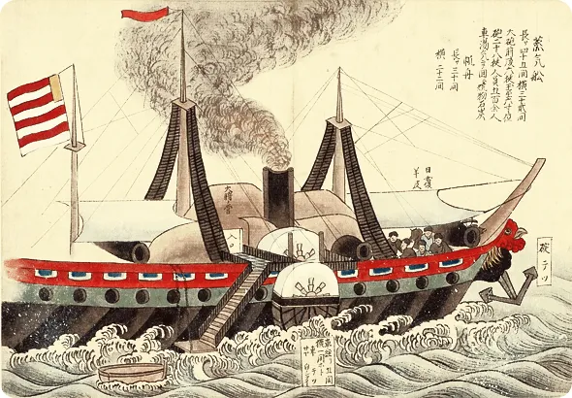
US Policy: Free and Open Trade
Commodore
Perry’s
Ships in
Tokyo Bay
1853-54
Japanese Woodcut, from the University of Indiana
From: https://timpanogos.blog/2014/07/07/july-8-1853-perry-anchors-u-s-ships-in-edo-bay-the-beginning-of-american-imperialism-161-years-ago/

Slide 16
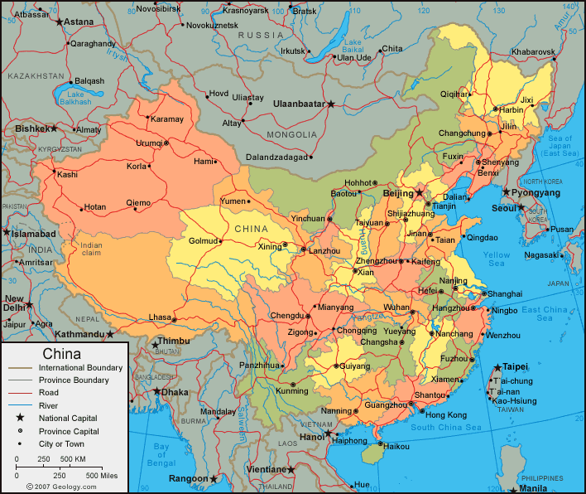
US “Open Door” Policy
Hay Notes
1899-1900

Slide 17
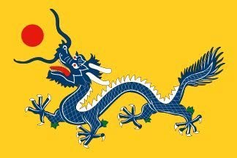

1911-1912: Qing Falls
Republic of China Born
Qing Flag ROC Flag

Slide 18
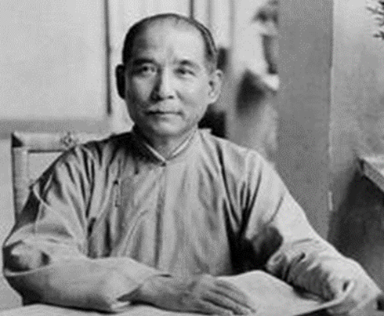
Republic of China
Nationalist Political party
Kuomintang (KMT)
or
Guomindang (GMD)
Pres. Sun Yat-sen (Sun Yixian)

Slide 19
Collapse of Qing Dynasty and Chaos 1911-1949
(for reference; remember ones in gold)
1911: Birth of Republic of China
Provisional President Sun Yat-Sen 1911
Sun Overthrown 1912 (by military)
1916-1927: Warlord Period
Japan in Manchuria 1931
1937 Japanese invasion
1946-1949 Chinese Civil War
  Nationalists vs. Communists

Slide 20
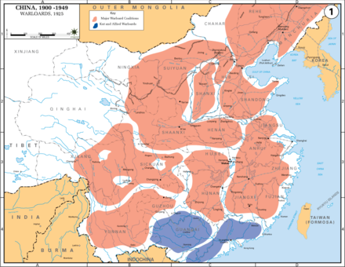
1916-1927 Warlord Period

Slide 21
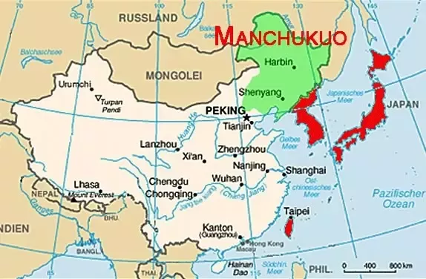
Japanese Aggression 1930s

Slide 22
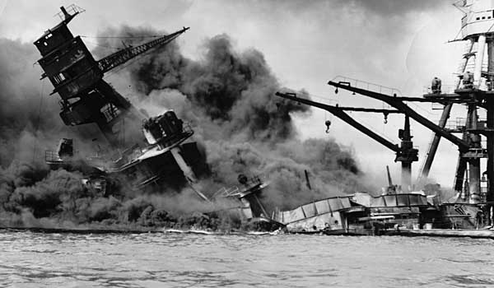
Pearl Harbor, December 7, 1941

Slide 23
2. WW II
and
Chinese Civil War

Slide 24
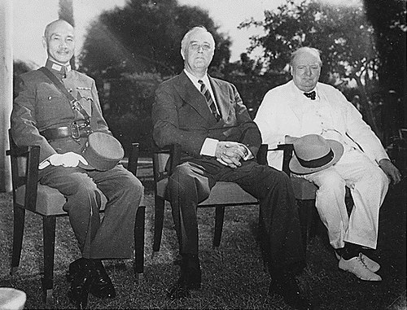
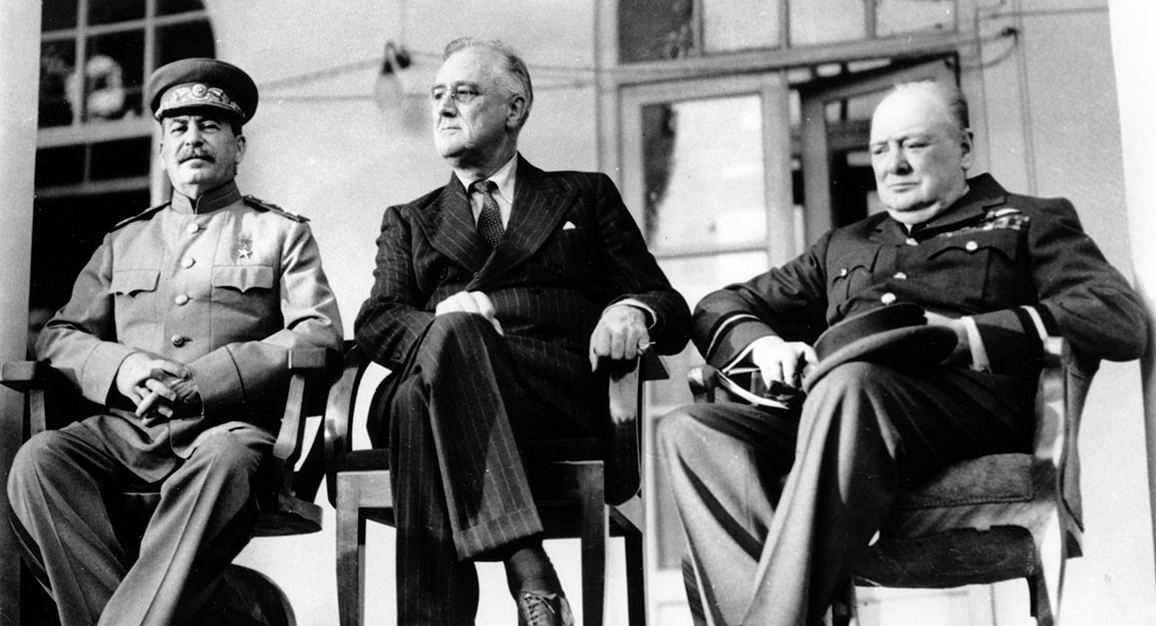
Big Four Powers 1943
Cairo Conference, November 22-26, 1943
Tehran Conference November 28-December 1
Chiang Kai-shek
FDR
Churchill
Stalin
FDR
Churchill

Slide 25
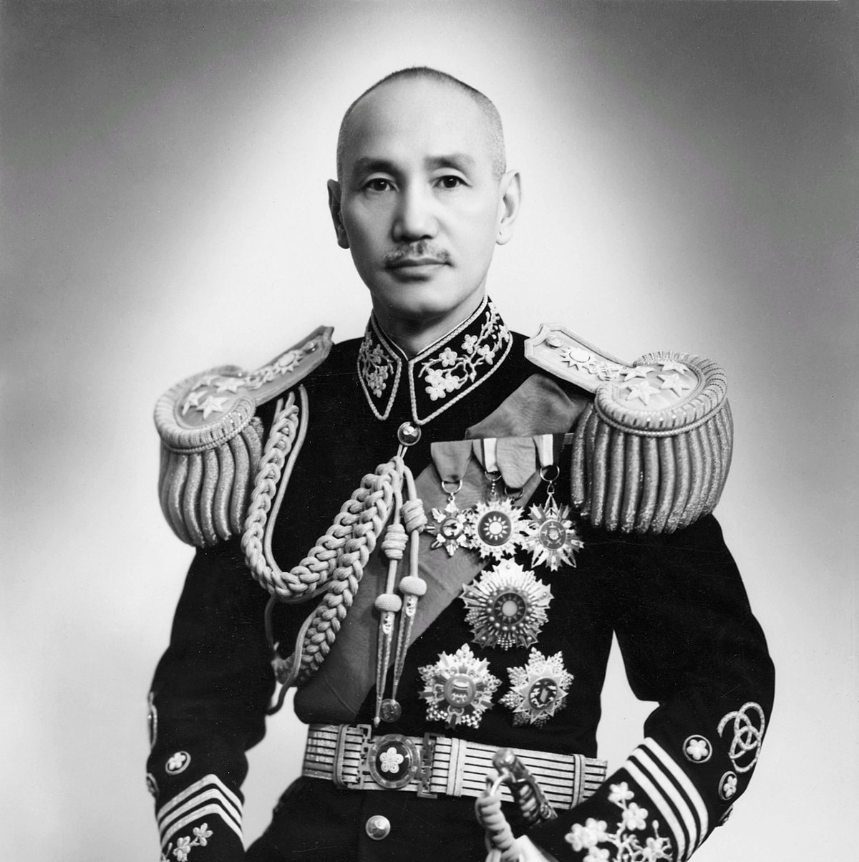
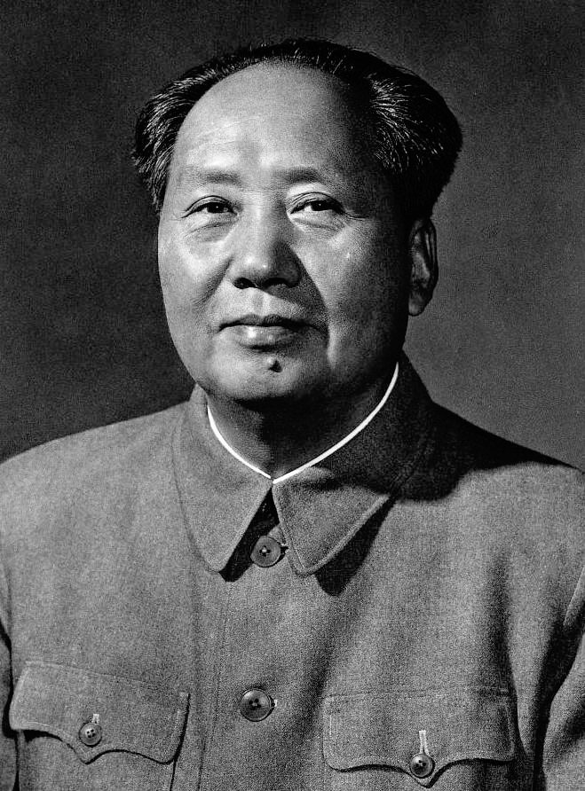
Post-WW II: Civil War
Republic of China Nationalists
Communists
People’s Republic of China
Chiang Kai-shek
Mao Zedong

Slide 26
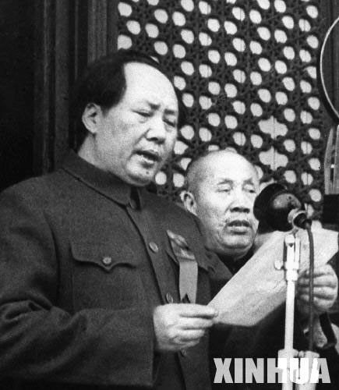
Communist Victory
October 1, 1949
National Day
Ends 100 Years
Of Humiliation

Slide 27
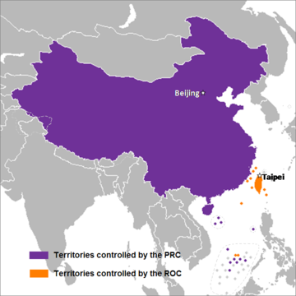
Two Governments or Two Chinas 1949--

Slide 28
3. Cold War: Isolation
1949-1969

Slide 29


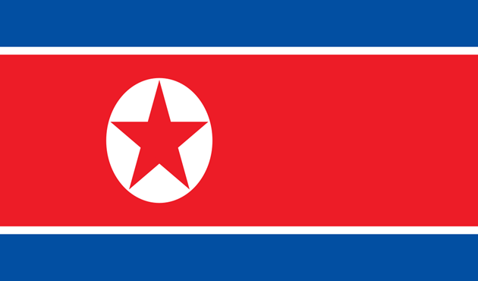

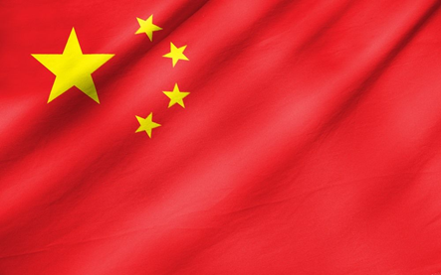


Cold War Bipolarity

Slide 30
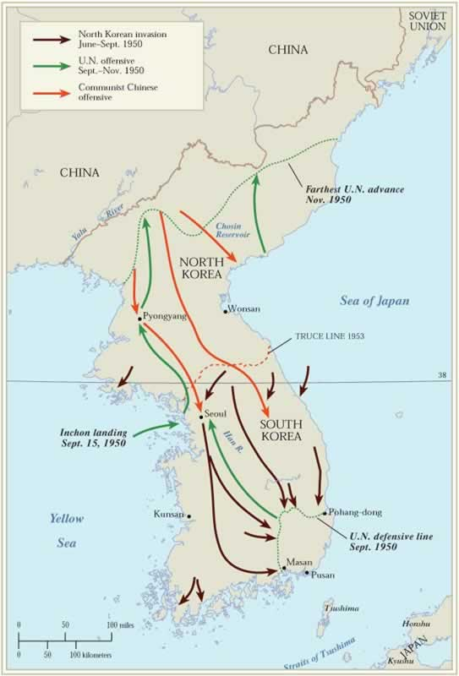
Korean War 1950-53
  US, S. Korea, UN
  vs.
  N. Korea, China
Notes:
30

Slide 31
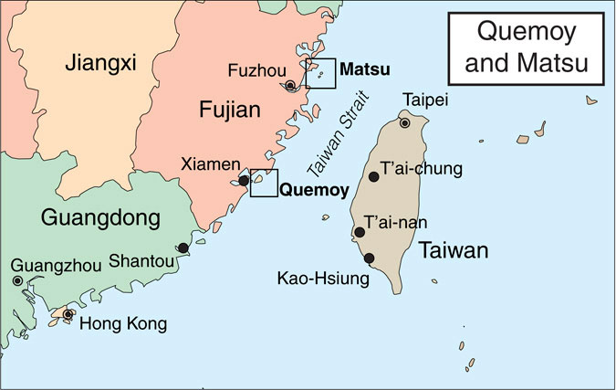
1950s
US-ROC Mutual Defense Treaty 1954

Slide 32
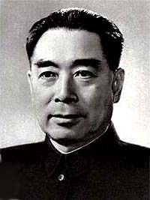
Chinese Foreign Policy
1950s-1960s
Spread global communist revolution
Five Principles of Peaceful Coexistence
  mutual respect for sovereignty and territorial integrity
  mutual non-aggression
  non-interference in each other's internal affairs
  equality and mutual benefit
  peaceful coexistence
  Zhou Enlai, Foreign Minister 1949-58
  Premier 1949-1976

Slide 33
4. Cold War: Engagement
1969-1980s

Slide 34
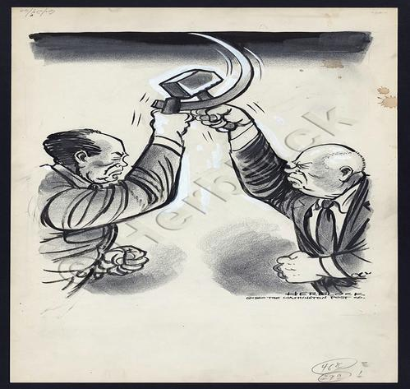
Sino-Soviet Conflict

Slide 35
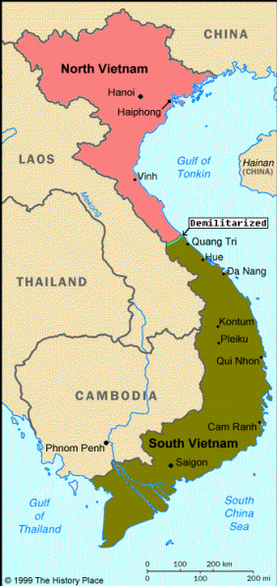
Viet Nam (after 1954)
Notes:
35

Slide 36
US Thinking
Balance of Power
“Triangular Diplomacy”
  US
  USSR PRC
Notes:
36

Slide 37
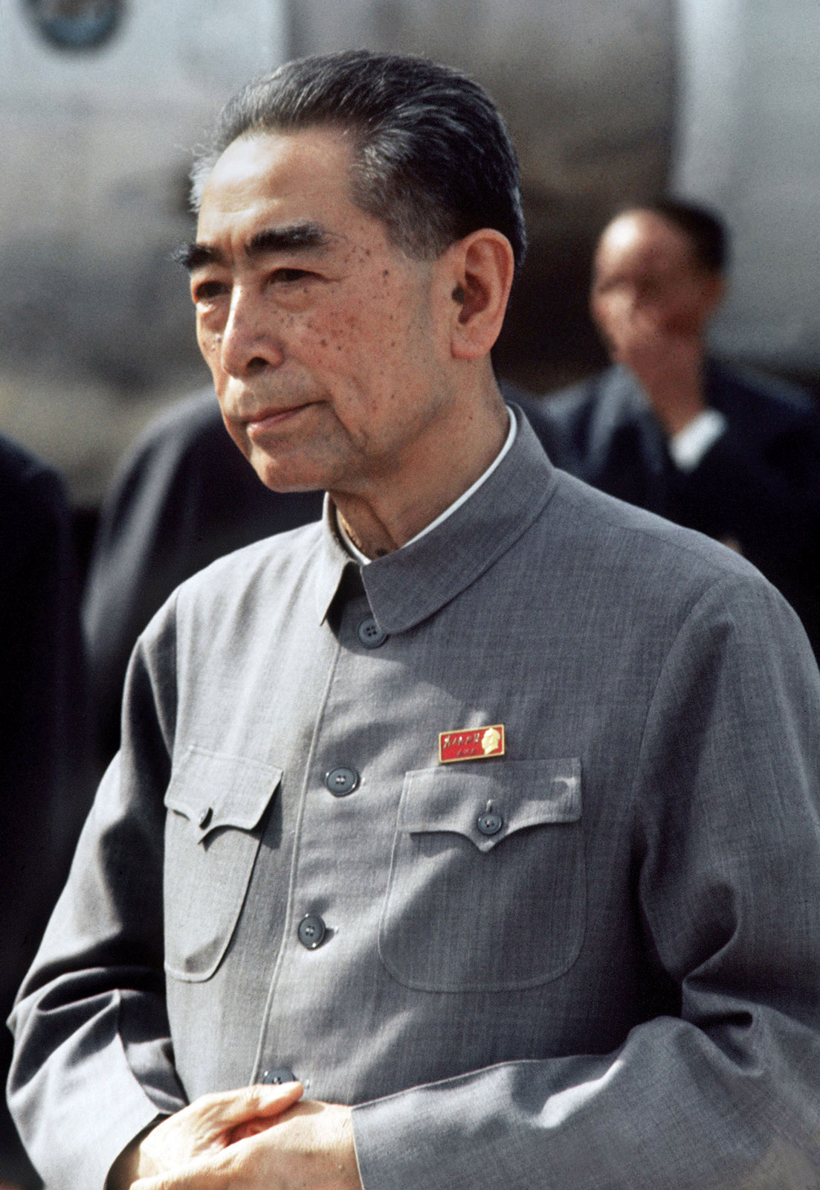
Chinese Thinking
Balance of Power
Premier Zhou Enlai
US
PRC USSR

Slide 38
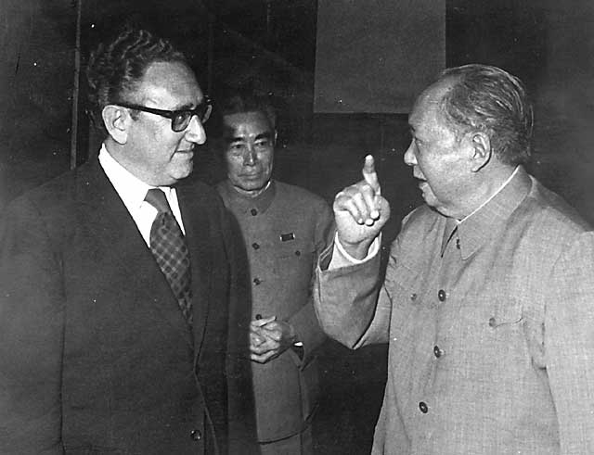
Kissinger to China, July 1971
Notes:
38

Slide 39
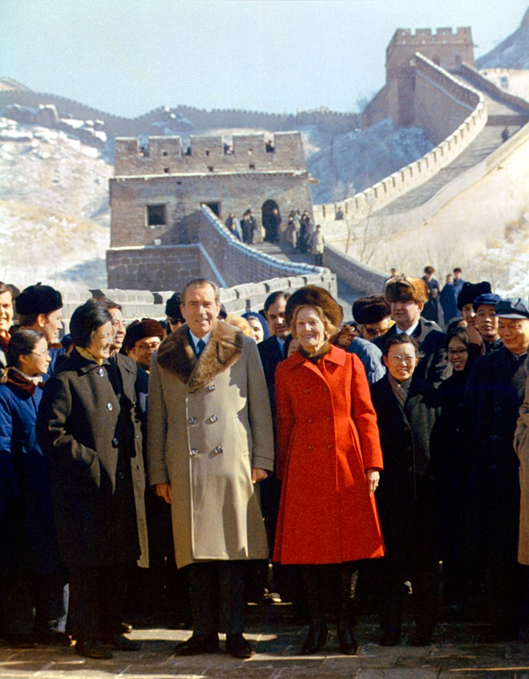
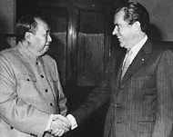
Nixon-Mao Summit in China, February 1972
Notes:
39

Slide 40
Shanghai Communique
(US-PRC Joint Communique #1)
Agree and Disagree in writing
Disagree: Non-Use of Force
Agree: Anti-hegemonism
Taiwan
Both: There is one China
  China: None of US business
  US: Peaceful Resolution
  US will remove forces from Taiwan

Slide 41
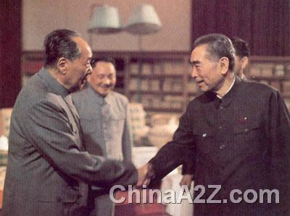
The End of the Era In China: 1976
Mao 9/9/76 Zhou 1/8/76

Slide 42
Politics in Three Capitals
Beijing: Deng Xiaoping – Continuity
Taipei: Sense of Doom; lobbying US; China Lobby
US: Bipartisanship; search for a way to not abandon Taiwan

Slide 43
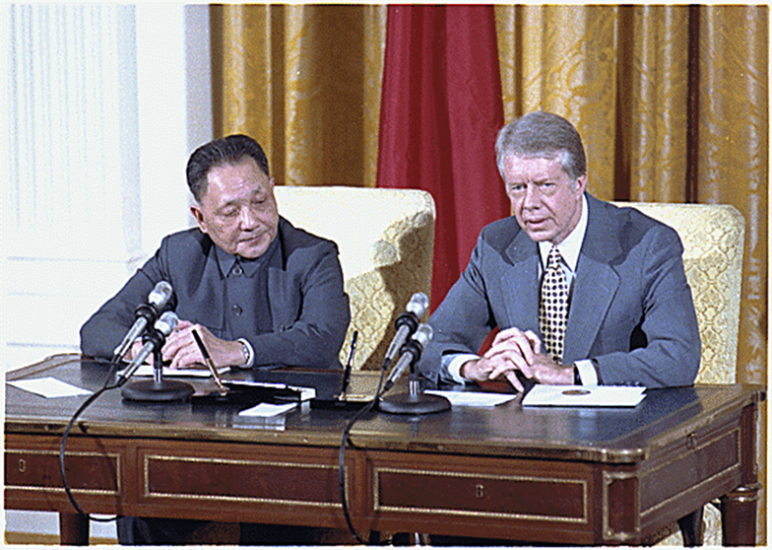
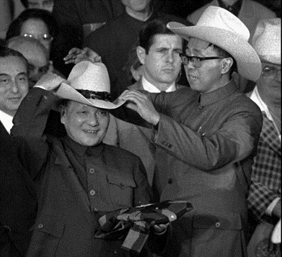
Official Recognition 1/1/79
Joint Communique on Establishment of Relations 12/16/78 (US-PRC Joint Communique #2)
Carter-Deng Xiaoping

Slide 44
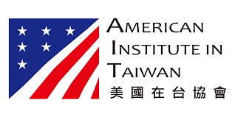
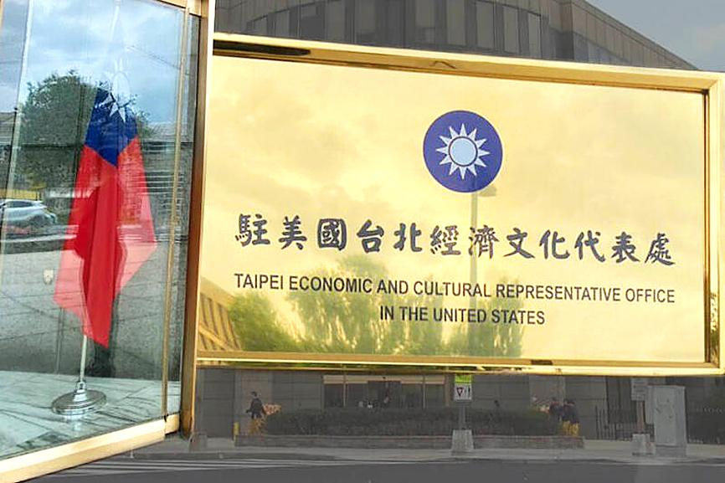
Congress Responds
Taiwan Relations Act April 10, 1979
  TRA Legislative History
American Institute in Taiwan
Taiwan Economic and Cultural Representative Office in the US

Slide 45
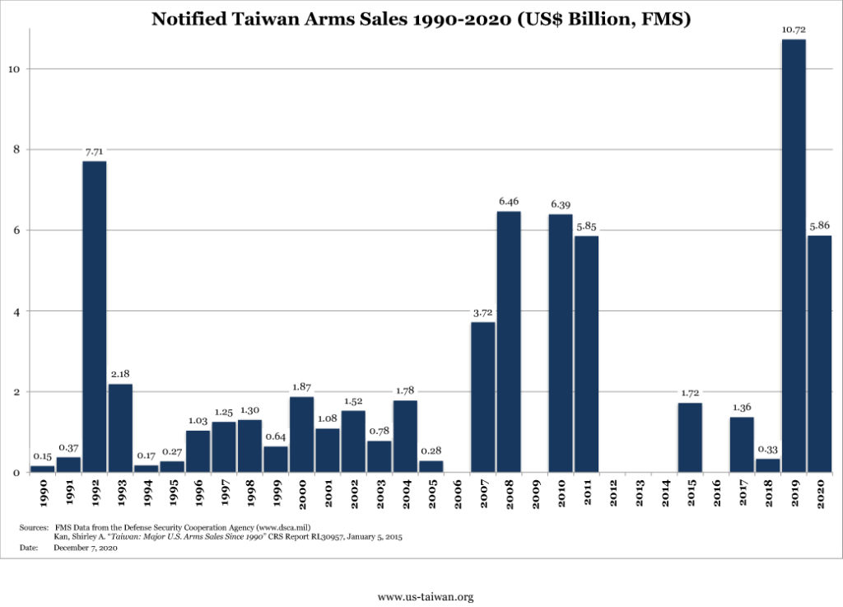
US Arms Sales to Taiwan

Slide 46
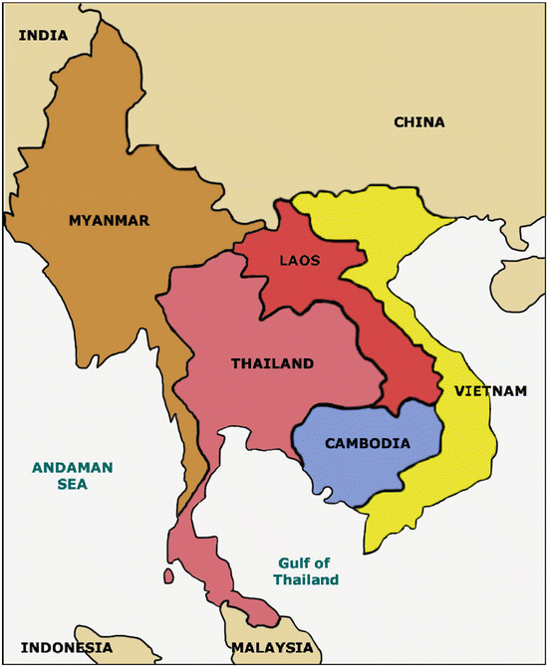
China, Vietnam, Cambodia Triangle
China vs. USSR

Slide 47
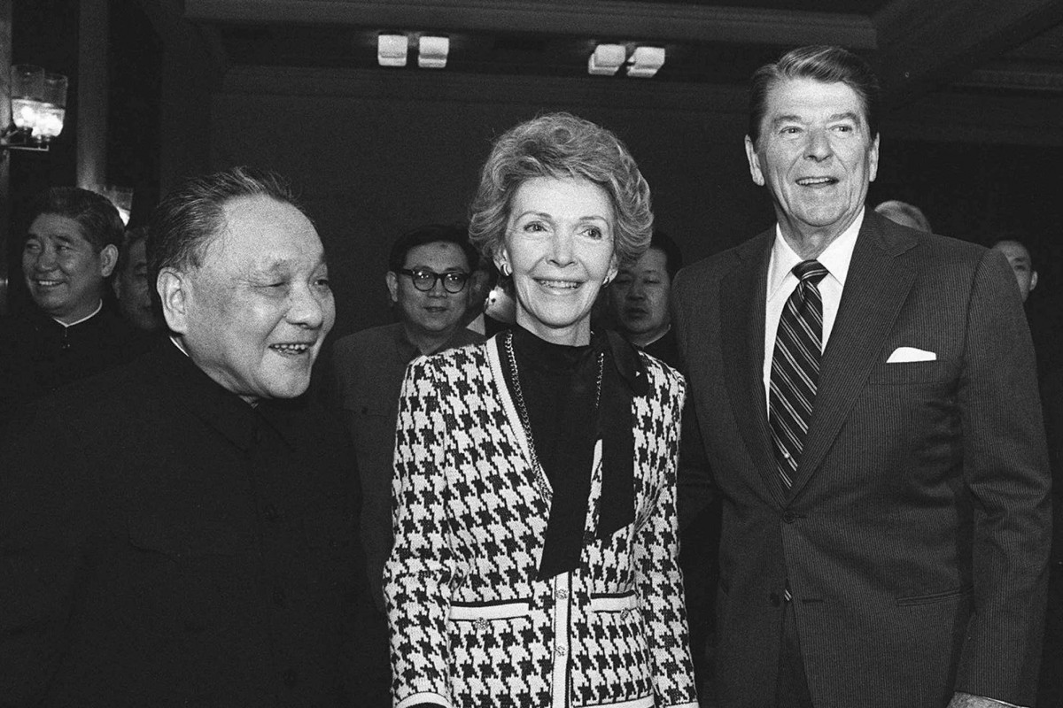
1982 Diplomacy
US-PRC Joint Communique #3 (8/17/82)
US-Taiwan Six Assurances (July 1982)
  CRS Briefing on them
  Declassified Cables
  Reagan 8/17/1982 Memo
Reagan in
China 1984

Slide 48
Policies in Three Capitals
Beijing: Reunification Eventually (force if necessary)
Taiwan: Dealing with Identity; uncertain about US commitments
US: Strategic Ambiguity

Slide 49
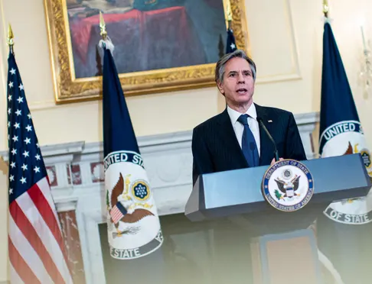
Continuity in US Policy
April 9, 2021 US State Department Announcement
US Secretary
of State
Antony Blinken, April 12, 2021
“What we’ve seen, and what is of real concern to us, is increasingly aggressive actions by the government in Beijing directed at Taiwan, raising tensions in the Straits,”
Using force in the Taiwan Strait is a “serious mistake”

