Slide 1
US-China Trade
Interdependence or Trade War
(or something in between)

Slide 2
Is US-China Economic Rivalry like English-German Economic Rivalry?
Hegemon vs Challenger?

Slide 3
Competition and/or Interdependence
Two Views
Zero-Sum Game: One winner; one loser
2. Complex Game: Winners and losers
Based on choices
Win a little; lose a little
Both can win; both can lose

Slide 4
Issues in the Debate
Is Chinese wealth a threat to the US?
Liberalism or Nationalism?
State Capitalism as a Rival Model?
4. Is the US trade deficit with China a threat?

Slide 5
1. Chinese Wealth

Slide 6
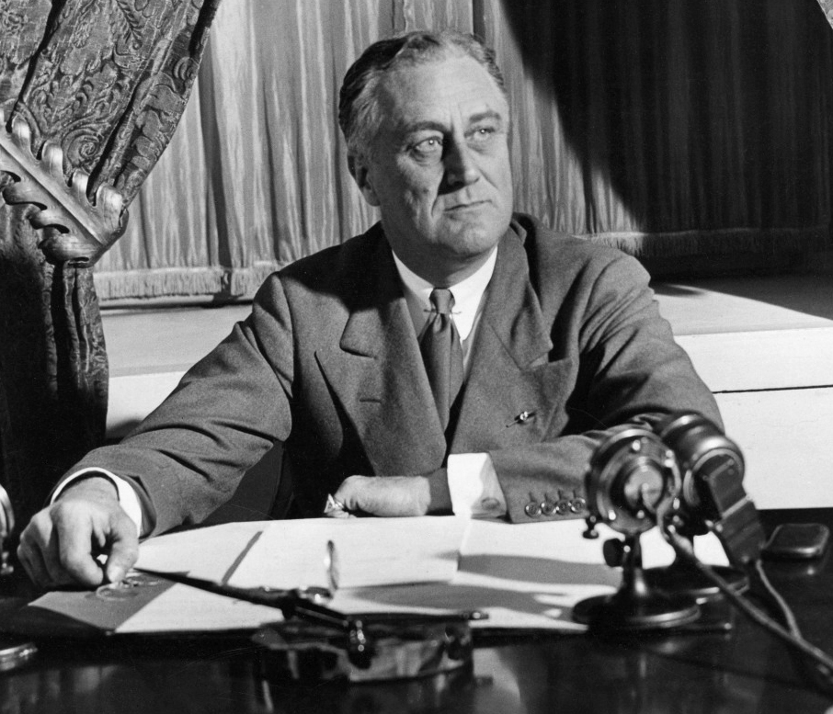
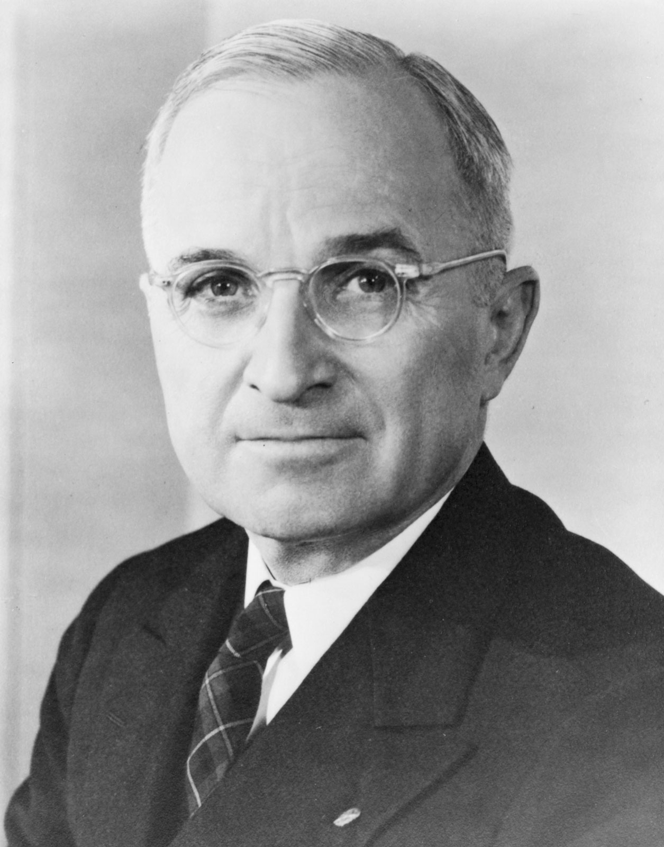
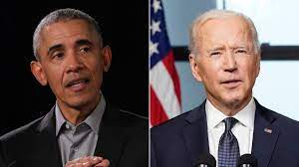
2. Liberalism or Nationalism Post-WW II Liberal Rules

Slide 7
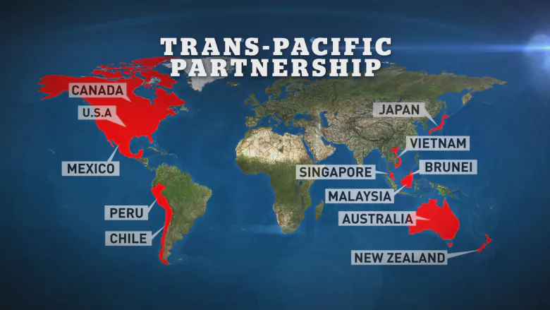
Obama-Era Liberalism (Biden too?)
TPP Agreement
Comprehensive and Progressive TPP Text

Slide 8
Intellectual Property Rights (IPR)

Slide 9
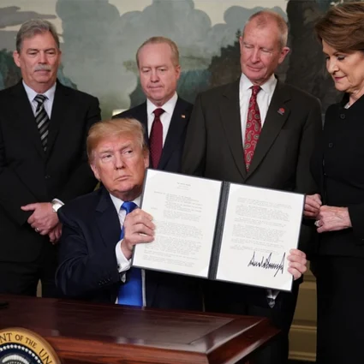
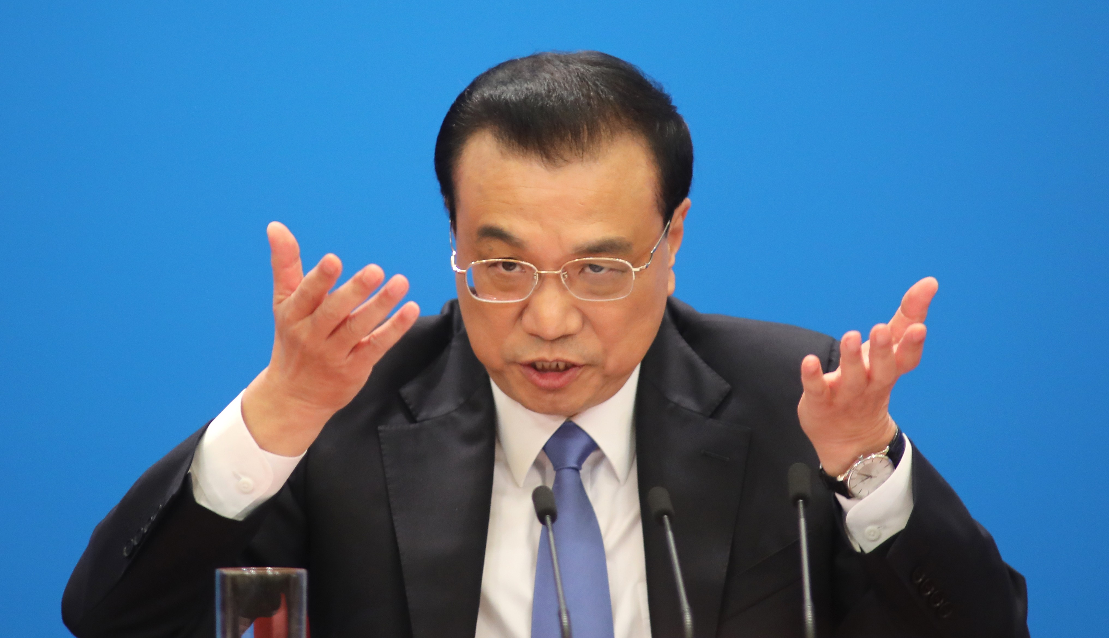
Nationalist Trend?
Does China want to change the rules?
Does the US Want to Change the Rules?
Chinese 2019 Foreign Investment Law
Premier Li Keqiang
Trump Tariffs on China and Others
Trump signing executive order on China tariffs

Slide 10
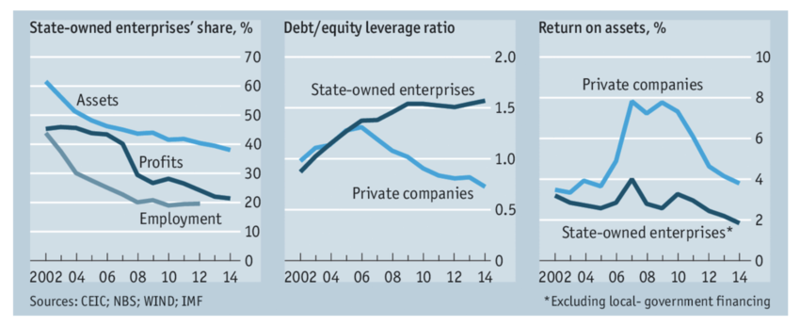
3. State Capitalism as a Rival Model?
Washington Consensus
vs.
Beijing Consensus

Slide 11
Chinese State Owned Enterprises

Slide 12
State Owned Enterprises’ Debt

Slide 13
4. US Trade Deficit and Trump Tariffs on China

Slide 14
Employment by Sector Long View

Slide 15
US Trade Deficit with China to 1985 to 2016

Slide 16
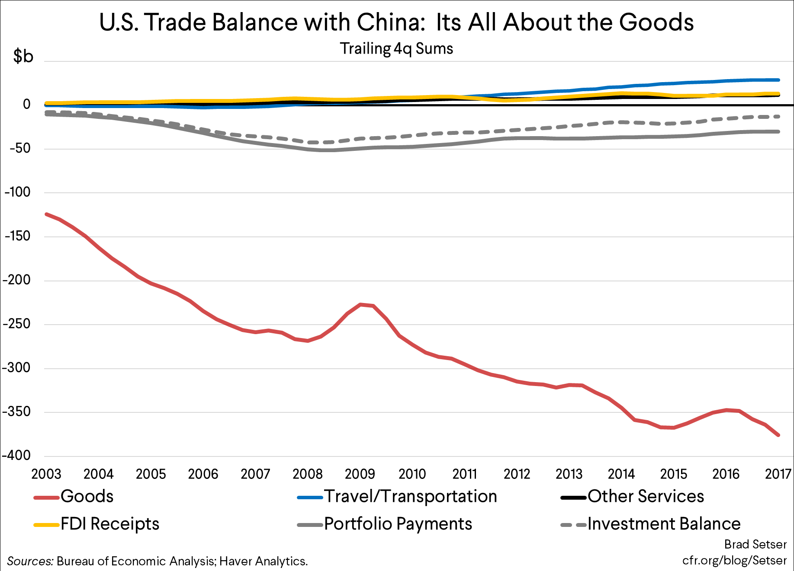
Trade Deficit is in Manufacturing

Slide 17
More Detailed View

Slide 18
But…US Exports to China

Slide 19
Chinese Exports to the US

Slide 20
Biggest Importer by State, 2016 https://www.businessinsider.com/state-trading-partners-map-2016-10

Slide 21
Biggest Exporter by State, 2016 https://www.businessinsider.com/state-trading-partners-map-2016-10

Slide 22
Industrial Robots

Slide 23
Opioid Deaths 2017

Slide 24
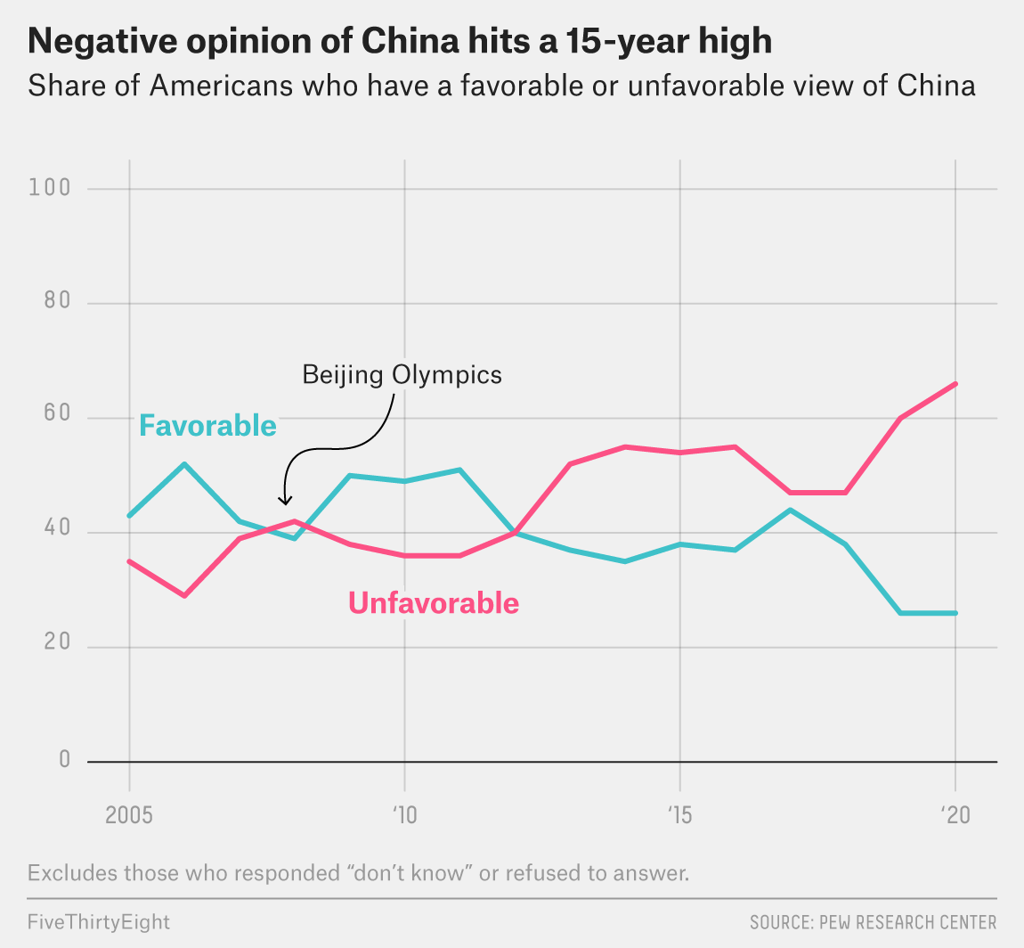
The Bigger Problem?
What if the US and China blame each other for their political and economic problems?

Slide 25
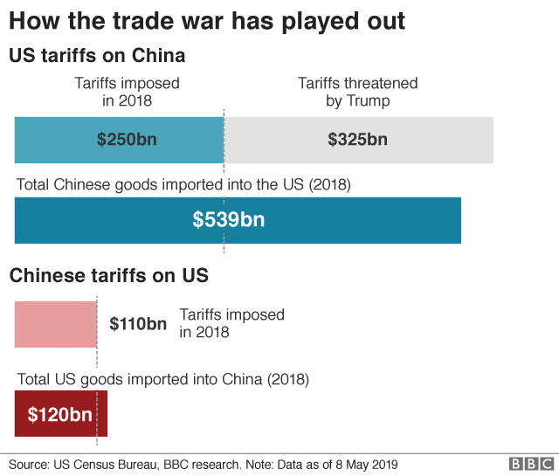
Trump Solution
Tariffs to force open the Chinese economy

Slide 26
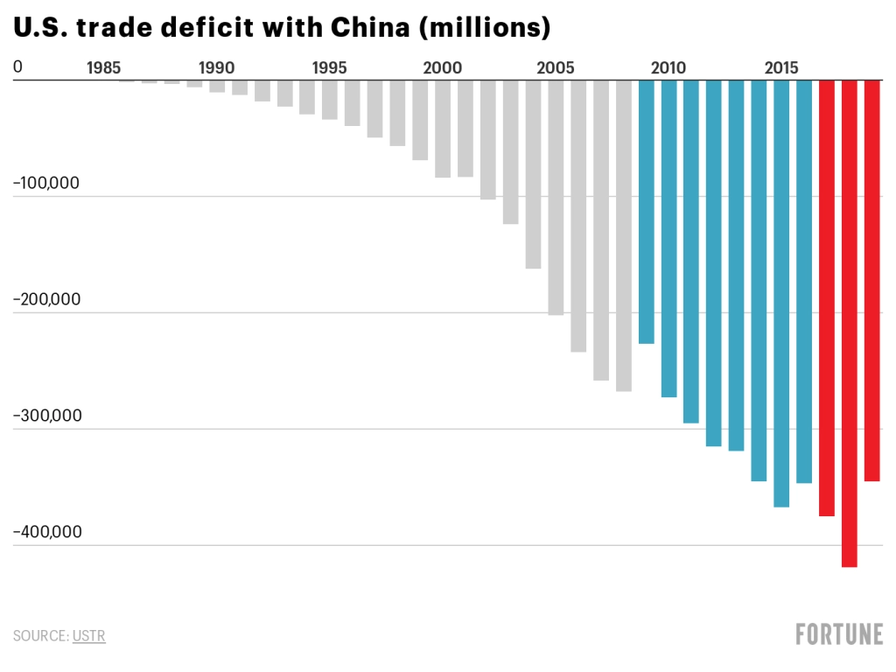
Tariffs Didn’t fix the Trade Deficit

Slide 27
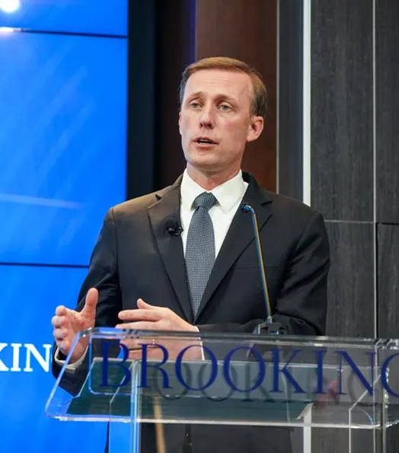
Biden Policy
National Security Advisor Jake Sullivan, April 27, 2023
US-China economic competition
Industrial Policy by US Gov’t
Public Investment
Strategic Sectors
“De-Risking”

