Slide 1
US and China Foreign Policies since 1990s

Slide 2
For US: What is China?
Amazing Economic Opportunity
Dangerous Economic Challenge
Ideological Challenge: Authoritarian State Capitalism
Great Power Rival; Peer Competitor
Partner in Managing 21st Century

Slide 3
For China: What is the US?
Amazing Economic Opportunity
Dangerous Economic Challenge
Nation Encroaching on Chinese Sovereignty
Declining Hegemon; Obstacle to Chinese Power
Threat: Containment to Encircle China in East Asia
Threat: Trying to Destroy China by Dismembering It

Slide 4
Policies of Each Nation
China
1990s-2002
US
1993-2001 Clinton
Deng Xiaoping’s
Low profile
Bide time
Accomplish some tasks
Human Rights, but priority on economics
BEM: Big Emerging Markets

Slide 5
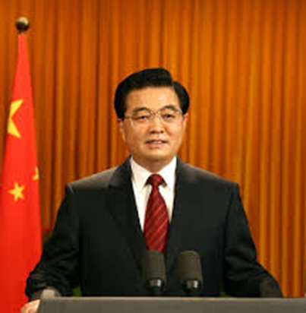
Turn of the Century
China
2002-2009
US
2001-2009 GW Bush
Hu Jintao’s “Peaceful Rise”
“strategic competitor”
“Responsible Stakeholder”
Robert Zoellick

Slide 6
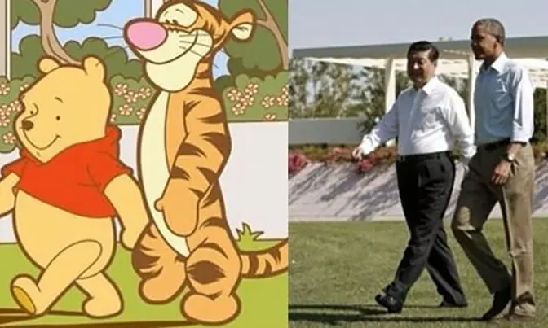
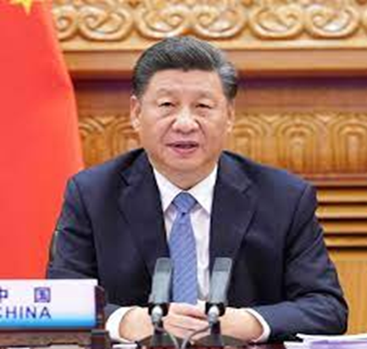
2009-2012 and Beyond:
Meaning of 2008 Great Recession
2009-2010 Assertiveness
2012 Xi Jinping

Slide 7
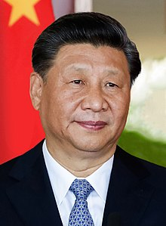
Xi Jinping’s Chinese Dream
End of low profile
“Great Rejuvenation of the Chinese Nation”
Xi’s Role as “Core” Leader

Slide 8
Xi’s Chinese Dream
Belt and Road Initiative 2013

Slide 9
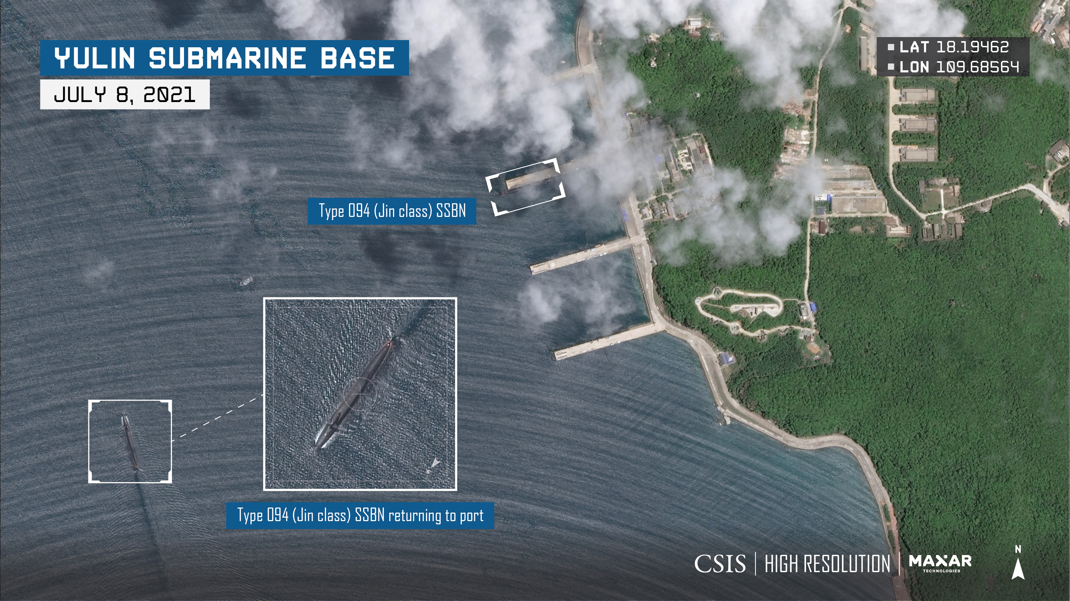
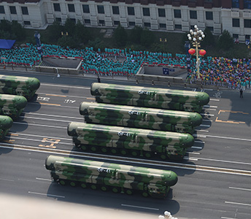
2049 Goals: World Class Military
2019 White Paper on Defense
Jin Class SSBN
DF-41 ICBM

Slide 10
Ideology
Anti-Western ideas
“Socialist Market Economy”
“Beijing Consensus” and State capitalism
Confucianism for legitimacy
Confucianism as global alternative
Confucius Institutes

Slide 11
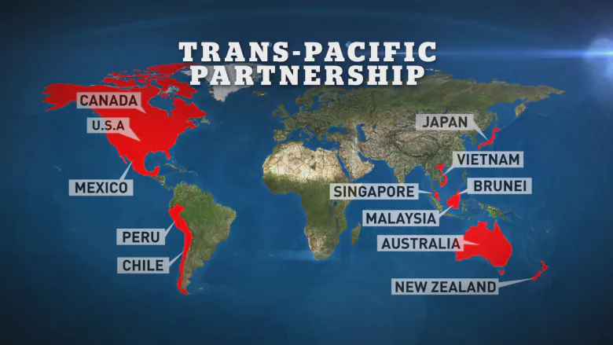
Obama Response
TPP Agreement February 2016
“Rules-based International Order”

Slide 12
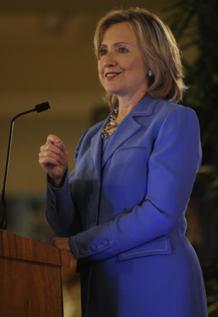
Pivot (Rebalance to Asia)
Defense Guidance 2012
Clinton’s
East-West Center
speech
“America’s
Engagement in
the Asia-Pacific”

Slide 13
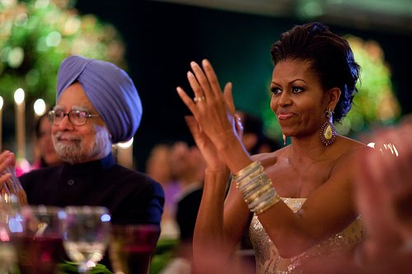
Balance of Power?
Obama Administration’s first state dinner
Michelle Obama and Indian PM Singh

Slide 14
US vs. China
Great Power Rivalry
Difference on Economic Model
Difference on Political Model
US Wants to Maintain Hegemony
China Feels US has Lost Legitimacy and Power
Iraq 2003
Great Recession 2008

