Slide 1
First and Second Nuclear Ages
First
1945-90s
Second
1990s to present
Bipolarity
Rationality
Balance of Power
Deterrence
Arms Control
to achieve stability
Multipolarity
Rationality?
Asymmetry
Deterrence
BMD
Arms Control
Stability
Non-Proliferation

Slide 2
Topics
Strategic Level
(US, Russia, China)
The Proliferation Problem
India and Pakistan
Iran
North Korea
Third Nuclear Age?

Slide 3
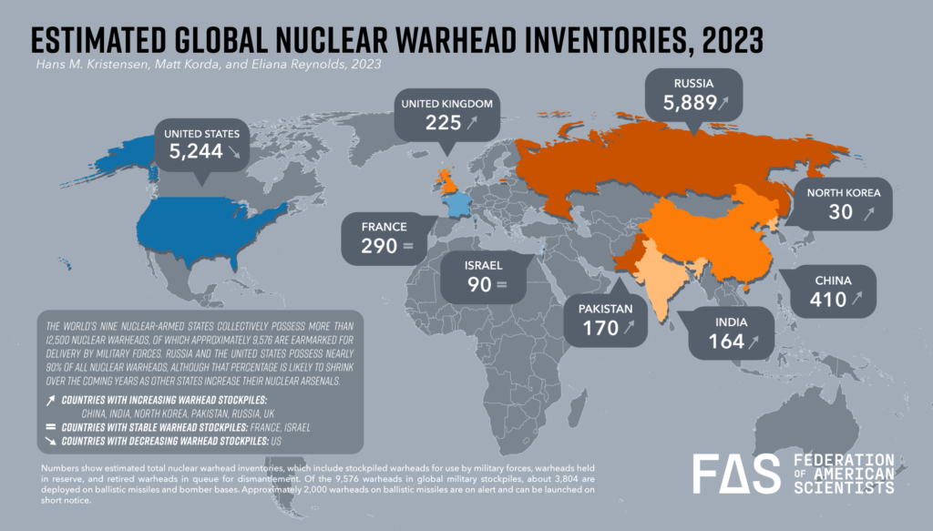
Where We Stand

Slide 4
A Deeper Look From https://ourworldindata.org/nuclear-weapons

Slide 5
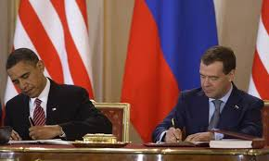
US and Russia
What’s the same?
What’s New?
Triad
Modernization
Arms Control
Signing New Start 2010
Missile Defense

Slide 6
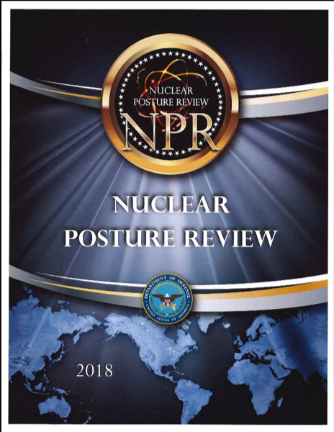
US Strategy
Deterrence of Russia
Deterrence of China
Deterrence of North Korea, Iran
Better Limited War Capability
Counterforce targeting
Nuclear Posture Review 2001
Nuclear Posture Review 2010
Nuclear Posture Review 2018
Nuclear Posture Review 2022

Slide 7
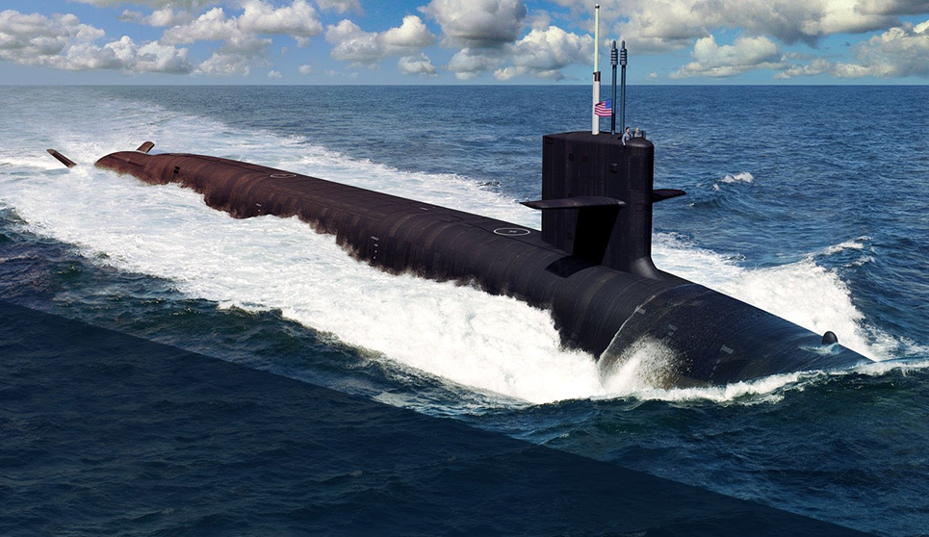
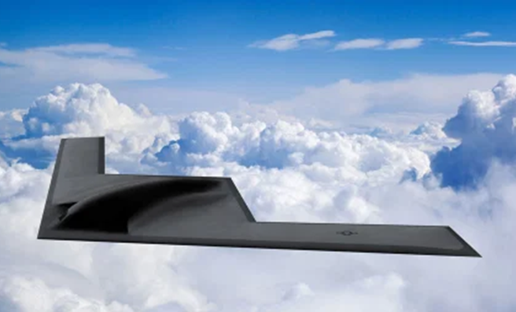
US Nuclear Modernization (reference)
Triad Modernization
Sentinel ICBM (2029)
Columbia class SSBN (2031)
B-21 (mid-2020s)

Slide 8
Arms Control with Russia
2002: Strategic Offensive Reductions Treaty
2011: New START Renewed for Five Years in 2021
Each bomber counts as one warhead no matter how many bombs or ALCMs it may have
Freedom to mix (shift ICBMs to SLBMs or the reverse, for example)

Slide 9
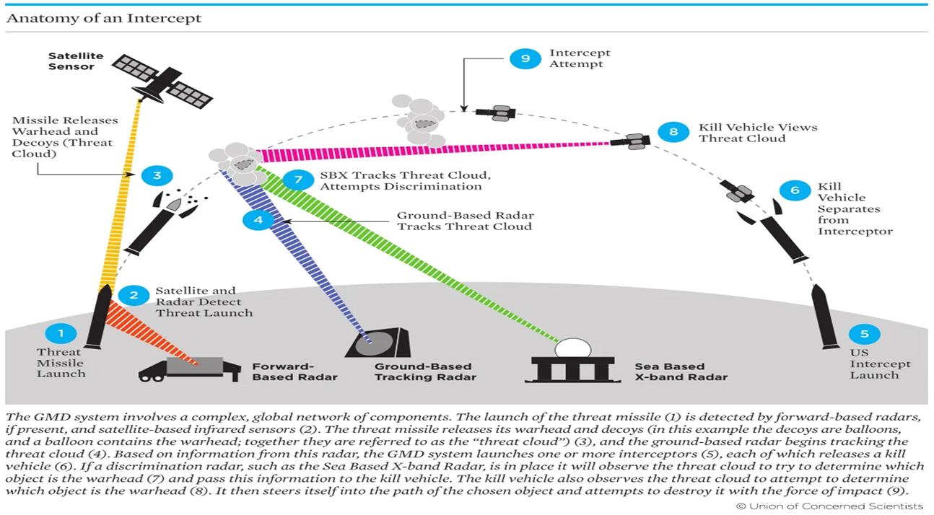
National Missile Defense The Big Change
US Missile Defense Agency
Ground-based Midcourse Defense

Slide 10
NMD: Deterrence by Denial
Missile Defense Review 2022

Slide 11
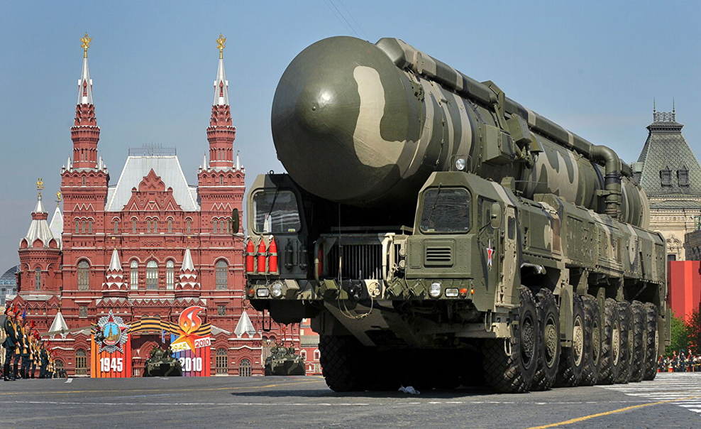
Russia Return to Great Power Status
1982: No-First Use
1993: End No-First Use
Escalate to de-escalate?
Mobility
NMD
Topol-M
(SS-27)

Slide 12
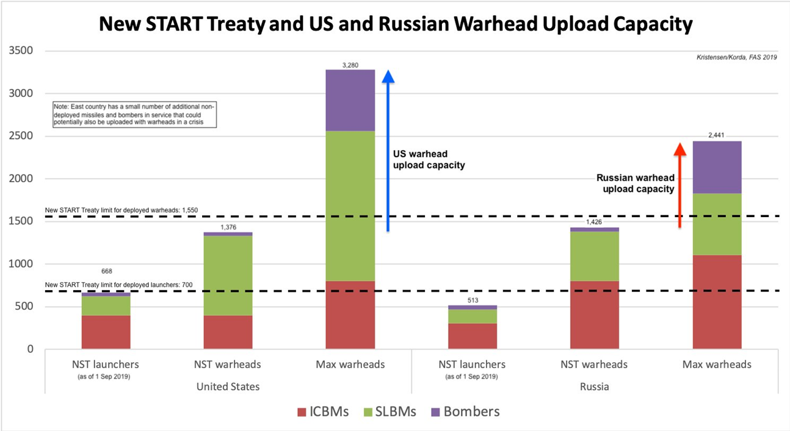
Agreement February 2021 to Five-Year Extension on New START
From https://fas.org/blogs/security/2020/02/count-down-begins-for-no-brainer-extend-new-start-treaty/

Slide 13
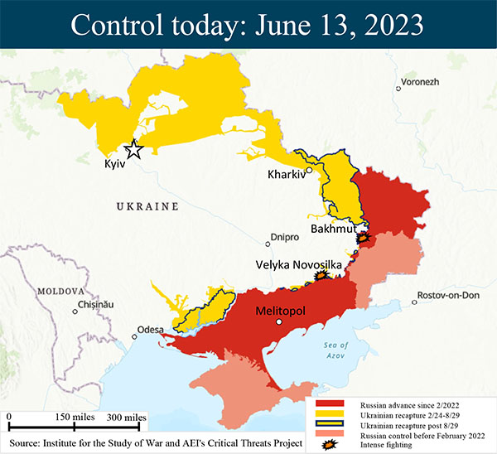
But…
February 21, 2023:
Russia suspends New START

Slide 14
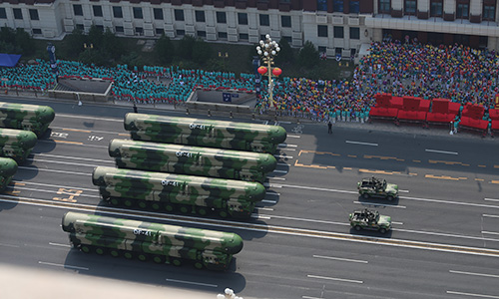
China Return to Great Power Status*
US Report to Congress on Chinese Military Power 2022
DF-41
Mobile ICBM

Slide 15
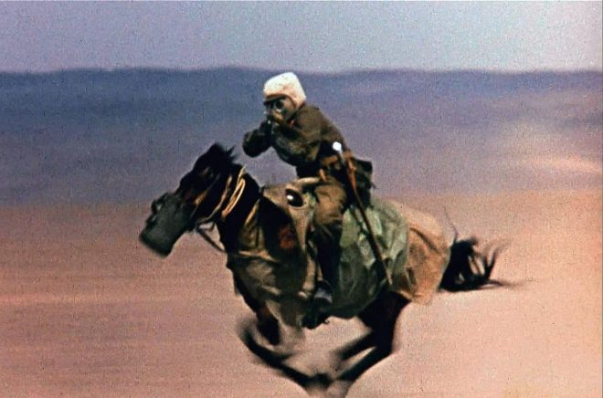
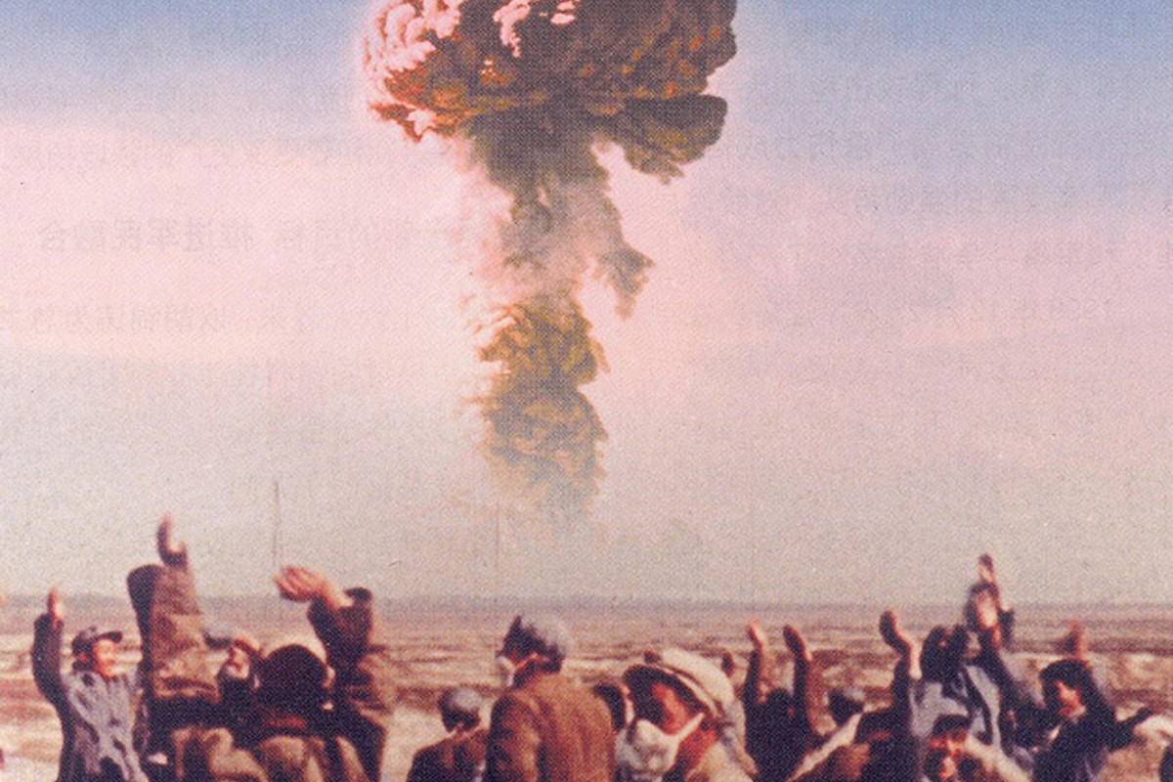
China’s First Bomb
Sino-Soviet Split
October 16, 1964
22 KT

Slide 16
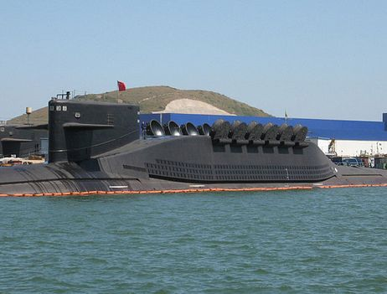
Chinese Strategy
Minimum Deterrence
NFU
Create strategic TRIAD
PLARF (2016)
MIRVs
Bombers
Mobile missiles
NMD
Jin class (Type 094)

Slide 17
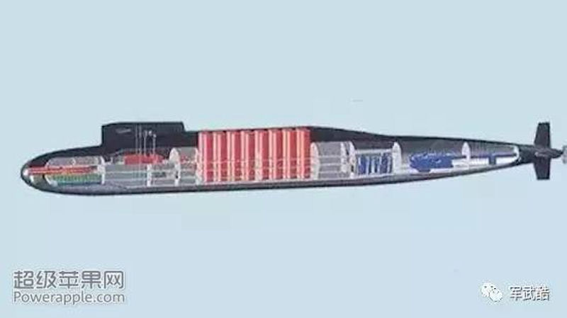
Chinese Response to US NMD
Nullifies Chinese Deterrent
Requirement: MORE
Arms Control: NO
US-China arms race is on
US defense vs. Chinese offense
Cyberattack
Type 096 SSBN

Slide 18
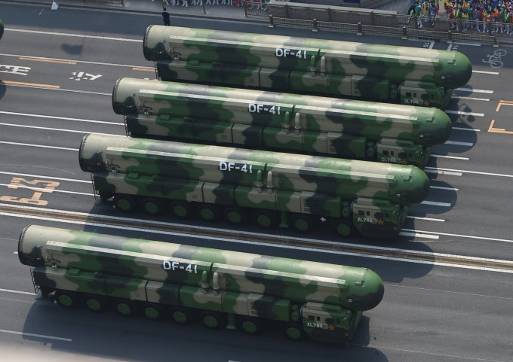
2021: Chinese ICBM Construction (From Bulletin of the Atomic Scientists)
Yumen (Gansu Province): 120 silos
Hami (Eastern Xinjiang): 110
Hangin Banner (Ordos City, Inner Mongolia): 40~

