Slide 1
South China Sea

Slide 4
Paracel and Spratly Islands

Slide 5
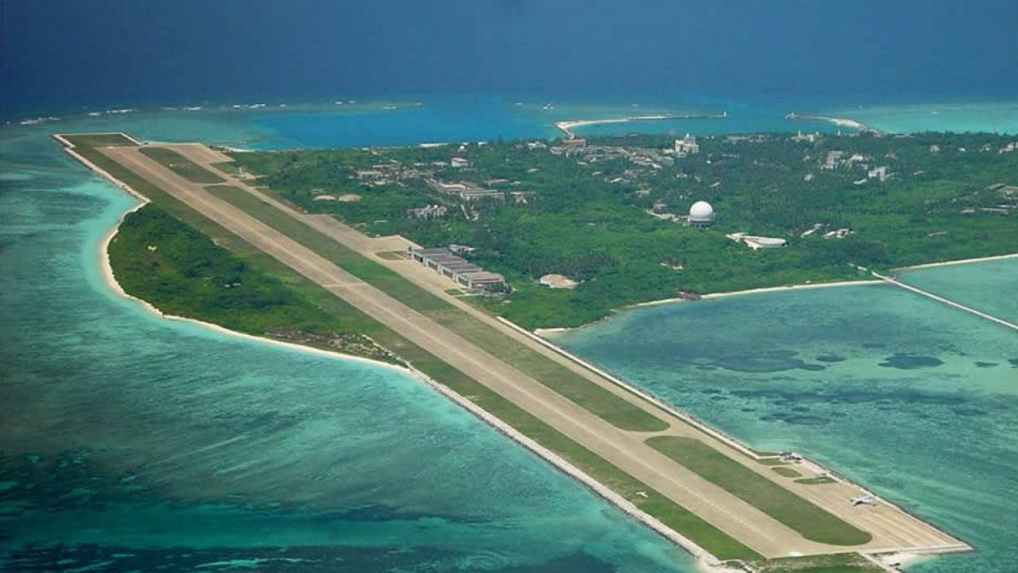
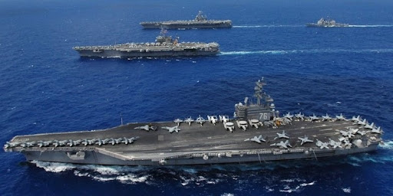
Disputes between…
China
Vietnam
Philippines
Malaysia
Brunei Woody Island
Taiwan
US Aircraft Carriers

Slide 6
Competing Claims

Slide 8
China’s Nine-Dash Line

Slide 9
Oil and Gas

Slide 10
Oil Trade

Slide 11
Natural Gas Trade

Slide 12
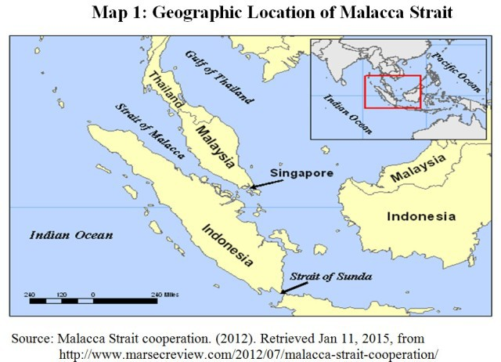
Strait of Malacca
China’s access to Indian Ocean and OIL

Slide 13
Establishing Sovereignty
Discovery
Occupation
Administration
Citizens live or work there historically

Slide 14
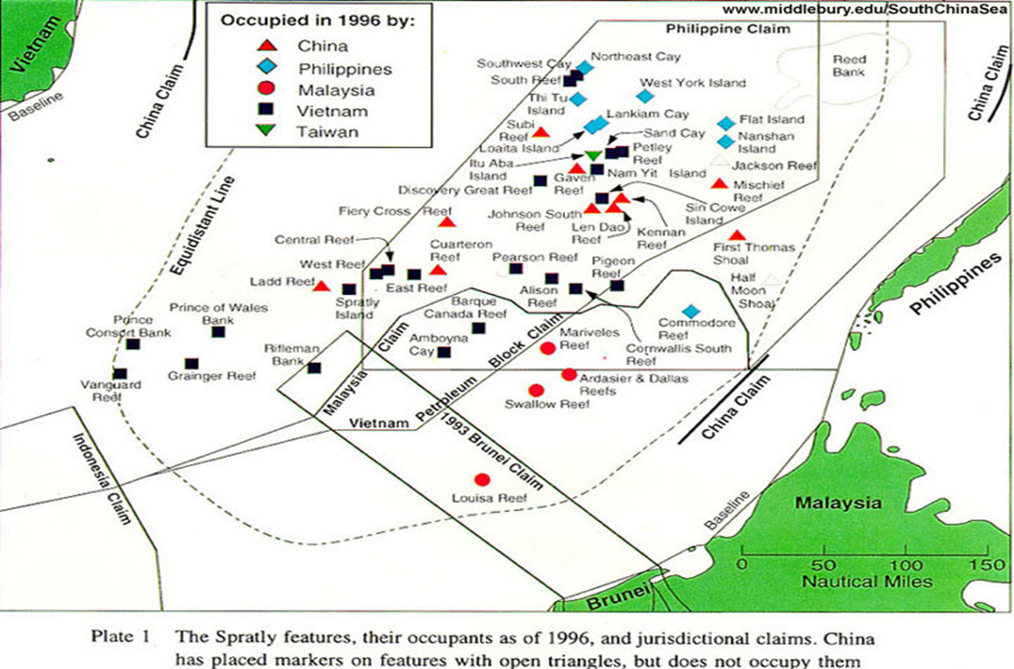
Spratly Islands Disputes
Nations begin to occupy islands

Slide 15
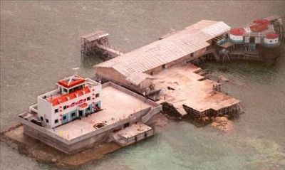
Mischief Reef Chinese “Naval Base”
1990s
2010s

Slide 16
Mischief Reef 2018

Slide 17
Fiery Cross Reef (Spratly Islands)

Slide 18
Chinese Bases in the Spratly Islands 2018

Slide 19
Philippine Claim to the Second Thomas Shoal

Slide 20
Paracel Island Disputes and Chinese Oil Rig 2014

Slide 21
UN Convention on the Law of the Sea (UNCLOS) 1982
12 mile limit from a nation’s coast: legal jurisdiction for the nation
200 miles form a nation’s coast Exclusive economic rights for the nation
Dispute resolution mechanism
Direct talks between the parties.
If they fail:
submission of the dispute to the International Tribunal for the Law of the Sea
adjudication by the International Court of Justice
submission to binding international arbitration procedures
submission to special arbitration tribunals with expertise in specific types of disputes. All of these procedures involve binding third-party settlement
Exceptions for cases involving national sovereignty. Parties submit their dispute to a conciliation commission; results are non-binding.

Slide 22
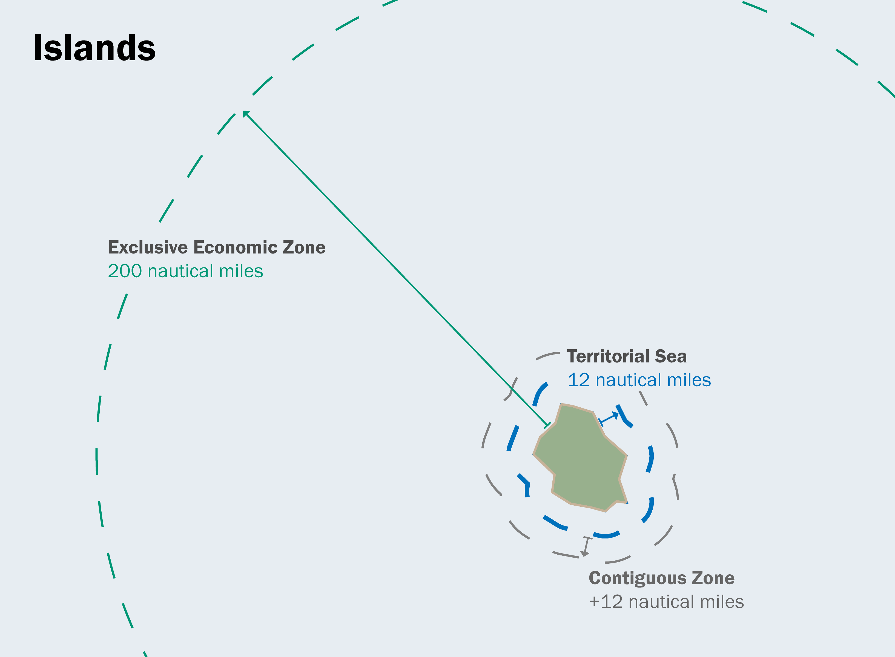
UNCLOS Terms
Territorial Sea
Contiguous Zone
Exclusive Economic Zone

Slide 23
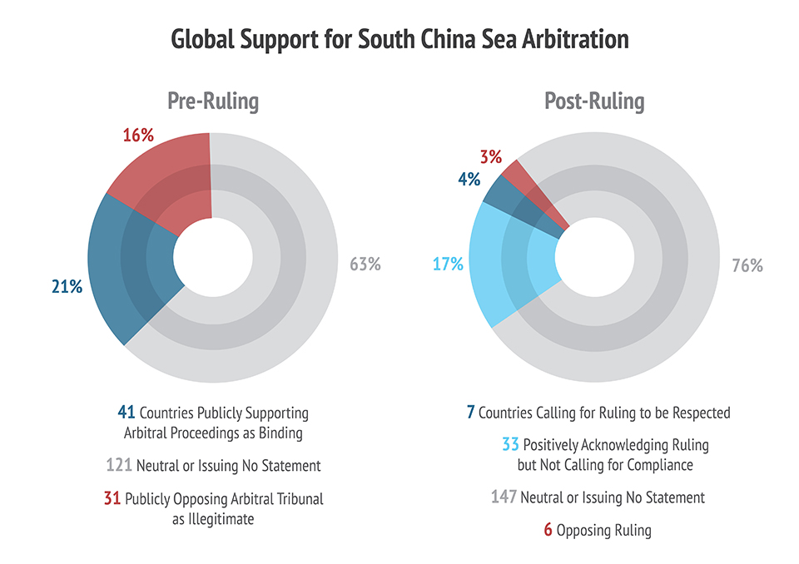
Permanent Court of Arbitration 1899
2016 Ruling

Slide 24
Solutions? The ASEAN Way
ASEAN (Association of Southeast Asian Nations)
Consensus
Economic Cooperation
Non-Interference in each
other’s domestic affairs

Slide 25
ASEAN Multilateralism (for reference only)
ARF: ASEAN Regional Forum
ASEAN Free Trade Agreements
ASEAN Plus 3
ASEAN Plus 6
East Asia Summit (annually)
RCEP: Regional Comprehensive Economic Partnership

Slide 26
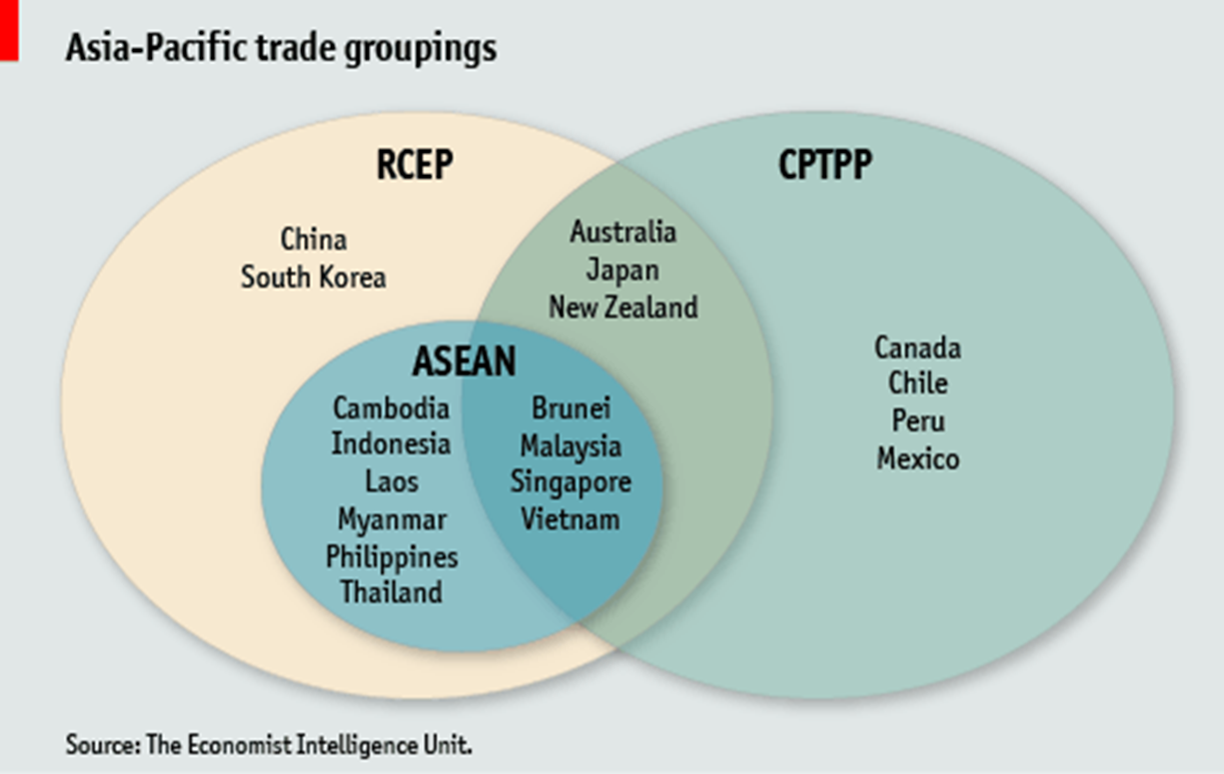
Venn Diagrams for FTAs (for reference only; and because Venn Diagrams are cool)
From: Economist Intelligence Unit, http://country.eiu.com/article.aspx?articleid=1258651509&Country=Myanmar&topic=Economy&oid=68511790&aid=1

Slide 27
Issues in “Code of Conduct”
ASEAN and Chinese negotiations:
Defining the South China Sea
Dispute Resolution Mechanism
Conflict Management
Legal Status of the Code

Slide 28
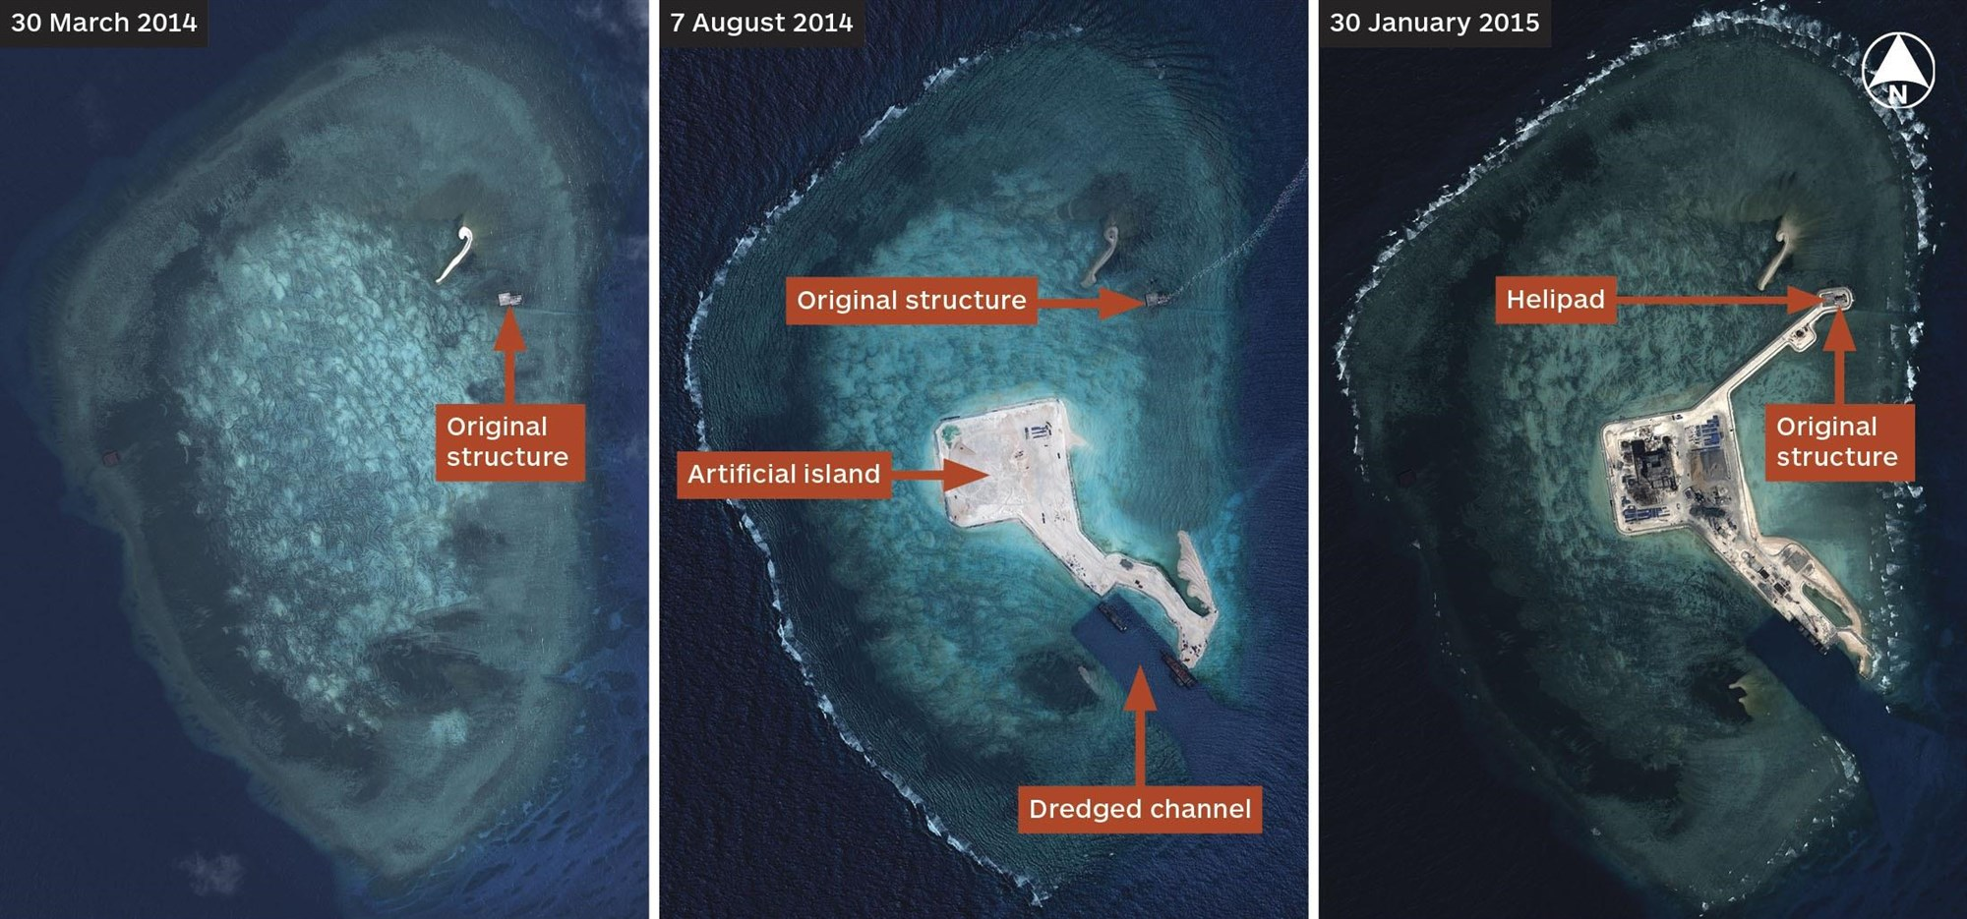
Does China Benefit from the Delay?
“New Status Quo”
“Facts on the Ground”

Slide 29
Militarization of the Disputes
Chinese challenges
Chinese Coast Guard Law 2021

Slide 30
US Freedom of Navigation Operations (FONOPs)
“Innocent Passage”
“Excessive Maritime Claims”

Slide 31
FONOPs

Slide 32
Resources
UNCLOS: Part II; Territorial Sea: Section 3, Articles 17-25
US FONOPs Reports
Asia Maritime Transparency Initiative (Center for Strategic and International Studies): FONOPs Analysis
Belfer Center
Guide to S. China Sea FONOPs

Slide 33
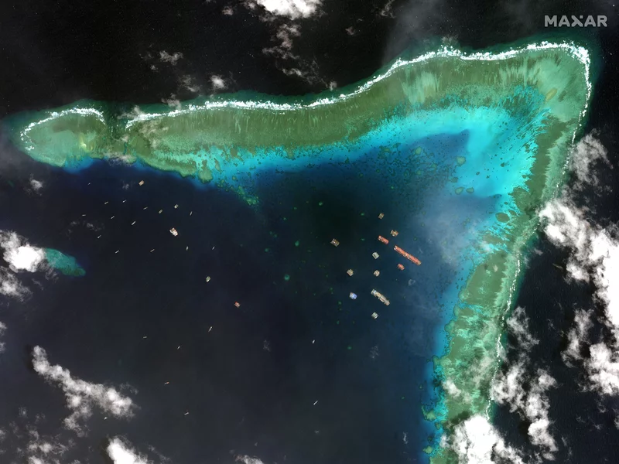
China Philippines Standoff 2021
March 2021
Whitsun Reef
Over 200 Chinese ships

