Slide 1
Theories of
International Relations and
Great Power Rivalry

Slide 2
Theories of International Relations
Realism
Idealism (Liberalism)
Constructivism

Slide 3
1. Realism
Power: the ability to influence others
Irrelevance of morality and ethics, law, and domestic political systems
Why is power the only thing?
Human nature (Classical Realism)
Anarchic world: no rules (Neorealism)

Slide 4
Realist Great Power Rivalry: Power Transition Theory
Great Power War (Hegemonic War)
Hegemon Declines; Winner becomes Challenger Rises Hegemon
Hegemon Rules

Slide 5
But maybe not war? The Cold War Balance of Power 1945-1990
Israel Syria/Egypt/PLO
Ethiopia Somalia
Taiwan China
S. Korea N. Korea
S. Viet Nam N. Viet Nam
W. Berlin E. Berlin
W. Germany E. Germany
Britain/France/Japan Poland/Czech
Nuclear Weapons Nuclear Weapons
US USSR

Slide 6
The Future of Asia? Balancing or Bandwagoning
Taiwan
Japan
South Korea
North Korea
Russia
Vietnam
Philippines
Malaysia
Thailand
India
Indonesia…
Nuclear Weapons Nuclear Weapons
US China

Slide 7
2. Idealism/Liberalism
Not just power
Common interests and common values
Interdependence
Desire for rules, predictability, stability
International law
International Institutions

Slide 8
International Law
Sovereignty
Voluntary
Choosing cooperation over rivalry
Multilateral Treaties Depository

Slide 9
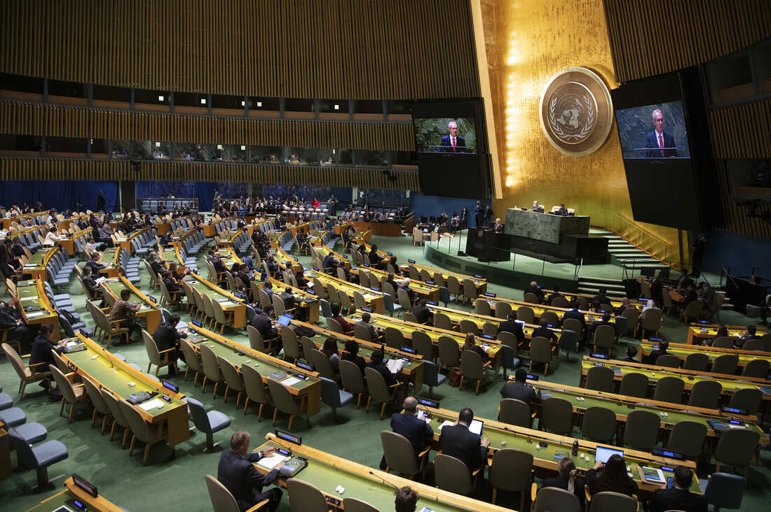
United Nations

Slide 10
Liberalism and Great Power Rivalry: Hegemonic Stability Theory
Hegemonic War
Winner becomes hegemon; makes rules for international system
Hegemon weakens;
system weakens
Rise of challenger to hegemon and system
Hegemon Rules System

Slide 11
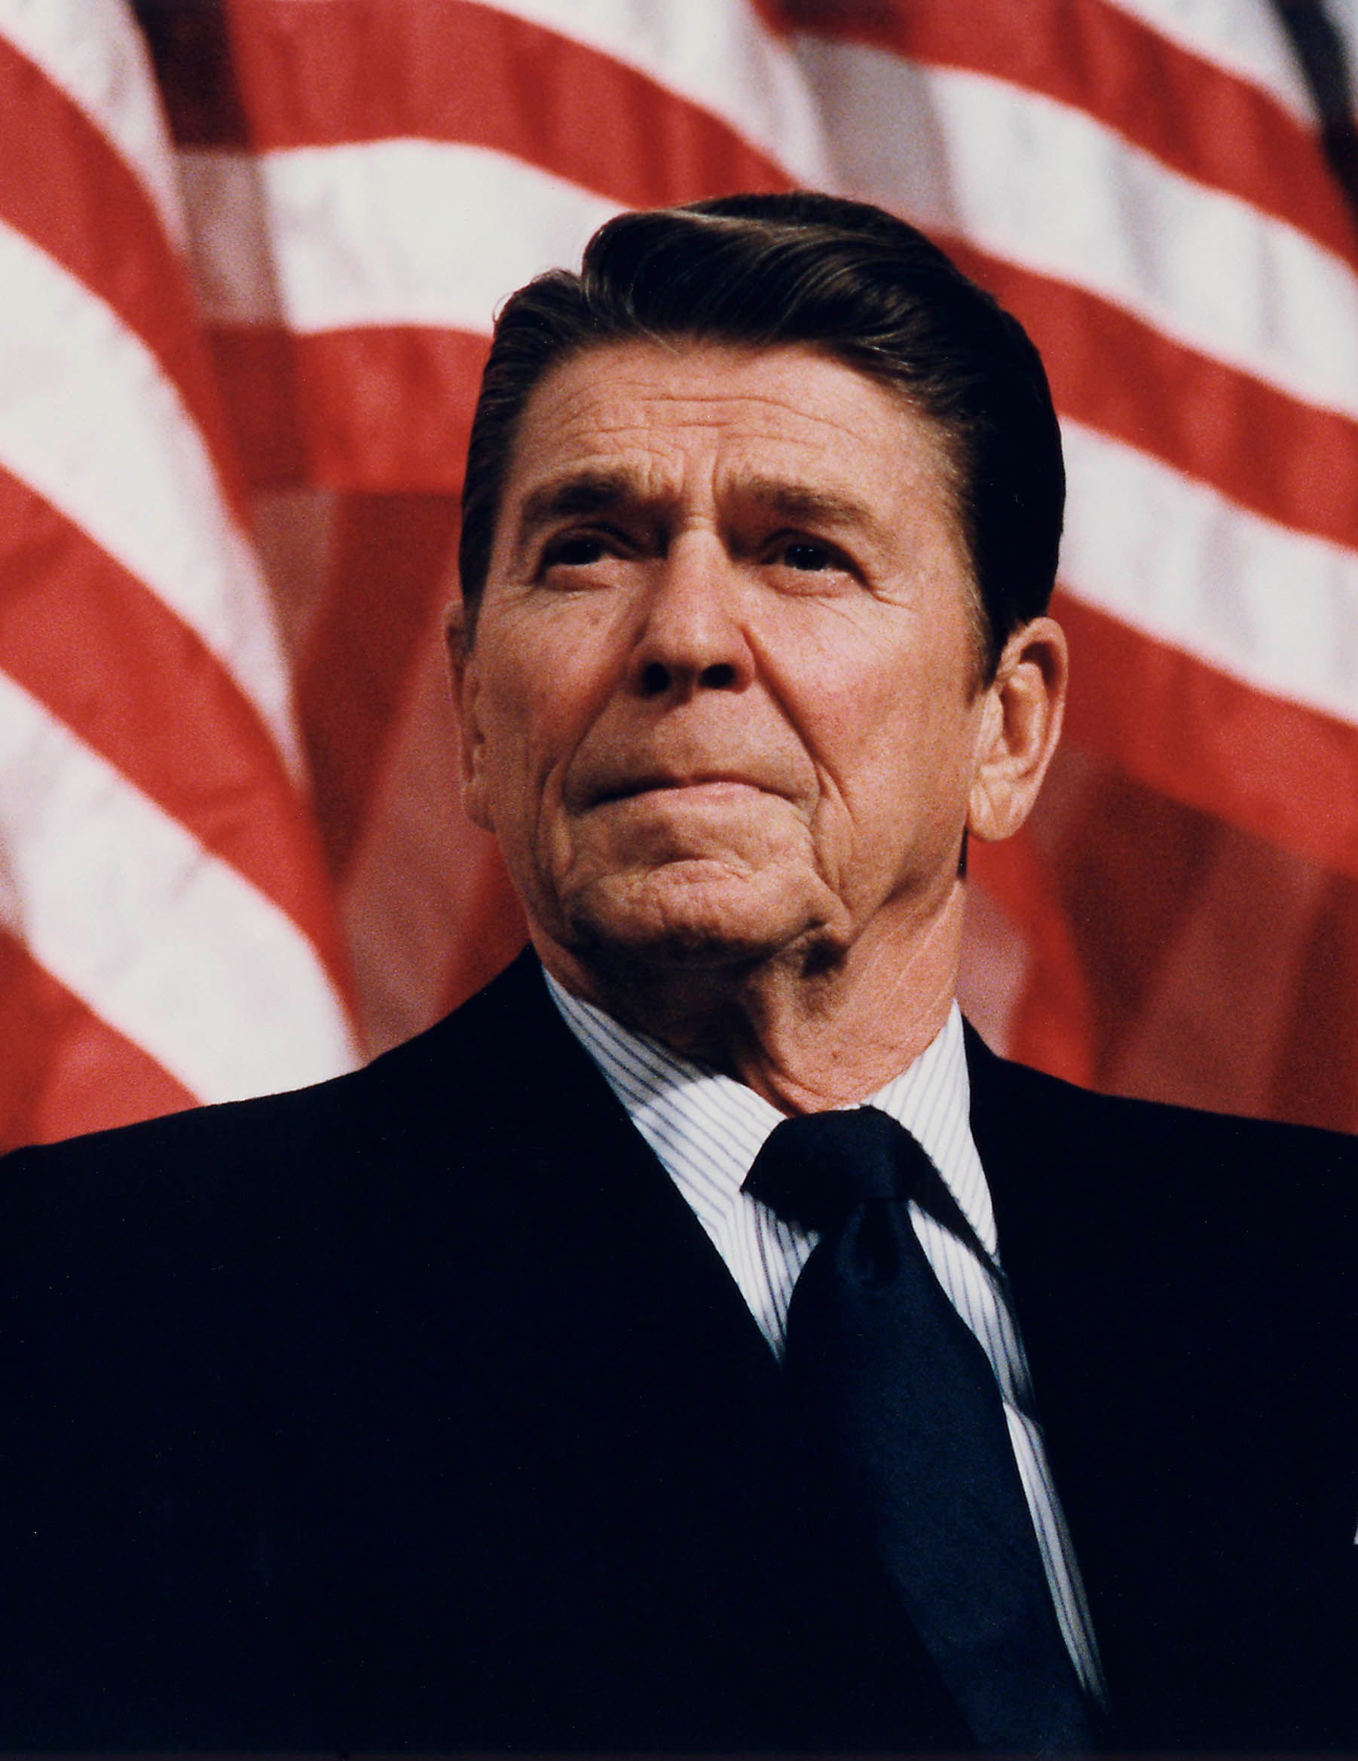
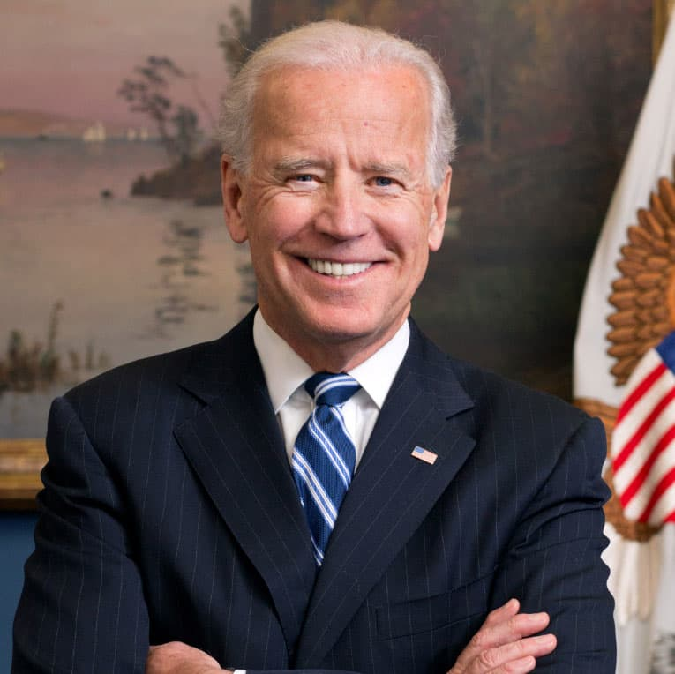
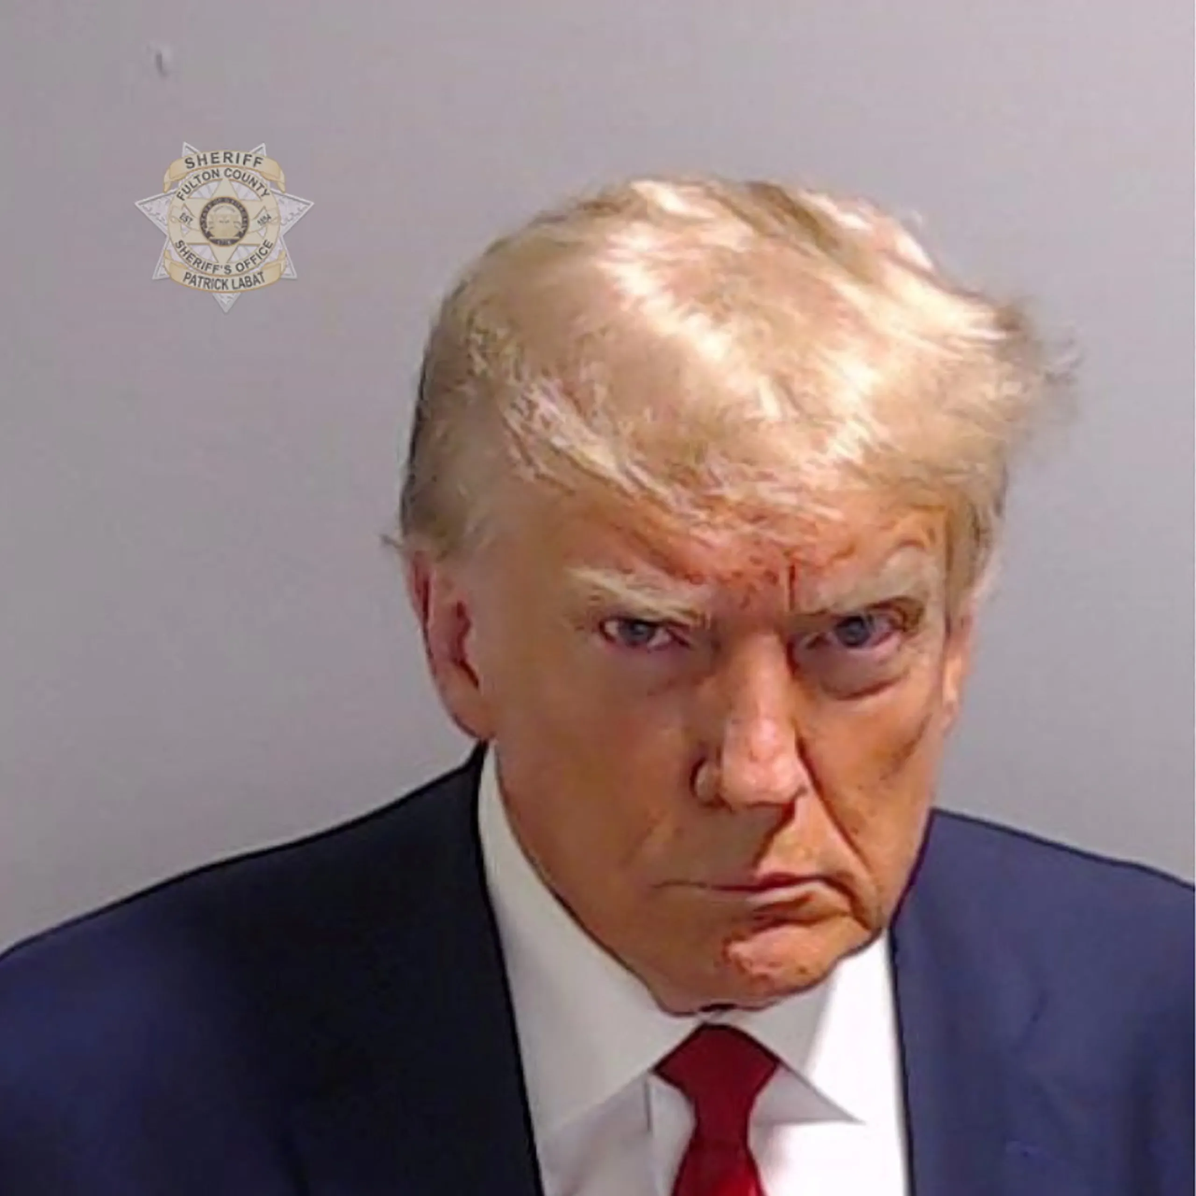
“Rules-based International Order”

Slide 12
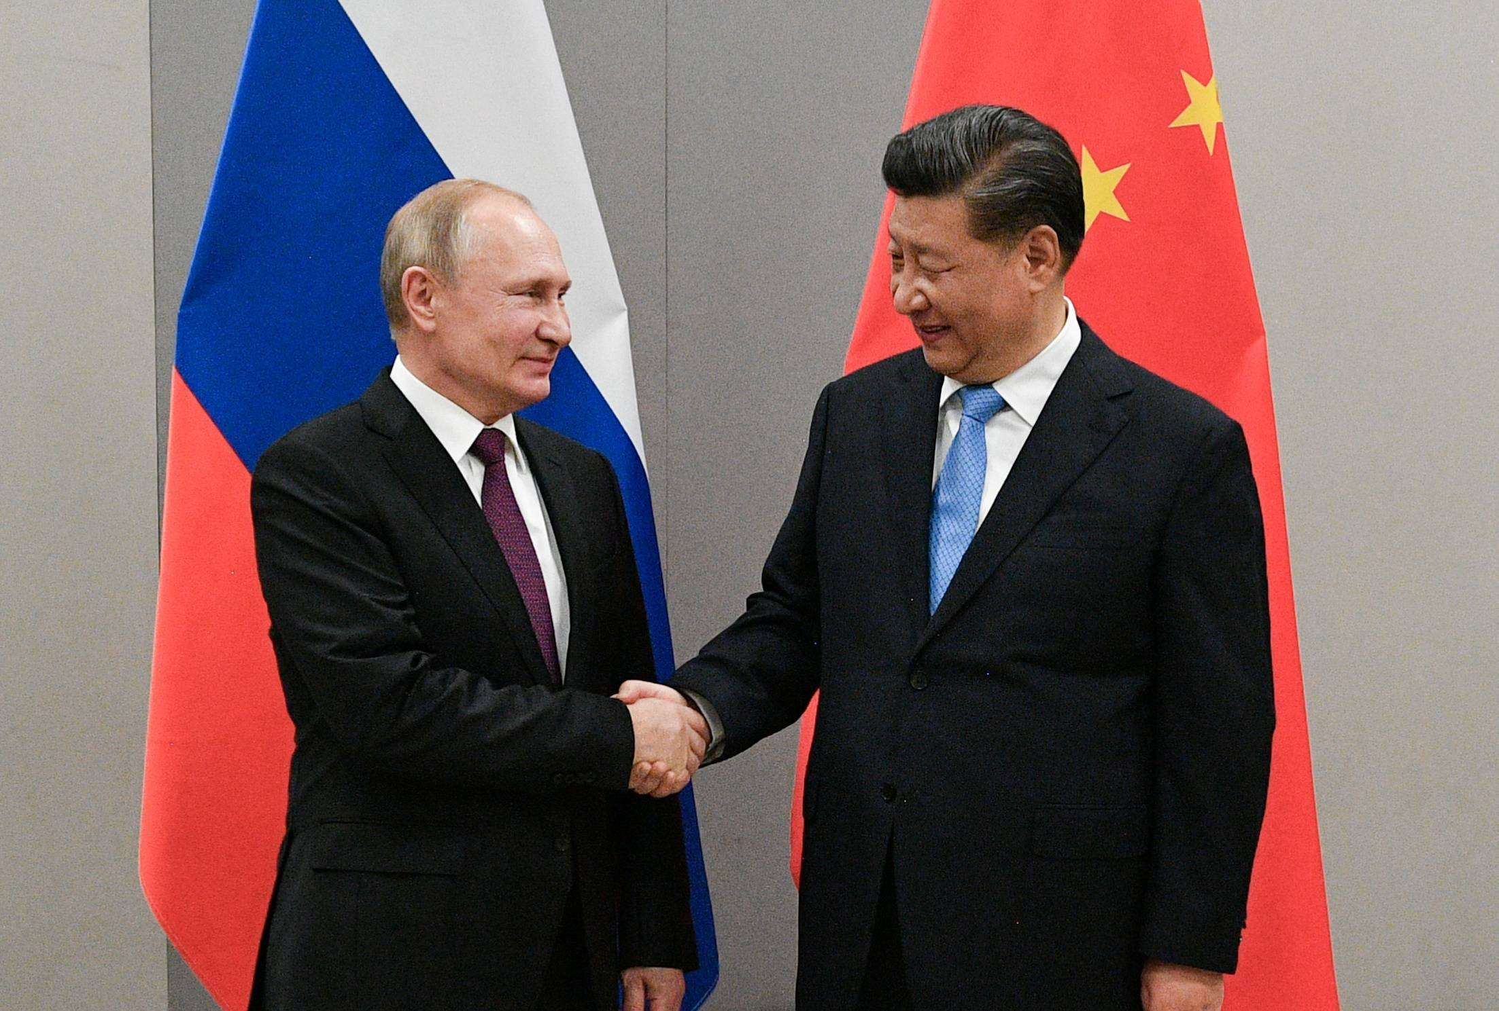
A New International Order?
Joint Statement of the Russian Federation and the People’s Republic of China on the International Relations Entering a New Era and the Global Sustainable Development, February 4, 2022 (Translation by US Air Force, Air University)
Global Civilization Initiative, March 2023
Putin and Xi
February 4, 2022
Notes:
Multipolarity
Redistribution of power in the world
Cultural Diversity and civilizational diversity of nations
Democracy is culturally defined
Non-interference in internal affairs of nation
All states must accept “diversity of their civilizational, cultural, and historical backgrounds…”
“Certain states” cause “instability” by acting unilaterally
“Certain states” impose their standards on others, and try to change other countries political systems
Alliances are divisive (NATO expansion is bad)
Oppose “certain states” attempts to gain military superiority and “ideologized cold war approaches”
Russia-China friendships has no limits**
Russia believes in one China and Taiwan is part of China
Calls for “new kind of relationships between world powers on the basis of mutual respect, peaceful coexistence, and mutually beneficial cooperation.”

Slide 13
3. Constructivism
Nation-states are not all alike
Foreign Policy is shaped by:
Political culture
Form of government
History
Domestic political trends and debates
States have identity

Slide 14
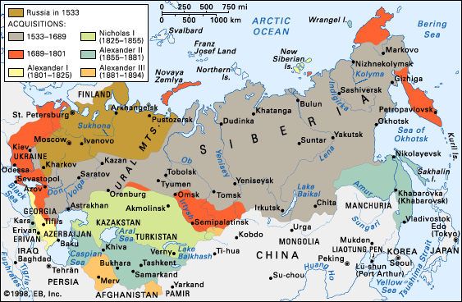
Russian fear of invasion

Slide 15
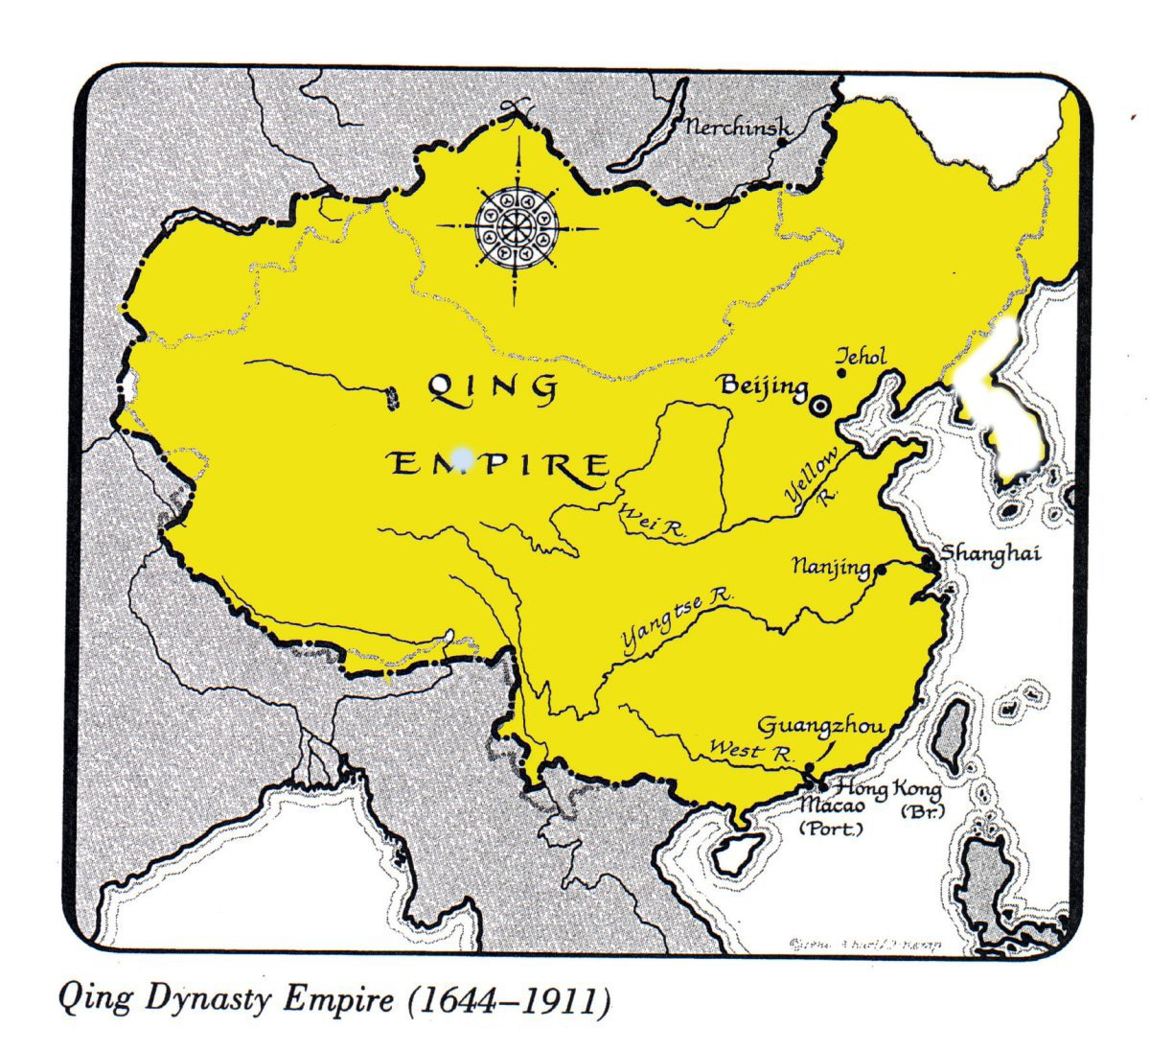
China: Qing Dynasty 1644-1911

Slide 16
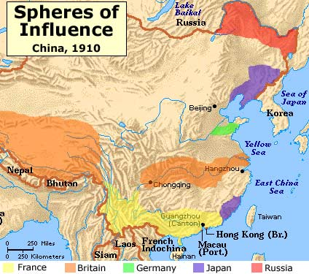
China: “100 Years of Humiliation”

Slide 17
US: Woodrow Wilson, 1917
“The world must be made safe for democracy. Its peace must be planted upon the tested foundations of political liberty. We have no selfish ends to serve. We desire no conquest, no dominion. We seek no indemnities for ourselves, no material compensation for the sacrifices we shall freely make. We are but one of the champions of the rights of mankind. We shall be satisfied when those rights have been made as secure as the faith and the freedom of nations can make them. “

Slide 18
US: GW Bush, 2005
“And we have declared our own intention: America will stand with the allies of freedom to support democratic movements in the Middle East and beyond, with the ultimate goal of ending tyranny in our world.“

Slide 19
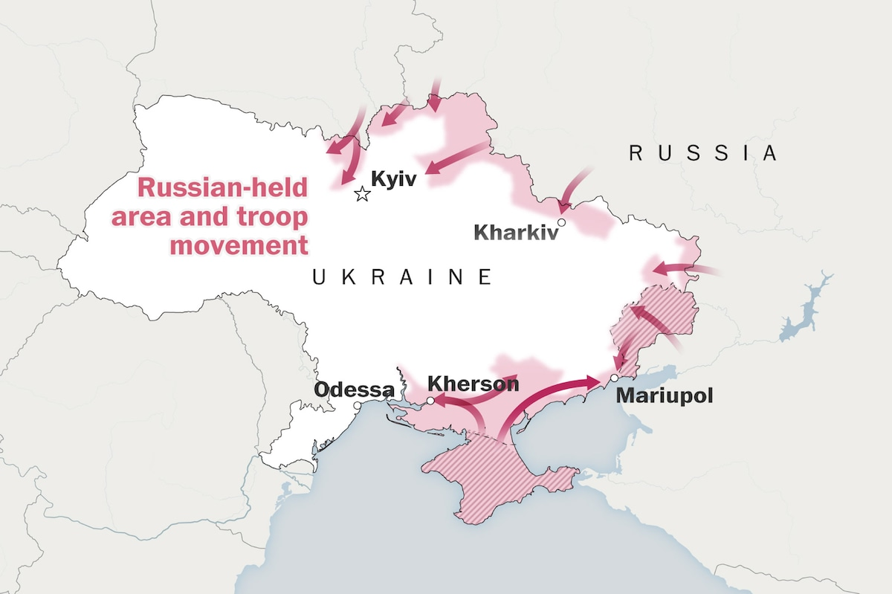
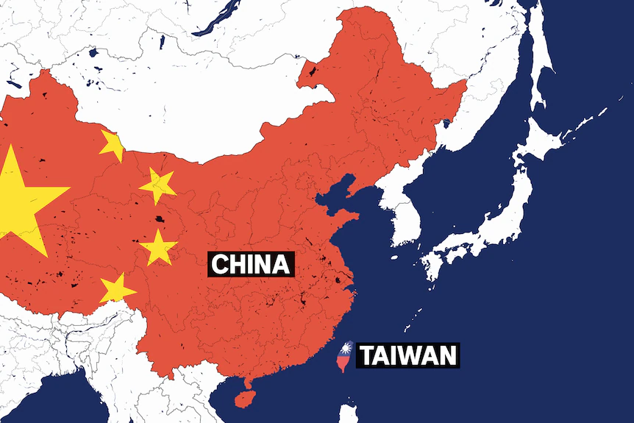
Constructivism and Great Power Rivalry
When Identities Clash…

