Slide 1
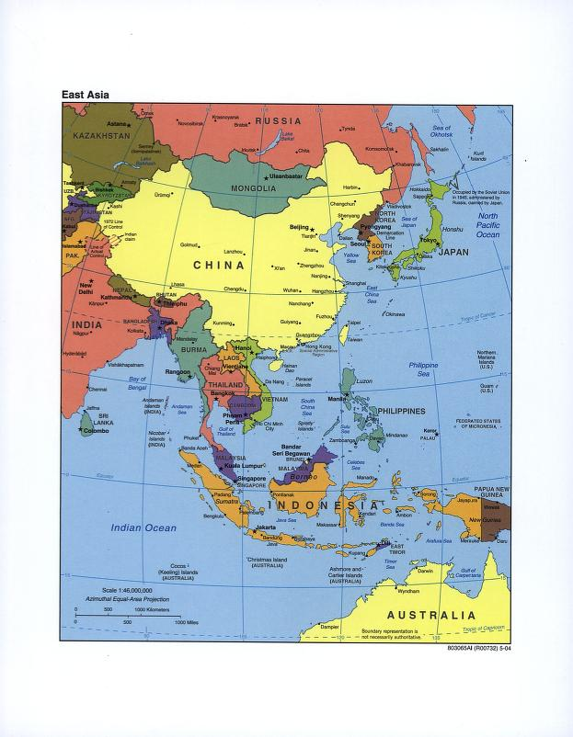
East Asia

Slide 2
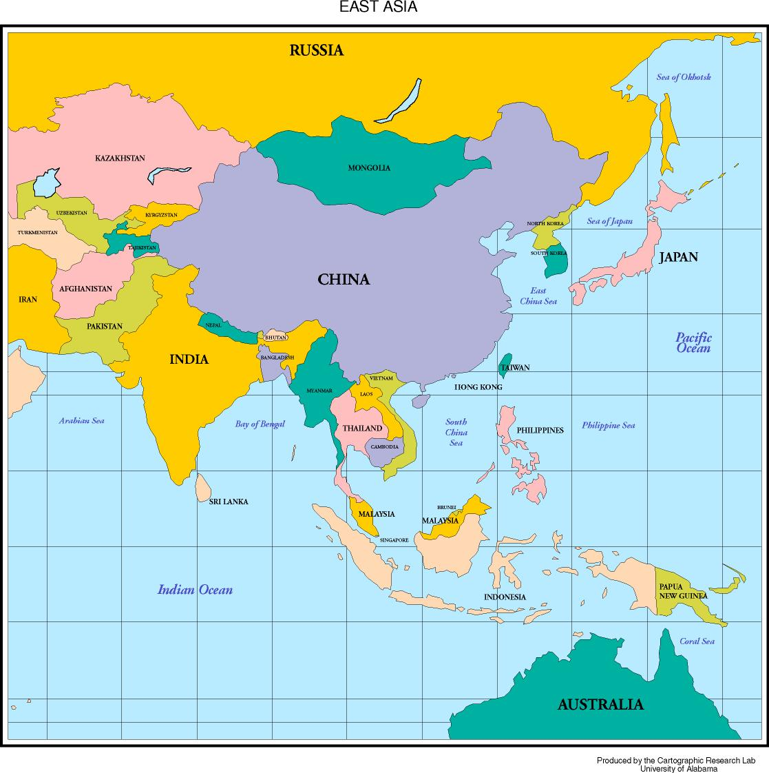
East Asia Again

Slide 3
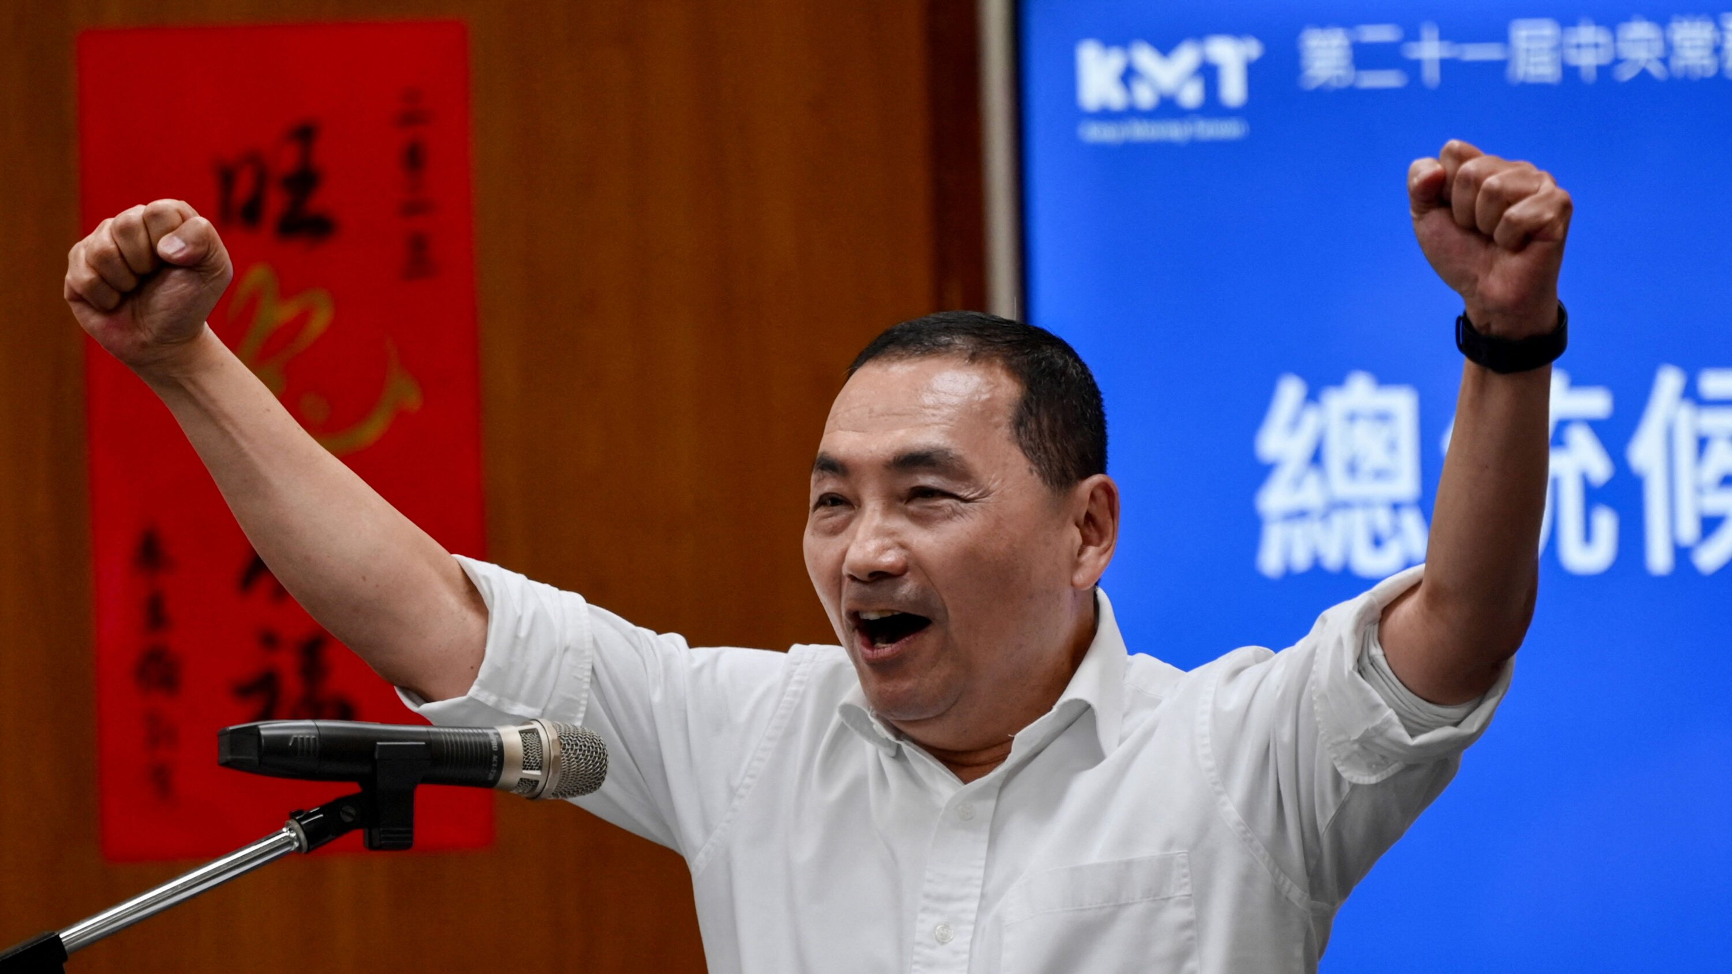
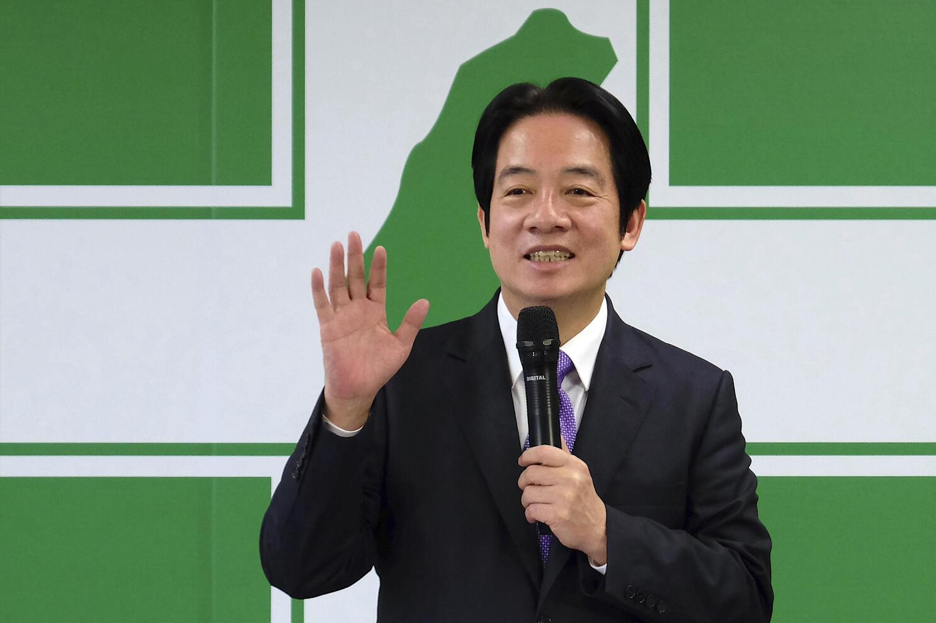
2024 Taiwan Presidential Election
January 13, 2024
KMT Candidate
Hou Yu-ih
(pronounced like Ho Yo-ee)
DPP Candidate
Lai Ching-te
(pronounced like Lie Ching-tee)

Slide 4
Simulation Roles
For
Australia Russia
France Singapore
India South Korea
Indonesia Thailand
Japan United Kingdom
Malaysia United States
Philippines Vietnam
Minster for Foreign Affairs
Minister for Defense
Minister for Finance

Slide 5
Your Assignment
(from the paper instructions)
If you’re assigned a minister of foreign affairs role, you’ll be focusing on the diplomatic aspects of the situation; if you’re assigned a minister of defense role, you’ll focus on the military/security aspects; if you’re assigned the minister of finance role, you’ll focus on the economic aspects of the situation.
What is in your nation’s national interest when it comes to a potential conflict between China and Taiwan? Is it in your nation’s interest to side with China (bandwagoning with the rising power in the region and the world)? Is it in your nation’s interests to side with Taiwan (balancing against a revisionist power that aims to coerce other nations in the region)? Will you lean toward neither, but hedge a little in one direction or the other? Is it in your nation’s interest to be neutral and to do what you can to defuse the situation (because the status quo is best for you)?

