Slide 1
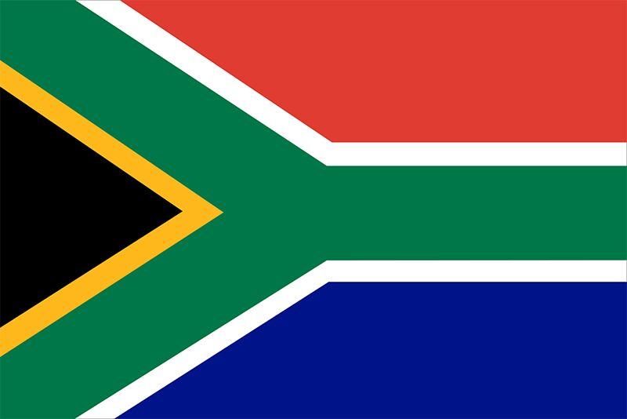
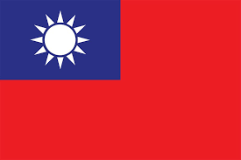
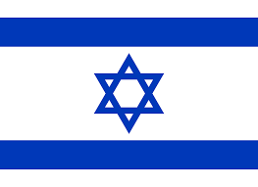
Outliers
South Africa Taiwan Israel

Slide 2
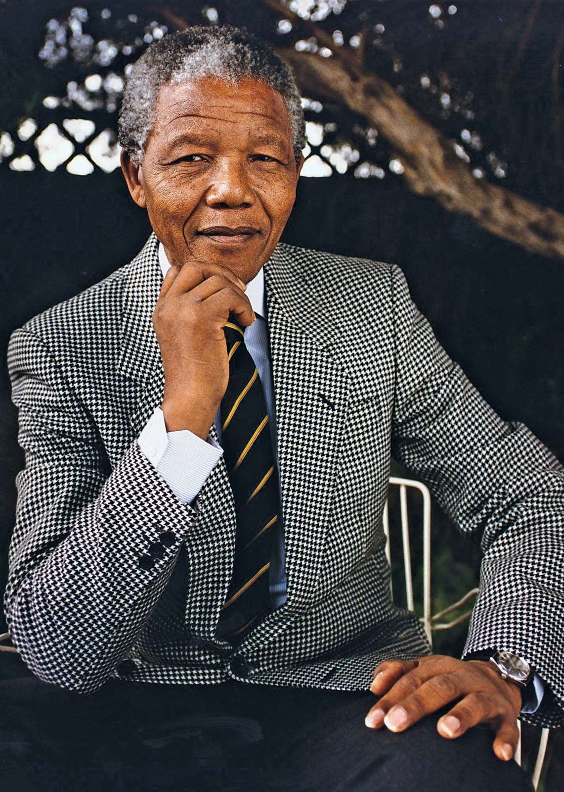
South Africa
Apartheid 1948-1989
Dismantled nuclear program 1989
Signed NPT in 1991
Free elections in April 1994
Nelson Mandela
Political prisoner 1964-1990
President 1994-1999

Slide 3
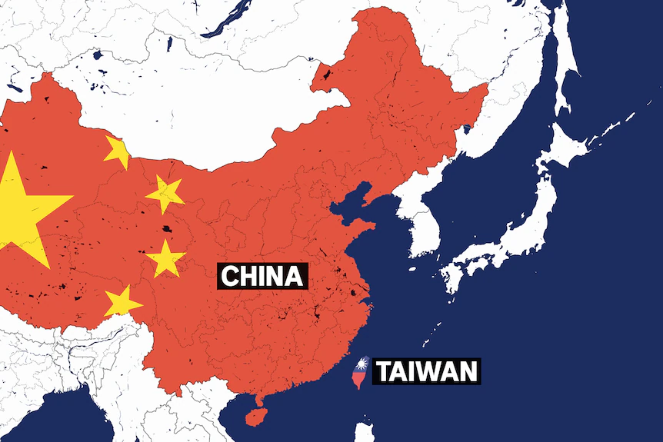
Taiwan
Signed NPT in 1968
Ousted from NPT in 1971 (when PRC brought into UN; Taiwan withdrew)
Cooperates with IAEA and US to follow NPT rules

Slide 4
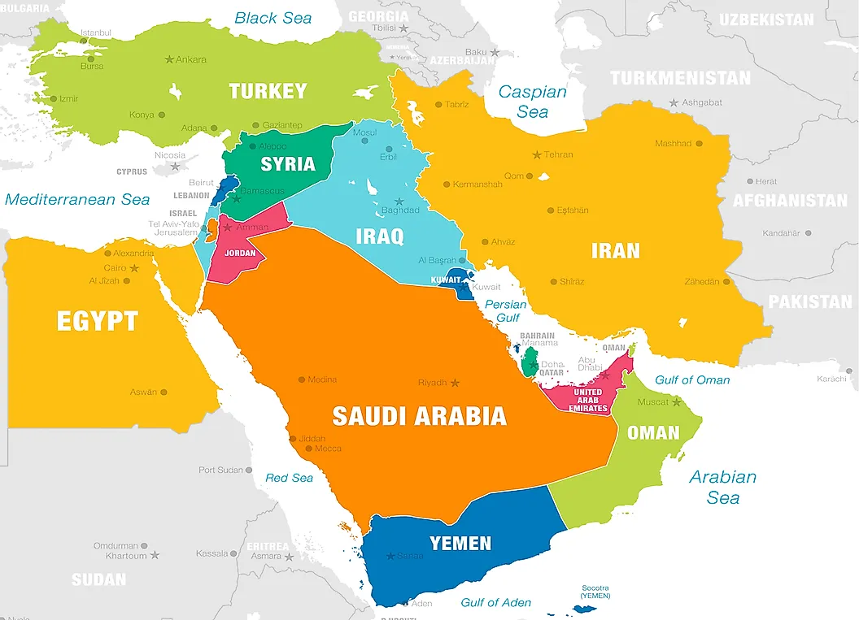
Israel
Has not signed NPT
Declaratory Policy?
Early 1960s?
Deterrence
Wars
1948
1956
1967
1973

Slide 5
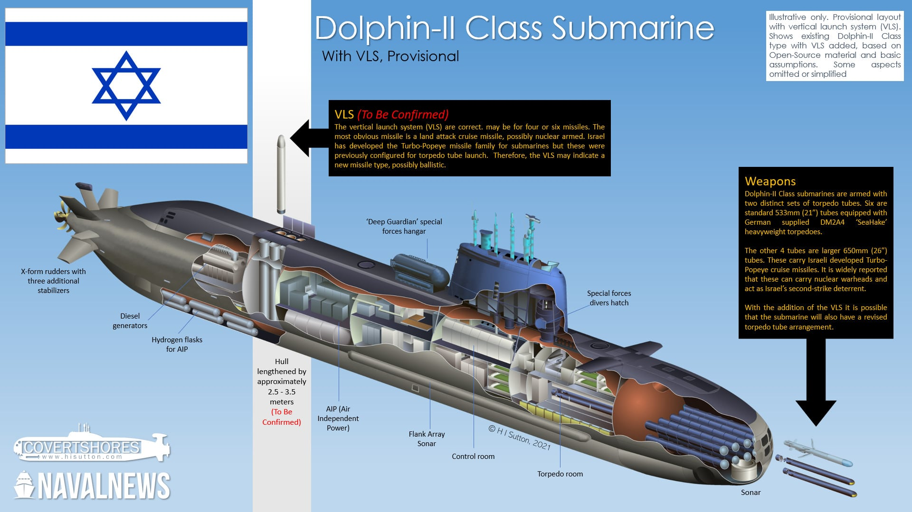
Israel: Regional Triad
Fighters
Subs with SLCMs
Jericho III Missiles: IRBMs

Slide 6
Israeli Capability

