Slide 1
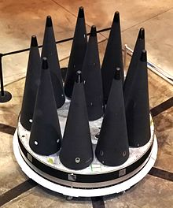
Nuclear Strategy
We have all these weapons.
How might we use them?
Deterrence strategies.
If deterrence fails?
MIRVs on MX Missile

Slide 2
Two Debates
Are nuclear weapons usable?
Strategy for Deterrence?
Assured Destruction vs. Warfighting

Slide 3
Are nuclear weapons usable?

Slide 4
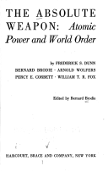
Usable? NO
Bernard Brodie,
The Absolute Weapon, 1946
The Nuclear Revolution
Existential Deterrence

Slide 5
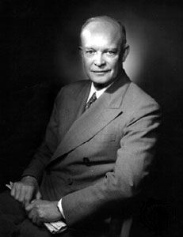
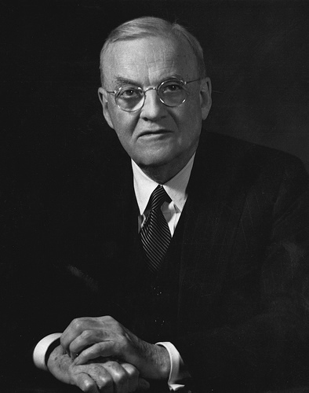
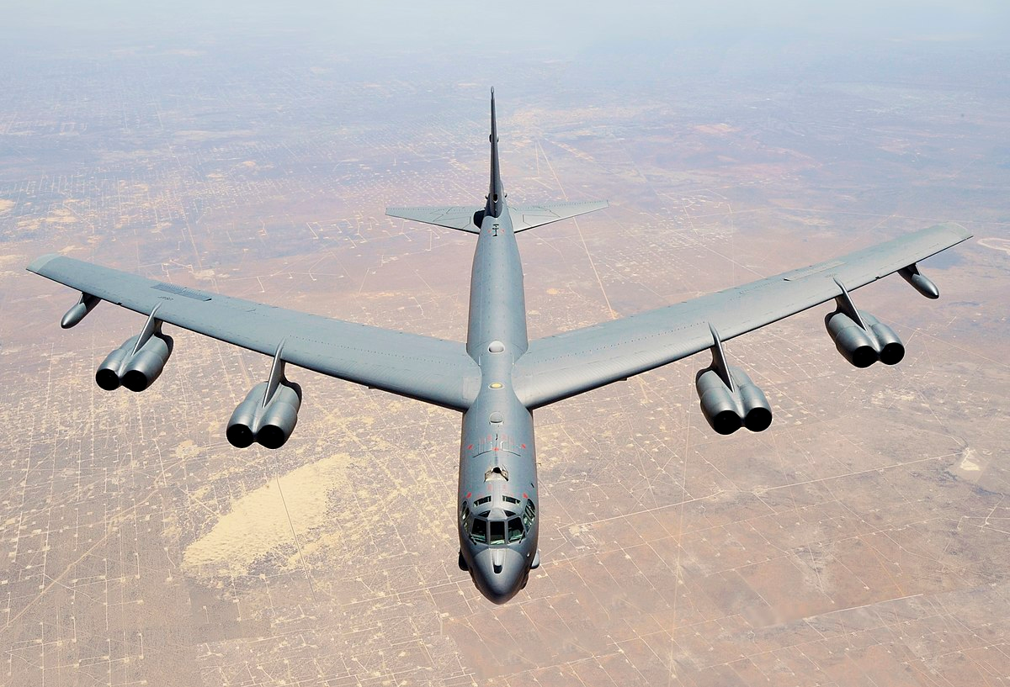
Usable? Maybe… Eisenhower’s Massive Retaliation
Secretary of State John Foster Dulles speech January 12, 1954
Eisenhower Dulles

Slide 6
Strategy for Deterrence?
Assured Destruction vs. Warfighting

Slide 7
Warfighting or Limited Nuclear War
To deter a war
To fight a war
To end a war
Targeting
Countervalue--cities, people
vs.
Counterforce– weapons, military targets

Slide 8
Nuclear Warfighting Strategies During the Cold War
JFK: Flexible Response
Nixon: Limited Nuclear Options: NSDM-242
Carter: Countervailing Strategy: PD-59
Reagan: Prevailing Strategy: NSDD-13

Slide 9
Assured Destruction
Deterrence = Second Strike capability
Soviet First Strike: Successful: USSR “wins”
US Second strike
US
USSR

Slide 10
US Second Strike Capability
Soviet First Strike
US Second strike
Scenario: Everyone Dies
US
USSR

Slide 11
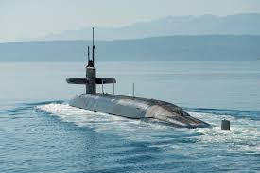
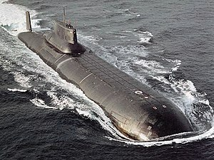
Survivable Second Strike Capability
Nuclear Triad
US Ohio-Class SSBN USSR Typhoon/Akula-class SSBN

Slide 12
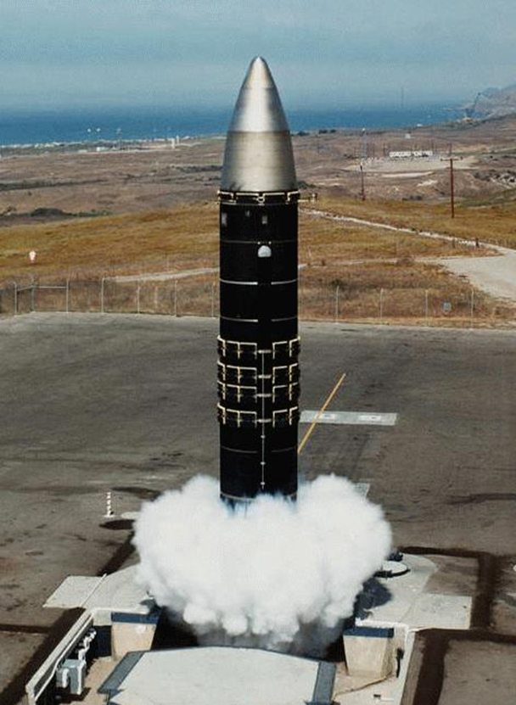
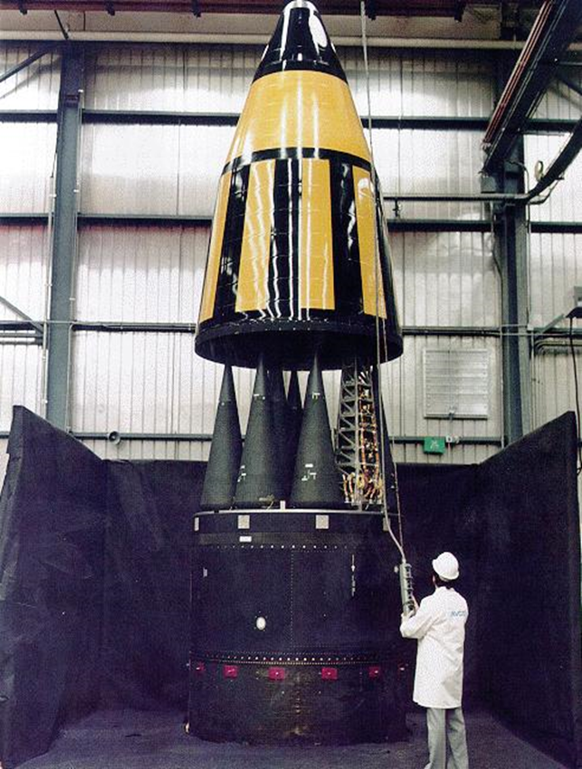
ICBM Vulnerability 1970s
MX Missile

Slide 13
The Threat: Soviet “Heavy” Missiles

Slide 14
The Future Threat: More Vulnerability?

Slide 15
MX Multiple Protective Shelters

Slide 16
Cluster Based MPS

Slide 17
Another View of MPS

Slide 18
1981: Back to Drawing Board
Townes Commission (Executive)
OTA, MX Missile Basing, 1981 (Legislative)
IDEAS:
35 Basing modes considered!!!!

Slide 19
1. Rail Mobile

Slide 20
The HO Version

Slide 21
2. Underground Basing: A “DUMB” Idea?

Slide 22
Launch of Underground-based MX

Slide 23
3. Submarine-based MX

Slide 24
But wait! There’s More…
Silo-Based
Airborne
Surface ship launch
Closely-Spaced Basing (Dense Pack)
Ballistic Missile Defense
Launch on warning…

Slide 25
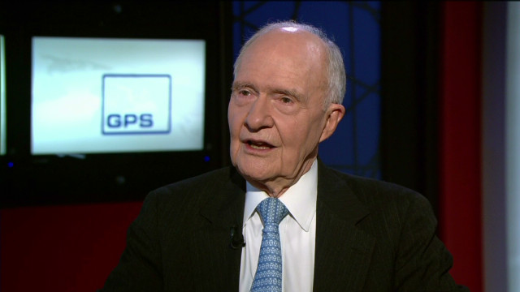
New Commission 1983
Scowcroft Commission (President’s Commission on Strategic Forces)
Solution
MX in Silos
Small ICBM (Midgetman): Road Mobile

Slide 26
Small ICBM (Midgetman)

Slide 27
SICBM-HML

Slide 28
SICBM-HML

Slide 29
Rail-Mobile MX: 1985-1986

Slide 30
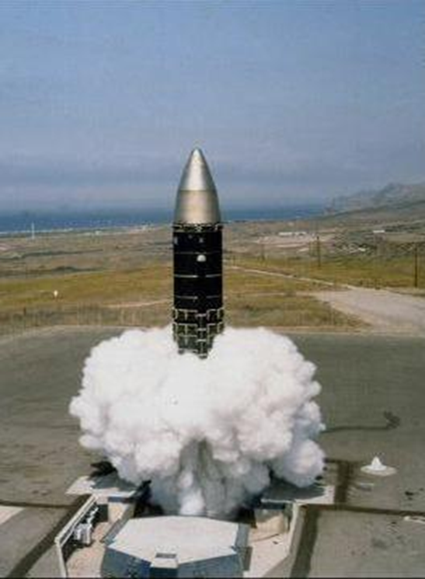
1989: MX Back in Silos 1991: START II Eliminates it
START II 1991

