Slide 1
North Korea
The Challenge:
Realism, Extortion, and Survival
The Response:
Negotiations and Sanctions

Slide 2
Geopolitics

Slide 3
Key Dates (for reference)
57-668: Three Kingdoms Era
668 Unification
1894-1895 Sino-Japanese War
1904-1905 Russo-Japanese War
1910 Colonization by Japan
1948 Independence and Division
1950-1953 Korean War

Slide 4
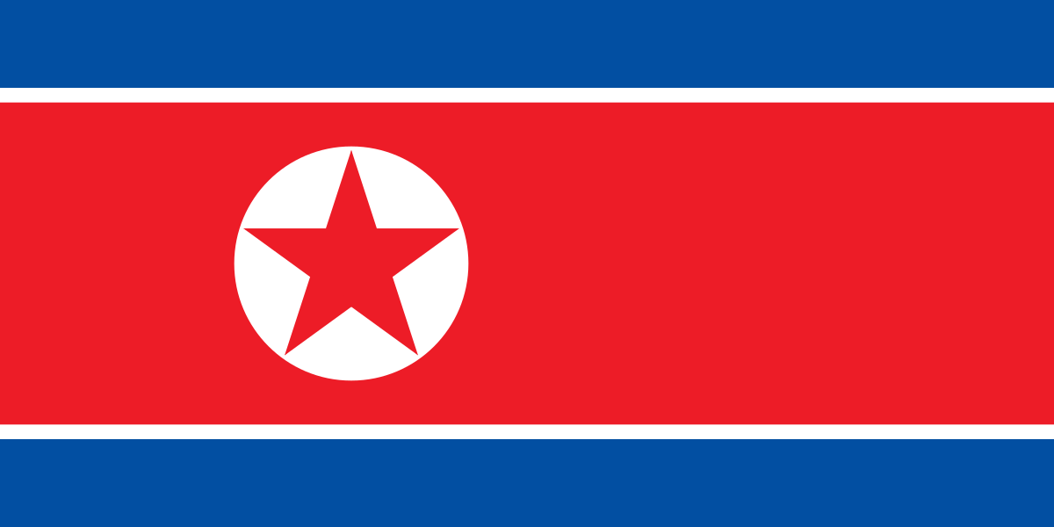
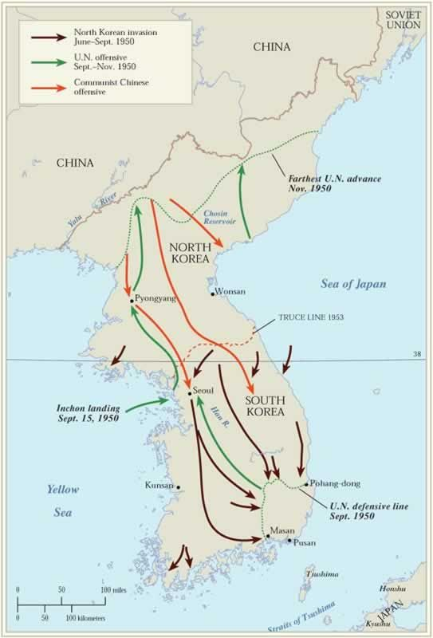
Independence and Division

Slide 5
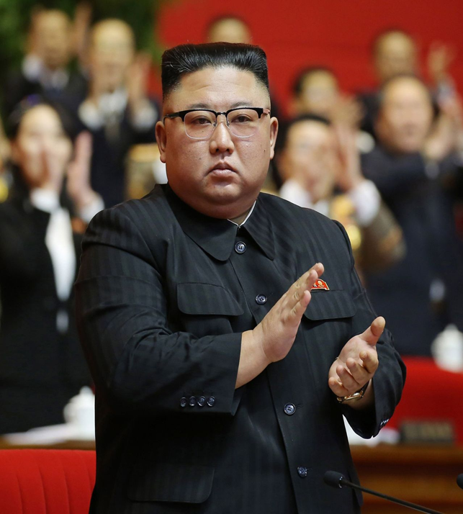
The Hermit Kingdom
Kim Il-sung Kim Jong-il Kim Jong-un
1948-1994 1994-2011 2011--

Slide 6
South Korea
Seoul Skyline

Slide 7
North vs. South

Slide 8
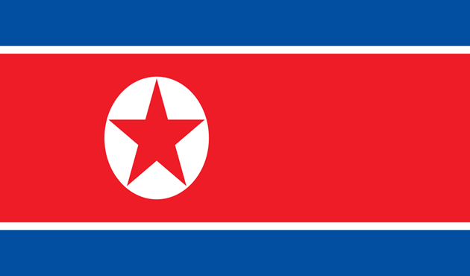
Cold War

Slide 9
North Korean Strategy (Why Build a Bomb?)
Regime Survival
Demonstration of Power
Deterrence of Rivals
ROK, Japan, US
Asymmetric Escalation
Catalytic
Self-reliance (“juche”)

Slide 10
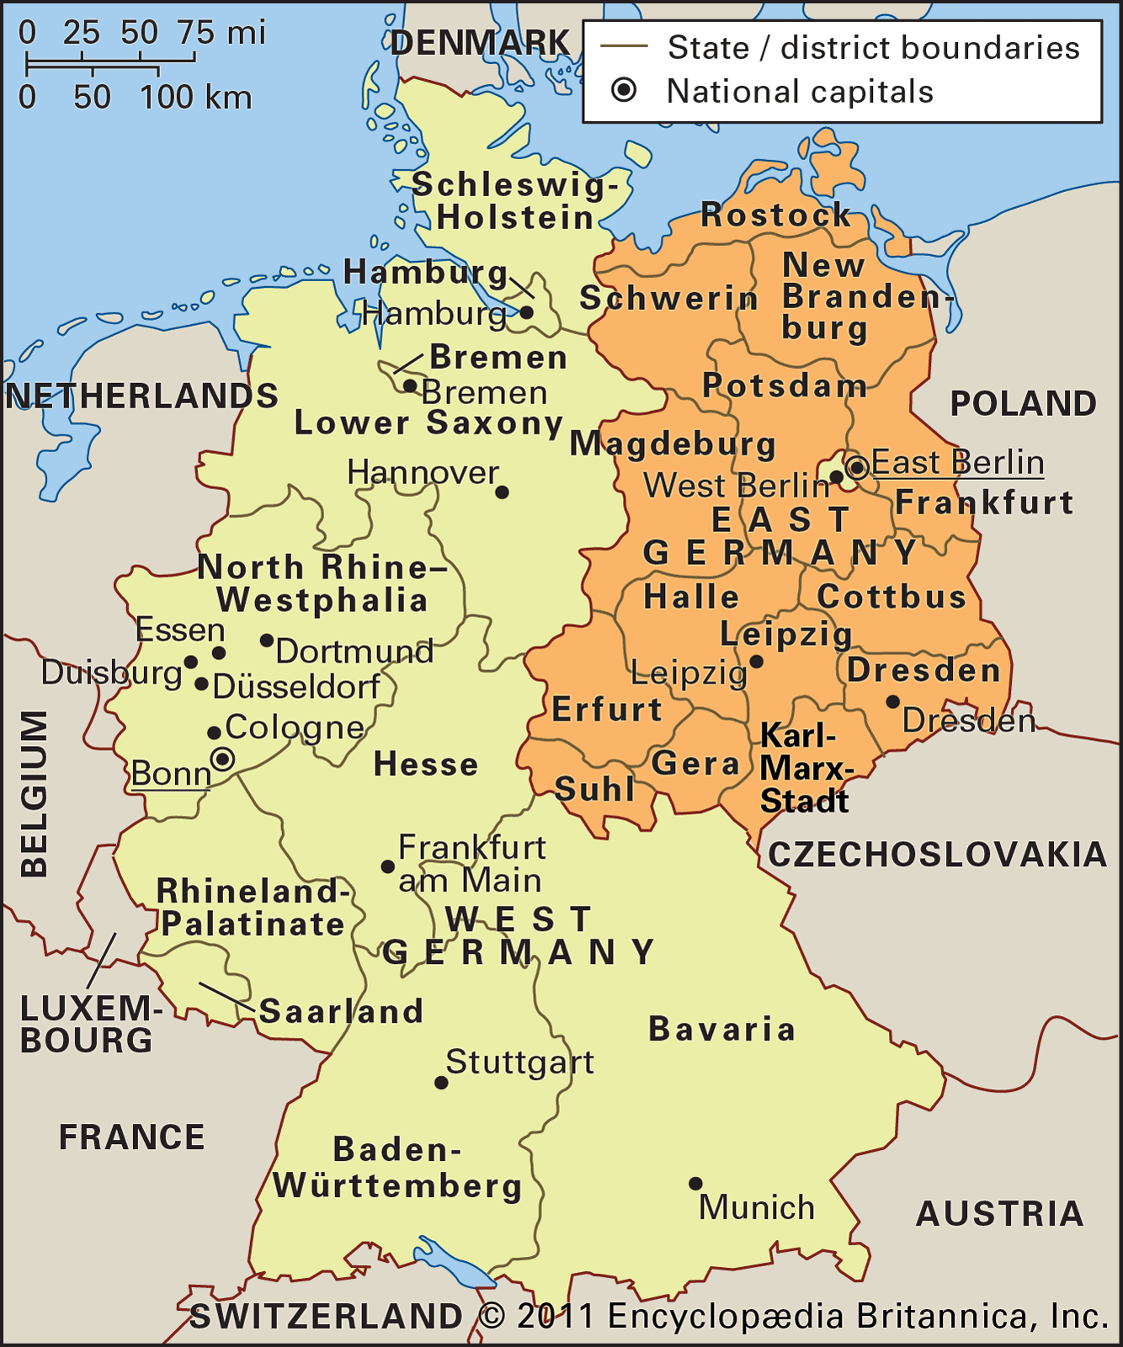
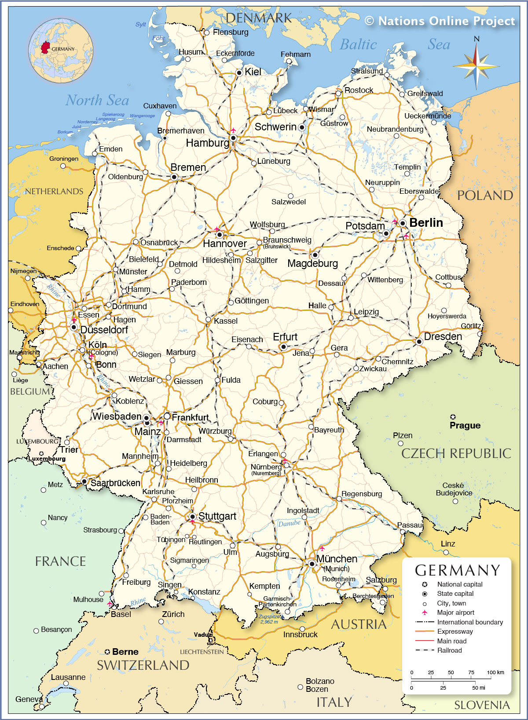
The Nightmare?
German Unification
Pre-1989 After 1990

Slide 11
The Tactical Maneuver
Increase Threat
Get to the Bargaining Table
Try to Cut a deal, but continue developing the weapons
Try again with next South Korean or US President

Slide 12
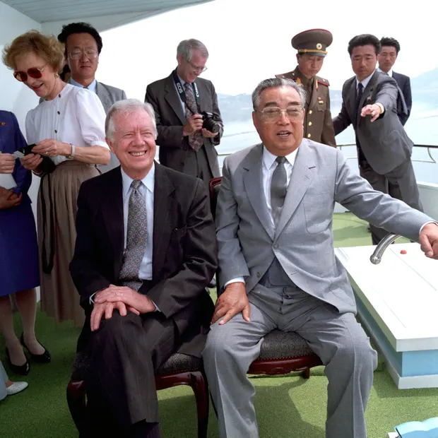
1990s: Agreed Framework
1985 NPT
1991 UN Membership
1991 De-nuclearization Agreement
1992 Safeguards Agreement
March 12, 1993
Decision to Withdraw
Agreed Framework
October 1994
Pres. Carter and Kim

Slide 13
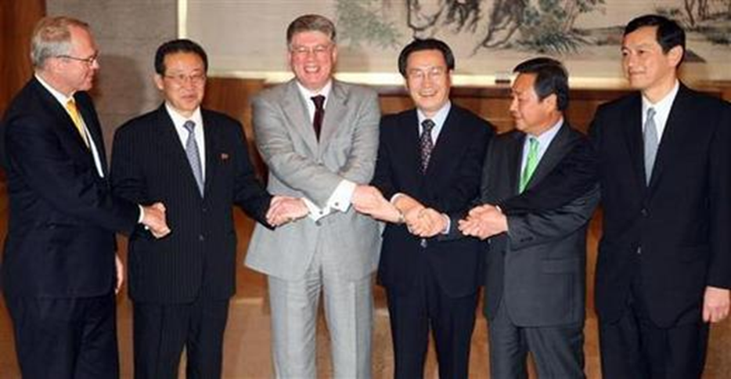
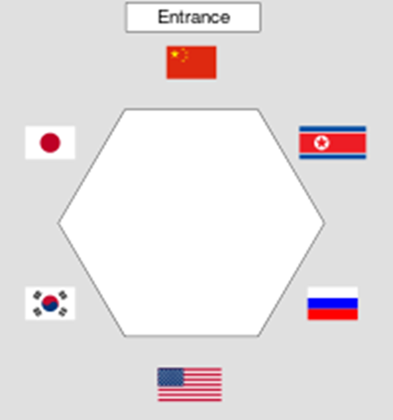
2003-2009 Six Party Talks
October 2002: US Confronts DPRK
January 2003: DPRK leaves NPT
August 2003: Six Party Talks Begin

Slide 14
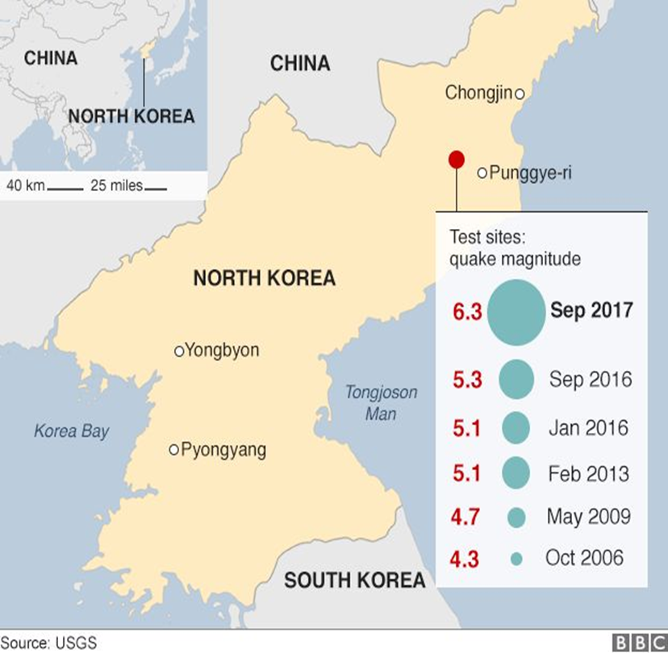
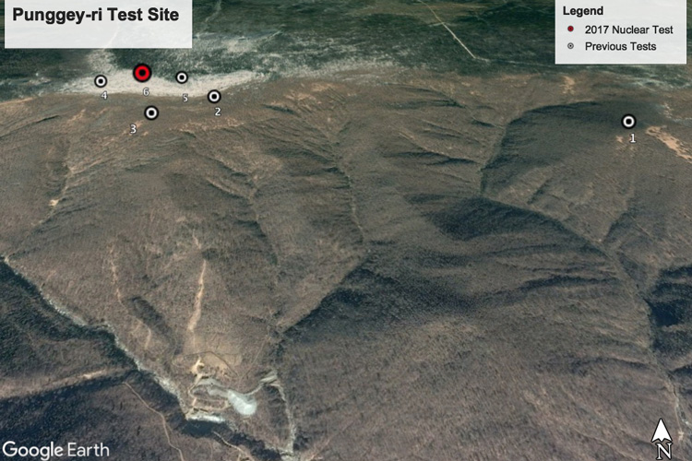
North Korea Goes Nuclear
October 9, 2006
.2-1 KT

Slide 15
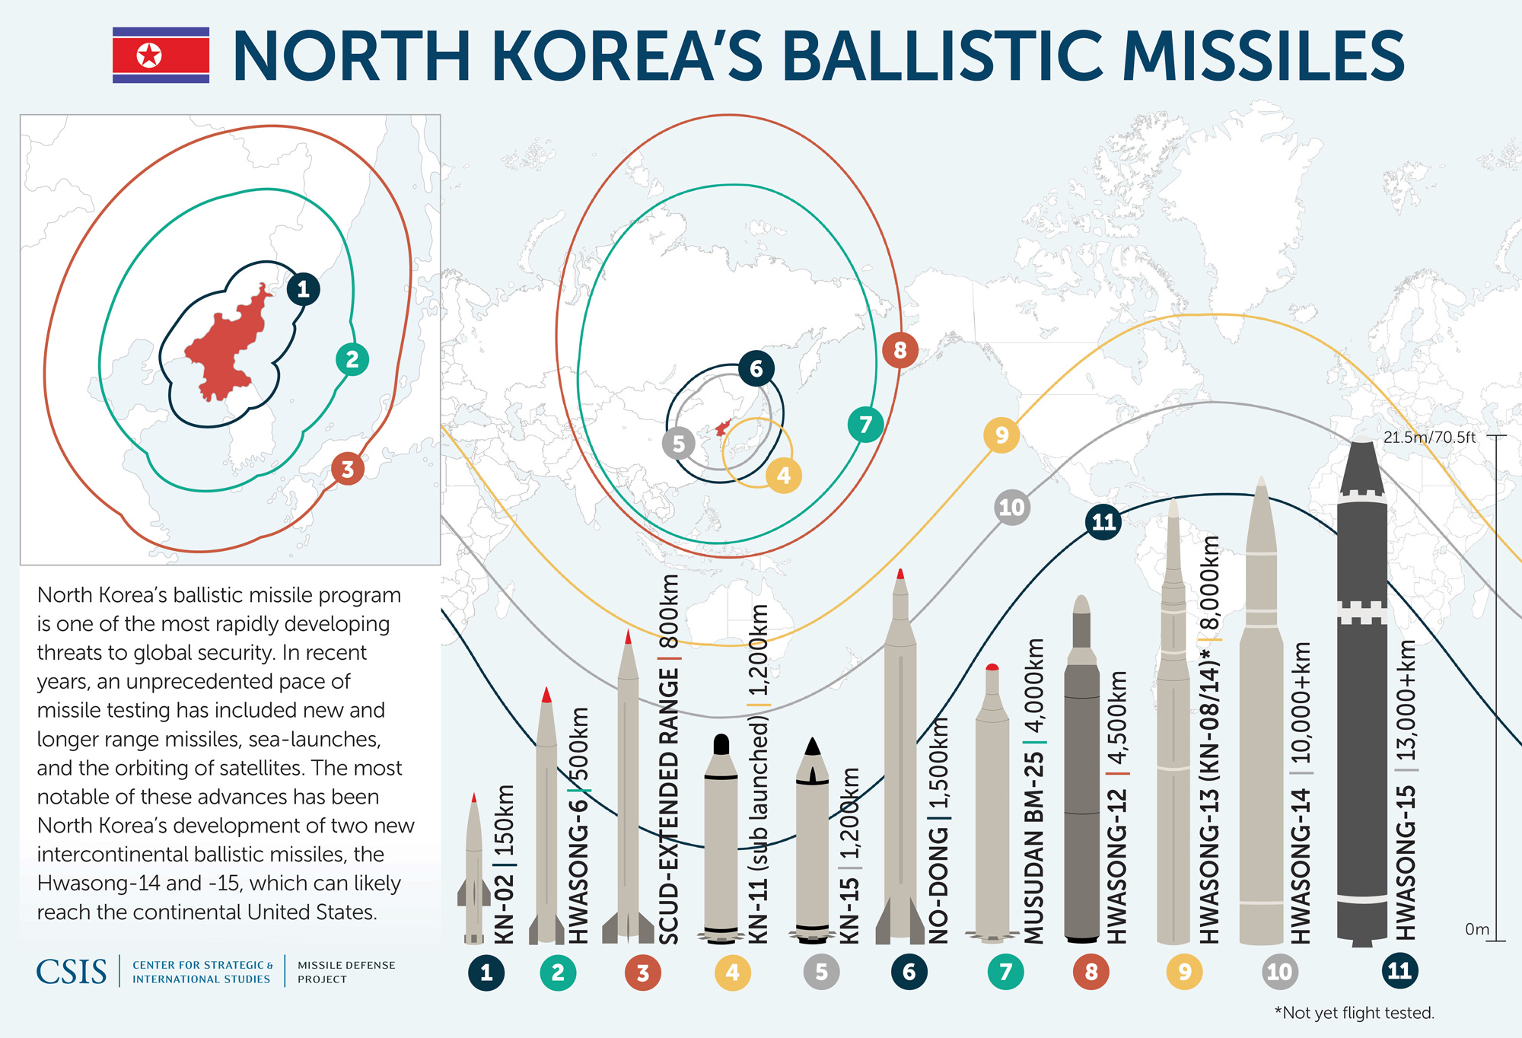
Ballistic Missile Program
Favfddfdf

Slide 16
Swaggering?

Slide 17
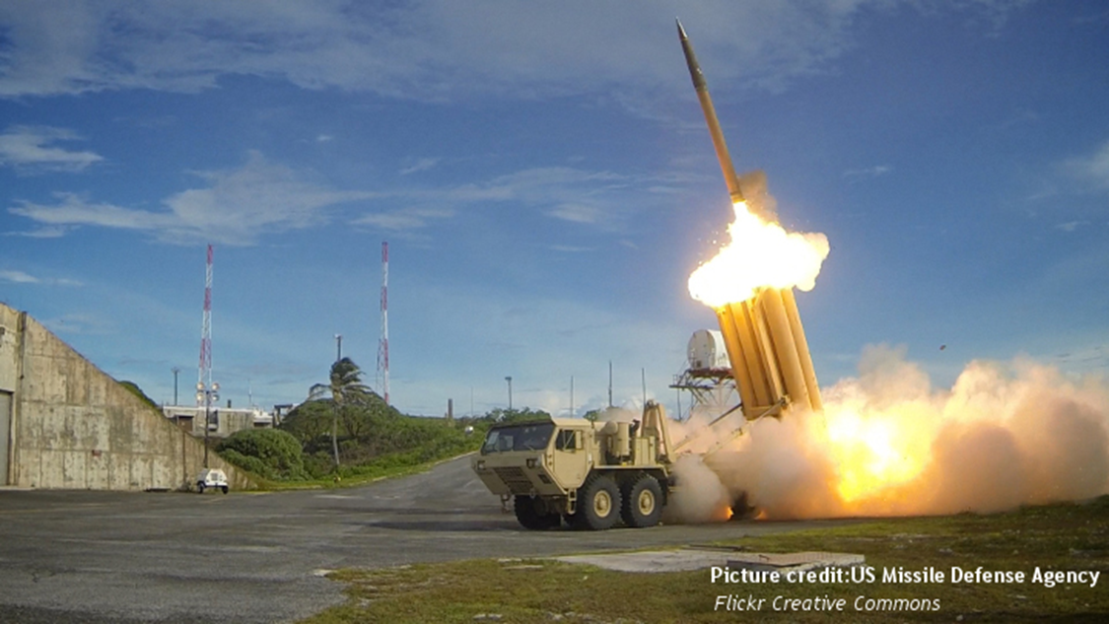
ROK
Let’s talk, but…
Terminal High-Altitude Air Defense (THAAD) (NMD) 2017

Slide 19
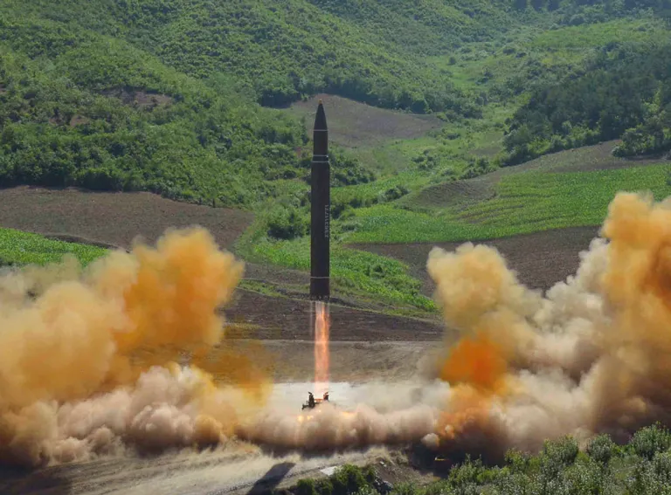
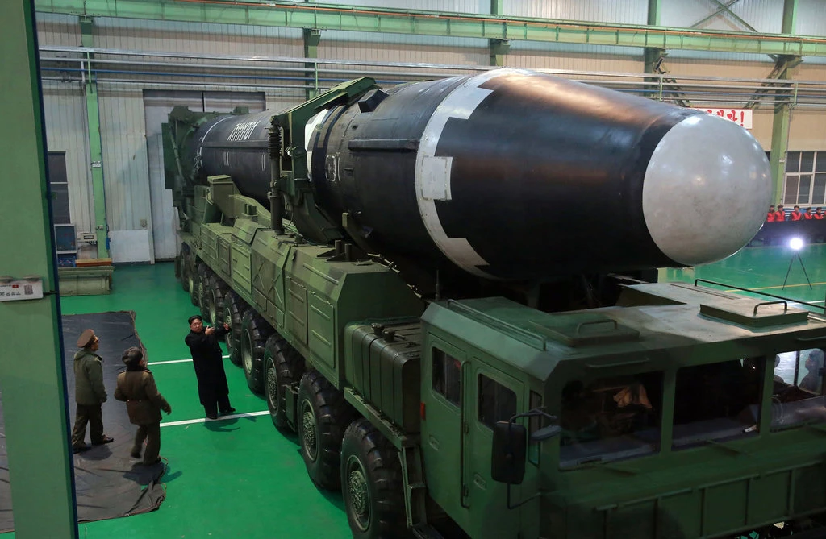
North Korean ICBMs
Hwasong 14
Tested July 4, 2017
Hwasong 15
Tested Nov. 2017

Slide 20
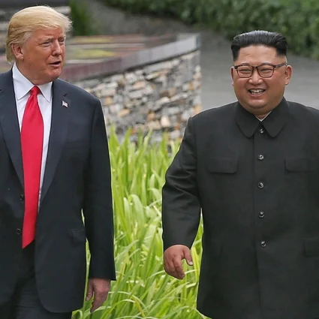
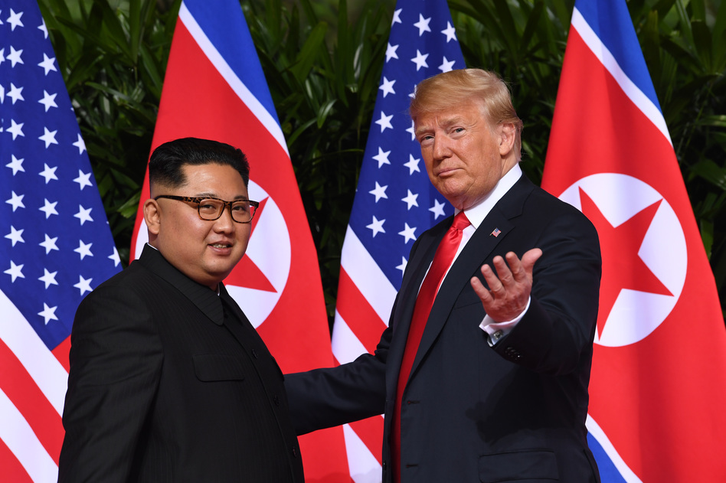
Trump-Kim Summits
Singapore Hanoi
June 2018 Feb. 2019
Agreement

Slide 21
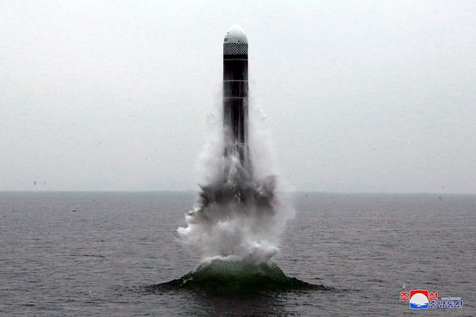
DPRK Dyad
MRBMs, IRBMs, ICBMs
SLBMs
SLBM Test
Pukguksong
4 and 5
(since 2017)

Slide 22
North Korean Strategy (how it might use its weapons)
2013 Law on Consolidating Position of Nuclear Weapons States
Deterrence
Assured retaliation
NFU: With important exceptions
Is this even NFU?

Slide 23
The Question
Can you stop a nation from developing a nuclear weapons capability if it believes that nuclear weapons serve their national interests?
Are we back to deterrence?

Slide 24
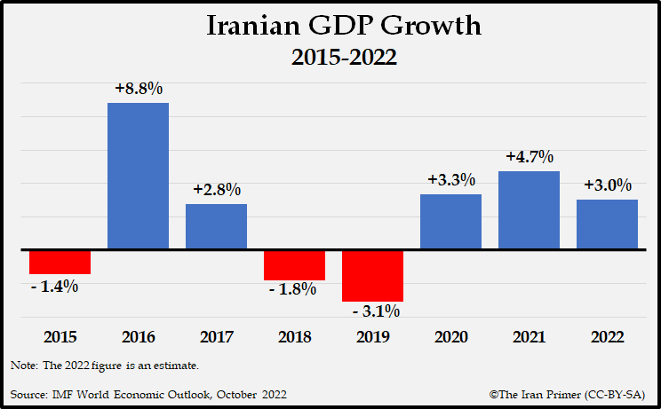
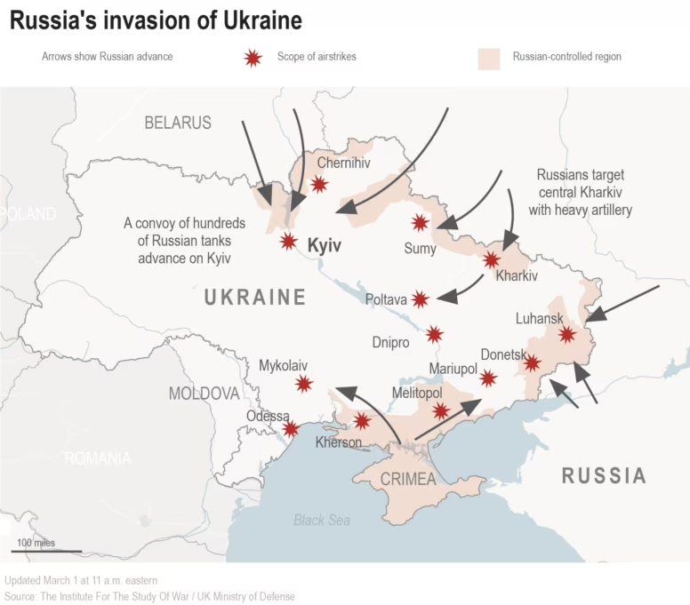
Another Question: What does nuclear capability give you?
Bad Stuff
Good Stuff
Economic sanctions
Threat of force
Pariah status
Isolation
Bargaining chip
Defense
Prestige
Hands off

