Slide 1
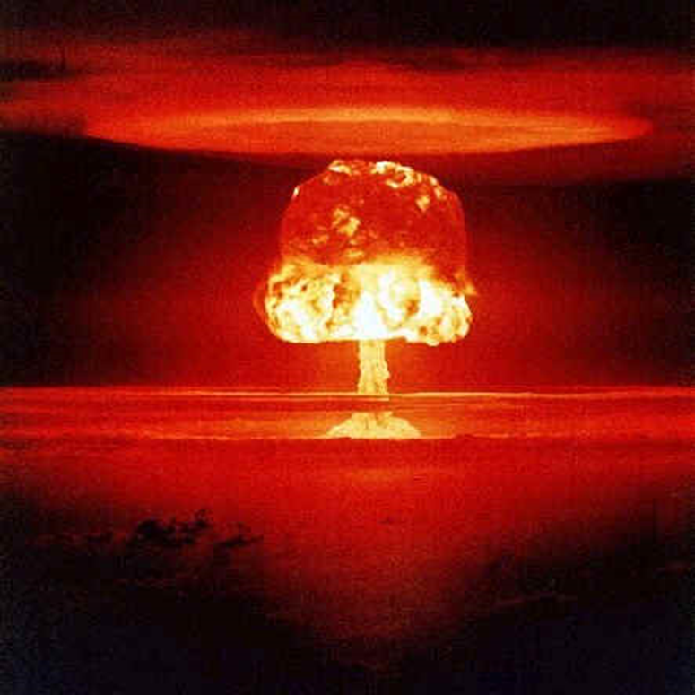
The Proliferation Problem
“Nth Country Problem”
By the end of the Cold War:
US 1945
USSR/Russia 1949
UK 1952
France 1960
China 1964
Israel (19??)

Slide 2
Reducing the Spread of Nuclear Weapons
Nuclear Non-Proliferation Treaty 1968 (1970)
Two Types of States
Nuclear Weapon States
Non-Nuclear Weapons States

Slide 3
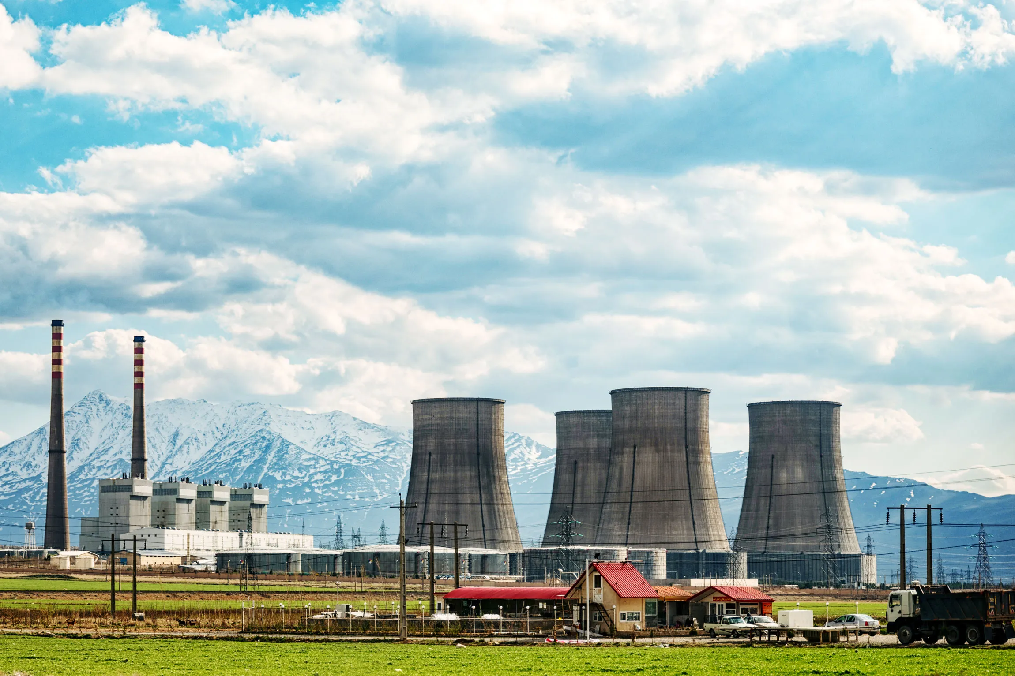
The Complicated Part
Nuclear Energy
Arak, Iran

Slide 4
Very Simple Version
Waste
U U and Pu (storage
(or Pu) or recycle)
Weapon
U = Uranium
Pu = Plutonium
See: https://whatisnuclear.com/recycling.html
Reactor

Slide 5
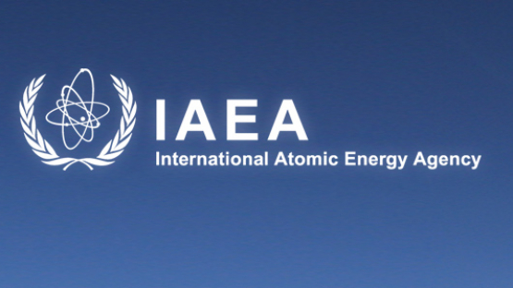
Verification of Treaty Obligations
IAEA Safeguard Basics
Inspections
Surveillance cameras
Seals
Accounting

Slide 6
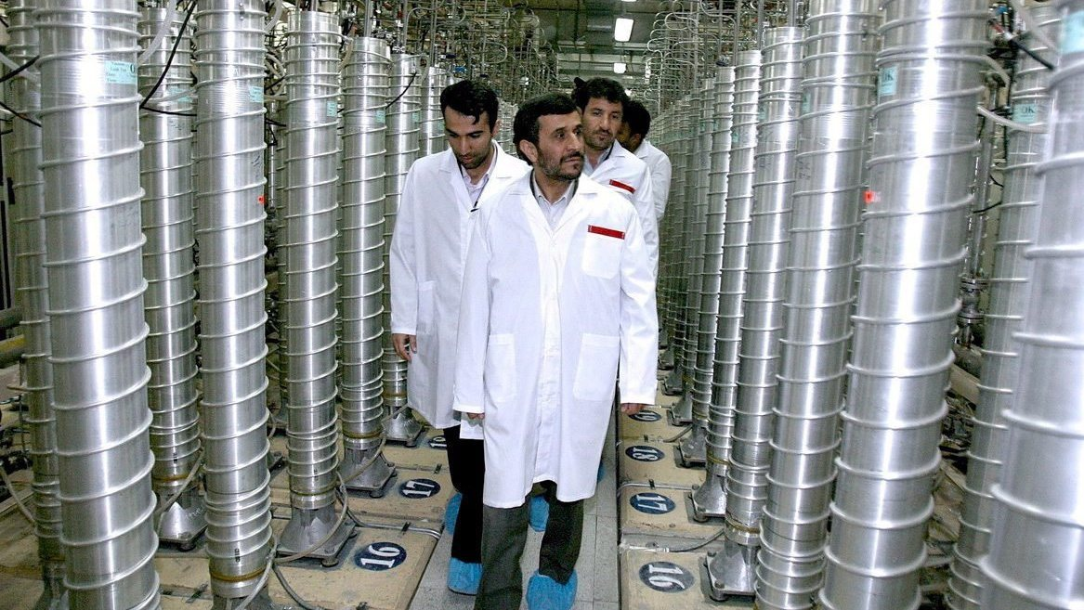
Uranium Enrichment
U²³⁵
Natural Uranium: .7% U²³⁵
Enriched Uranium for energy: 3-5%
Highly Enriched Uranium: 20%
Weapon-grade Uranium: 80%
https://phys.org/news/2019-06-nuclear-weapons-iran-uranium-enrichment.html

Slide 7
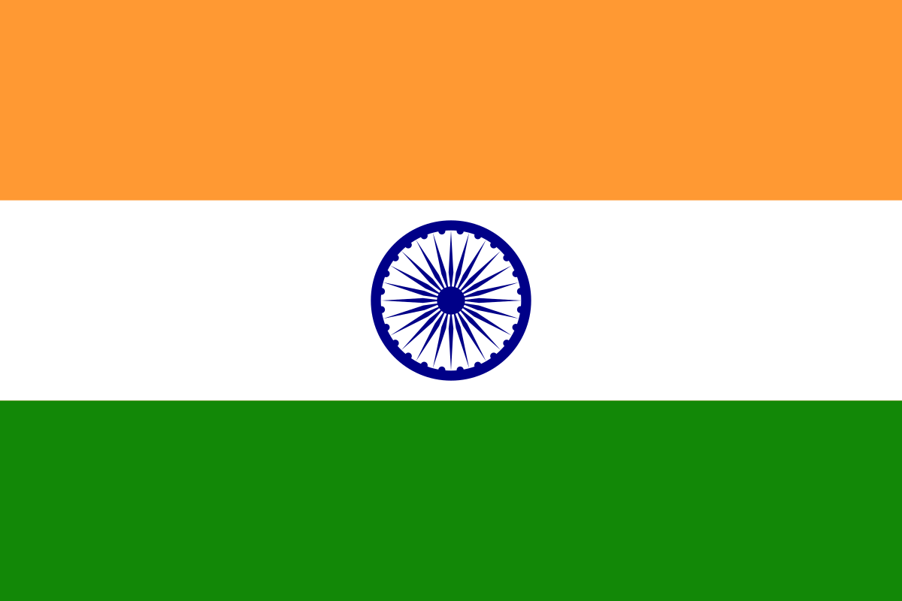
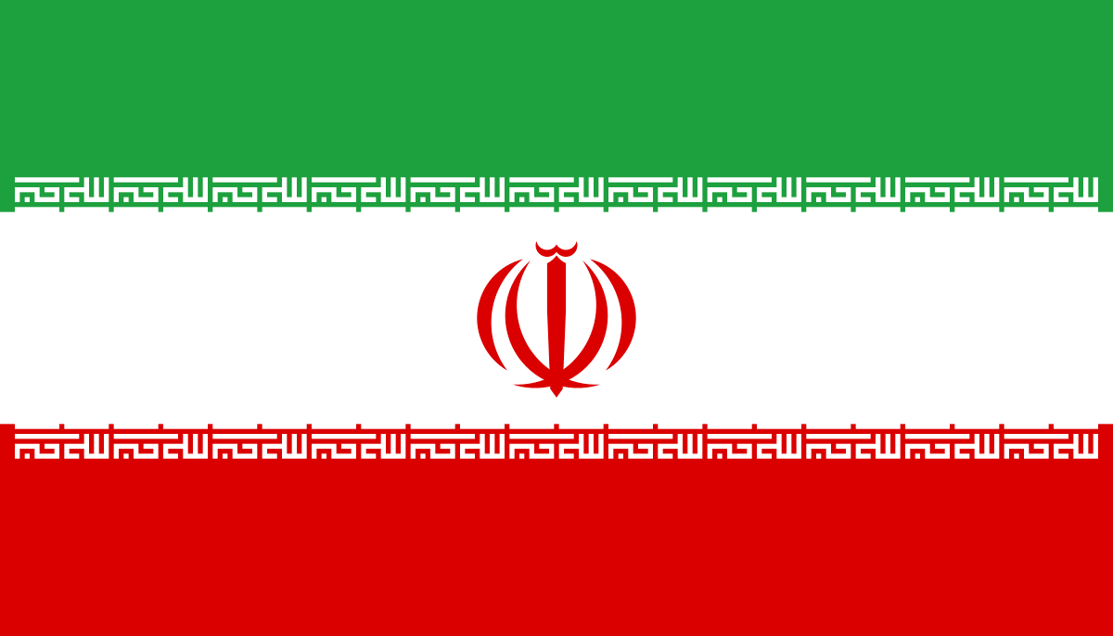
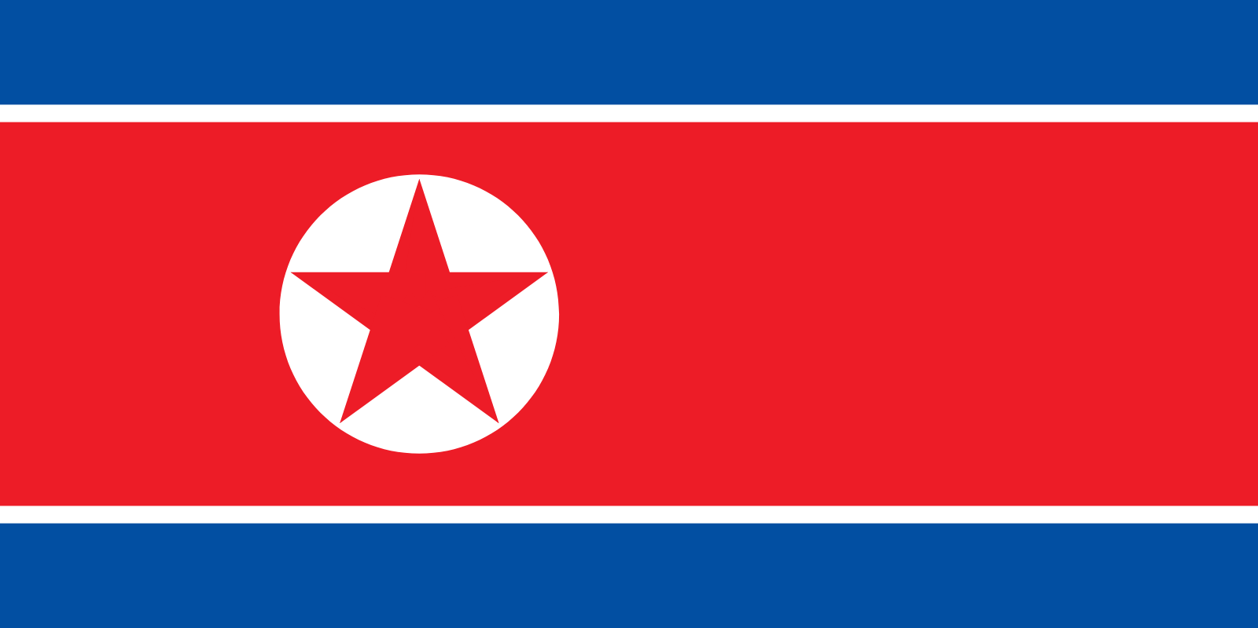
Problems?
Never Signed NPT
Israel
India
Pakistan
Violated Treaty Provisions
Iraq
Iran
North Korea

Slide 8
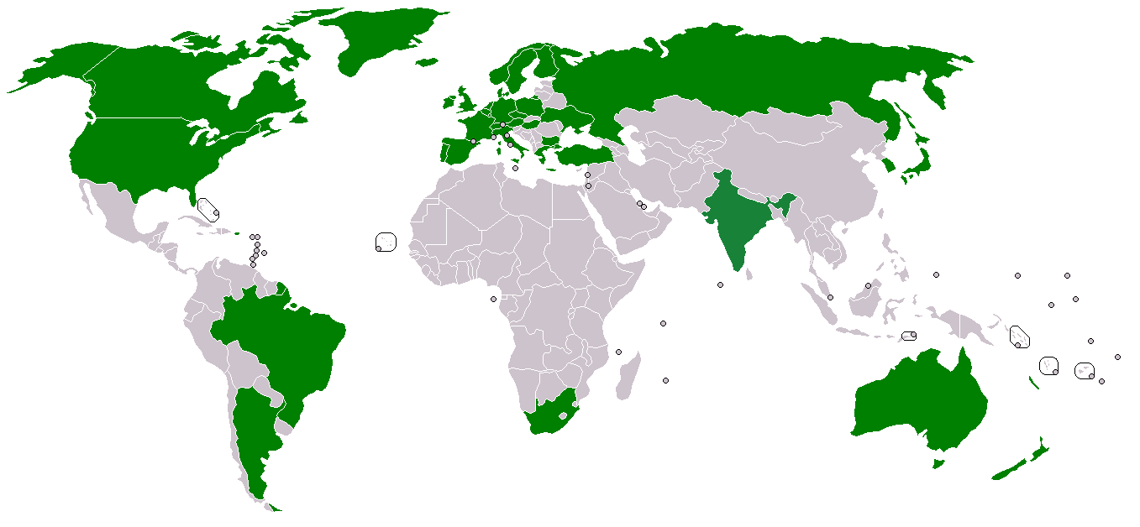
Missile Technology Control Regime
35 Members

Slide 9
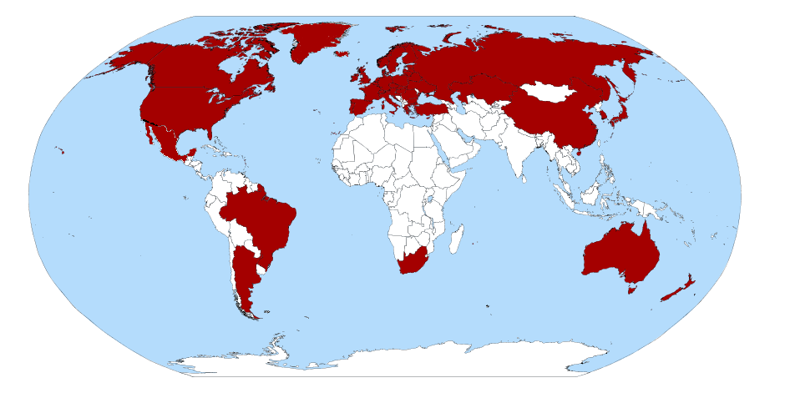
Nuclear Suppliers Group
1974
48 participating nations

Slide 10
The Questions
Why does a nation decide it wants nuclear weapons?
What can the world do about it?
Does it really matter when a nation goes nuclear?

Slide 11
Why does a nation decide it wants nuclear weapons?
Deterrence: assured retaliation against a rival
To demonstrate power: Realism (Swaggering)
To Bargain: achieving political goals (compellence)
Asymmetric Escalation: to compensate for a disadvantage
Catalytic: to bring a third party into the situation

Slide 12
What to do with non-signatory nations or violators?
Options
Ignore the NPT issues (it’s an ally)
Sanctions
Negotiations
Destruction of nuclear facilities
Regime Change
A combination of these

Slide 13
Does it really matter when a nation goes nuclear?
If deterrence is strong, does it matter?
Instability?
Arms races?
Is it all really political?
My allies can have nuclear weapons; my rivals can’t
It’s all just a calculation of the balance of power:
Global
Regional

