Slide 1
New Cold War?
US-USSR
US-China
Capitalism vs. Communism
Land Power vs. Maritime Power
Democracy vs. Dictatorship
Global power vs. Global Power
Nuclear deterrence
Both Capitalist; different styles
Both Maritime Power
Democracy vs. Dictatorship
Global vs. Regional Power
Nuclear deterrence

Slide 2
Capitalist Competition

Slide 3
1. Capitalism = Interdependence Mutually Assured Bankruptcy
US Trade Partners
China’s Trade Partners

Slide 4
2. Direct Maritime Disputes

Slide 5
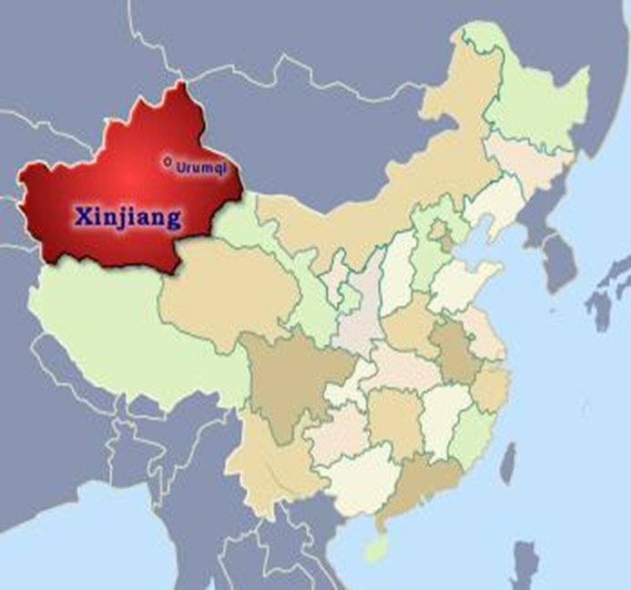
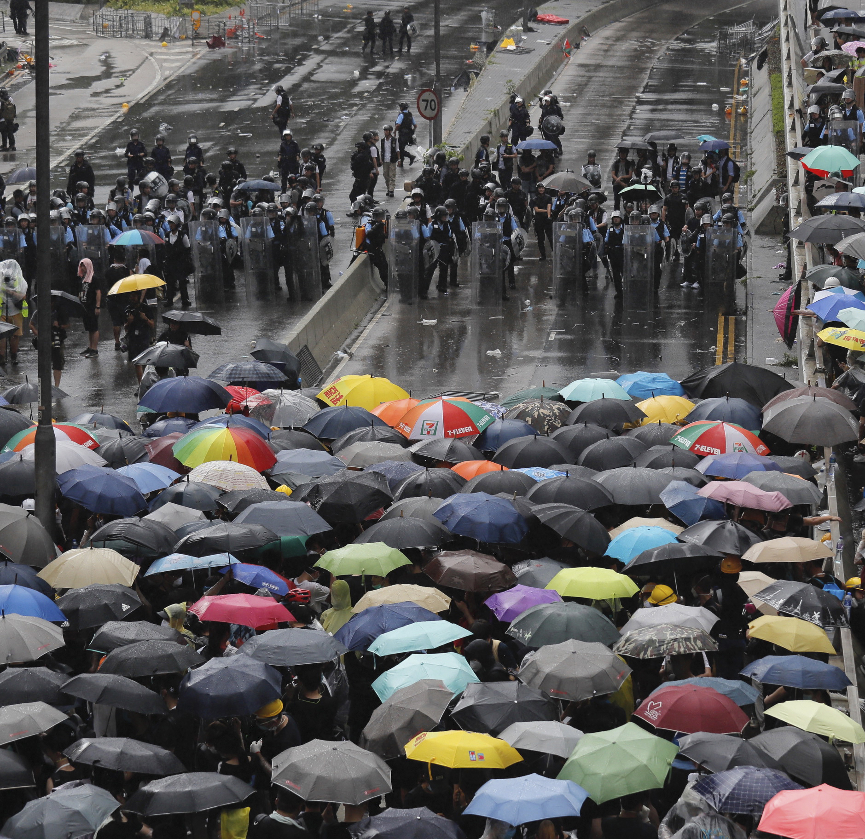
3. Democracy vs. Dictatorship
Xinjiang Hong Kong

Slide 6
4. Global vs. Regional Power

Slide 7
5. Nuclear Deterrence

Slide 8
Advantages
vs.
Disadvantages

Slide 9
US Advantage: Allies

Slide 10
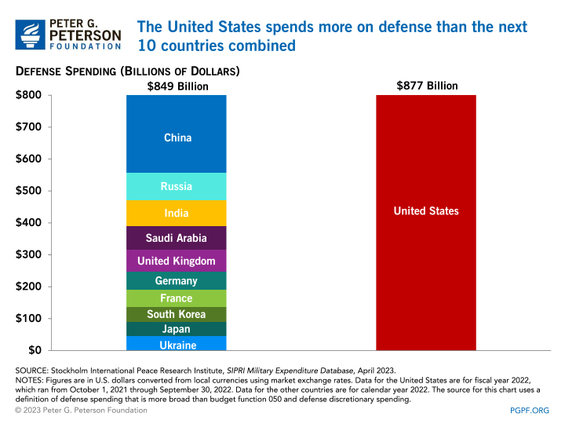
US Advantage: Military

Slide 11
China Advantage: Expanding Presence

Slide 12
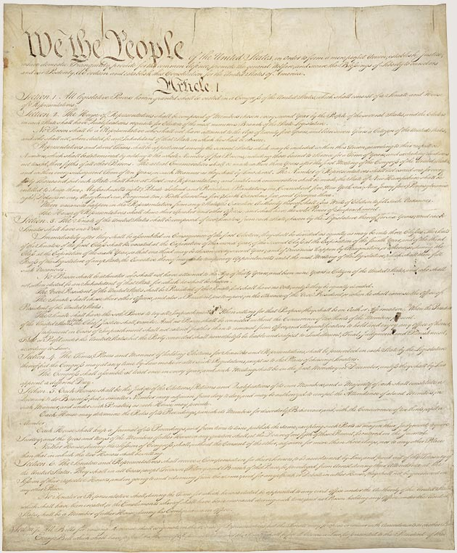
US Advantage: Political System
Arrest of Jimmy Lai, publisher of Apple Daily, 2022

Slide 13
China Advantage: US Polarization

Slide 14
Two Questions
Does China need to become the dominant power in East Asia before it can be a global power?
How much is US willing to do to maintain its central role in the Indo-Pacific?

