Slide 1

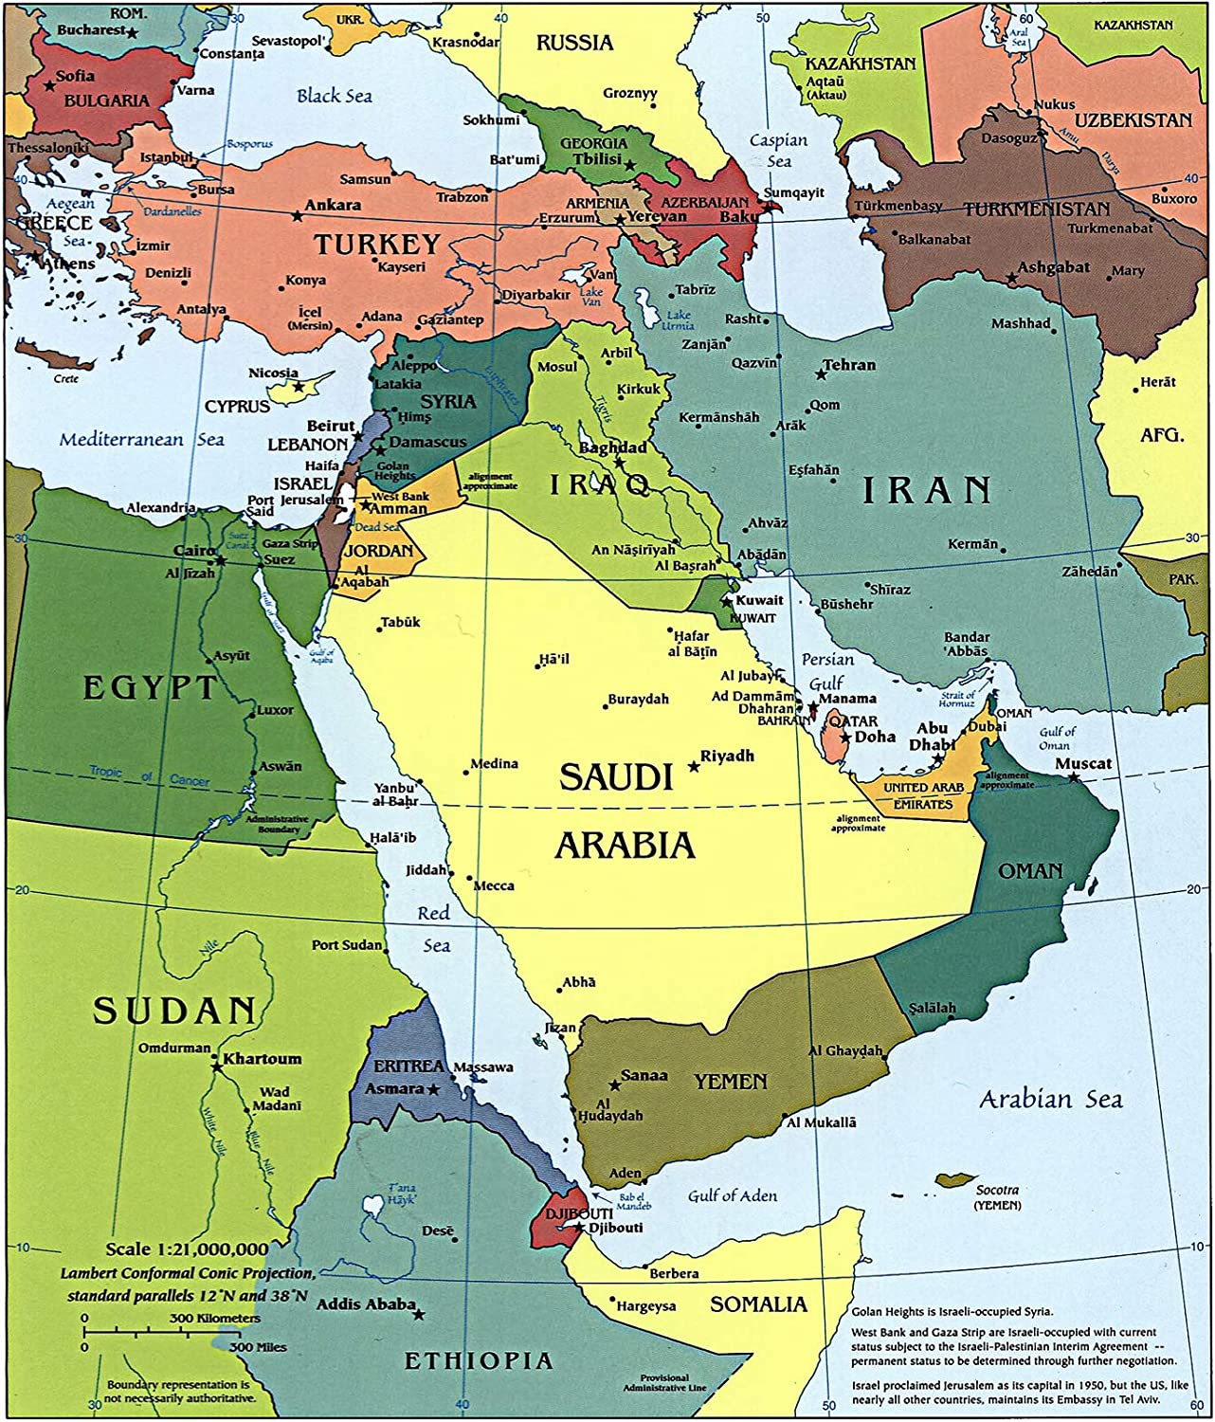

Iraq and Iran

Slide 2
The Neighborhood?
Iran vs. Iraq
Persian vs. Arab
Shi’ite vs. Sunni
Radical Theocracy vs. Military Dictatorship
Each vs. Israel
Each vs. Saudi Arabia
Each vs. the US
OIL

Slide 3
Iraq:
Using Force as a Non-Proliferation Tool

Slide 4
Iraq’s Strategy
(why keep trying to build nuclear weapons)
Deterrence
  Of Israel
  Of Iran
  Of the US
Involved in an arms race
Demonstrating regional power
Deterrence related to regime survival

Slide 5

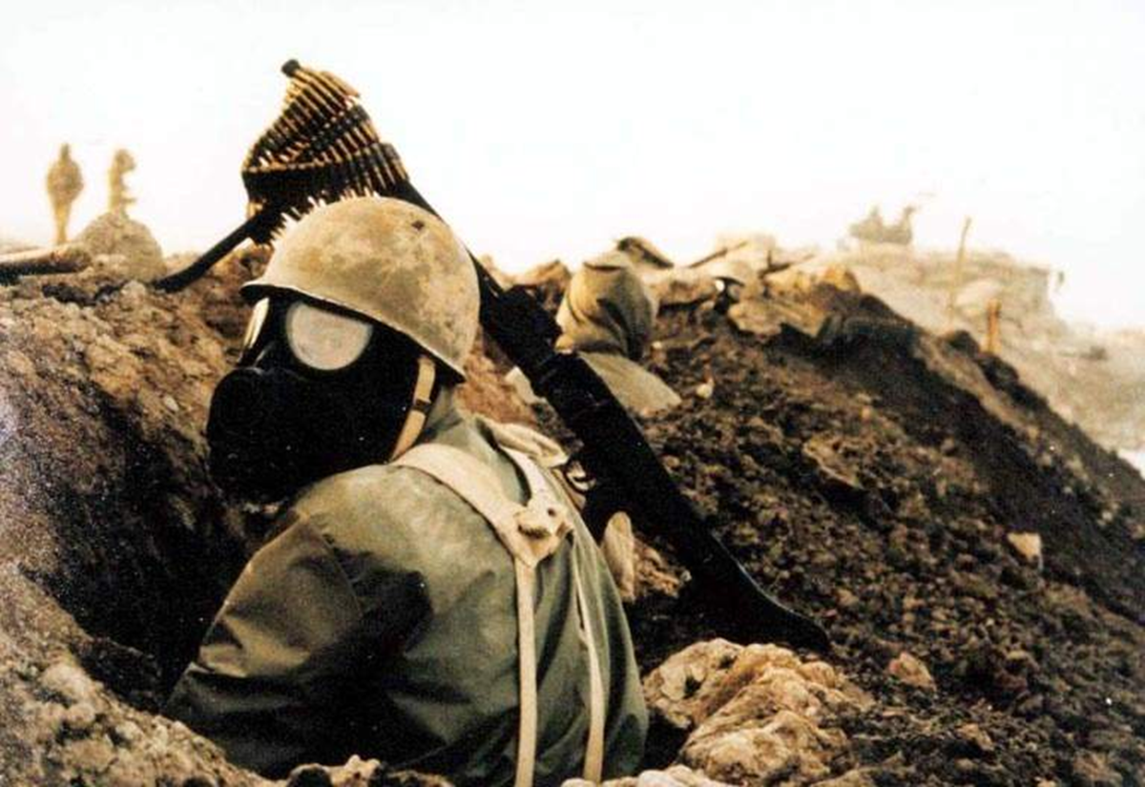
Saddam Hussein Iran-Iraq War
1979-2003 1980-1988

Slide 6
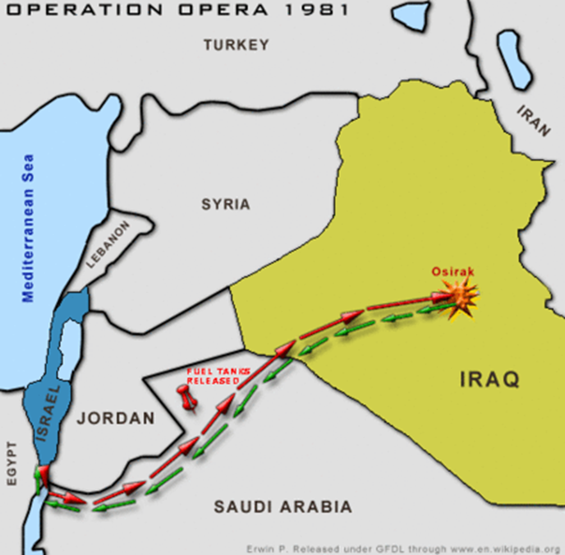
Israel Sets Precedence
June 7, 1981

Slide 7
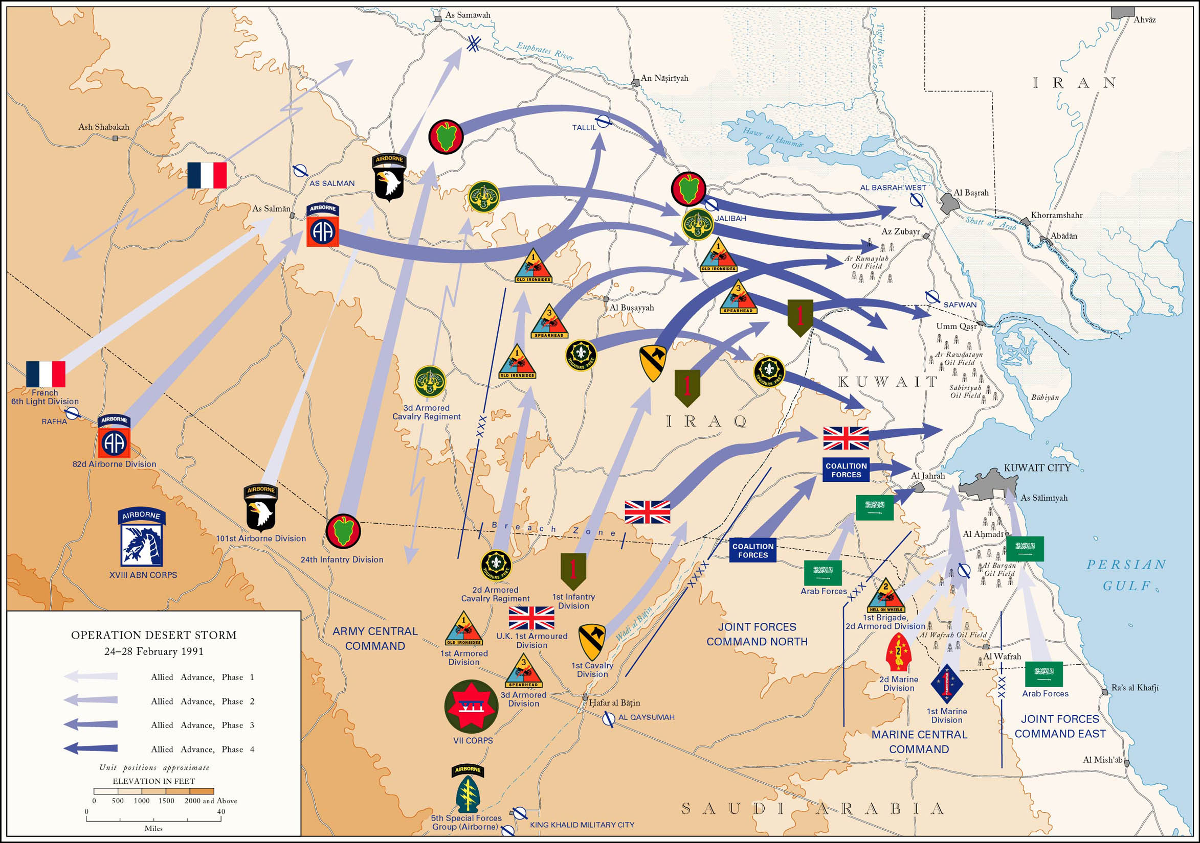
1990-91
August 2, 1990 Iraq invades
April 3, 1991 Iraq Surrenders
  Deal: WMD Disarmament (UNSRC 687)
  IAEA Inspections

Slide 8
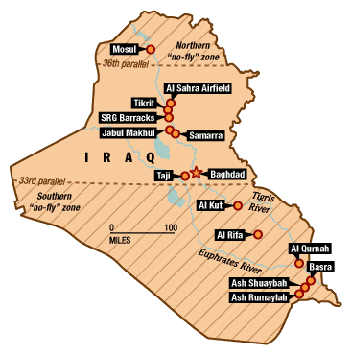
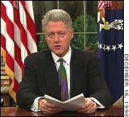
More Force
October 1998: Iraq Liberation Act
December 1998 Operation Desert Fox

Slide 9
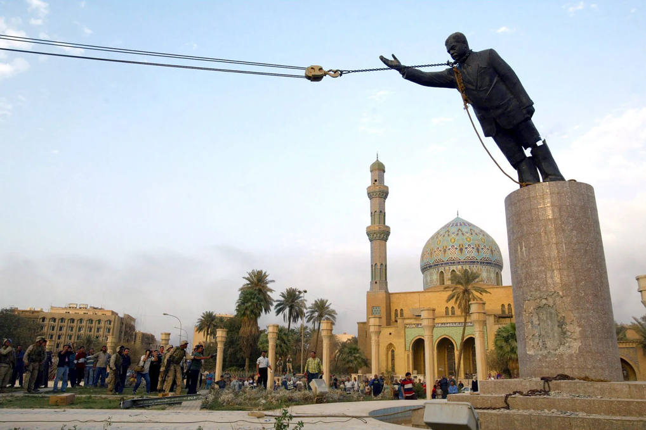
Regime Change
GW Bush Administration
Iraq has WMD
Ties to Terrorists
Iraq is “undeterrable”
Irrational
March 2003

Slide 10
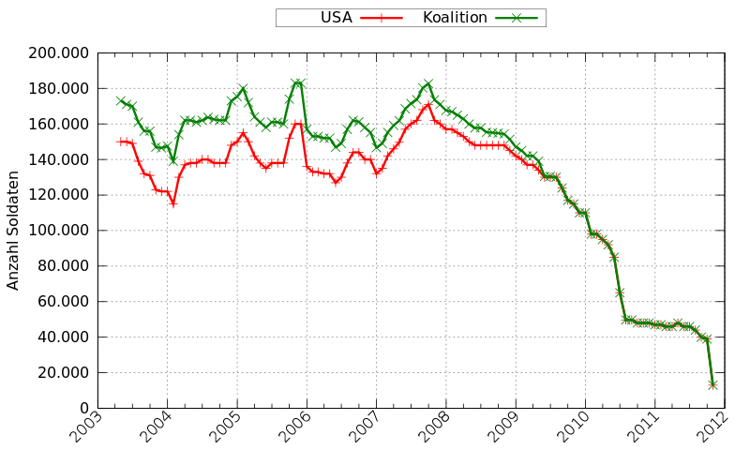
US Troop Levels

Slide 11
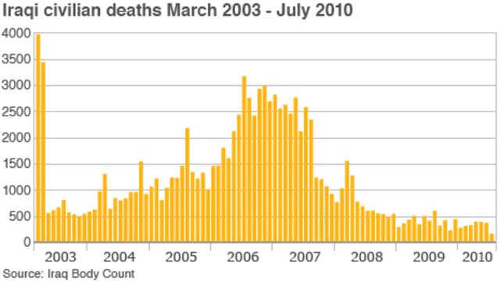
Iraq Casualties

Slide 12
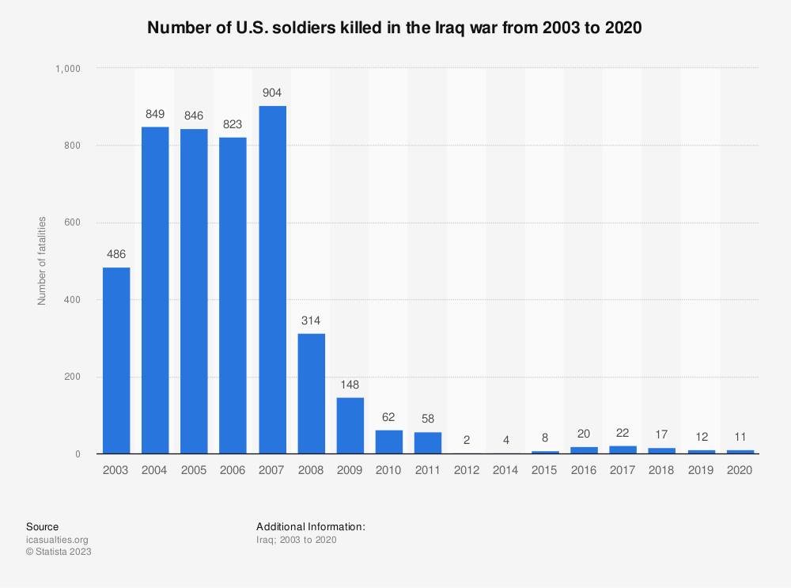
US Troop Deaths

Slide 13
Iran:
Sanctions, Negotiations, and a Little Bit of Force

Slide 14
Iranian Strategy
Deterrence of neighbors
Asymmetric Escalation
  (against Israel and US)
Regional Power
Arms Race

Slide 15

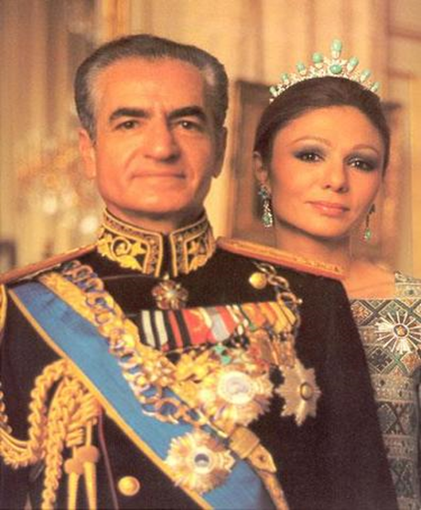
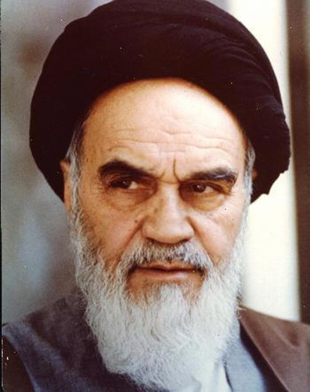
Modern Iran and the Outside World
PM Mohammad Shah of Iran Ayatollah
Mossadegh Mohammed Ruhollah
1951-53 Reza Pahlevi Khomeini

Slide 16
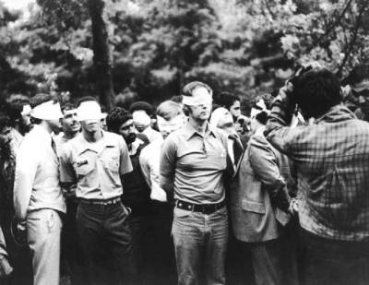
November 4, 1979
Notes:
16

Slide 17
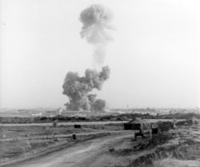
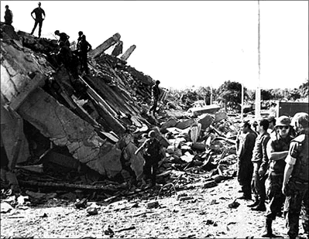
Beirut 1983

Slide 18



The Program and Response
Decision: 1982-1984
Detection: 1990s
Highly Enriched Uranium (HEU)
E3 Negotiations 2003-2005

Slide 19
Sanctions and Negotiations
UN Security Council Resolutions
June 2006: P5+1
US Sanctions
The Deal:
End suspicious activities
or
Tightening economic sanctions

Slide 20
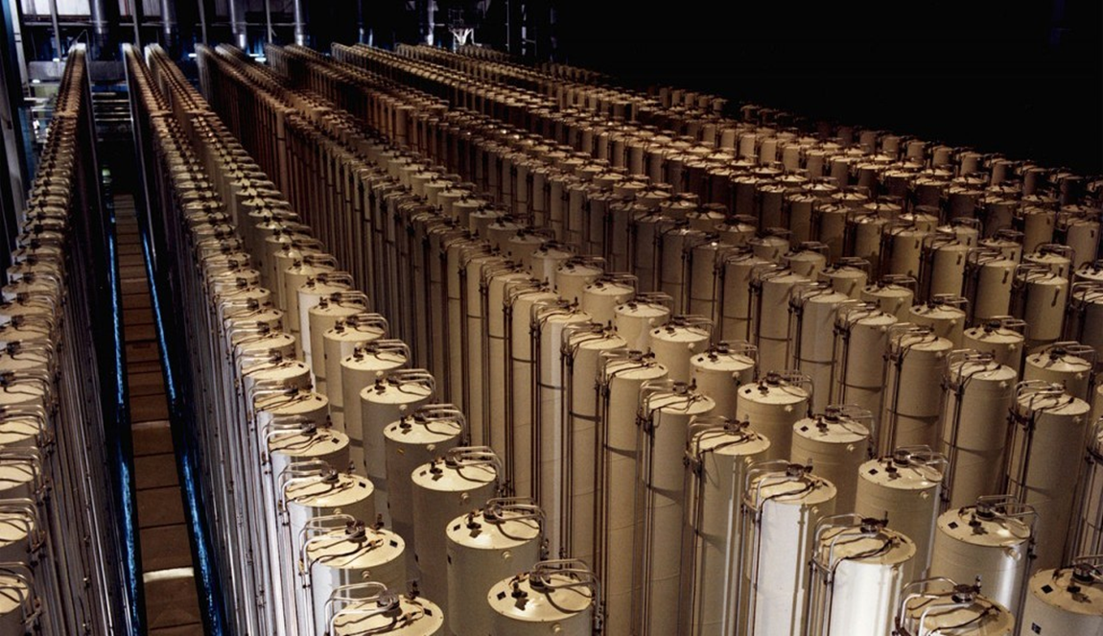
More Pressure: 2010
June 2010: UNSCR 1929
Stuxnet/Olympic Games
  Cyberattack by the US and Israel

Slide 21
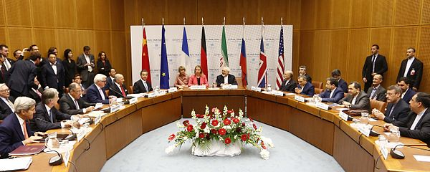
Deal: JCPOA
Joint Comprehensive Plan of Action
July 14, 2015
UNSCR 2231 July 20, 2015
Summary

Slide 22
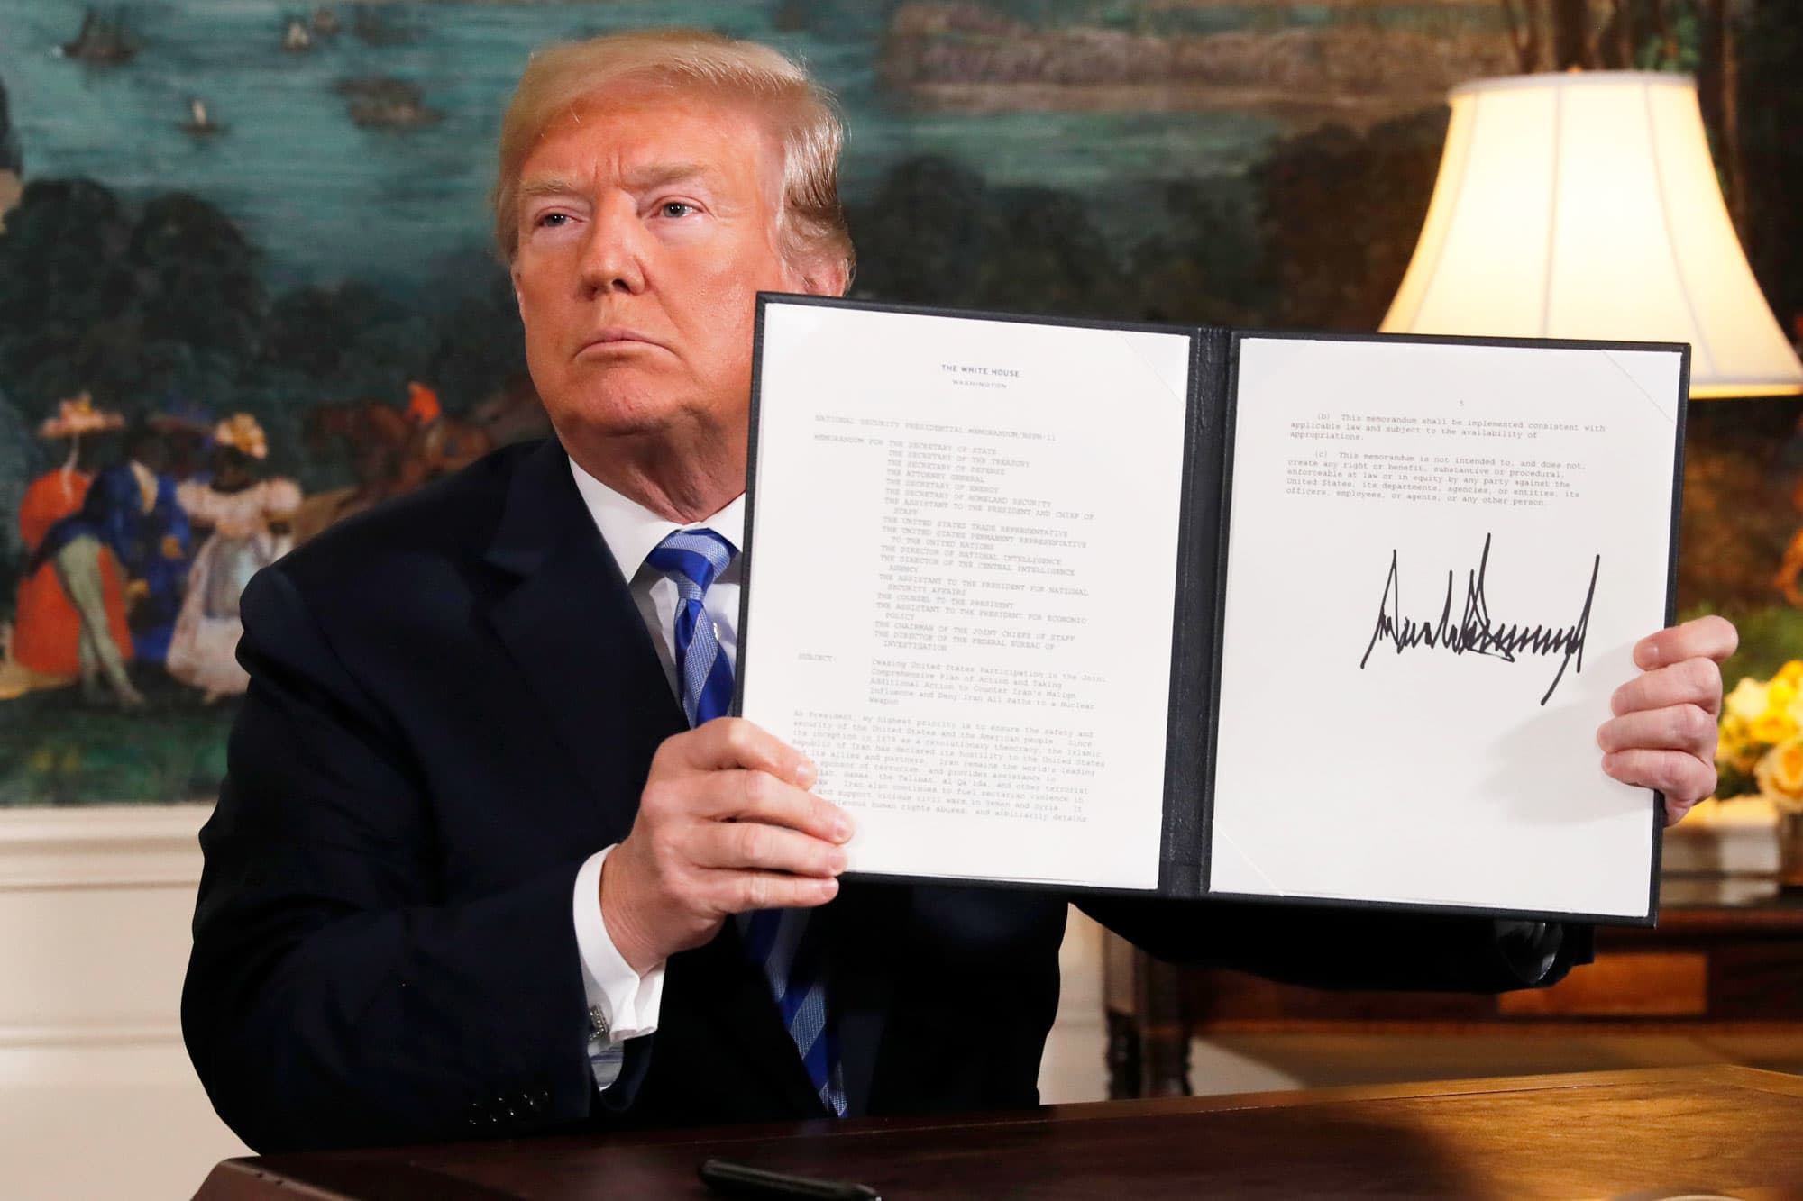
But…
May 8, 2018
US withdraws: “Maximum Pressure”
Reimposes sanctions
12 Demands

Slide 23
Iranian Response
2018-2019 “Strategic Patience”
May 2019: selected non-compliance
  60 day intervals
  Pressure on EU to change US mind

Slide 24
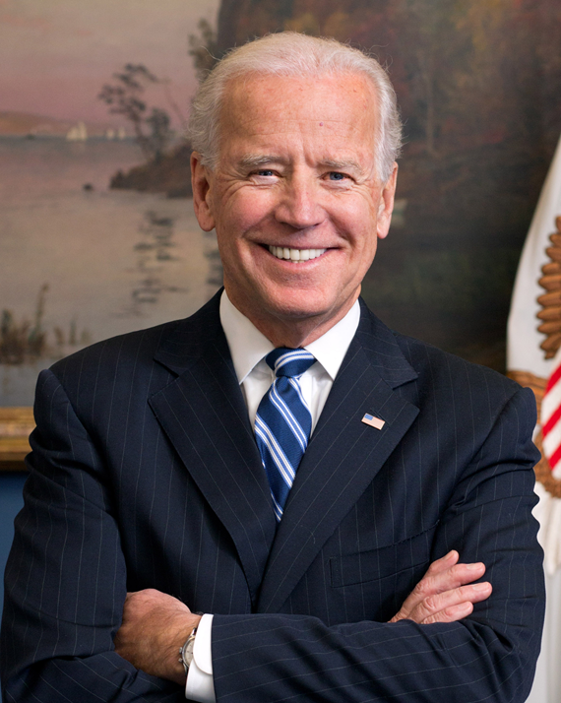
Back to JCPOA?
January 2021: Biden Administration

Slide 25
Two Choices
Nuclear deal delinked from other issues
vs
Comprehensive change in Iranian foreign policy

