Slide 1
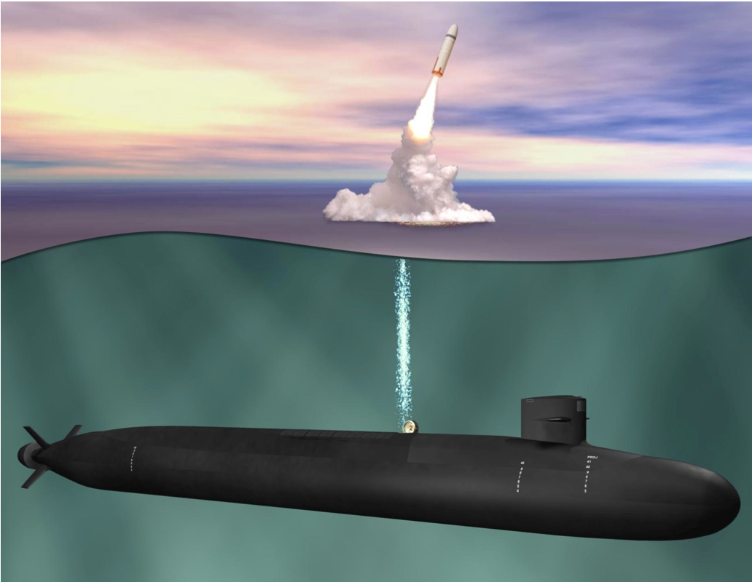
The Nuclear Arms Race
Concepts
Ideas
Columbia
Class SSBN

Slide 2
The Functions of Weapons or Force
Why do we have weapons?
What can you do with them?
Answer: Achieve political goals

Slide 3
The Functions of Weapons or Force
Defense
Deterrence
Compellence (coercive diplomacy)
Swaggering and Prestige
Based in part on:

Slide 4
Sources
Thomas Schelling. Strategy of Conflict (Cambridge: Harvard University Press, 1960).
Thomas Schelling. Arms and Influence (New Haven: Yale University Press, 1966).
Alexander George, David Hall, William Simons. The Limits of Coercive Diplomacy (Boston: Little, Brown and Co., 1971).
Robert Art. To What Ends Military Power? International Security Vol. 4, No. 4 (Spring, 1980), pp. 3-35.
Herman Kahn. On Escalation (NY: Penguin, 1965).

Slide 5
1. Defense

Slide 6
Defense at its most basic

Slide 7
Defense at its most complex

Slide 8
2. Deterrence
Goal: To prevent action
Method: Threat
Aimed at influencing an opponent’s decision making
Assumption: rationality

Slide 9
RATIONALITY

Slide 10
Rational Choice
Cost Benefit Analysis
Threat: increases perception of costs
Options | Costs | Benefits
A | ? | ?
B | ? | ?
C | ? | ?

Slide 11
Credibility of Threat
Threat must be believable
“Beware of Dog” deterrent?

Slide 12
Communication
Europe during the Cold War
China and Taiwan

Slide 13
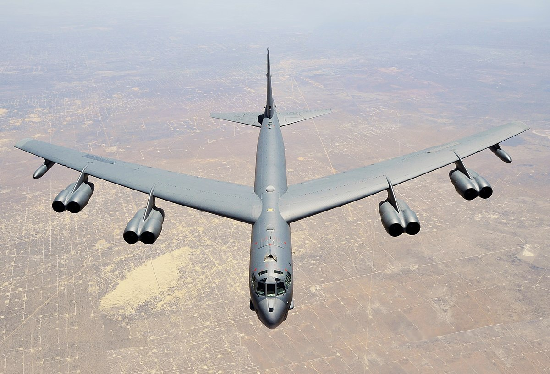
Two Types of Deterrence
1. Deterrence by Punishment

Slide 14
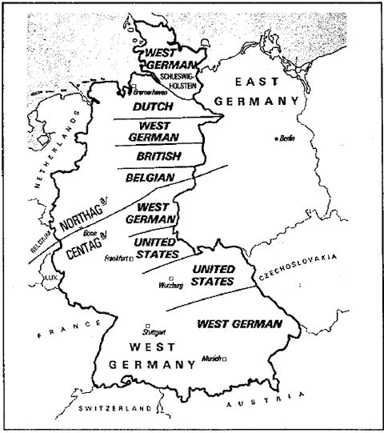
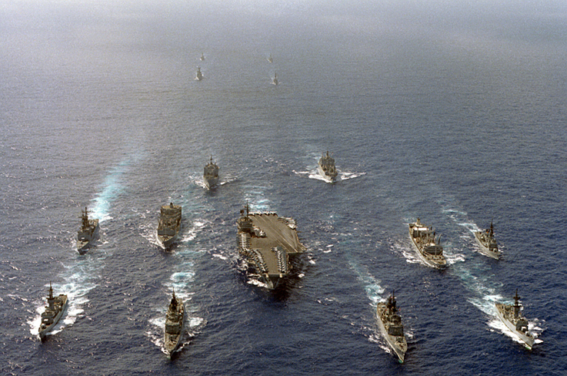
2. Deterrence by Denial

Slide 15
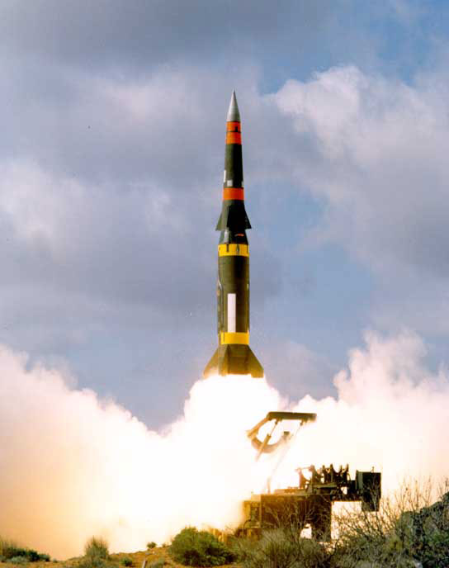
Extended Deterrence
Europe
Japan
S. Korea
Israel
Taiwan
Australia
New Zealand
US Pershing II
in Europe 1983-91

Slide 16
Complications?
1. Bounded Rationality (Herb Simon)
Things we don’t know as we use CBA
Incomplete information
Different calculations of CBA
Emotions, Bias…
Paul Boyce, https://boycewire.com/bounded-rationality-definition/

Slide 17
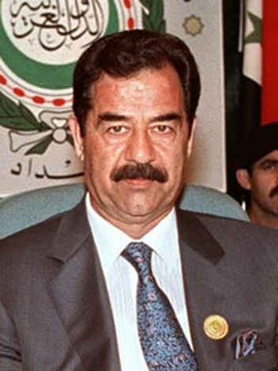
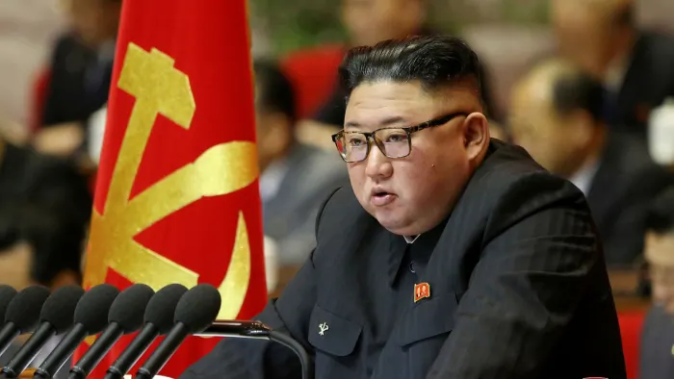
2. Irrationality?
Saddam Hussein Kim Jong-un
Iraq North Korea

Slide 18
3. If deterrence fails….

Slide 19
3. Compellence (coercive diplomacy)
Goal: To change opponent behavior
To stop an opponent from doing something they are doing
To get an opponent to do something they are not doing

Slide 20
Basic Elements
Brute force doesn’t always won’t work
Assumes rationality
War is bargaining
The power to hurt allows you to enter the bargaining

Slide 21
A. Is Brute force the best option?

Slide 22
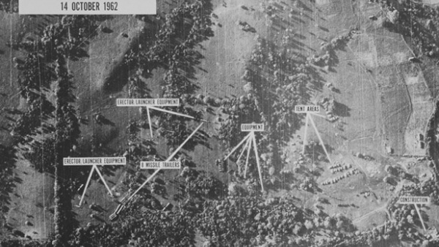
Cuban Missile Crisis 1962

Slide 23
B. Assumes Rationality
Cost Benefit Analysis
Options | Costs | Benefits
A | ? | ?
B | ? | ?
C | ? | ?

Slide 24
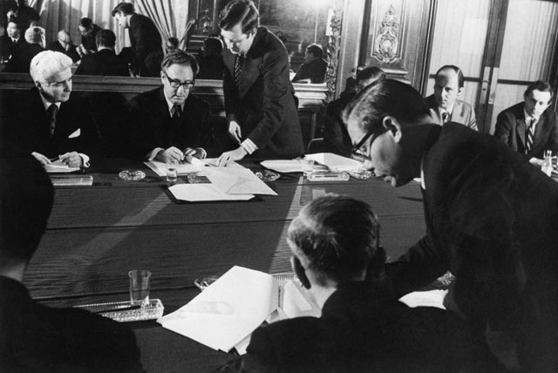
C. Compellence is Bargaining

Slide 25
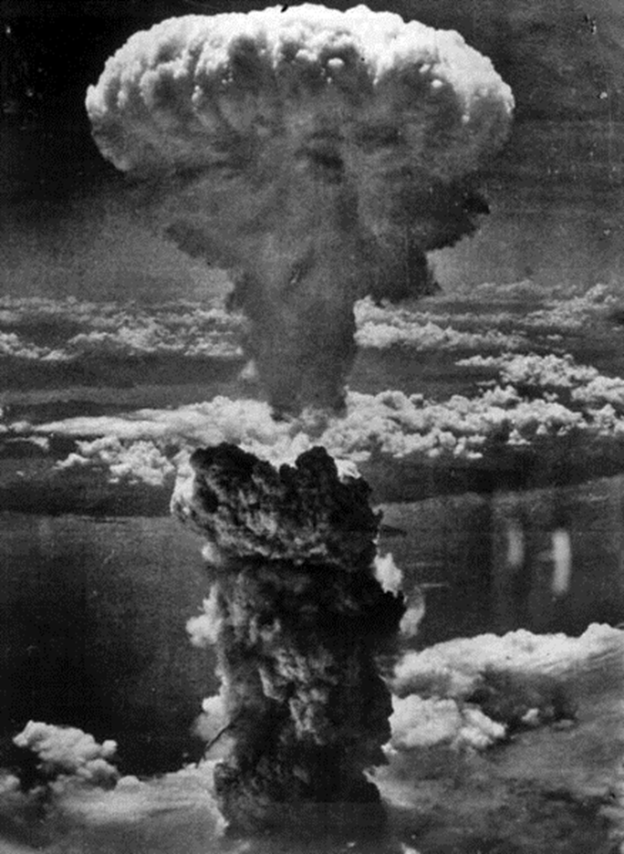
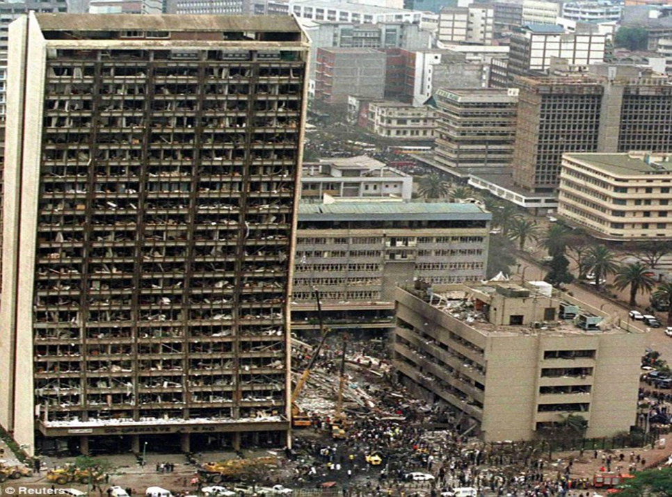
D. Entering the Bargaining?
The power to hurt
Capability
Intentions
US Embassy, Nairobi 8/7/98

Slide 26
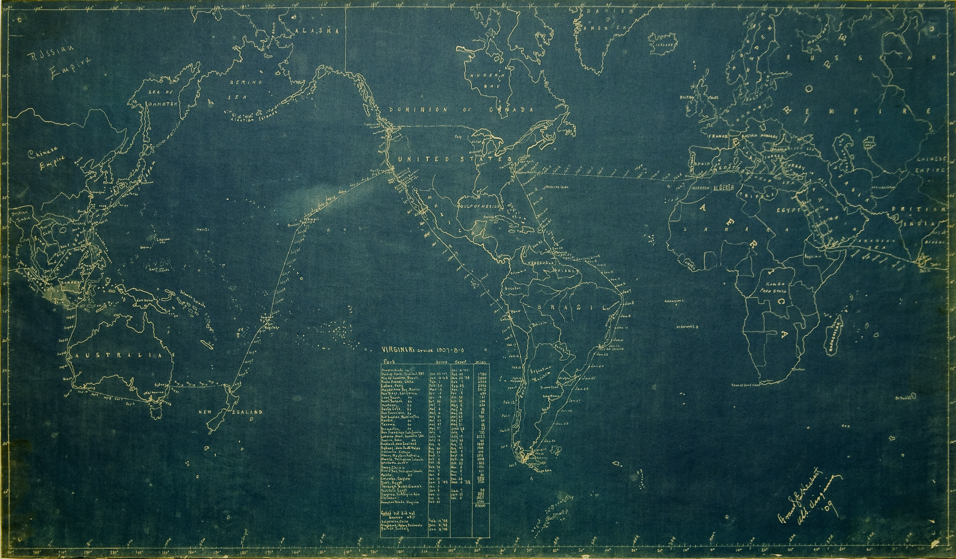
4. Swaggering
The Great White Fleet 1901

Slide 27
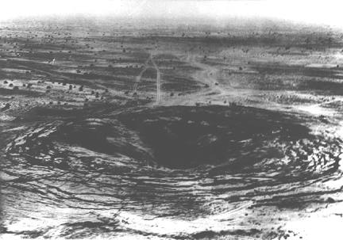
India
May 18, 1974 “Smiling Buddha” Test

