Slide 1
China, and the Russian Invasion of Ukraine: A New Great Power Challenge?

Slide 2
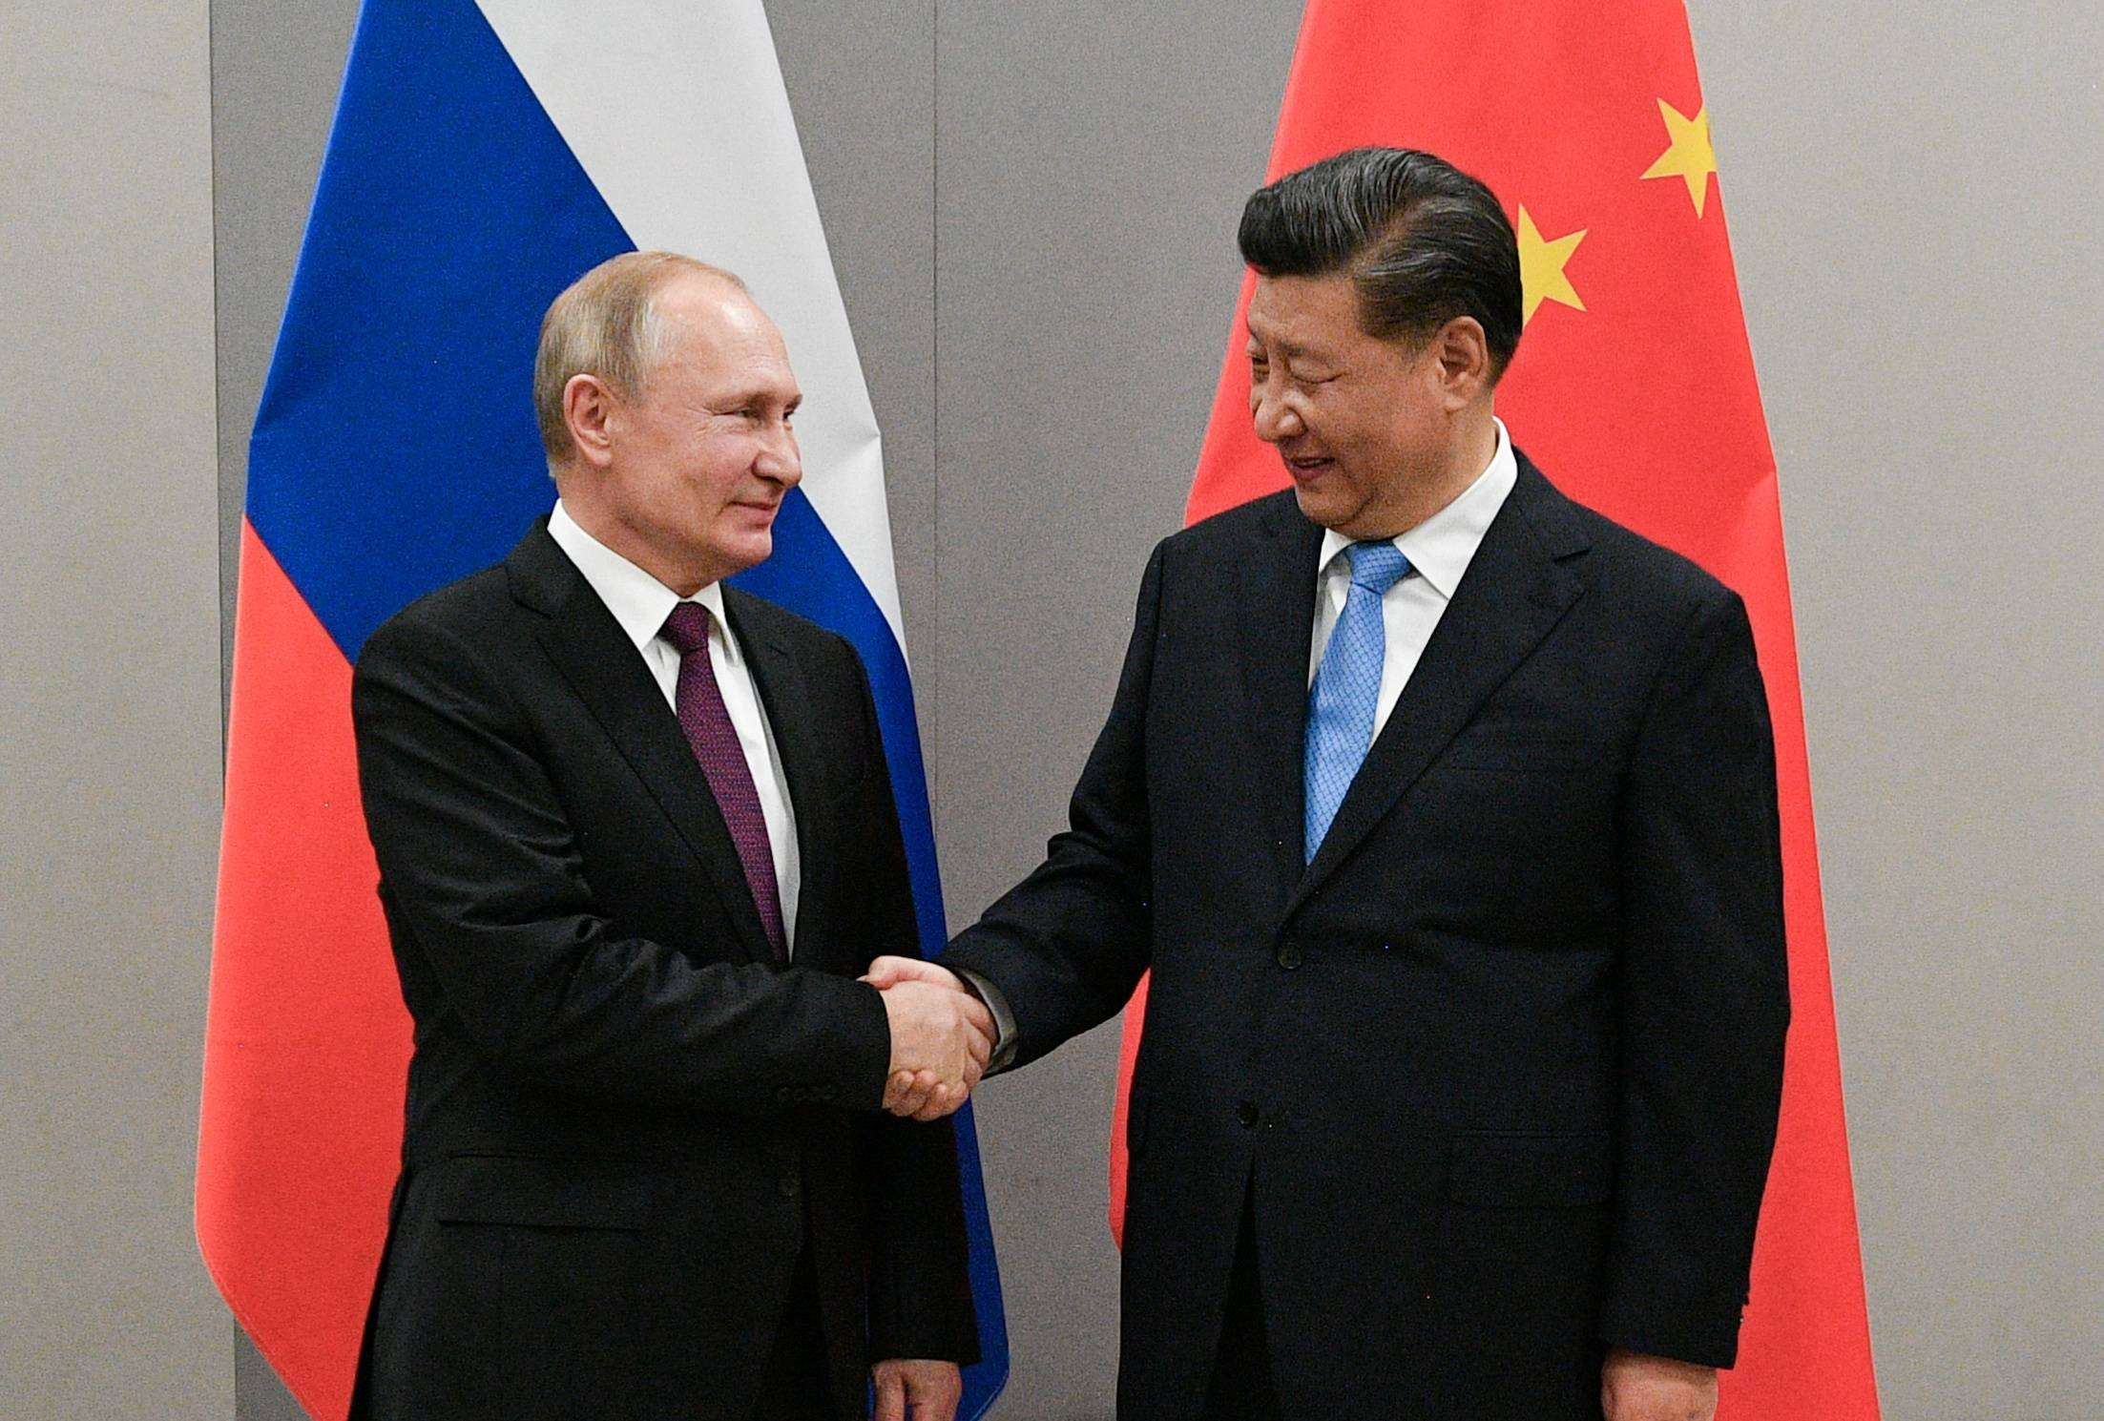
The Joint Statement
Joint Statement of the Russian Federation and the People’s Republic of China on the International Relations Entering a New Era and the Global Sustainable Development, February 4, 2022 (Translation by US Air Force, Air University)
Putin and Xi
February 4, 2022

Slide 3
Highlights of Joint Statement
Multipolarity
Redistribution of power in the world
Cultural Diversity and civilizational diversity of nations
Democracy is culturally defined
Non-interference in internal affairs of nation
All states must accept “diversity of their civilizational, cultural, and historical backgrounds…”
“Certain states” cause “instability” by acting unilaterally
“Certain states” impose their standards on others, and try to change other countries political systems

Slide 4
More Highlights of Joint Statement
Alliances are divisive (NATO expansion is bad)
Oppose “certain states” attempts to gain military superiority and “ideologized cold war approaches”
Russia-China friendships has no limits**
Russia believes in one China and Taiwan is part of China
Calls for “new kind of relationships between world powers on the basis of mutual respect, peaceful coexistence, and mutually beneficial cooperation.”

Slide 5
Builds on Other China Policies
Global Development Initiative, Sept 2021
Global Security Initiative, February 2023
Global Civilization Initiative, March 2023
Peace, Development, Equity, Justice, Democracy, Freedom
All defined by civilization
One nation or region can’t impose values on another
No ideological hegemony

Slide 6
February 24, 2022: Invasion

Slide 7
Why Invade? (For reference)
Ukraine/Kyiv as heart of old Russia
Russian return to Great Power Status
(“Putin the Great”)
NATO expansion and Russian traditional insecurity
Not enough NATO expansion
Few punishments after 2014
US commitment to Europe/NATO uncertain

Slide 8
Why Would China Support Russia?
Balance of Power: China and Russia vs. US
Test of US Response to Recapture of Territory
Think Taiwan
Two Front Challenge to US
Europe Allies?
Japan Russia
US China

Slide 9
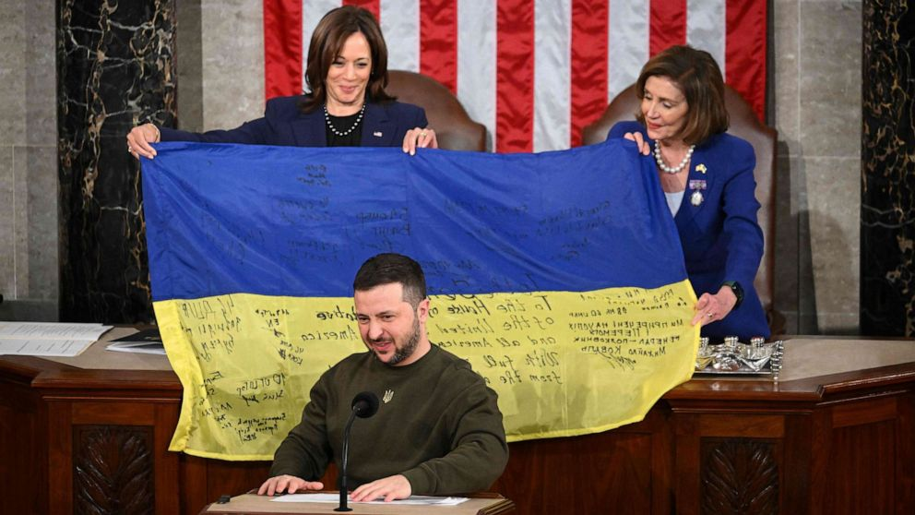
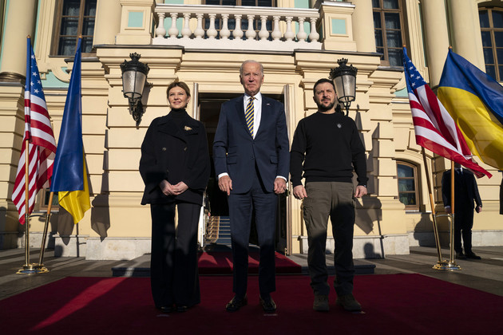
US Response
President Zelensky addresses US Congress 12/2022
Biden in Ukraine February 2023

Slide 10
Global Response
European
German increases in defense spending
NATO Supplies to Ukraine
Finland in NATO; Sweden wants in
Asian Response
Supplies to Ukraine
Japan doubles defense
spending

Slide 11
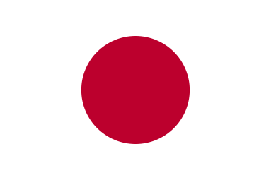
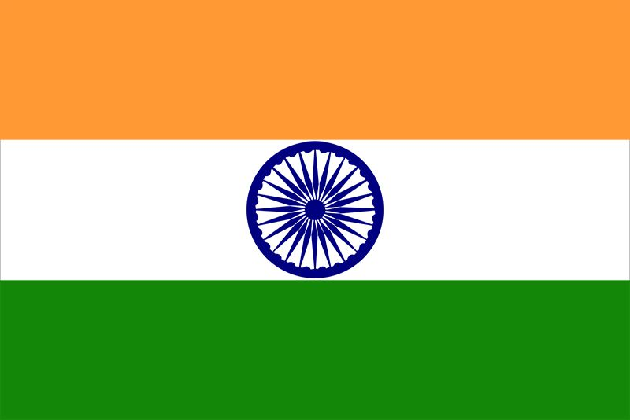
Blowback against China…
Quadrilateral Security Dialogue (Quad) Reinvigorated
US
Japan
India
Australia

Slide 12
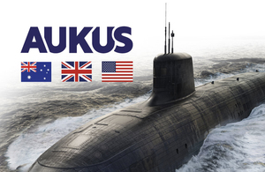
More Blowback…
AUKUS: 2021 accelerated

Slide 13
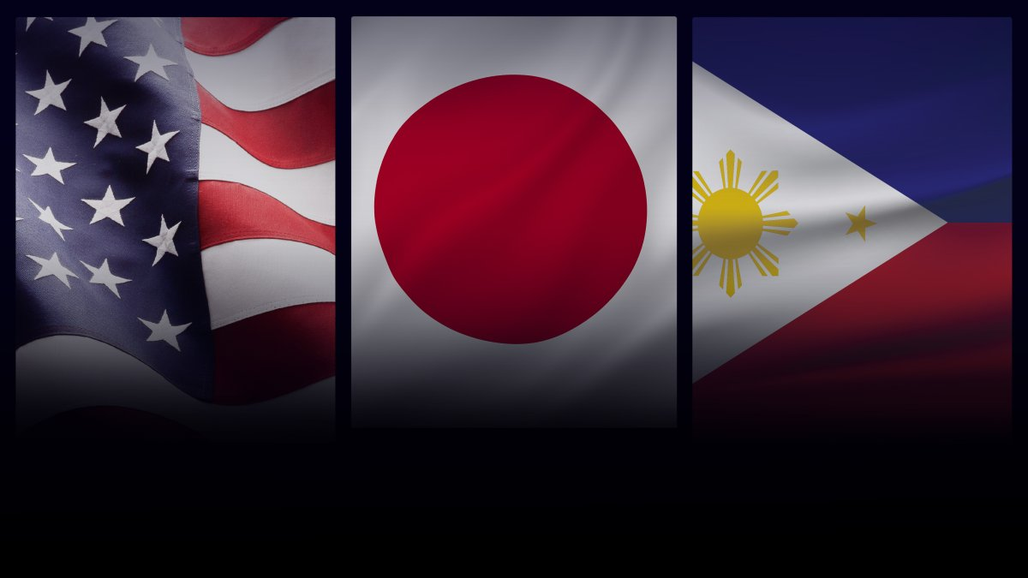
More Blowback…
US-Japan-Philippines Trilateral Agreement June 2023

Slide 14
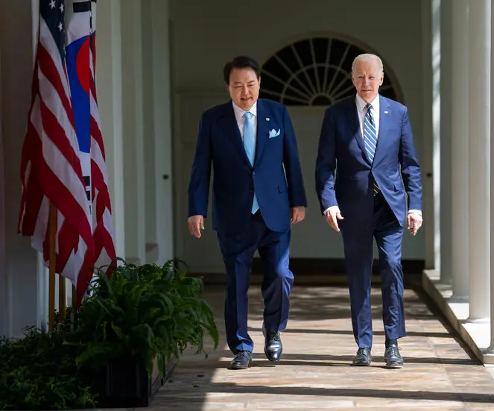
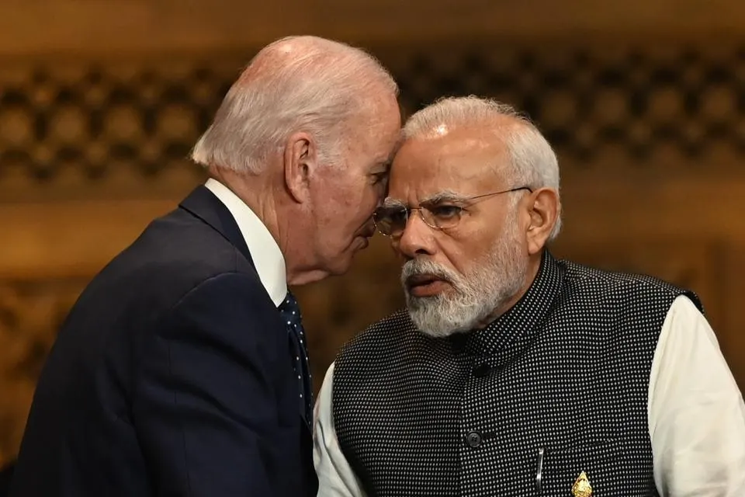
More Blowback…
US-South Korea US-India
Nuclear Agreement Defense Agreement
April 2023 June 2023
Pres. Yoon Suk-yoel Pres. Biden and
And Pres. Biden PM Narendra Modi

Slide 15
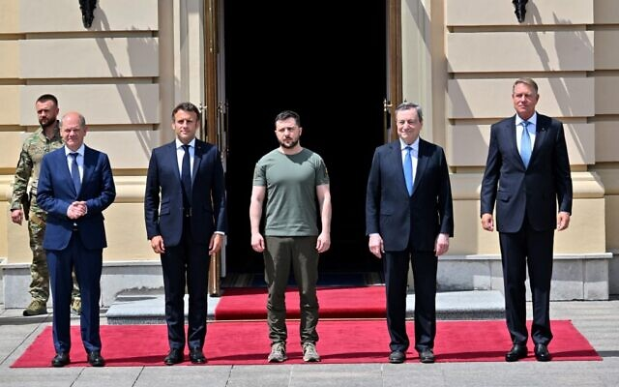
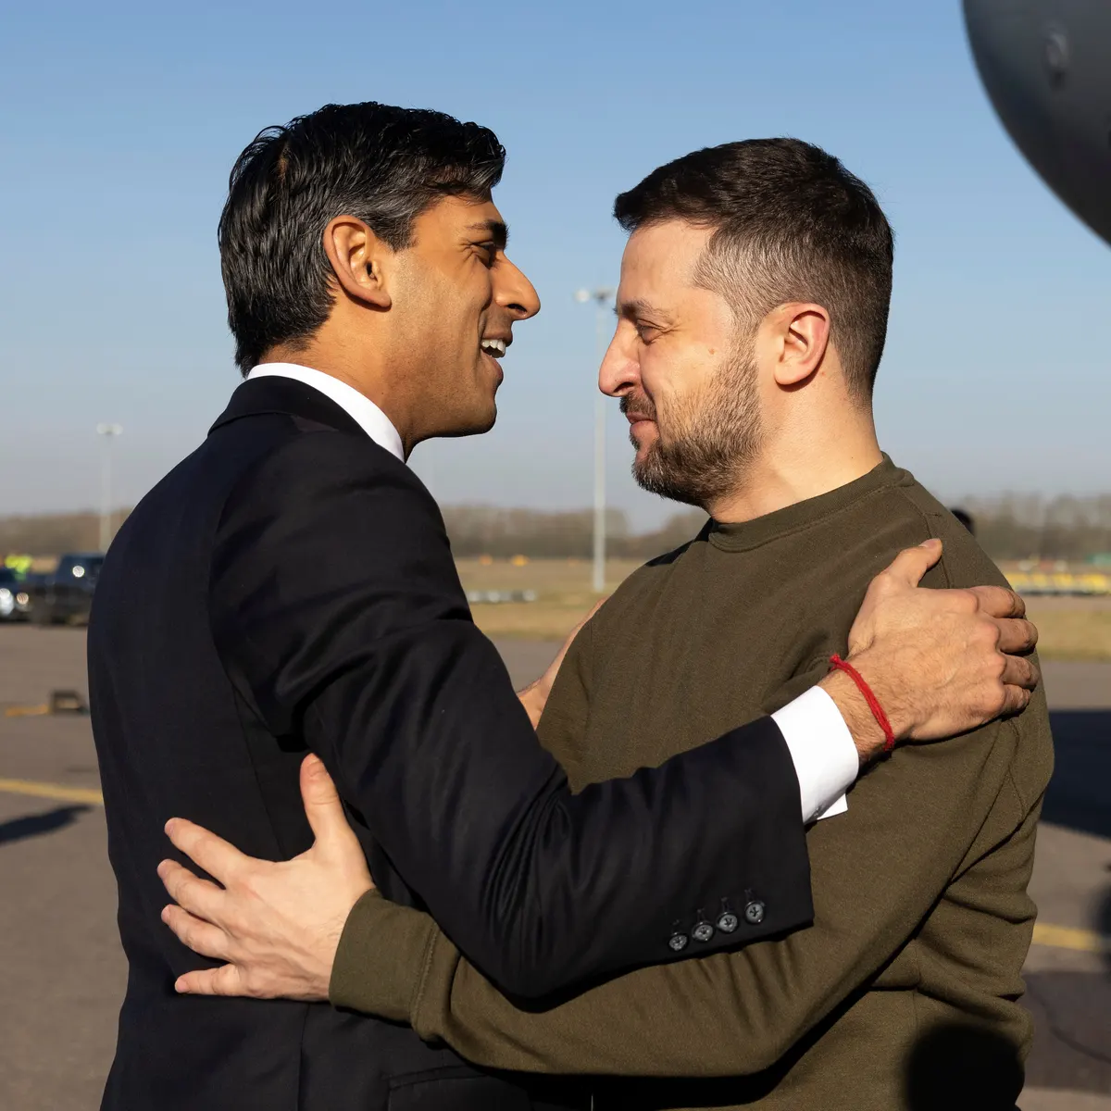
Why Is Ukraine So Important?
Left to right: Zelensky with German Chancellor Olaf Scholz, French PM Emmanuel Macron, then Italian PM Mario Draghi, Romanian President Klaus Iohannis, 2022; Zelensky with British PM Rishi Sunak, 2023;

Slide 16
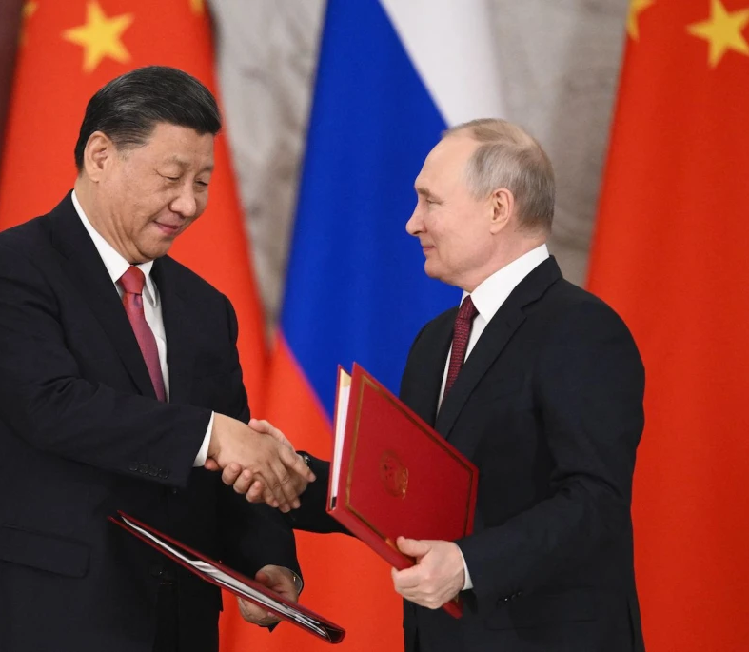
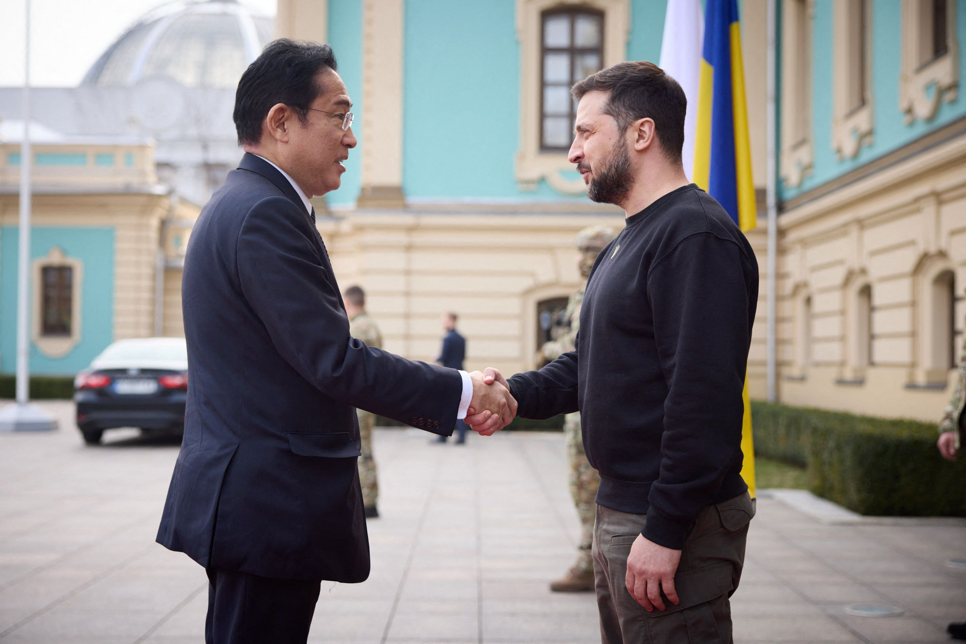
March 21, 2023
Moscow Kyiv
Xi and Putin Japanese PM Kishida and Pres. Zelensky

Slide 17
Is this the beginning of new Great Power Challenge?
If so, it’s starting out badly…

