Slide 1
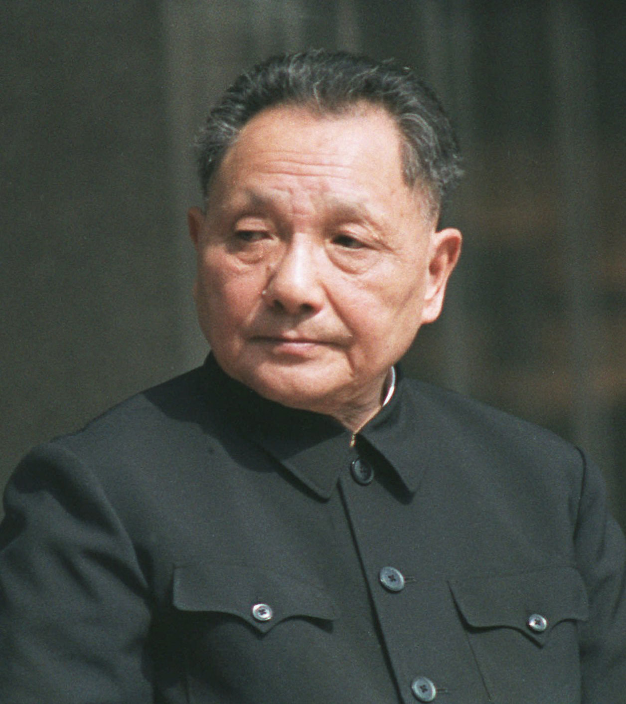
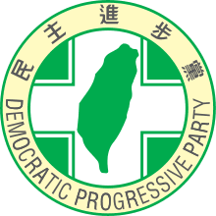
BIG Changes since 1970s
Chinese Economic Reform
Taiwanese Democracy
Deng Xiaoping DPP in Taiwan

Slide 2
1. Chinese Economic Reform
Goal: Returning China to its Rightful Status

Slide 3
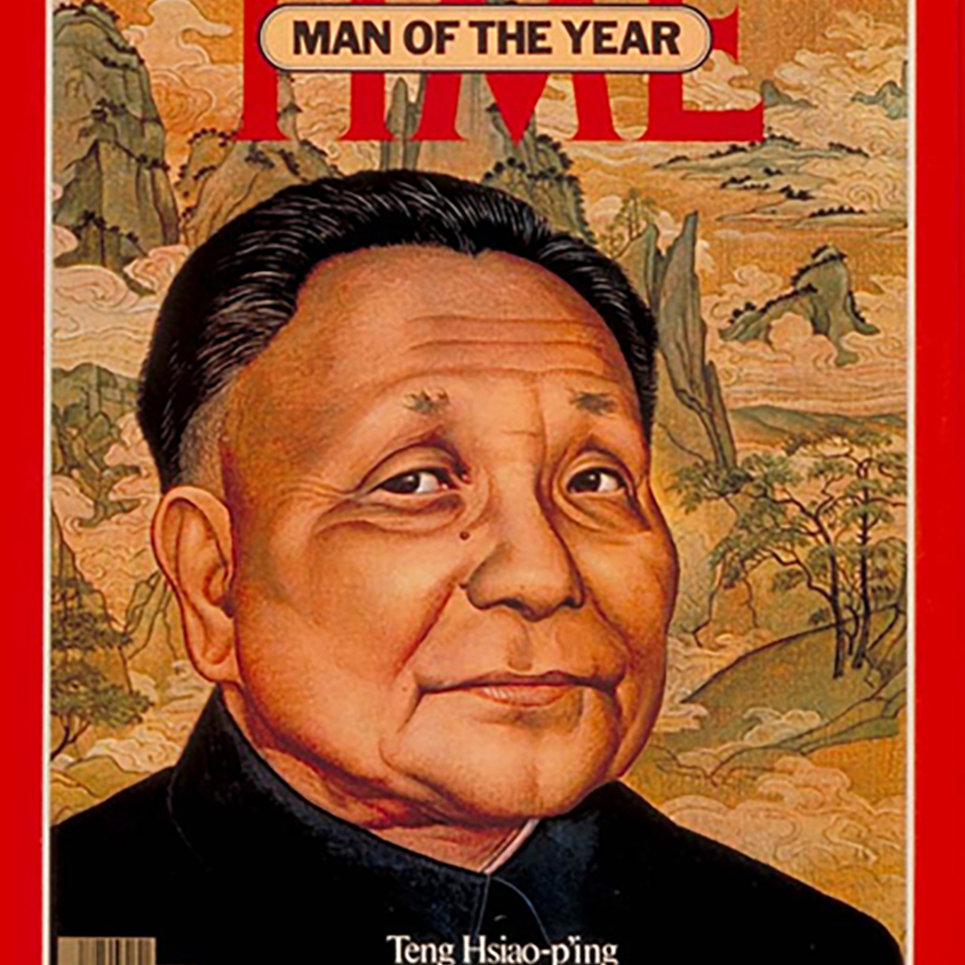
China Under Reform 1978--
Deng’s Policies
Priority on economic modernization
Integrating into the world
A more powerful China
Foreign Policy
“low profile”
“bide time”

Slide 4
Fastest growing Large economy in the World

Slide 5
Largest Economies in the World

Slide 6
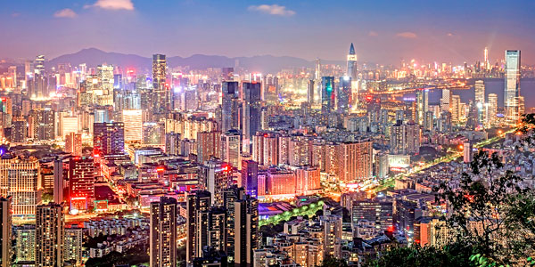
Shenzhen

Slide 7
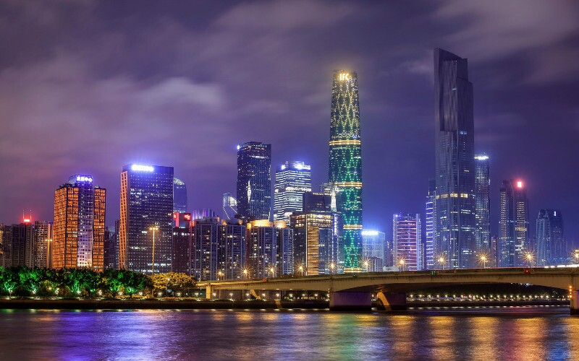
Guangzhou

Slide 8
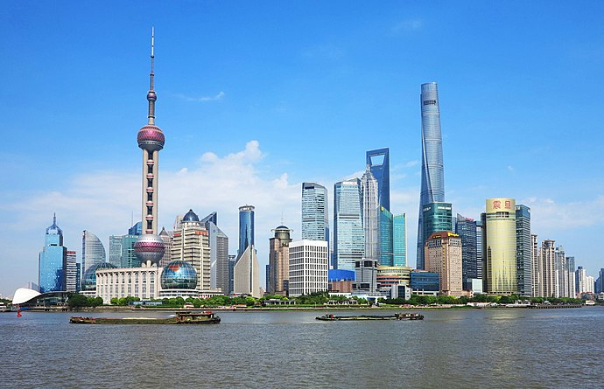
Shanghai

Slide 9
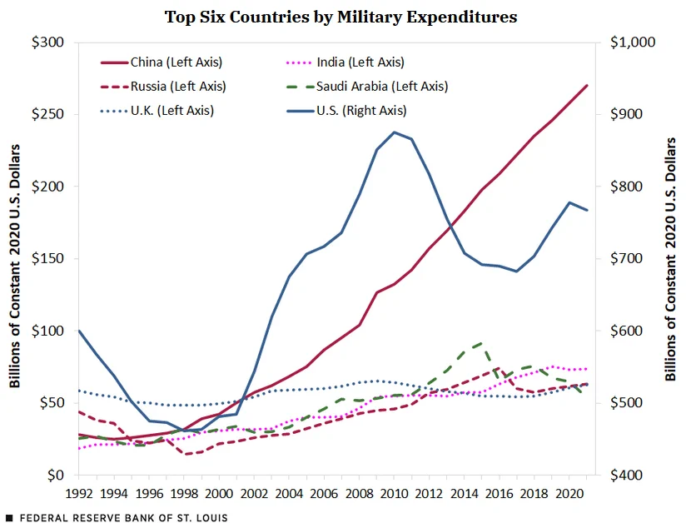
Defense Spending
//twitter.com/stlouisfed/status/1617266021810724866

Slide 10
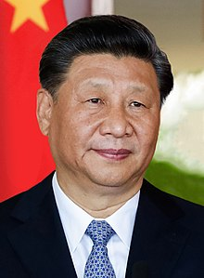
Xi Jinping’s Chinese Dream
End of low profile
“Great Rejuvenation of the Chinese Nation”
Meaning of Iraq War (2003) and Great recession (2008)
Confucianism

Slide 11
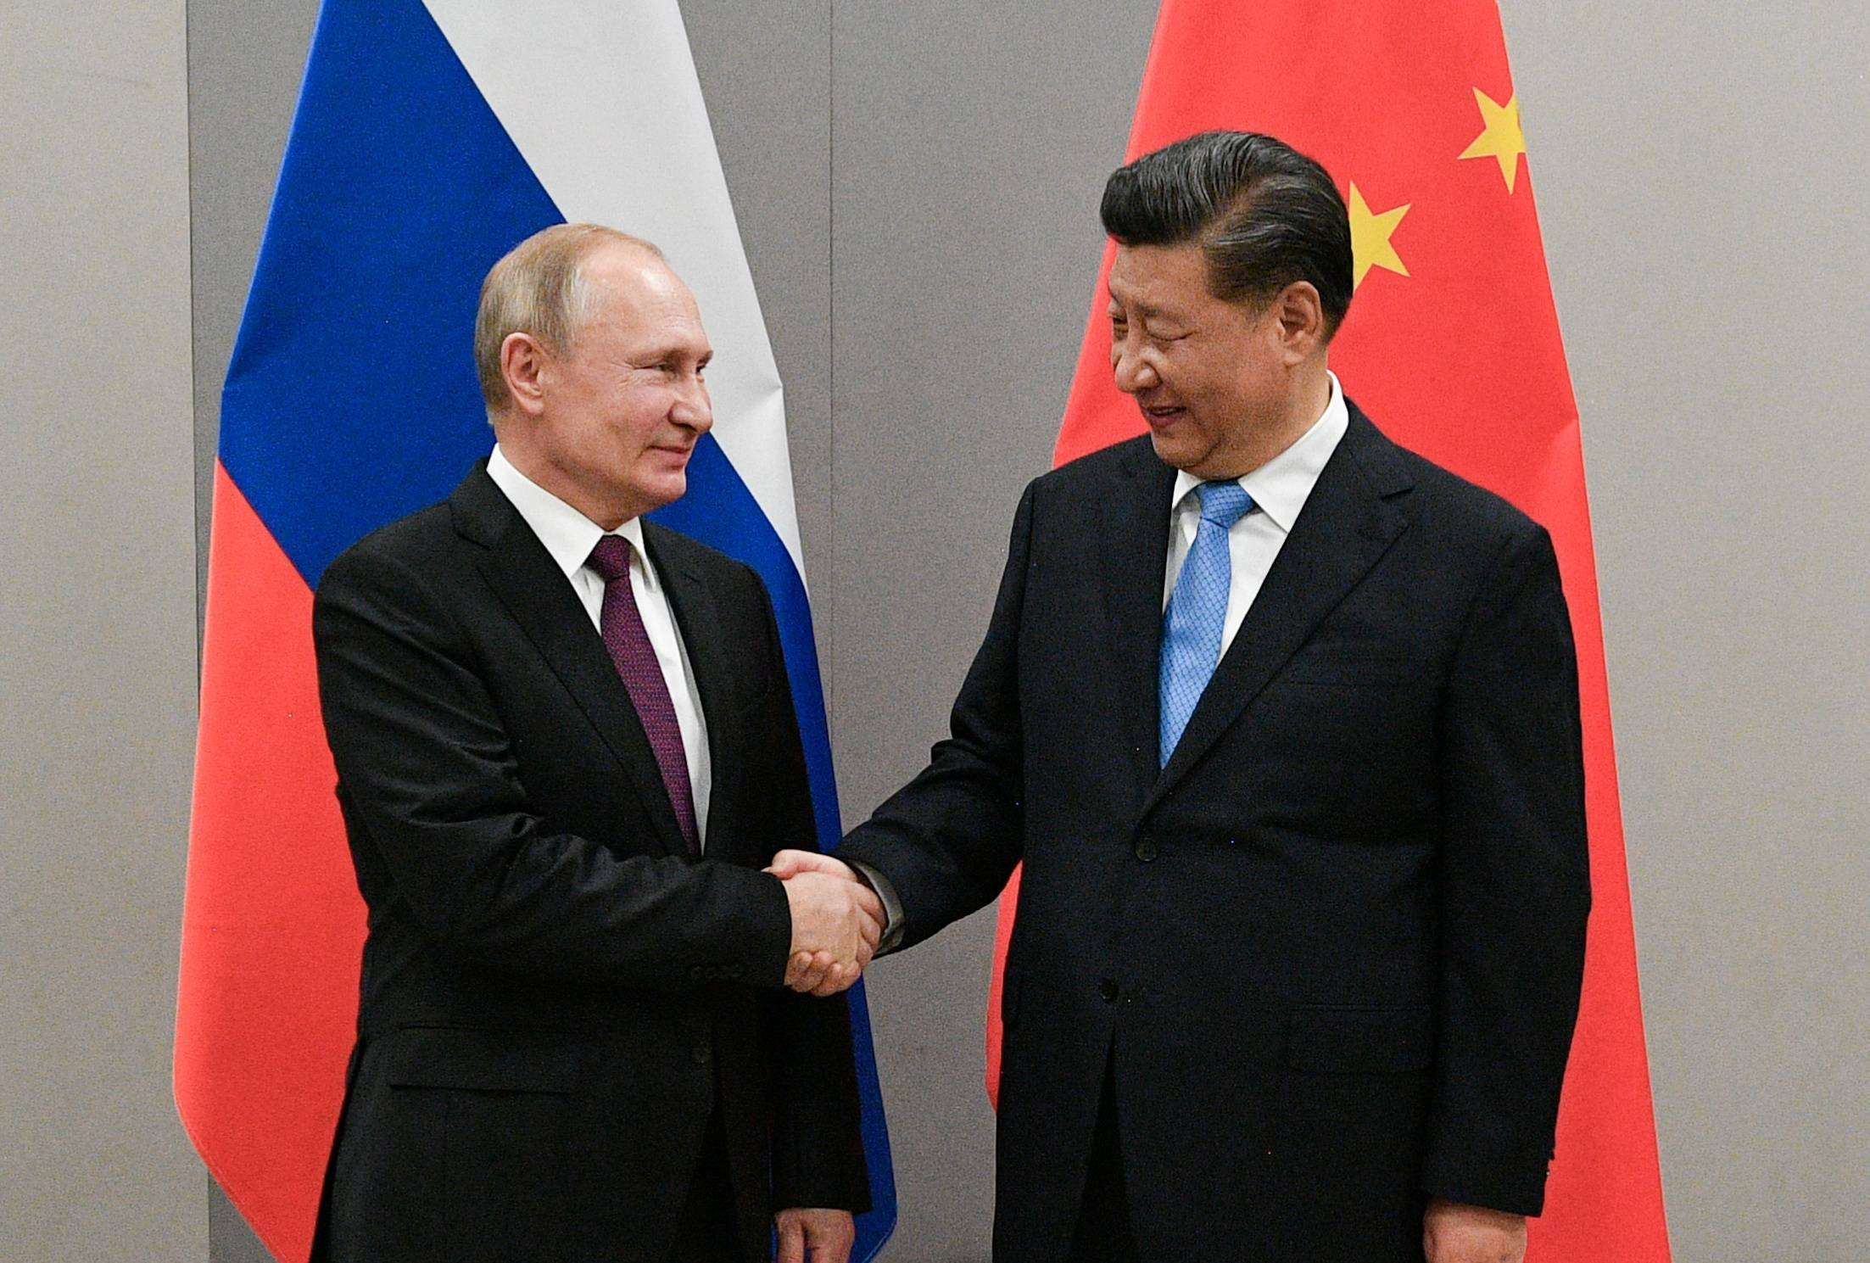
The Joint Statement
Joint Statement of the Russian Federation and the People’s Republic of China on the International Relations Entering a New Era and the Global Sustainable Development, February 4, 2022 (Translation by US Air Force, Air University)
Putin and Xi
February 4, 2022

Slide 12
Reunification (By 2049?)
White Paper: The Taiwan Question and China's Reunification in the New Era
“China's Complete Reunification Is a Process That Cannot Be Halted”
“The US authorities have stated that they remain committed to the one-China policy and that they do not support "Taiwan independence". But their actions contradict their words.”
One Country; Two Systems
China view of Taiwan Independence

Slide 13
2. Taiwan Democracy

Slide 14
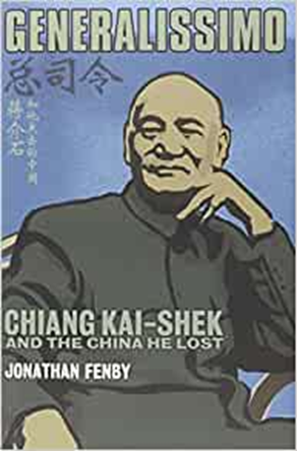
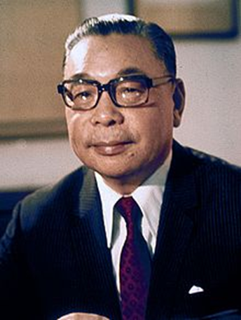
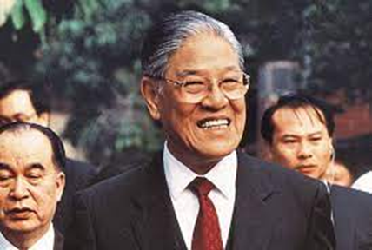
The Transition 1980s
Chiang Kai-shek Chiang Ching-kuo Lee Teng-hui
Pres. 1948-75 Pres. 1978-1988 Pres. 1988-2000

Slide 15
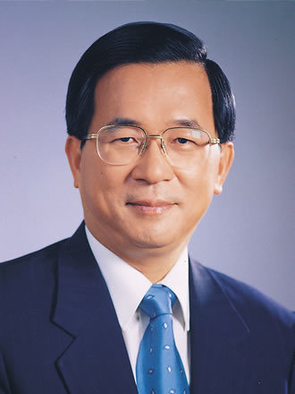
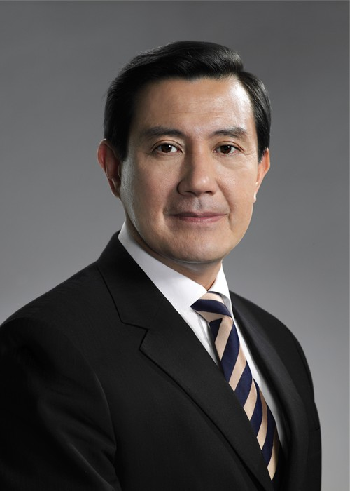
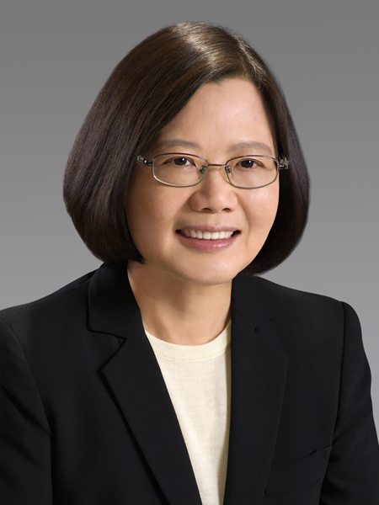
KMT vs. Democratic Progressive Party (DPP) Presidents
Chen Shui-bian Ma Ying-jeou Tsai Ing-wen
DPP KMT DPP
2000-2008 2008-2016 2016--

Slide 16
Taiwan-China Interdependence

Slide 17
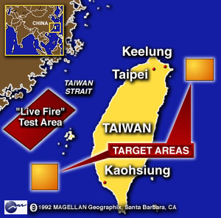
China Military Coercion
March 1996 Presidential Election
Chinese Missile Tests/Exercises March 1996
Current
Missile
Deployments

Slide 18
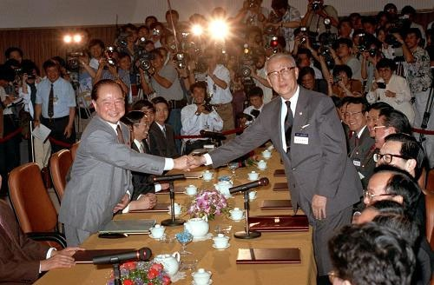
“1992 Consensus”
One China
Increase ties, exchanges
We’ll leave it undefined for now
But both have defined it differently…
1993 Meeting

Slide 19
KMT vs. DPP
KMT
DPP
Closer ties with China
Still talks about reunification
No independence
Taiwanese are Chinese
Nervous abut ties with China
Avoids talk of reunification
Flirts with independence
Taiwanese, not Chinese

Slide 20
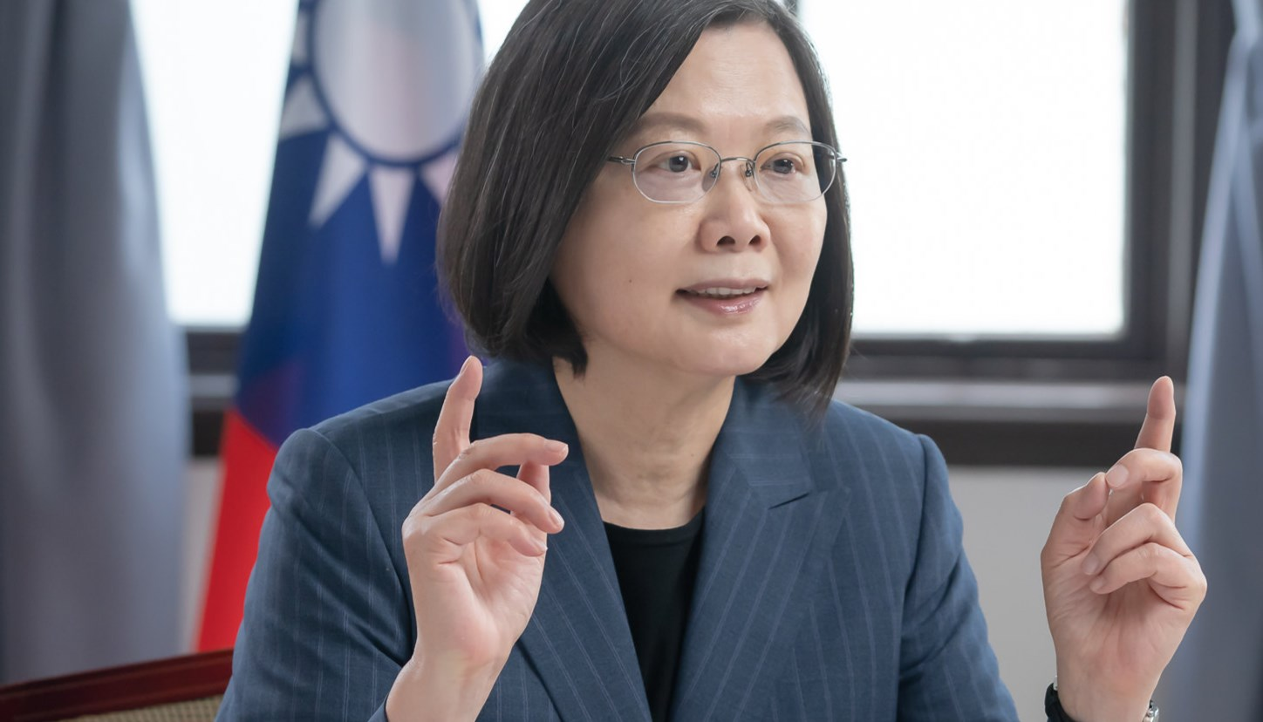
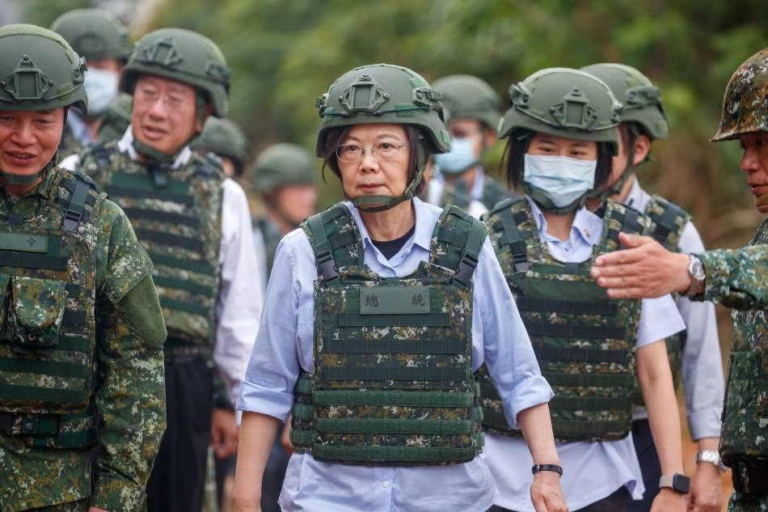
President Tsai Ing-wen Rejects 1992 Consensus

Slide 21
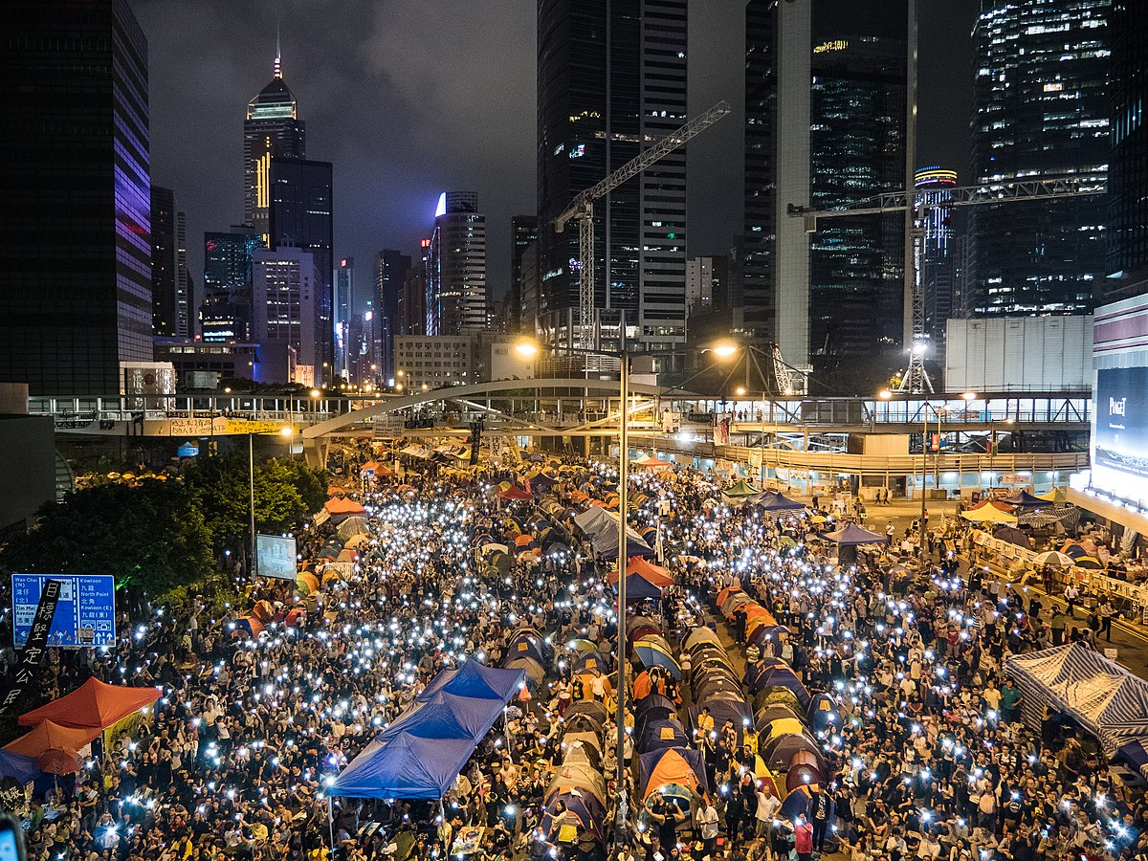
For Taiwan: Hong Kong is a Warning
2014

Slide 22
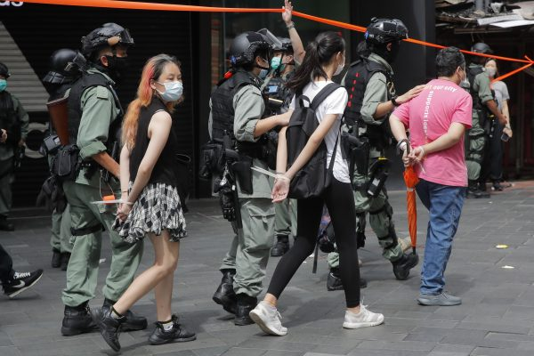
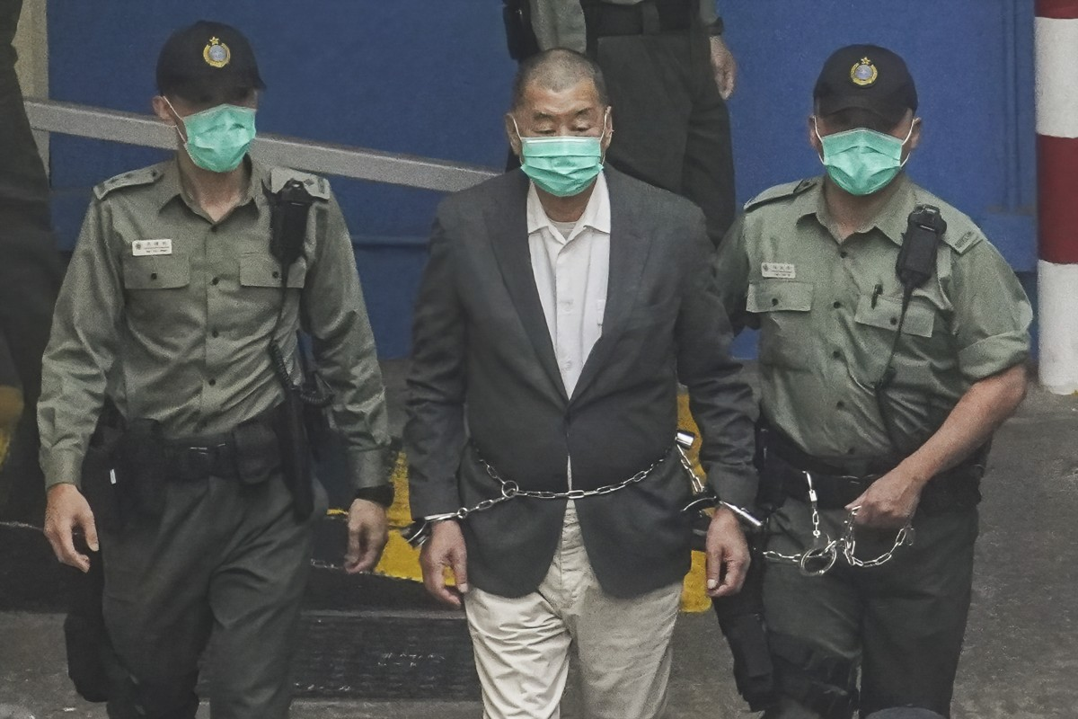
Hong Kong under One Country; Two Systems
2020

Slide 23
Summer 2022: Visit of US House Speaker Nancy Pelosi to Taiwan

Slide 24
2024 Taiwan Presidential Election January 13, 2024
KMT Candidate
Hou Yu-ih
(pronounced like Ho Yo-ee)
DPP Candidate
Lai Ching-te
(pronounced like Lie Ching-tee)

Slide 25
2024 Taiwan Presidential Election January 13, 2024
Terry Gou (Foxconn)
Independent (was KMT)
Ko Wen-je
Taiwan People’s Party

Slide 26
What if Taiwan declares independence
What if China tires to coerce Taiwan to reunify?

