Slide 1
China and Taiwan
One China?
Two Chinas?
One China, One Taiwan?

Slide 2
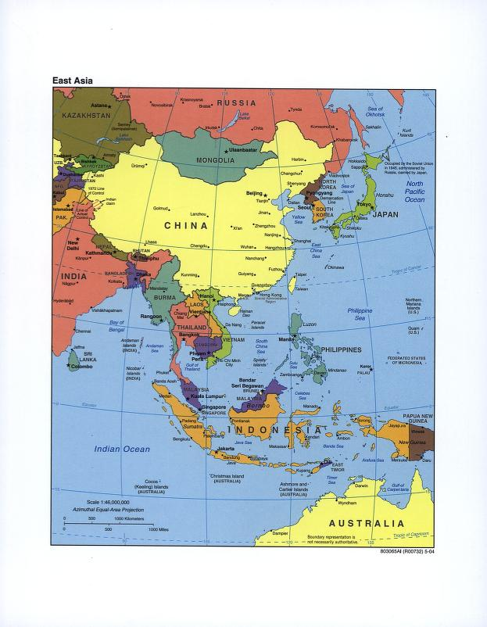
East Asia

Slide 3
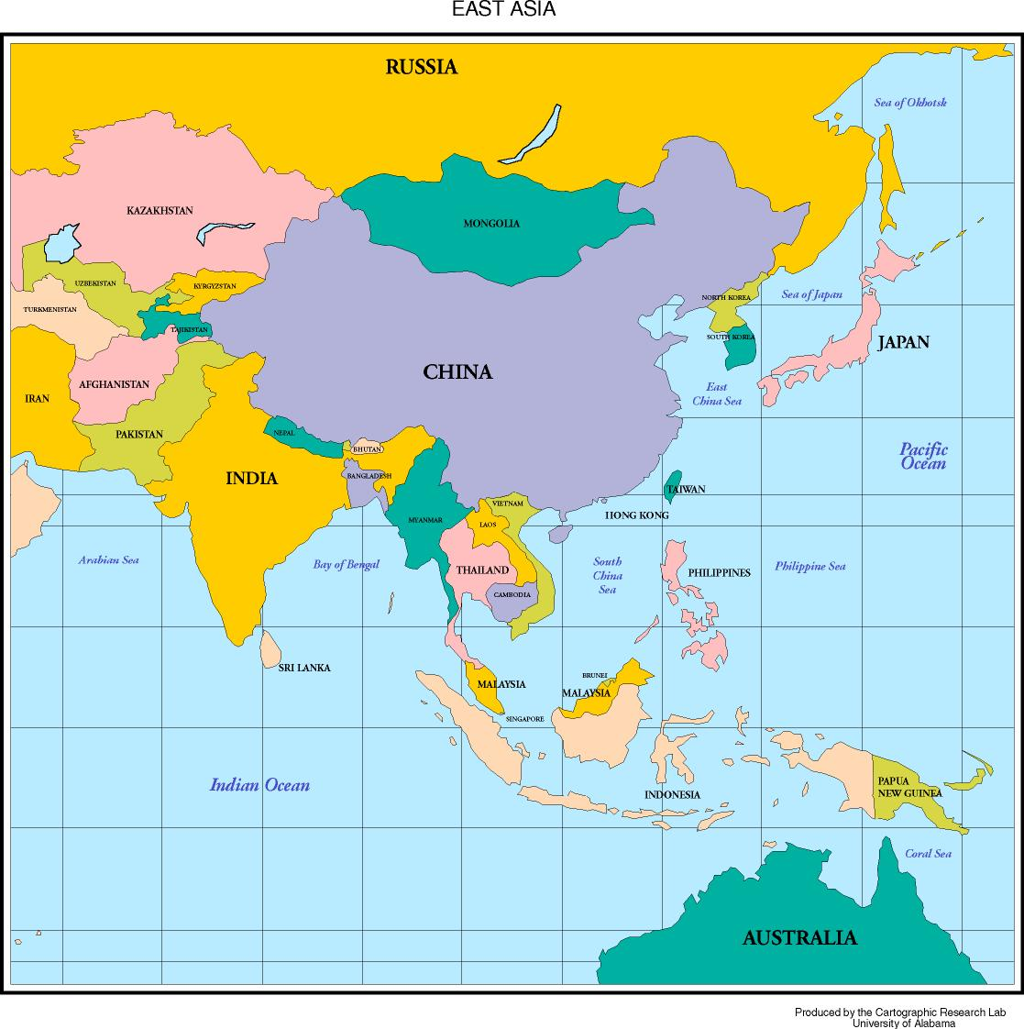
East Asia Again

Slide 4

The Big Bang

Slide 5
Chinese Dynasties (Reference)
Three Sovereigns and Five Emperors 2852-2205 (Pre-Dynasty)
Xia 2205-1766 BCE
Shang 1766-1122 BCE
Zhou 1122-221 BCE
  Spring and Autumn Period 770-476
  Warring States Period 475-221
Qin 221-206 BCE
Han 206 BCE-220 CE
Three Kingdoms 220-280
Western Jin 265-316
Eastern Jin 317-439
Southern and Northern 386-589
Sui 589-618
Tang 618-906
Five Dynasties and Ten Kingdoms 907-960
Song 960-1279
Yuan (Mongol) 1279-1368
Ming 1368-1644
Qing (Manchu) 1644-1911

Slide 6
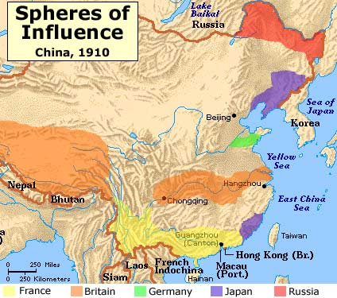
“Carving Up China like a Ripe melon”
1842-1949: “100 Years of Humiliation”
From: http://www.resourcefinder.org/imperialism/Colonial%20China.jpg

Slide 7
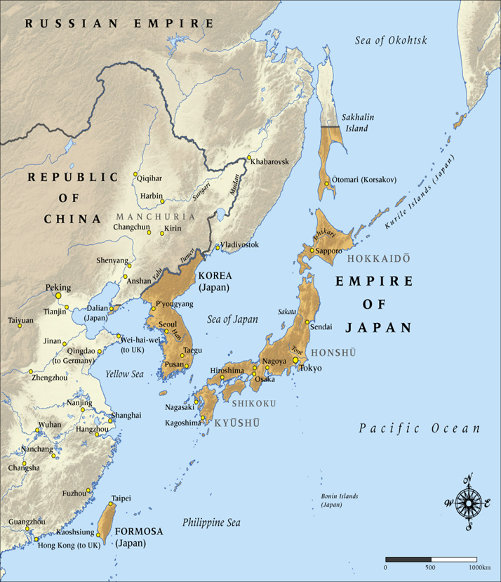
Japan 1914
Sino-Japanese War
1894-1895
Treaty of Shimonoseki

Slide 8

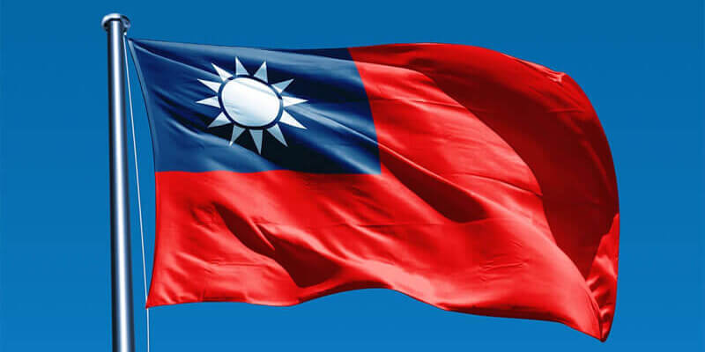
1911-1912: Qing Falls
Republic of China Born
ROC Flag
1911-1928
ROC Flag
1928 to present

Slide 9
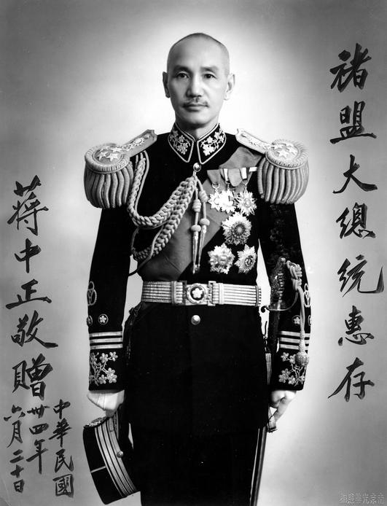
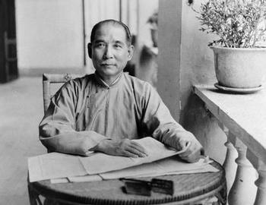
1. Nationalists: Guomindang
(Kuomintang-KMT) 1890s
Dr. Sun Yat Sen Chiang Kai-shek
1866-1925 1887-1975

Slide 10
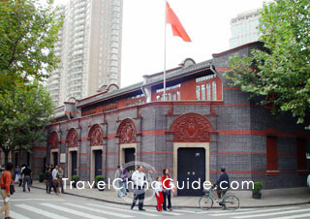
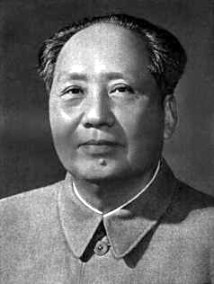
2. Communists (1921)
No.76 Xingye Road,
Shanghai
Mao Zedong
(1893-1976)

Slide 11
Collapse of Qing Dynasty and Chaos 1911-1949
(for reference)
1911: Birth of Republic of China
Provisional President Sun Yat-Sen 1911
Sun Overthrown 1912 (by military)
1916-1927: Warlord Period
Japan in Manchuria 1931
1937 Japanese invasion
1946-1949 Chinese Civil War
  Nationalists vs. Communists

Slide 12
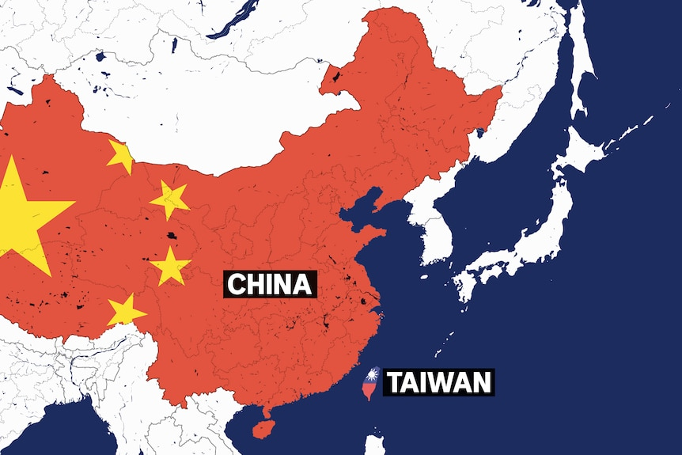
Two Rivals

Slide 13
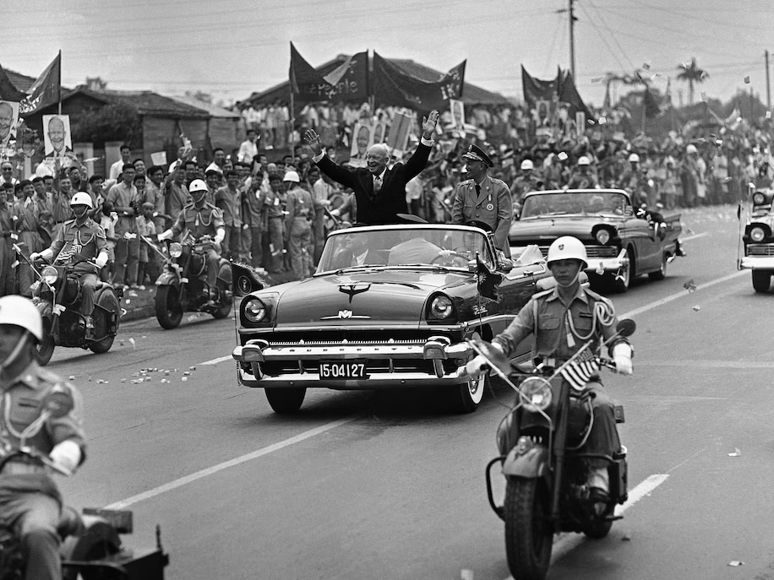
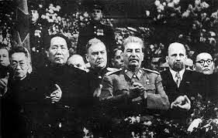
After 1949
Taipei: We are the legitimate government of China
Beijing: We are the legitimate government of China
US: Taipei is right
USSR: Beijing is right
Mao and Stalin 1949 Eisenhower and Chiang Kaishek, 1960

Slide 14
The Cold War Balance of Power
1945-1990
Israel Syria/Egypt/PLO
Ethiopia Somalia
Taiwan (Taipei) China (Beijing)
S. Korea N. Korea
S. Viet Nam N. Viet Nam
W. Berlin E. Berlin
W. Germany E. Germany
Britain/France/Japan Poland/Czech
Nuclear Weapons Nuclear Weapons
US USSR

Slide 15
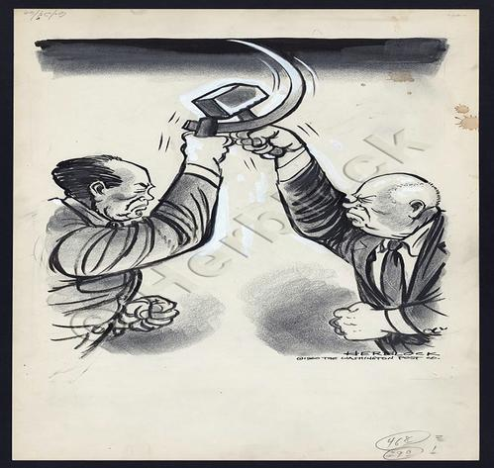
But…Sino-Soviet Conflict

Slide 16
US Thinking 1970s:
Changing the Balance of Power?
Taiwan ? China
S. Korea N. Korea
Indonesia Viet Nam
W. Berlin E. Berlin
W. Germany E. Germany
Britain/France/Japan Poland/Czech
Nuclear Weapons Nuclear Weapons
US USSR

Slide 17
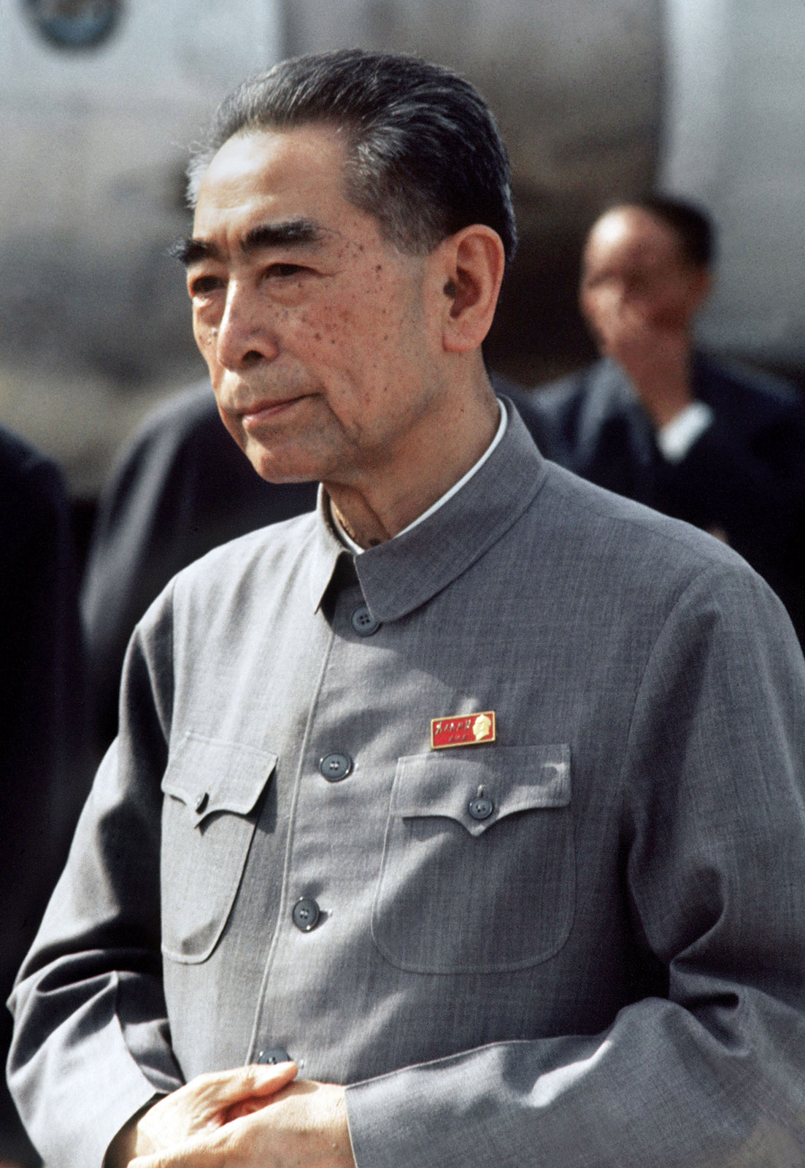
Chinese Thinking 1970s:
Balance of Power
Premier Zhou Enlai
US
PRC USSR

Slide 18
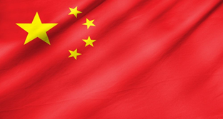
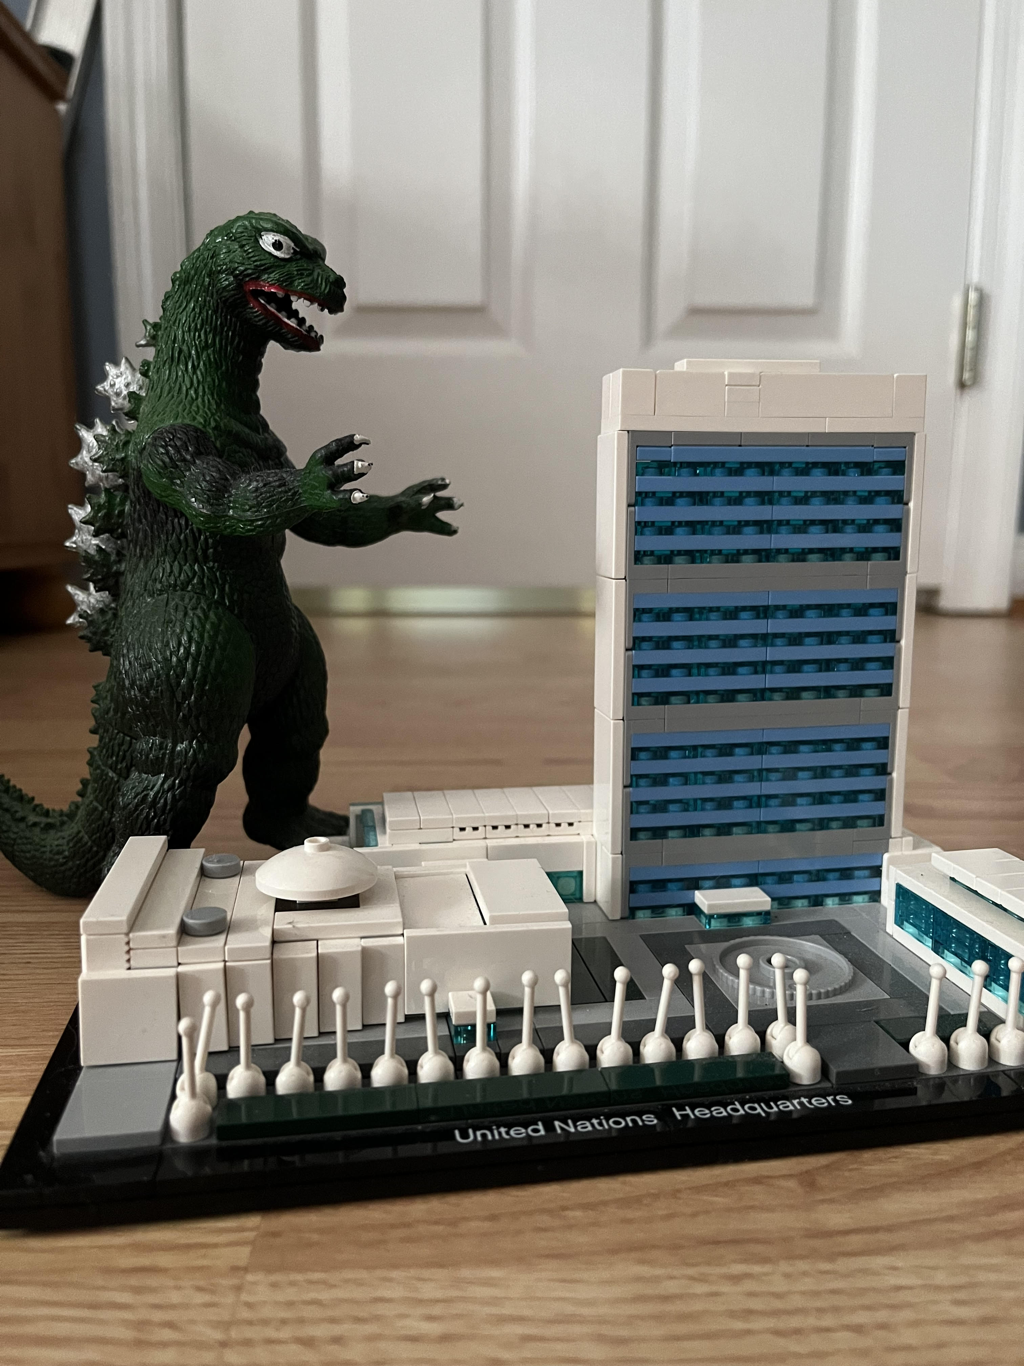

United Nations: 1971
IN OUT

Slide 19
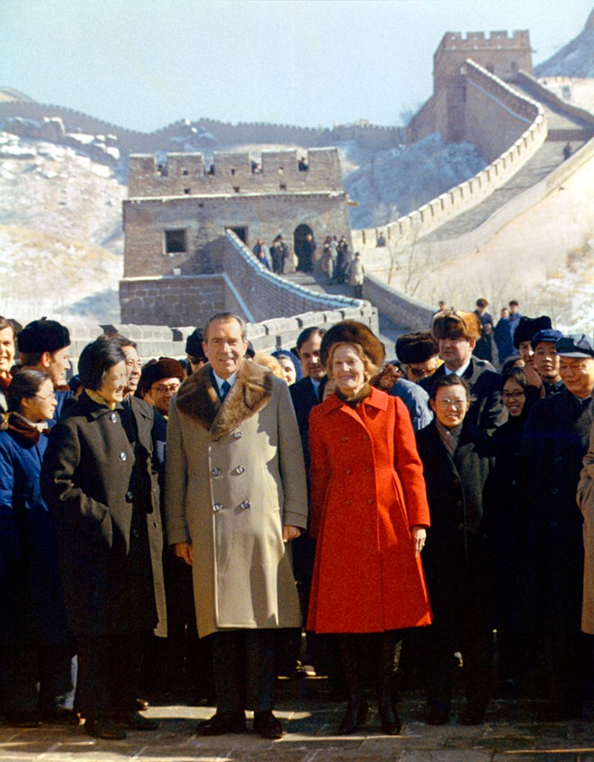
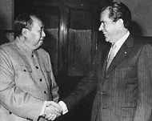
Nixon-Mao Summit in China, February 1972
Notes:
19

Slide 20
Shanghai Communique 1972 and Unwritten Understandings
Agree and Disagree in writing
Disagree: Non-Use of Force
Agree: Anti-hegemonism
Taiwan
Both: There is one China
  China: Reunification is internal matter
  US: Peaceful Resolution
  US will remove forces from Taiwan
  Japanese troops will not replace them
  End US-Taiwan Mutual Defense Treaty

Slide 21
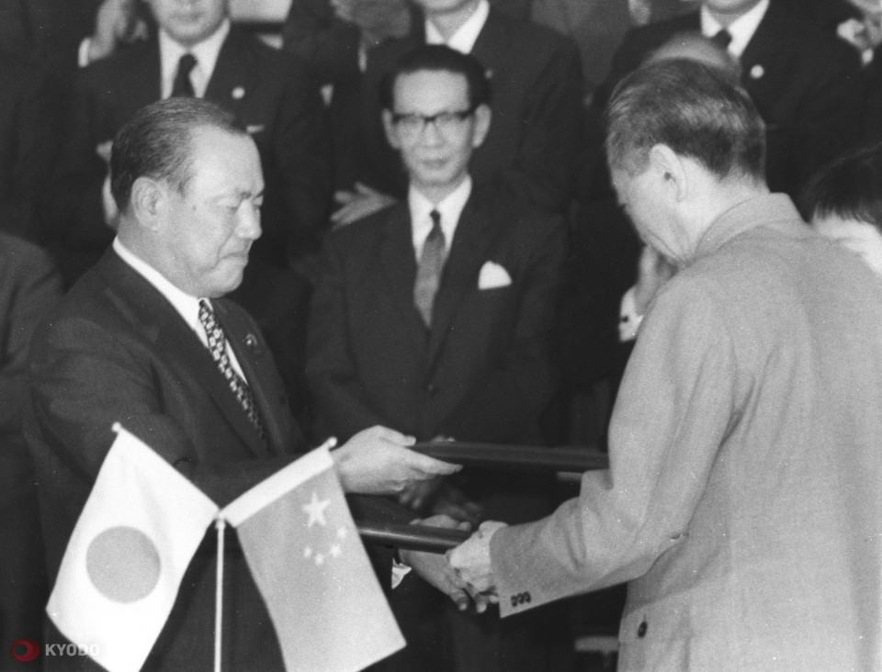
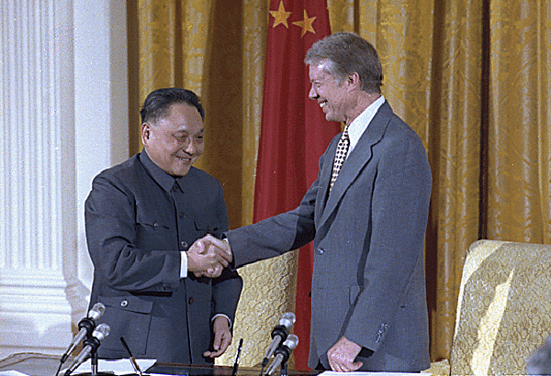
Normalization
  1972 1979
  Japan PM Tanaka Kekuei Pres. Jimmy Carter
  and Chinese Premier and Deng Xiaoping
  Zhou Enlai

