Slide 1
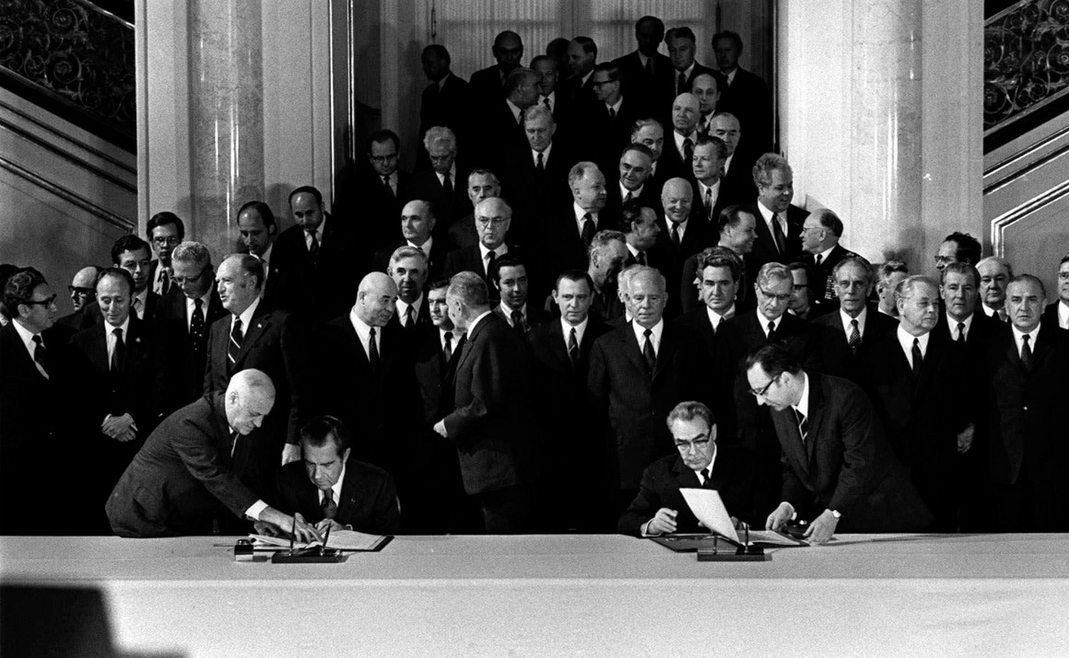
Arms Control and Stability
President Nixon and General Secretary Brezhnev Signing SALT I in Moscow, May 26, 1972

Slide 2
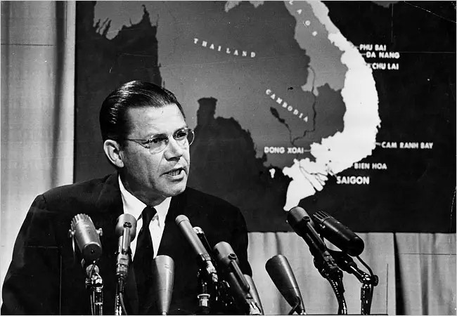
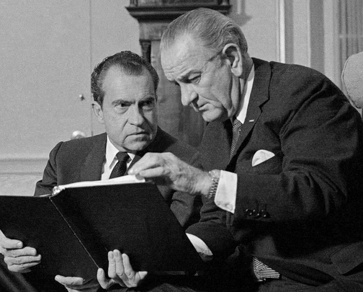
Arms Race
Action-Reaction Phenomenon
SecDef Robert McNamara 1961-1968
N Nixon and Johnson

Slide 3
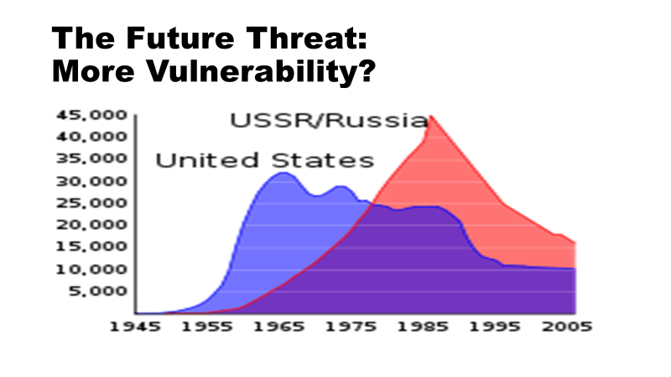
Arms Control Goals
Arms Race Stability
Management of the arms race
Cut costs
Increase predictability
Increase transparency
No “Breakout”
“Essential equivalence”
Allow modernization
Maintain deterrence

Slide 4
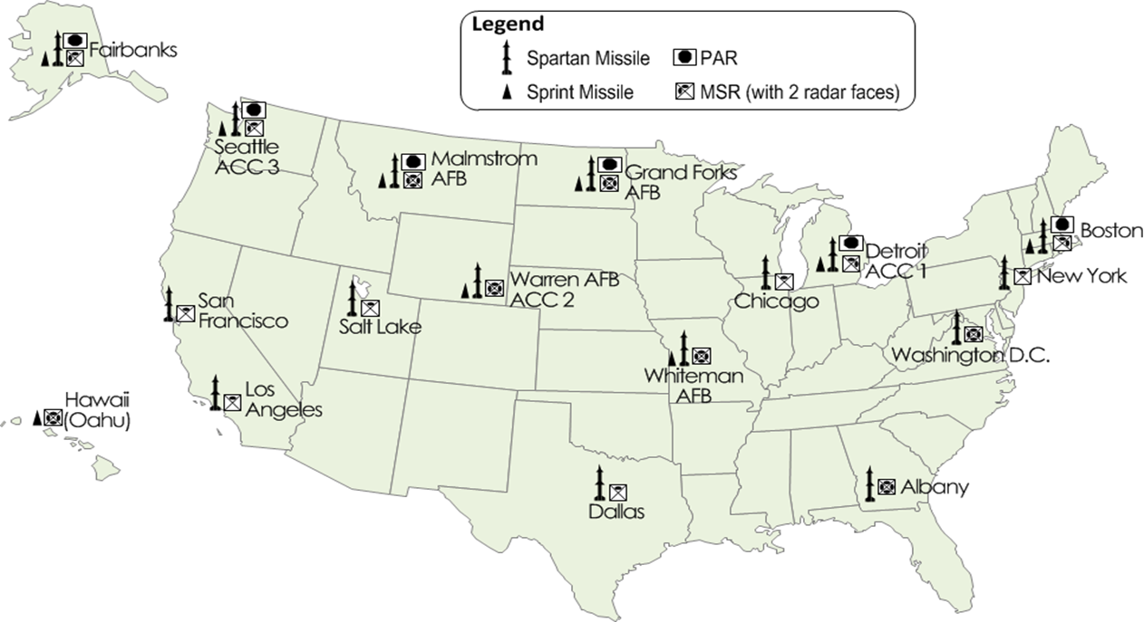
Two Arms Races by 1960s
Offense-offense
Offense-defense
LBJ Sentinel System
(proposed)

Slide 5
Stable Deterrence: Guaranteed Second Strike
Soviet First Strike
US Second strike
Scenario: Everyone Dies
US
USSR

Slide 6
Destabilizing Defenses
Soviet First Strike: Successful: USSR “wins”
Soviet ABMs
US Second strike
US
USSR

Slide 7
Strategic Arms Limitation Talks
SALT I
Interim Agreement on Offensive Arms 1972
 | US ICBMs | US RVs on ICBMs | US SLBMs | US RVs on SLBMs
1970 | 1054 | 1244 | 656 | 1552
May 1972 | 1054 | NA | 656 | NA
1980 | 1054 | 2144 | 512 | 5056
 | Soviet ICBMs | Soviet RVs on ICBMs | Soviet SLBMs | Soviet RVs on SLBMs
1970 | 1472 | 1472 | 317 | 287
May 1972 | 1607 | NA | 740 | NA
1980 | 1338 | 5362 | 990 | 1558

Slide 8
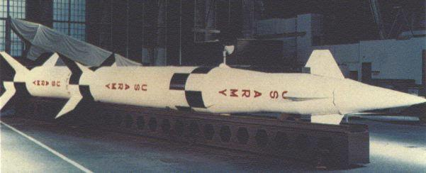
Strategic Arms Limitation Talks
SALT I
ABM Treaty 1972
US Spartan
Missile

Slide 9
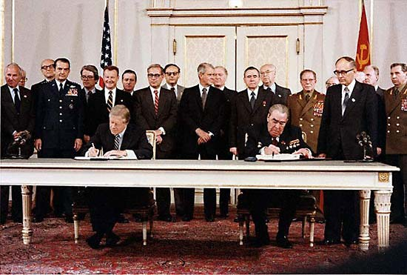
Strategic Arms Limitation Talks
SALT II Agreement 1979
Pres Carter and
Brezhnev signing
SALT II

Slide 10
Buildup then End of the Cold War

Slide 11
End of the Cold War
Strategic Arms Reduction Treaty (START) I 1991
START II 1993
 | US ICBMs | US RVs on ICBMs | US SLBMs | US RVs on SLBMs
 | Soviet ICBMs | Soviet RVs on ICBMs | Soviet SLBMs | Soviet RVs on SLBMs
1990 | 1000 | 2440 | 608 | 5312
2000 | 550 | 2000 | 432 | 3456
1990 | 1297 | 6857 | 908 | 2900
2000 | 756 | 3540 | 348 | 1576

