Slide 1
Watergate

Slide 2
Watergate Scandal
Comparison to other scandals
Lessons
Character Matters
Staff loyalty is double-edged sword

Slide 3
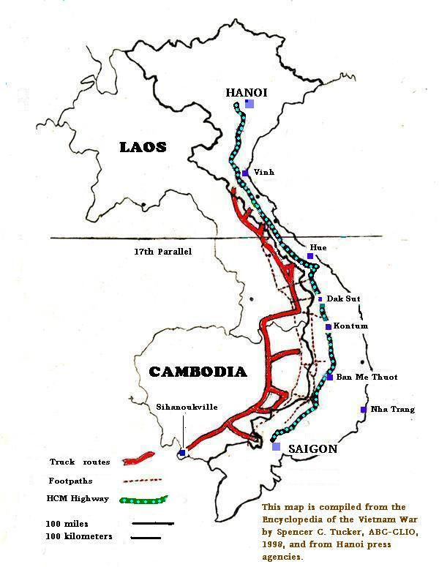
US Bombing of Cambodia 1969

Slide 4
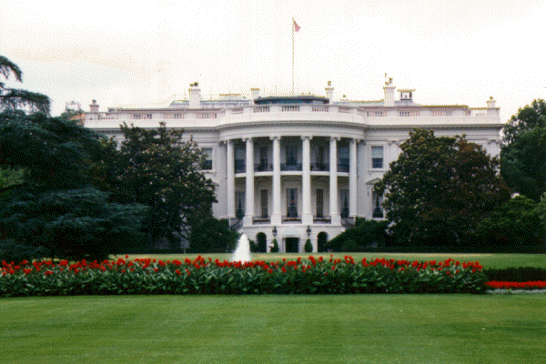
The Connection
Plumbers
Committee to
Re-Elect the
President
(CREP)

Slide 5
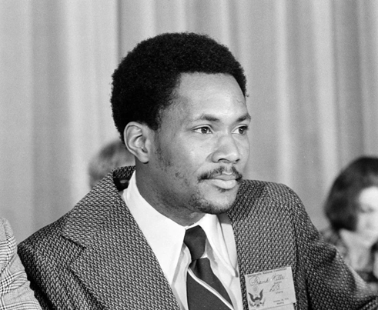
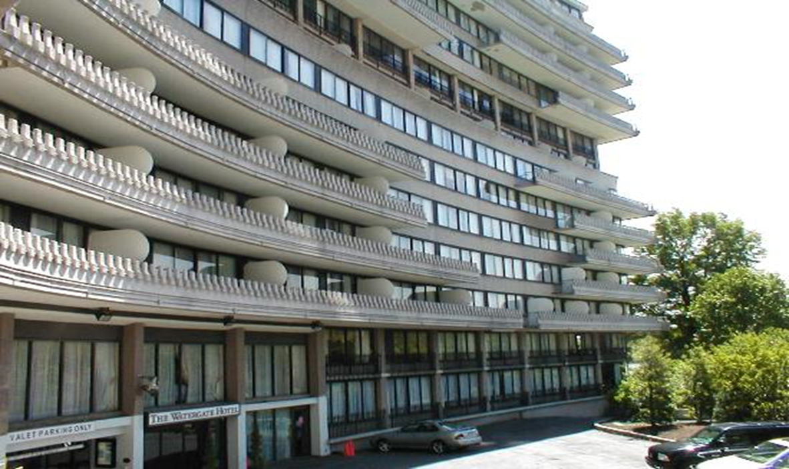
Watergate Hotel
Frank Wills
Security Guard

Slide 6
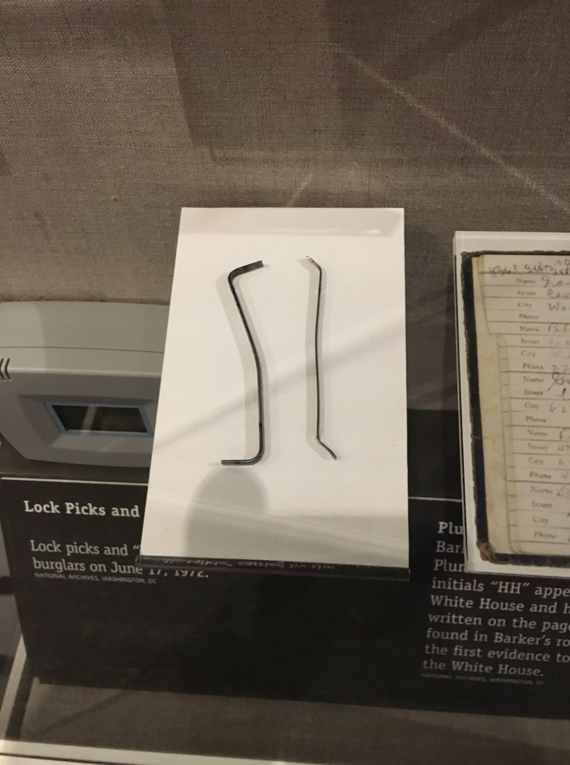
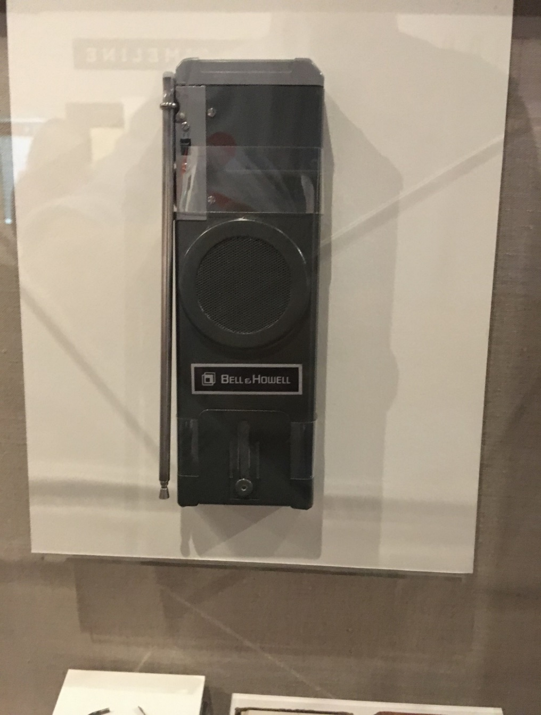
Burglar’s Equipment (from Nixon Library)
Lock Pick Walkie Talkie

Slide 7
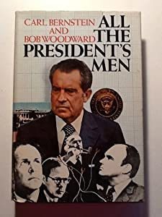
Bob Woodward and Carl Bernstein Washington Post

Slide 8
Investigations (Know this)
Legislative Branch: House and Senate Committees
Judicial Branch: Grand Jury
Executive Branch: Justice Department

Slide 9
Investigations: Legislative Branch (Reference)
Senate Select Committee on
Presidential Campaign Activities
Sen. Howard Baker (R-TN), Sen. Sam Ervin (D-NC)
House Judiciary Committee

Slide 10
Judicial Branch (reference)
Grand Jury
Judge John Sirica
US District Court
for Washington DC

Slide 11
One of the WH
Tape Recorders

Slide 12
Executive Branch Special Prosecutor (Justice Dept.) (Know this)
Special Prosecutor
Archibald Cox
5/18/73 --10/20/73
White House
Tape Recorder

Slide 13
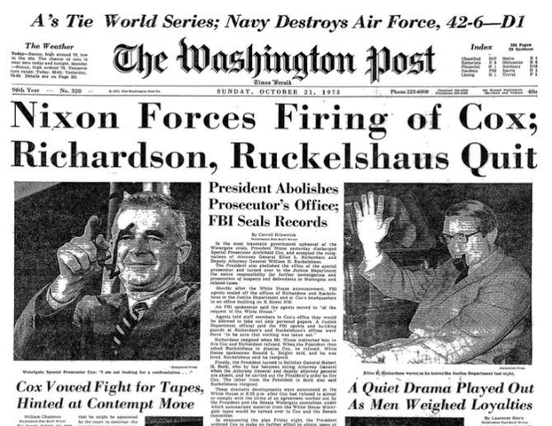
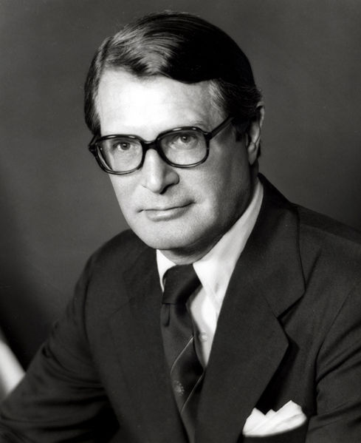
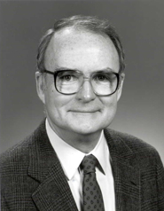
Saturday Night Massacre October 20, 1973
Elliott William
Richardson Ruckelshaus
Atty. General Dep. AG

Slide 14
Aftermath of Saturday Night Massacre
Cox Fired by new Acting AG Robert Bork
House begins impeachment proceedings
New Special Prosecutor Appointed:
Leon Jaworski: I want the tapes

Slide 15
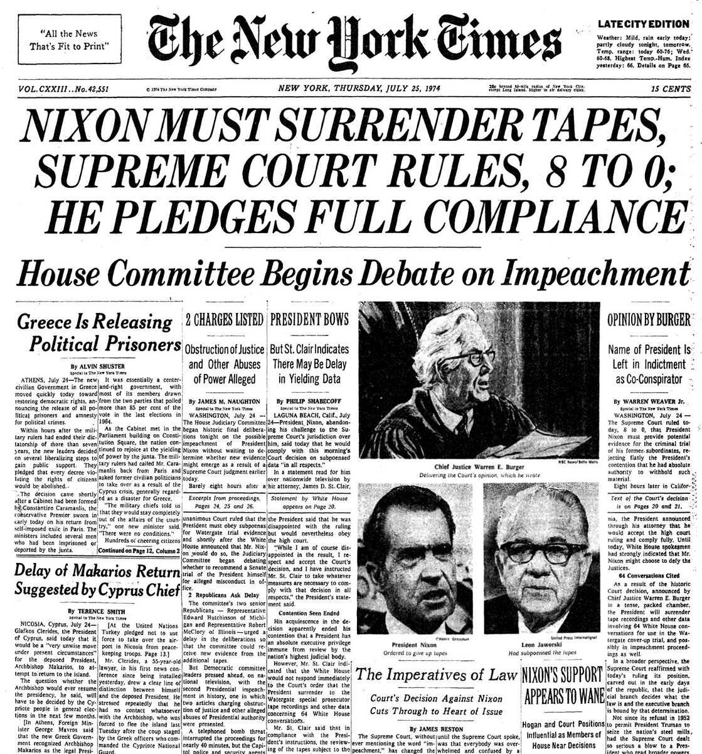
The Fate of the Tapes
US Supreme Court Ruling
US v. Nixon
From Washington Post
The “Smoking Gun” Tape
Nixontapes.org:
Source for Nixon tapes on
every subject

Slide 16
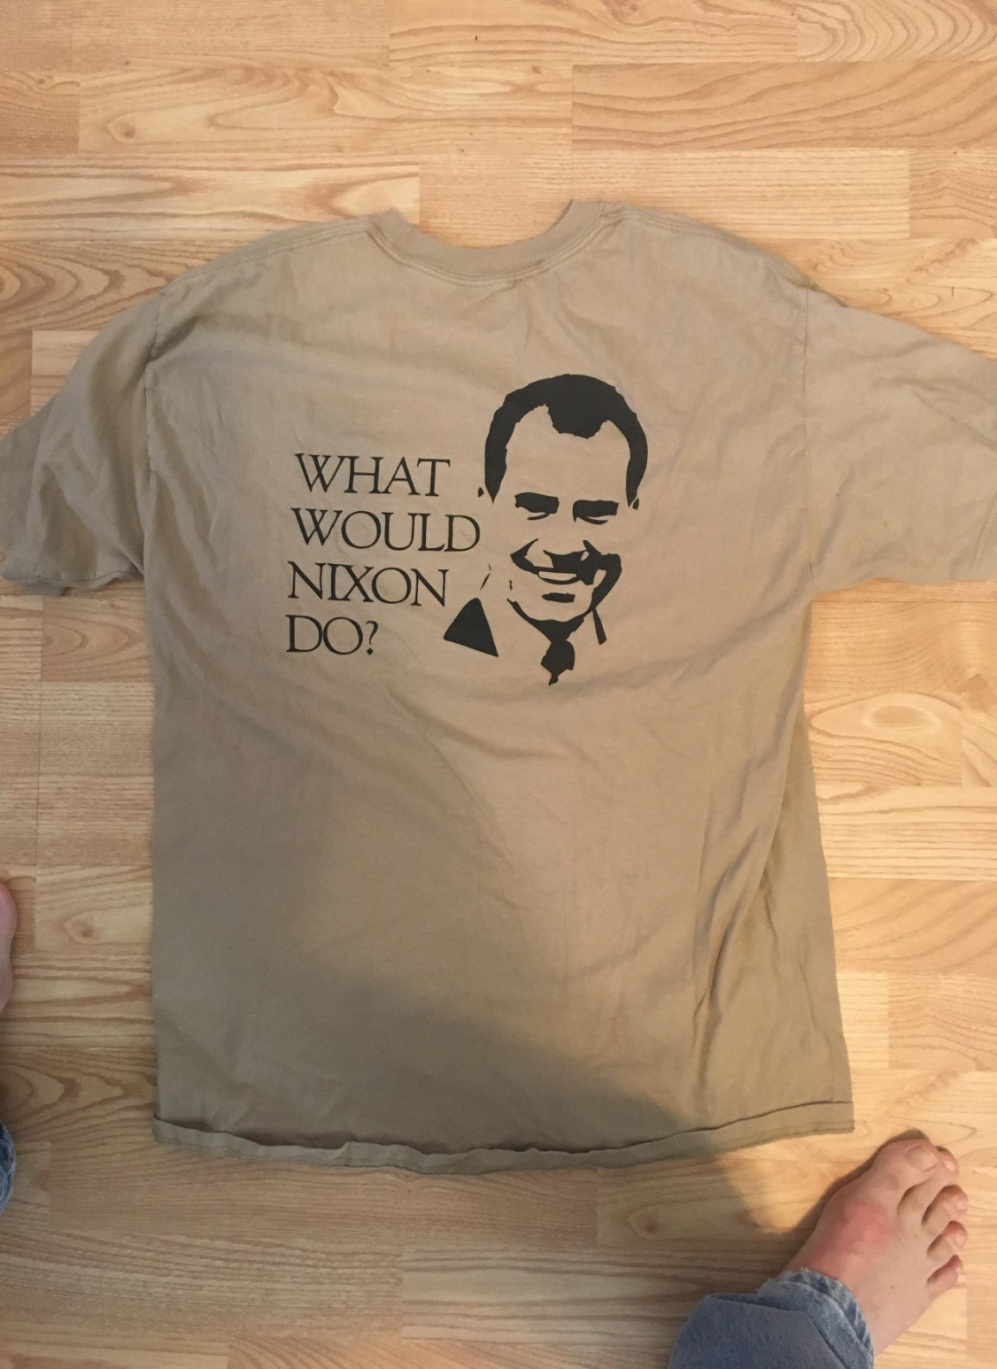
Unfortunate Campaign Slogans

Slide 17
Impeachment: House of Representatives
US Constitution
Article I, Section 2, Clause 5: ”The House of Representatives shall chuse their Speaker and other Officers; and shall have the sole Power of Impeachment.”

Slide 18
Impeachment: US Senate
US Constitution
Article 1, Section 3, Clause 6: “The Senate shall have the sole Power to try all Impeachments. When sitting for that Purpose, they shall be on Oath or Affirmation. When the President of the United States is tried, the Chief Justice shall preside: And no Person shall be convicted without the Concurrence of two thirds of the Members present.”
Article 1, Section 3, Clause 7: “Judgment in Cases of impeachment shall not extend further than to removal from Office, and disqualification to hold and enjoy any Office of honor, Trust or Profit under the United States: but the Party convicted shall nevertheless be liable and subject to Indictment, Trial, Judgment and Punishment, according to Law.”

Slide 19
Standard for Impeachment and Removal
US Constitution
Article 2, Section 4: “The President, Vice President and all civil Officers of the United States, shall be removed from Office on Impeachment for, and Conviction of, Treason, Bribery, or other high Crimes and Misdemeanors.”

Slide 20
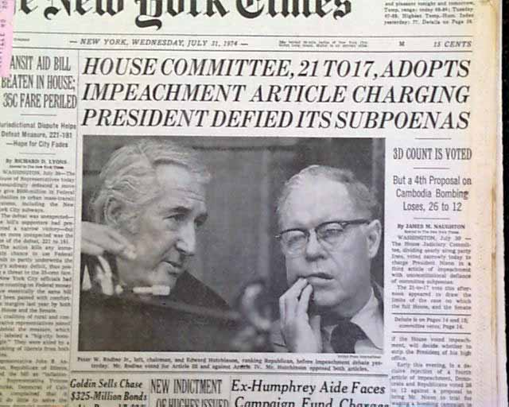
Impeachment of Nixon Begins
Articles of Impeachment
Obstruction of Justice
Abuse of Power
Contempt of Congress
House Judiciary Committee
Impeachment Hearings
Gerald Ford Library
Watergate Info

Slide 21
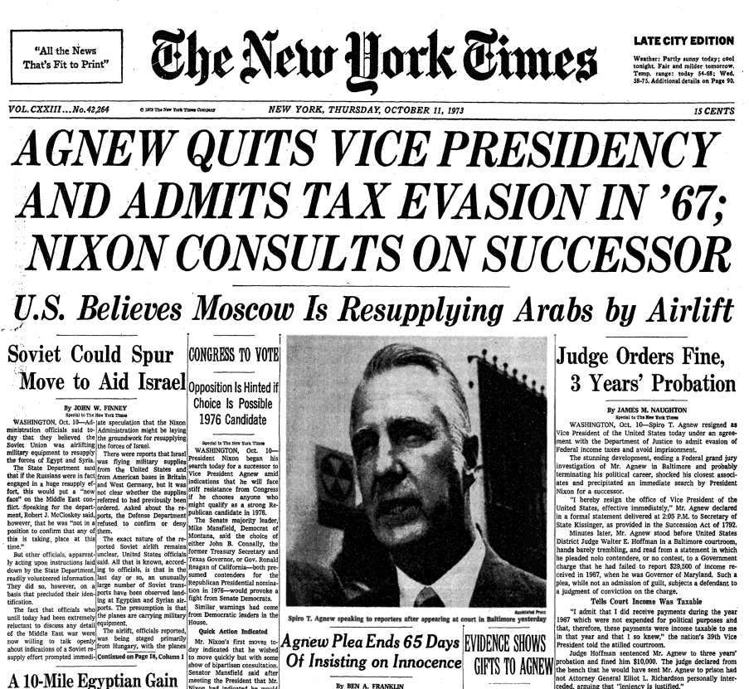
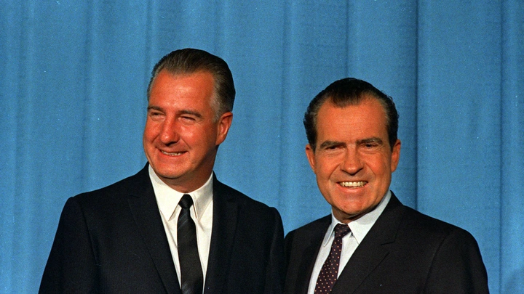
Vice President Spiro Agnew
October 10, 1973
Agnew Resignation

Slide 22
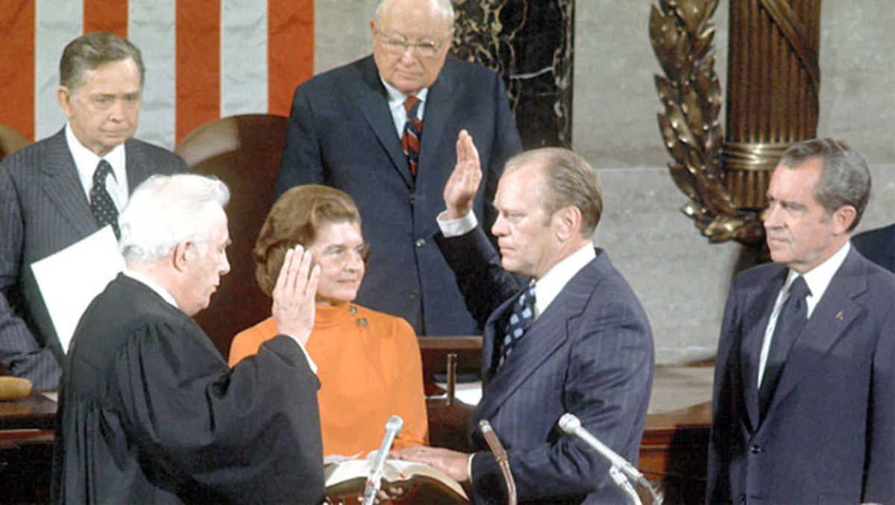
New Vice President Gerald Ford December 6, 1973
25th Amendment
Passed by Congress July 6, 1965
States ratify by February 10, 1967
LBJ February 23, 1967
Ford Process
Appointed by Nixon 10/12/73
Approved by Senate 11/27/73
Approved by House 12/6/73

Slide 23
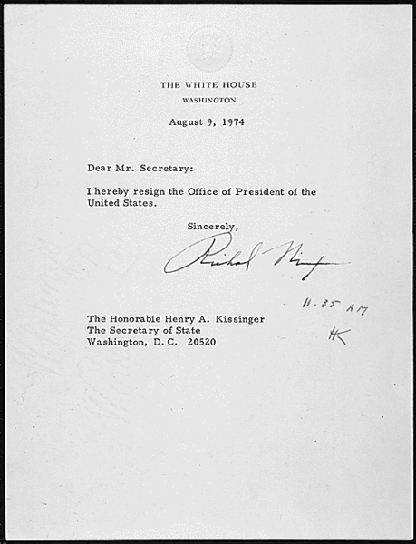
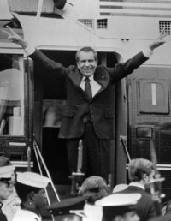
The Fate of Nixon
Resignation speech 8/8/74

Slide 24
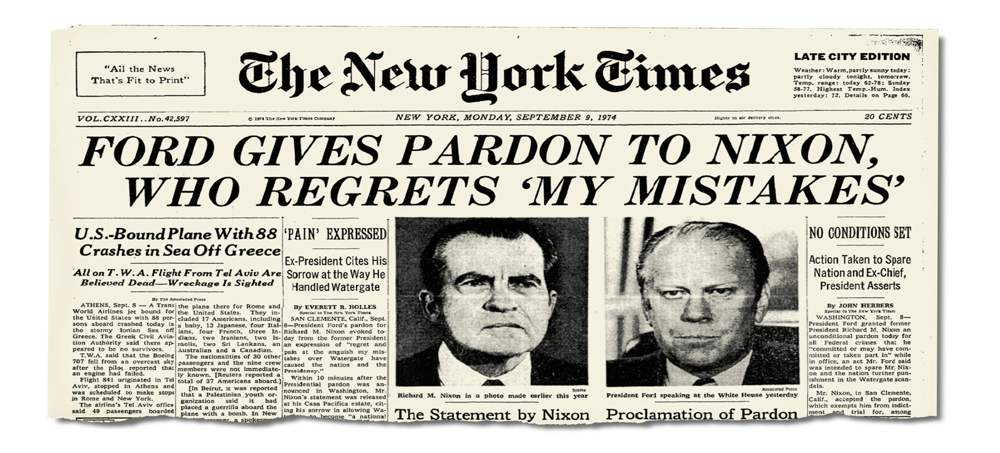
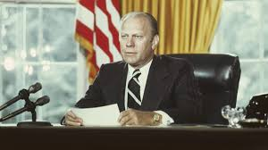
Ford Pardons Nixon
Video of Ford Pardon Speech
September 8, 1974

Slide 25
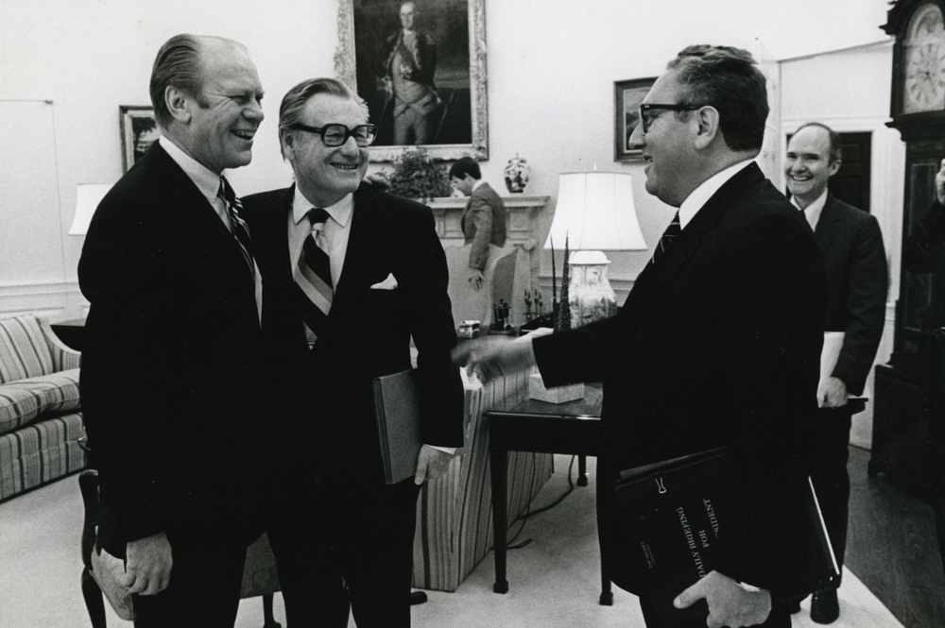
President Gerald Ford August 9, 1974
(left to right): Ford, VP Nelson Rockefeller; Sec. of State Kissinger;
National Security Advisor Brent Scowcroft

