Slide 1
Trump

Slide 2
2016 Election

Slide 3
2016 Election by County

Slide 4
2016 By the Numbers
Candidate | Popular Vote
Donald Trump | 62,980,160
Hillary Clinton | 65,845,063
Gary Johnson | 4,488,931
Jill Stein | 1,457,050
Evan McMullen | 728,830

Slide 5
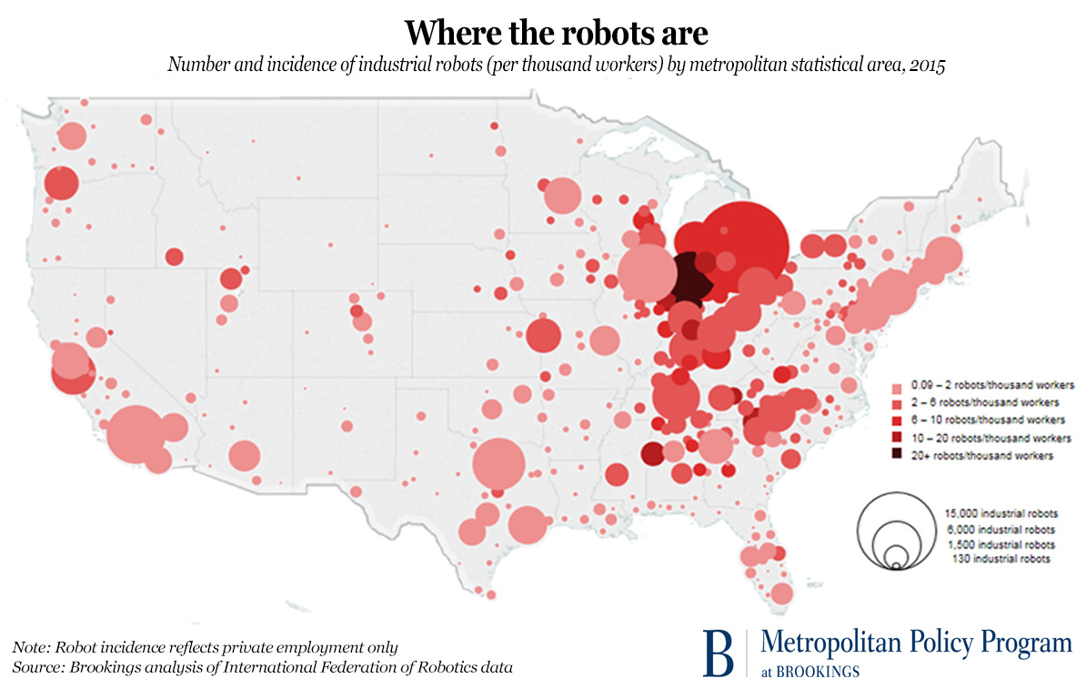
States that Voted for Obama and Trump
Florida
Michigan
Iowa
Ohio
Pennsylvania
Wisconsin

Slide 6
2016 Coalitions?
Trump Coalition
Obama/Clinton Coalition
Non-white Women
New England
West Coast
College-Educated
African-Americans
Latino-American
Asian-Americans
Non-College-Educated White Men
White Southerners
Blue Collar in North and Midwest
Union and non-union
Anti-free trade
Anti-intervention/nation-building
Evangelicals
Conservative nationalists
(white/Christian)
Rural/anti-elite
Tea Party

Slide 7
The Meaning of Trump
Anti-Establishment
Anti-Globalization
Three Billion New Capitalists – competition
Decline of Traditional US Manufacturing
US Education problems
Polarization
Republican Party Crisis
Demagoguery out of control
Conspiracy Theories
Social media and bullying
White Nationalism?

Slide 8
Precedents
Popular vote winner does not win electoral college (1824, 1976, 1888, 2000)
No previous governmental/military experience
Facing over 70 lawsuits
TV celebrity
Use of social media

Slide 9
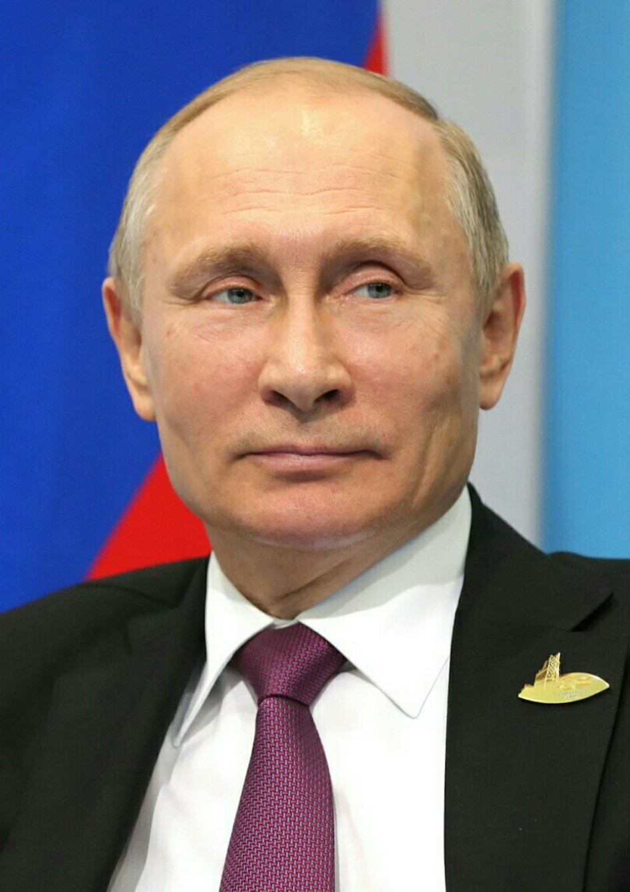
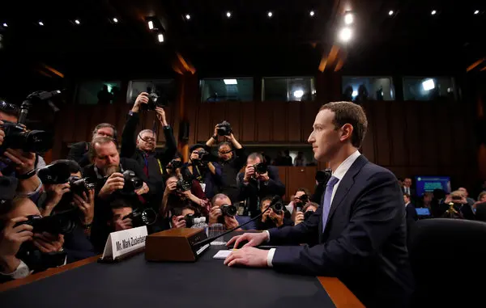
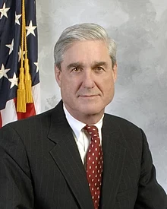
Social Media, Disinformation, and Russia
Russian Disinformation
Director of National Intelligence Report, January 2017
House Intelligence Committee Report, March 2018
Putin Facebook CEO Zuckerberg Special Counsel Robert Mueller

Slide 10
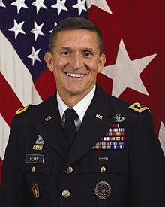
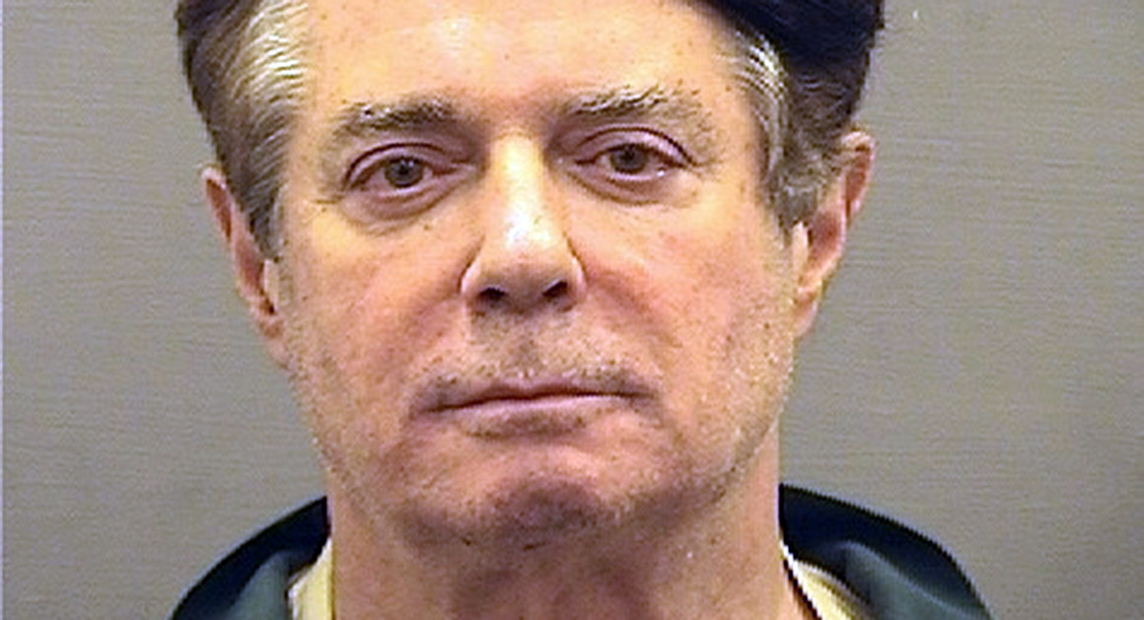
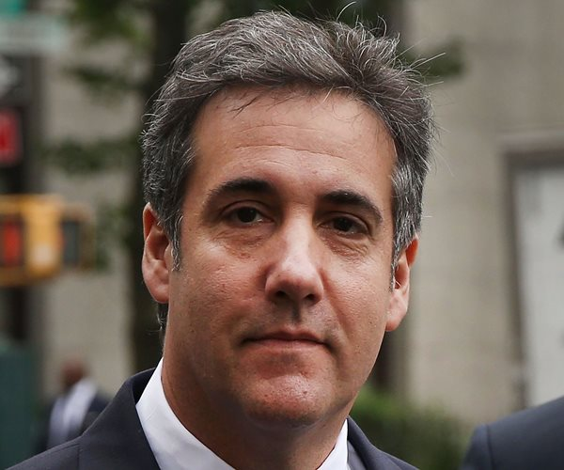
Convicted of Crimes Related to Russia Connections
Michael Flynn Paul Manafort Michael Cohen
National Security Campaign Manager Personal Lawyer
Adviser

Slide 11
The Big Question
Democratic National Committee Hacked
Guccifer 2.0 and others working for Russian Intelligence
Wikileaks Releases Emails from Campaign
Trump Campaign?

Slide 12
Big, Big, Big Picture: Civilization Timeline (all dates estimations)
Hunting-Gathering
195,000 – 10,000 BC
Agricultural
Revolution
~10,000 BC
Industrial
Revolution
~1750/60 Computer Revolution
1930-40s, 1980s, 1995
You are here

Slide 13
Computer Revolution (1930s-40s, 1970s, 1990s) (for reference only)
Computers and Globalization
Computing Power
Ease of travel
Ease of global finance
Communications
Ability to communicate instantly
Ability to communicate globally
Information
Ability to share large amounts of
information with anyone, anywhere
Global spread of technology

Slide 14
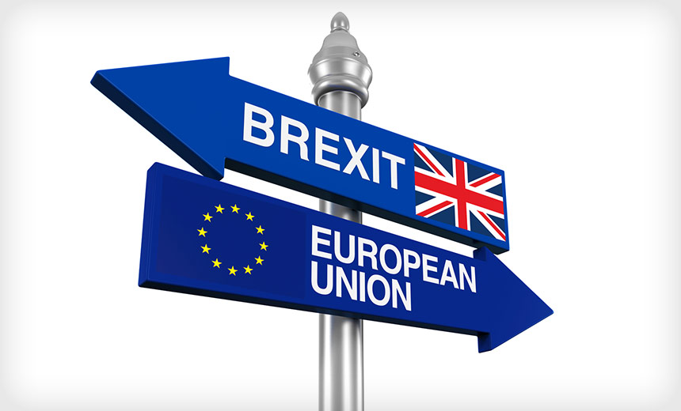
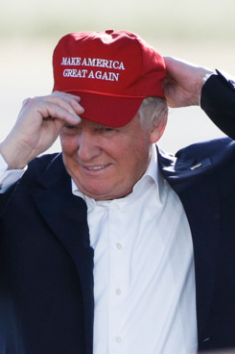
Implications For Industrialized Nations (at least)
Shift from Older industrial Decline in
Industrial era Economies Traditional
To Digital era Reluctance/Inability Industrial Sectors
To Change (mining or manufacturing)
Established Parties
Offer Nothing New
Rejection Birth of New of Established Parties
Policy Consensus or New Movements
within Established Parties

Slide 15
Populist Nationalism: A Global Phenomenon
To Establish Authority
To Delegitimize Opponents
Personalistic Rule
Conspiracy Theories
“Alternative Facts”
Attacks on the Press
Attacks on Institutions
Scapegoating
Trolling of Critics/Rivals
Encouraging Violence against Press and Political Opponents
Calls for Jailing Political Opponents
Declaration of Fraud at Elections that Don’t Go as Planned

Slide 16
To Establish Authority
Only the leader can be trusted
Only the leader can provide truth
All other sources of information are “fake news” from individuals with bad or even evil intent
All others are against you

Slide 17
1. Personalistic Rule

Slide 18
2. Conspiracy Theories
Birth Certificate (Not true)
“Obama created ISIS” (Not true)
Massive electoral fraud gave Clinton popular vote (no significant fraud found by any state)
George Soros paid for the 2018 “caravan” (nope)
Senator Ted Cruz father involved in JFK assassination (not true)
Missing server (nope)

Slide 19
3. “Alternative Facts” PolitiFact Tracking of Trump Statements
Largest inauguration crowds in history (No)
One of the biggest electoral victories in history
(No: Reality: 46th of 58)
Massive illegal immigration of 30-40 million annually
(actually at a 40 year low in 2016)
Cheering Crowds in Jersey City on 9/11 (No)

Slide 20
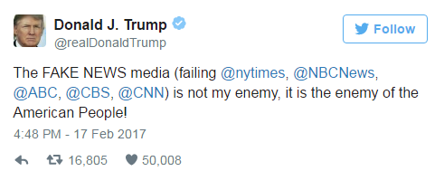
4. Attacks on the Press
“pathetic” “disgraceful” “sick”
Vs. Jeff Bezos, owner of Washington Post and Amazon
Encouraging violence and harassment of reporters

Slide 21
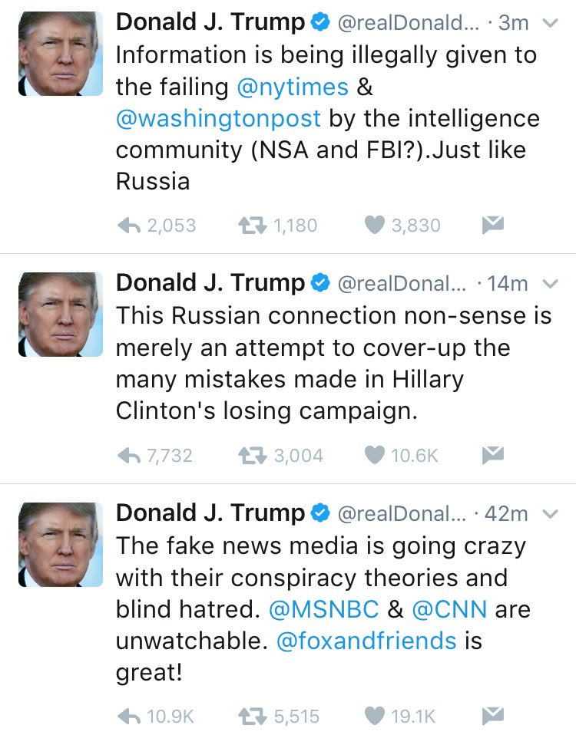
5. Attacks on Institutions: Trump vs The Intelligence Community
Notes:
One of the other characteristics of this populist nationalism is to discredit any societal institutions that challenge your authority or your version of events. The US Intelligence Community (IC) concluded that Russia had interfered in the 2016 election. Trump has repeatedly downplayed these conclusions and has directly challenged them, once even saying that no one really knows who hacked into the Democratic National Committee computers. He suggested it could be some kid in the basement of his parent’s house. But the US IC was very clear. It was the Russian government and people on its payroll and President Putin had a direct role in ordering it. The picture above is from a July 2018 summit. Trump was asked about Russian interference in the election. He said that Putin denied Russian involvement and that Trump believed him. Here was an instance where a US President was saying he believed the word of a foreign leader of an authoritarian state over his own intelligence agencies. That is unprecedented. Trump also answered the question by accusing the FBI of covering up crimes of Hillary Clinton. One of the conspiracy theories is that there was a server at Democratic headquarters that had been destroyed to prevent the FBI from seizing it. That never happened. The Democratic National Committee (DNC) had its hacked server investigated by a private company before the FBI asked for it. When the FBI asked for it, the DNC gave the forensic report to the FBI. The FBI thought the investigation was a good job and used that company’s report in its investigation. We can question why the FBI used the private report (probably because the job was done well and because it saved the FBI money by not duplicating the report), but there simply isn’t any other server or missing server.

Slide 22
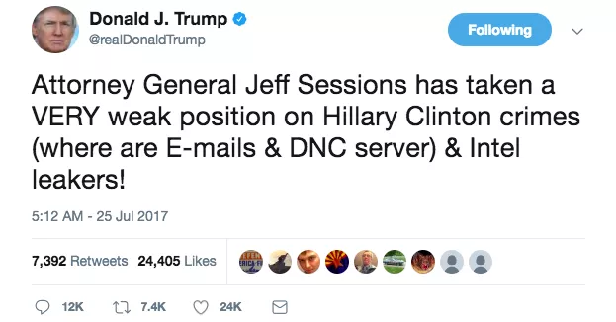
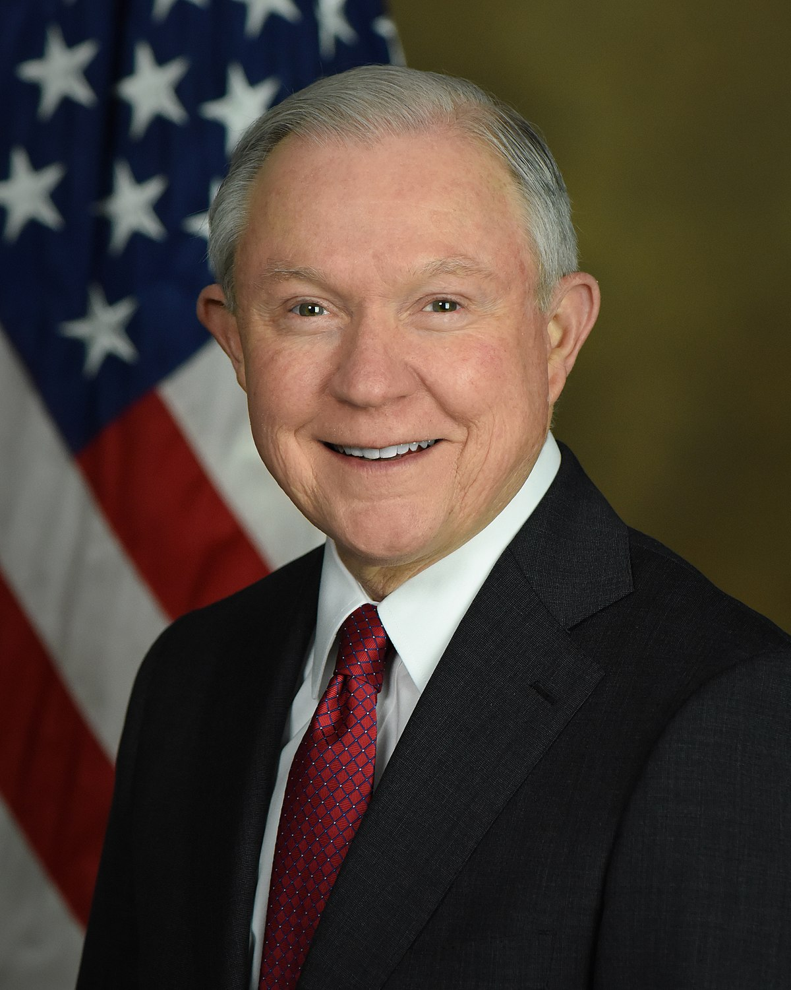
5. Attacks on Institutions: Trump vs. The Justice Department
Attorney General
Jeff Sessions, 2017-2018
Notes:
Another example is Trump’s attacks on his own Justice Department. Robert Mueller the Special Counsel was appointed by Rod Rosenstein, the Deputy Attorney General. Attorney General Jeff Sessions recused himself from the investigations into the Trump campaign because he was part of the Trump campaign. Recusal means that he declined to be involved in the investigations; he did so because of a potential conflict of interest. That recusal is a standard practice that all good lawyers (like Sessions) know they have to do in potential conflict of interest cases. Trump has used Twitter to essentially troll both Sessions and Rosenstein over the Mueller investigation. These attacks on members of his own administration, people that Trump appointed, are also unprecedented. Sessions was fired the day after the November midterm elections. Trump actually said that he fired Sessions because of the Russia investigation and that he did not do it before the election because he didn’t want it to be a political issue. Wow.

Slide 23
To Delegitimize Enemies
Political opponents of the leader are liars, cheat, criminals
No criticism is legitimate
Political opponents are bad actors
Paranoia as Policy
We are under siege

Slide 24
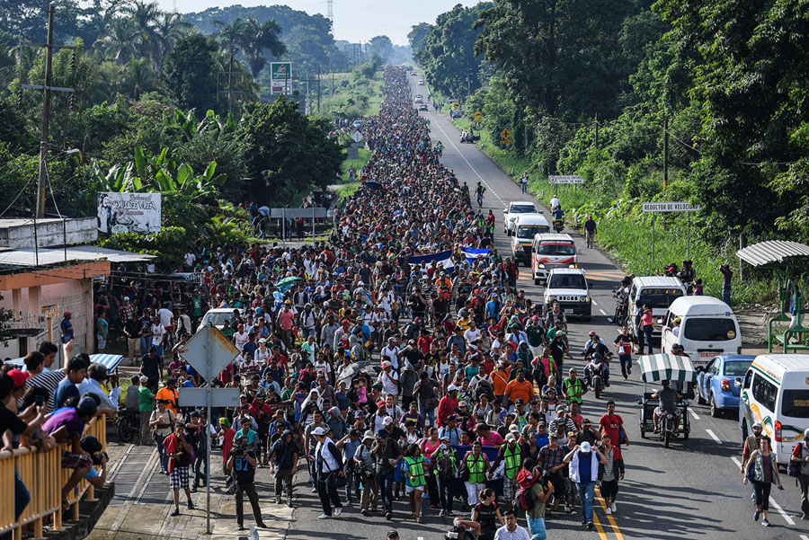
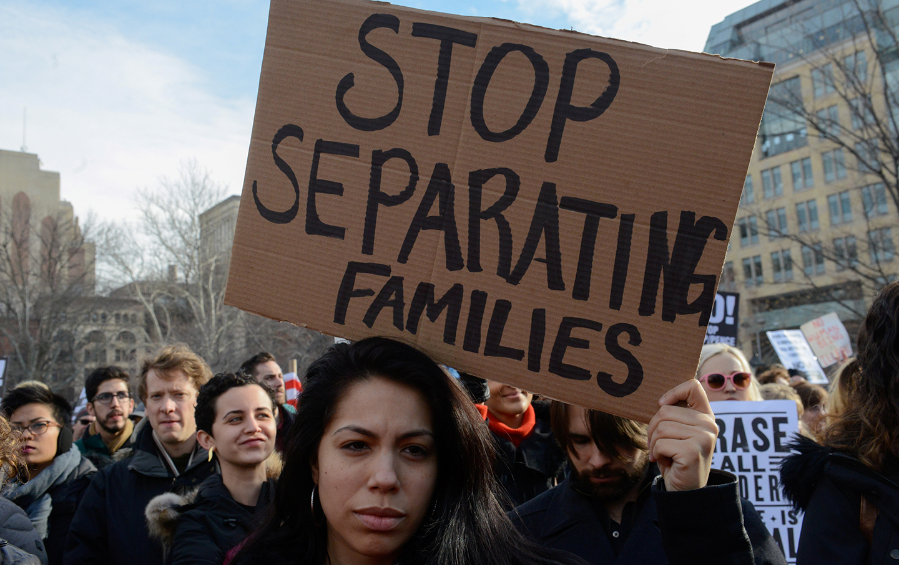
1. Scapegoating
Muslim immigrants
Central and Latin American Immigrants

Slide 25
2. Trolling of Critics or Rivals Compendium of Trump Twitter Insults
Robert Mueller
George Will (conservative Columnist)
“highly conflicted”
“highly conflicted”
“highly conflicted (and NOT Senate approved)”
“Why is he protecting Crooked Hillary, Comey, McCabe, Lisa Page & her lover, Peter S, and all of his friends on the other side?”
“Highly conflicted”
“Highly conflicted”
“Disgraced and discredited”
“just someone looking for trouble”
“heavily conflicted”
“heavily conflicted”
“totally conflicted”
“only appointing Angry Dems”
“Comey’s best friend”
“most conflicted of all”
“one of the most overrated political pundits”
“lost his way long ago”
“made many bad calls”
“deadpan”
“BORING”
“dopey”
“broken down political pundit”
“wrong almost all of the time”
“broken down”
“boring and totally biased”
“should be thrown off Fox News”
“wrong on so many subjects”

Slide 26
3. Encouraging Violence against Press and Political Opponents

Slide 27
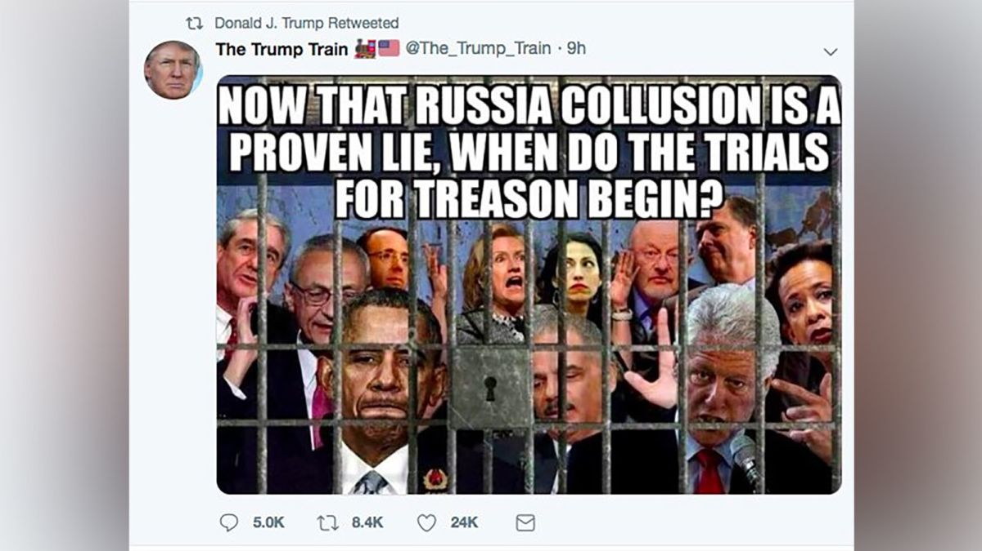
4. Calls for Jailing Political Opponents

Slide 28
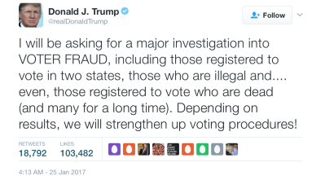
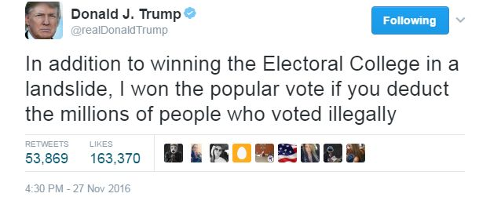
5. Declaration of Fraud at Elections that Don’t Go as Planned

Slide 29
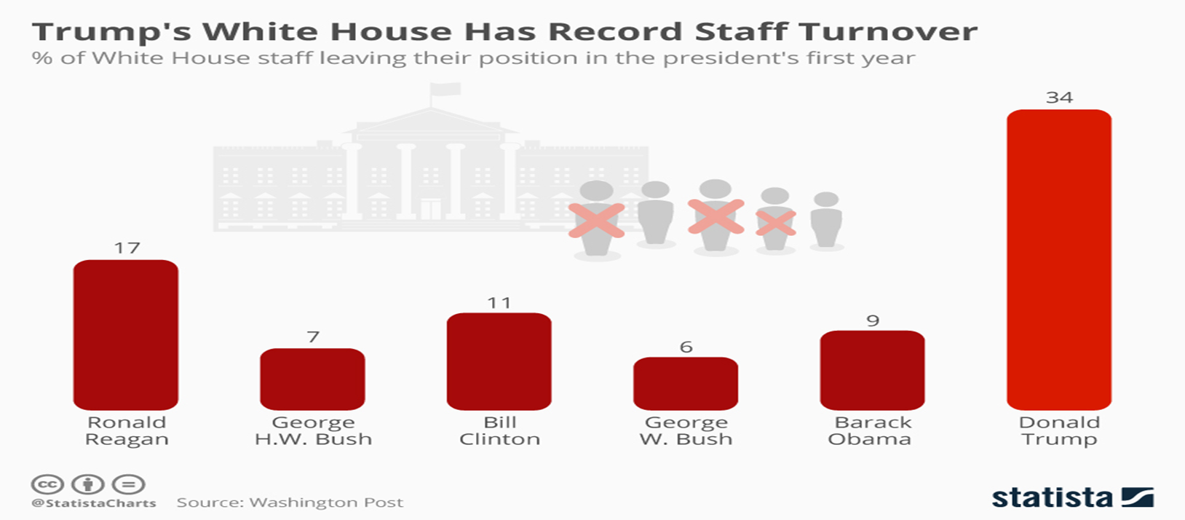
Administrative Problems
Turnover
No Nomination

