Slide 1
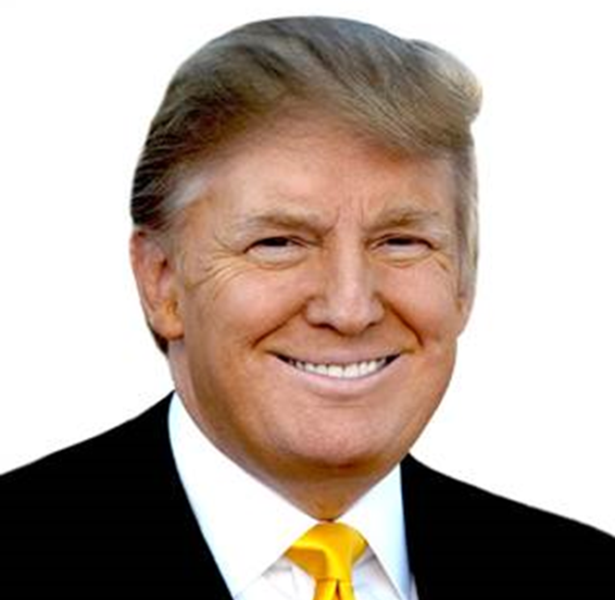
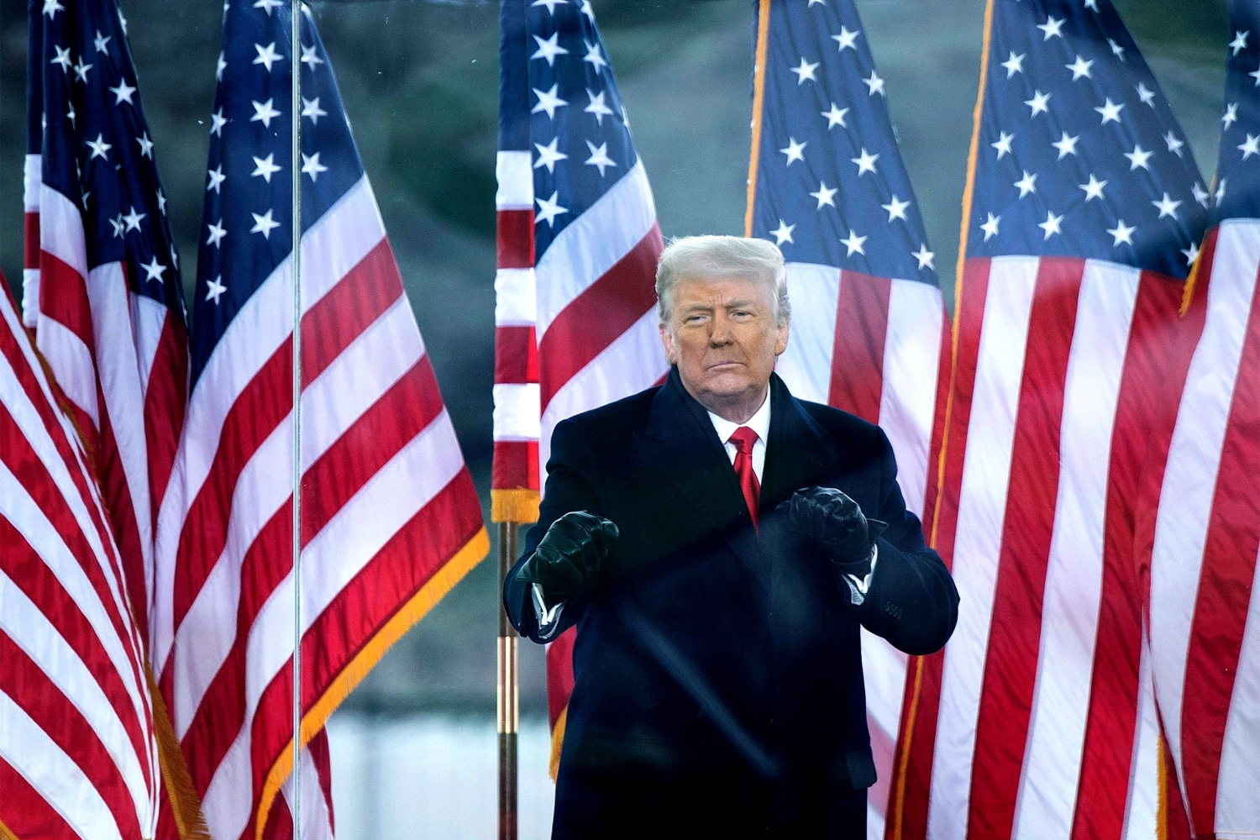
Trump

Slide 2
The Crisis in US Democracy Is Trump the demagogue the founders feared?
“…it has been fully confirmed by experience that they are daily misled into the most baneful measures and opinions by the false reports circulated by designing men, and which no one on the spot can refute.” ~Elbridge Gerry, May 31, 1787
The Records of the Federal Convention of 1787, ed. Max Farrand (New Haven: Yale University Press, 1911). Vol. 1.
https://oll.libertyfund.org/title/farrand-the-records-of-the-federal-convention-of-1787-vol-1#Farrand_0544-01_457

Slide 3
“…of those men who have overturned the liberties of republics, the greatest number have begun their career by paying an obsequious court to the people; commencing demagogues, and ending tyrants.”
Hamilton, Federalist No. 1
Avalon Project, https://avalon.law.yale.edu/18th_century/fed01.asp

Slide 4
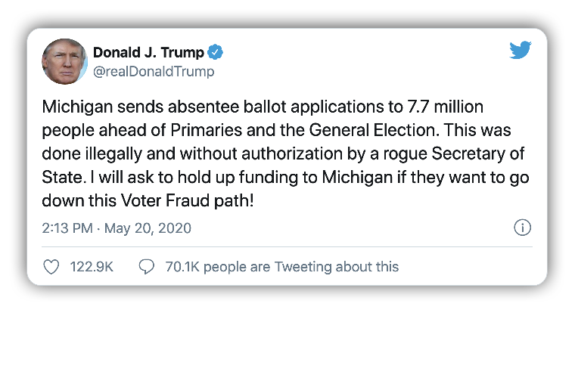
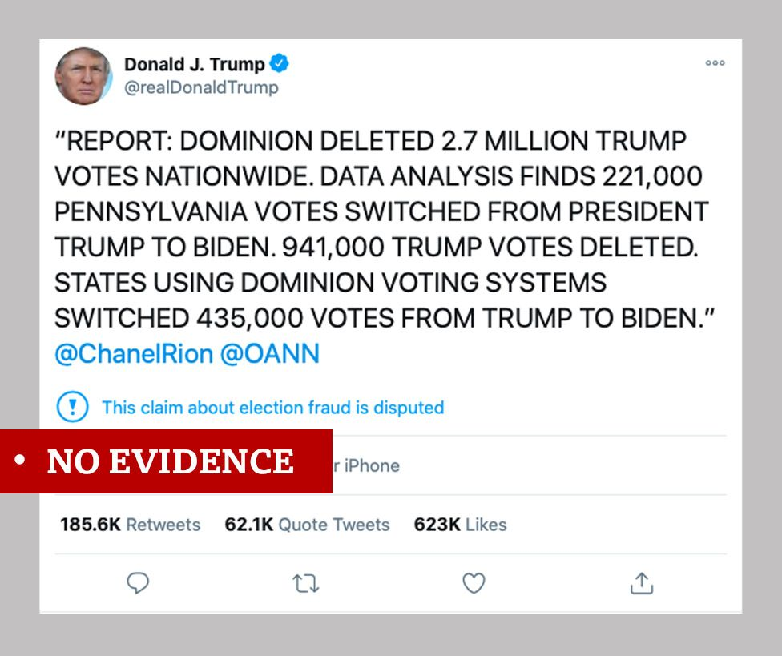
The Big Lie Information on Investigations, Court Cases…

Slide 5
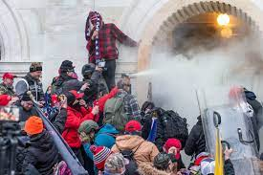
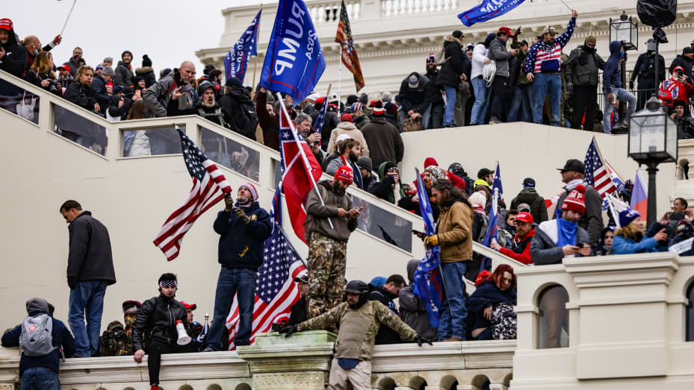
January 6, 2021 (about 650 arrests as of November 2021)

Slide 6
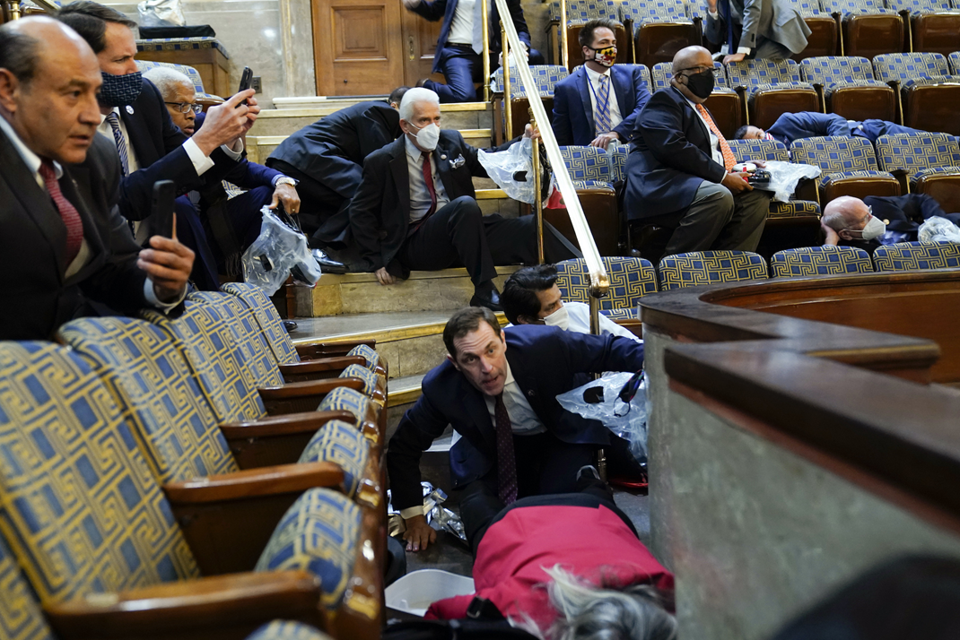
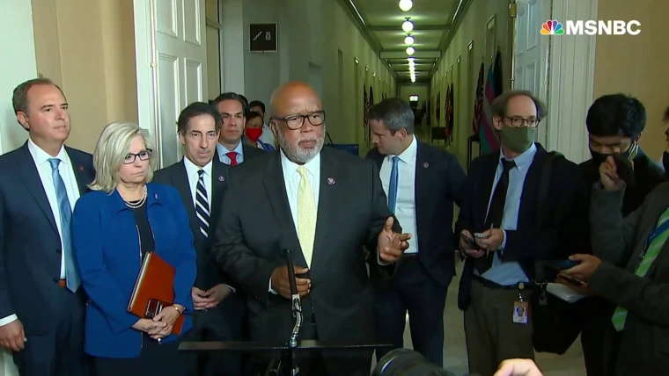
House Select Committee to Investigate the Attack on January 6
Chair Bennie Thompson (D-MS)
Vice Chair Lynne Cheney (R-WY)

Slide 7
What Comparative Politics Tells Us…
Party or leader Followers refuse to
claims only it/he accept opposition elected
can be trusted officials, reject facts;
(discredits independent news) only have faith and loyalty to leader
Party or leader
declares electoral Followers Followers lose
fraud where there believe the faith in electoral
is none election was system and the
stolen need for elections
Belief that since an End of free
election was stolen and fair
from them, they can elections;
justifiably steal the next one violence; collapse of
democracy

Slide 8
A Coup Attempt? (reference)
Charges of fraud before the election
Refusal to accept election results
Charges of fraud after the election
Encouraging protestors to confront Congress during electoral vote count
Meetings with President and senior officials to discuss a plan to reject election outcome/electoral votes Eastman Memo
Phone calls from the president to election officials in key states encouraging them to reject the election results or to “find more votes”
Presidential encouragement to VP to reject election outcome
Republican attempt to reject electoral votes of key states
Firing of officials who oversaw election
Firing of officials who would oversee protection of capitol building/region
Delay in sending reinforcements to capitol after rioting began
Presidential and Republican support for rioters on January 6 and after

Slide 9
Firings/Resignations After November 2020 Election (officials related to election, capital security issues) (reference)
11/9: Richard Pilger, Justice Dept. Election Crimes Division head
11/9: Secretary of Defense Mark Esper
11/10: Jen Stewart, DoD Chief of Staff
11/10: Alexis Ross, DoD Deputy Chief of Staff
11/10: Undersecretary f Defense for Intelligence and Security Joseph Kernan
11/10: Acting Undersecretary for Defense for Policy James Anderson
11/12: Asst. Secretary for Cybersecurity at CISA Bryan Ware
11/17 Chris Krebs, Director Cybersecurity and Infrastructure Security Agency
12/15: Resignation of Attorney General William Barr

Slide 10
Populist Nationalism or Neo-Authoritarianism (reference)
To Establish Authority
To Delegitimize Opponents
Personalistic Rule
Conspiracy Theories
“Alternative Facts”
Attacks on the Press
Attacks on Institutions
Identity-based nationalism (Us vs. Them)
Scapegoating
Trolling of Critics/Rivals
Encouraging Violence against Press and Political Opponents
Calls for Jailing Political Opponents
Declaration of Fraud at Elections that Don’t Go as Planned

Slide 11
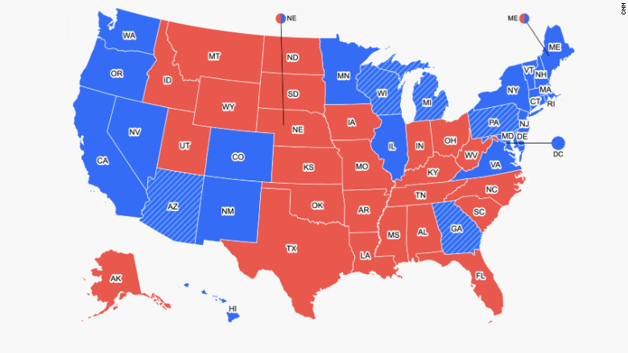
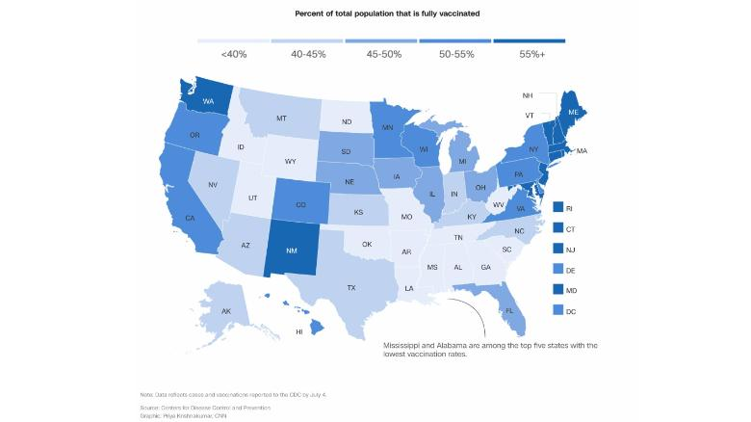
Vaccination Rates and Polarization Over 600,000 deaths and vaccines sitting in refrigerators
Electoral College 2020

Slide 12
Another Look

Slide 13
Trump
Election of 2016
Policy
Trump Style
Bigger Issues?

Slide 14
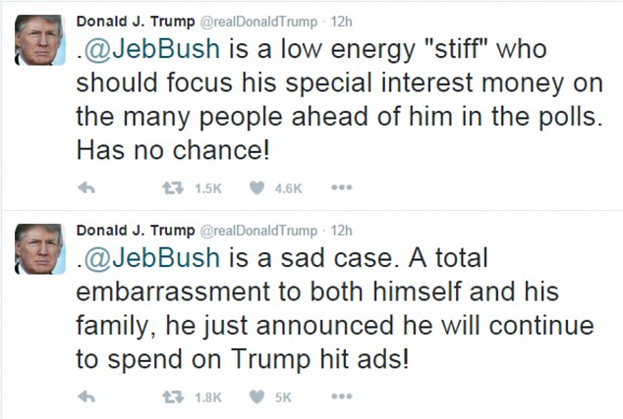
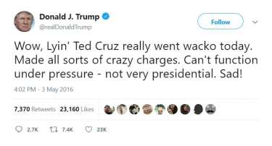
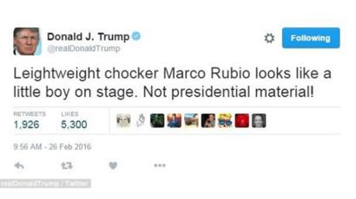
1. 2016 Election

Slide 15
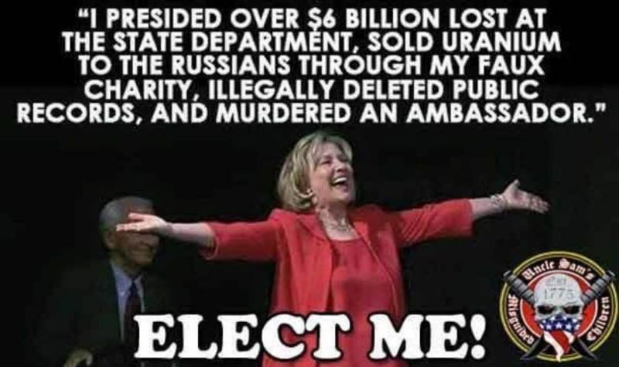
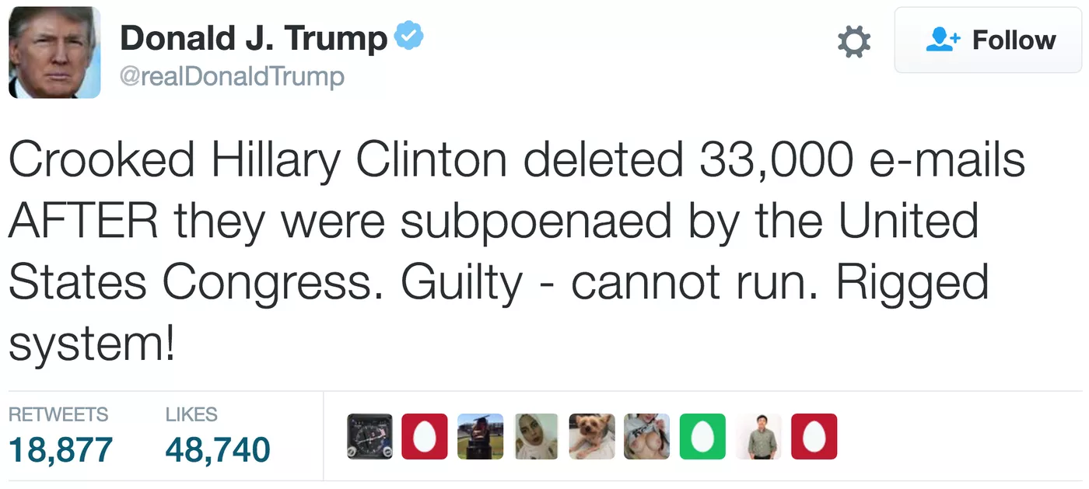
Clinton vs. Trump

Slide 16
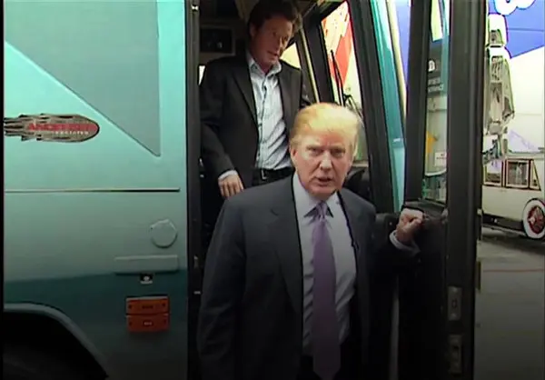
The Controversies
Access Hollywood Tape
(Trump brags about sexual assault)
Clinton Emails
(Investigated: Neither FBI nor Congress decides to take action)
Summary of the issue
State Department Inspector General Report on the Emails, May 2016
Comey Statement July 2016
Inspector General’s Report (June 2018)
The Actual Emails
Notes:
30,000 emails
110 had references to classified information
3 emails had classified information in them
All sent by other people to Clinton

Slide 17
2016 Election

Slide 18
2016 Election by County

Slide 19
2016 By the Numbers
Candidate | Popular Vote
Donald Trump | 62,980,160
Hillary Clinton | 65,845,063
Gary Johnson | 4,488,931
Jill Stein | 1,457,050
Evan McMullen | 728,830

Slide 20
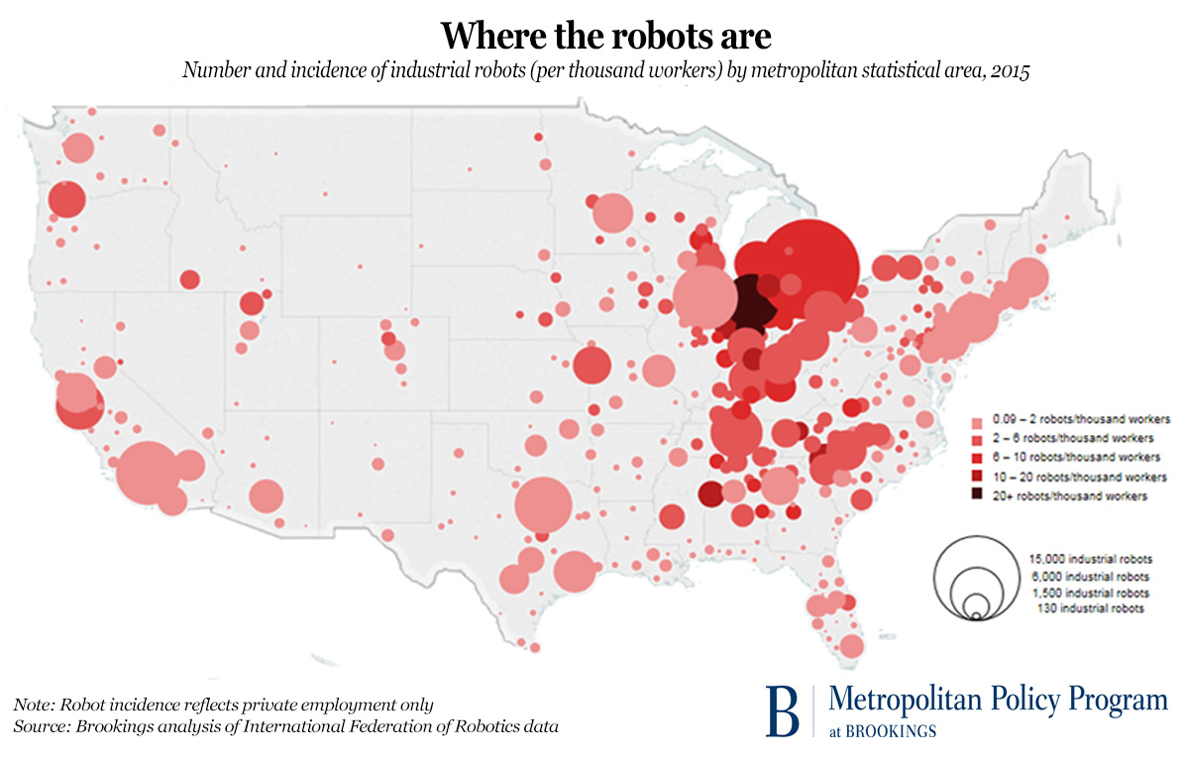
States that Voted for Obama and Trump
Florida
Michigan
Iowa
Ohio
Pennsylvania
Wisconsin

Slide 21
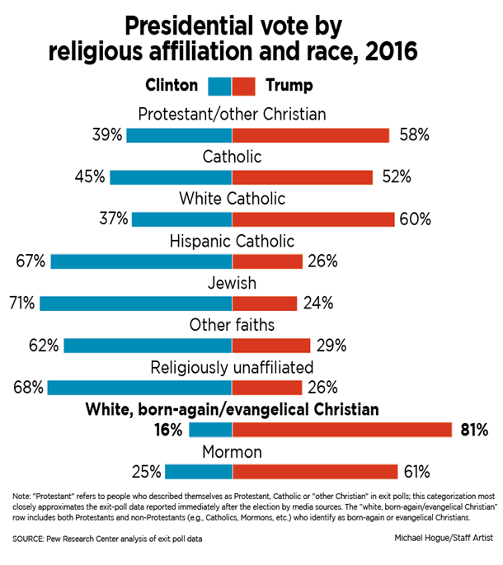
2016 Coalitions? (reference only)
Obama/
Clinton Coalition
Trump Coalition
Evangelicals
Non-College-Educated White Men
White Southerners
Blue Collar in North and Midwest
Anti-free trade
Anti-intervention
Nationalists
White
Christian
Rural/anti-elite
Tea Party
Non-white Women
New England
West Coast
College-Educated
African-Americans
Latino-American
Asian-Americans

Slide 22
The Meaning of Trump (reference)
Anti-Establishment
Anti-Globalization
Three Billion New Capitalists – competition
Decline of Traditional US Manufacturing
US Education problems
Polarization
Republican Party Crisis
Demagoguery out of control
Conspiracy Theories
Social media and bullying
White Nationalism?
Christian Nationalism?

Slide 23
Precedents
Popular vote winner does not win electoral college (1824, 1976, 1888, 2000)
No previous governmental/military experience
Facing over 70 lawsuits
TV celebrity
Use of social media

Slide 24
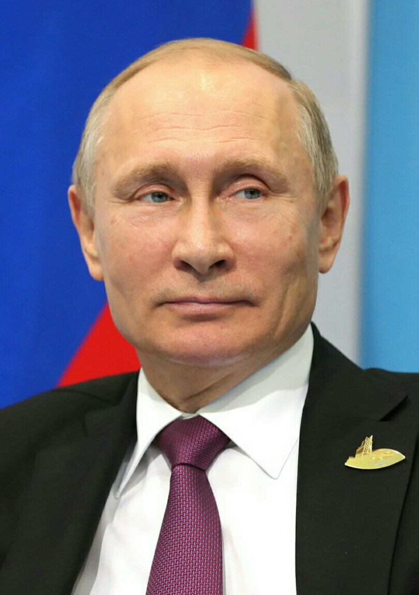
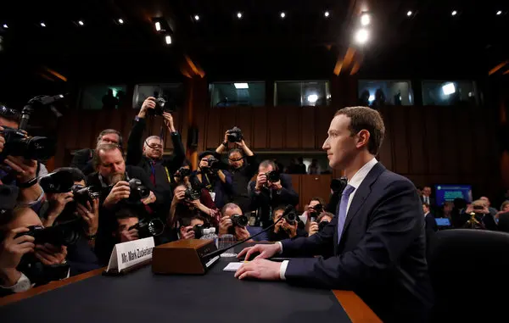
Social Media, Disinformation, and Russia
Russian Disinformation
Director of National Intelligence Report, January 2017
House Intelligence Committee Report, March 2018
Senate Intelligence Committee Reports
Senate Intelligence Committee Report April 2020
Putin Facebook CEO Zuckerberg

Slide 25
A Question
Democratic National Committee Hacked
Russian Intelligence and non-governmental groups
Wikileaks Releases Emails from Campaign
Trump Campaign?

Slide 26
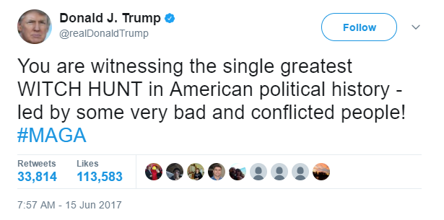
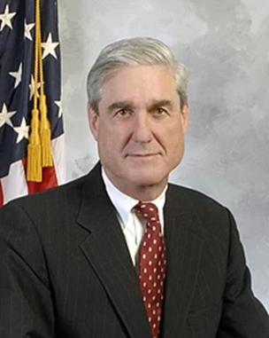
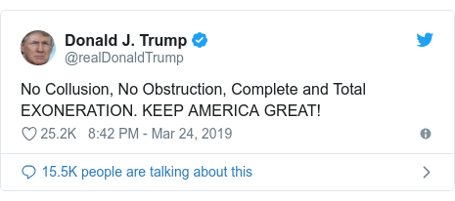
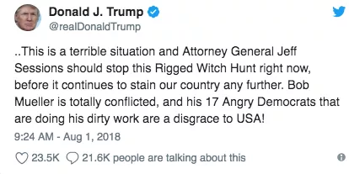
Mueller Report, April 18, 2019 Appointed May 2017
Special Counsel Robert Mueller

Slide 27
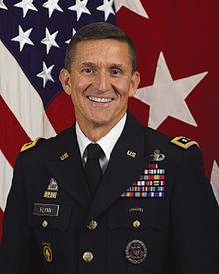
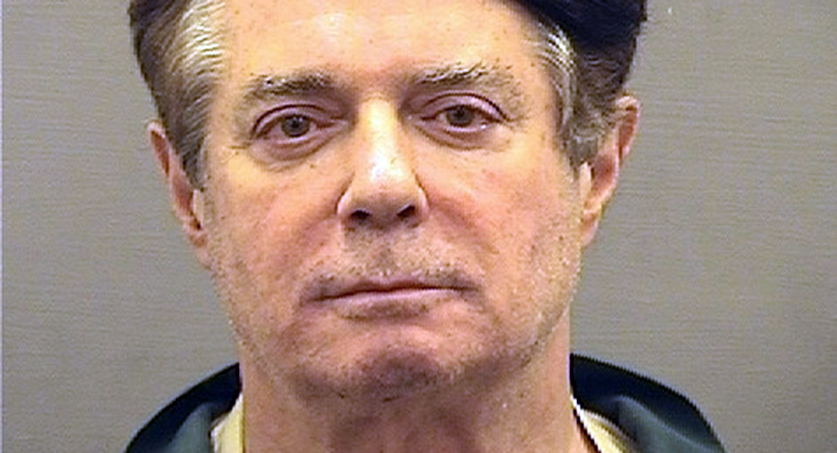
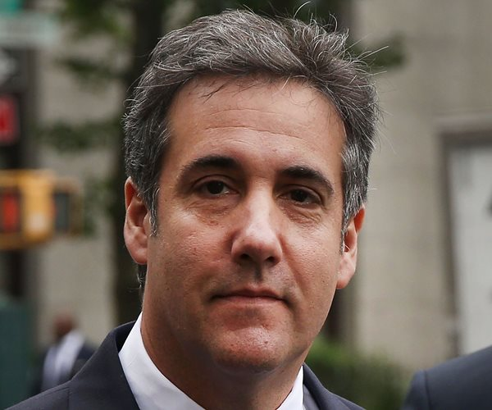
Convicted of Crimes Related to Russia Connections and financial fraud
Michael Flynn Paul Manafort Michael Cohen
National Security Campaign Manager Personal Lawyer
Adviser

Slide 28
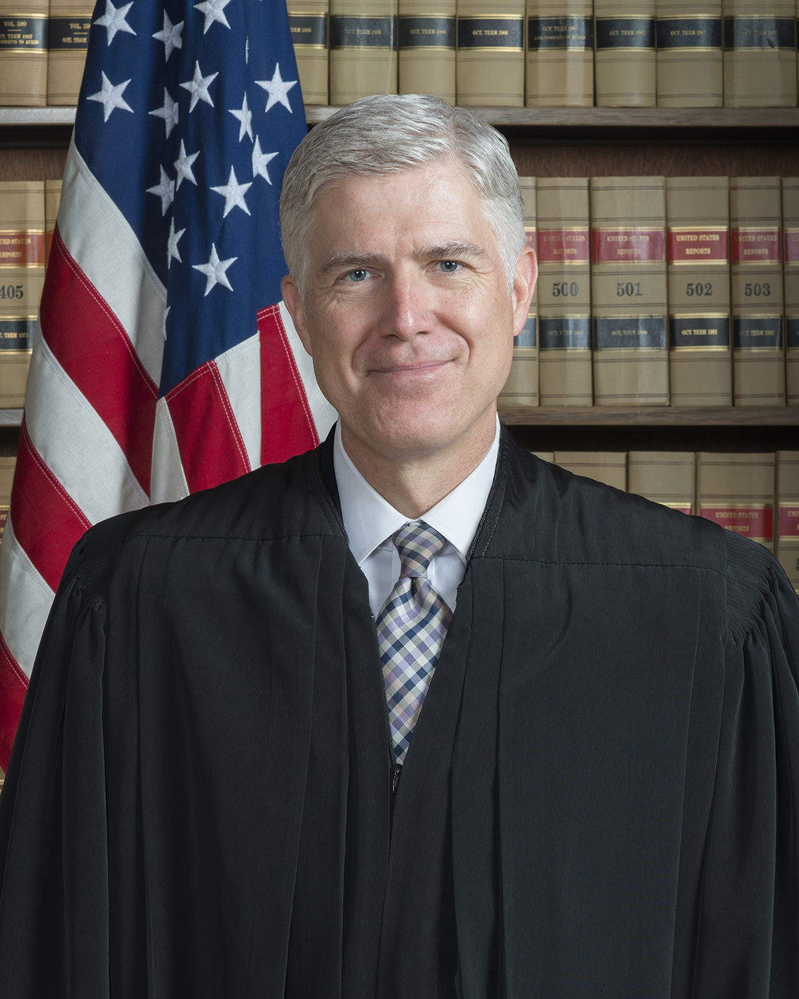
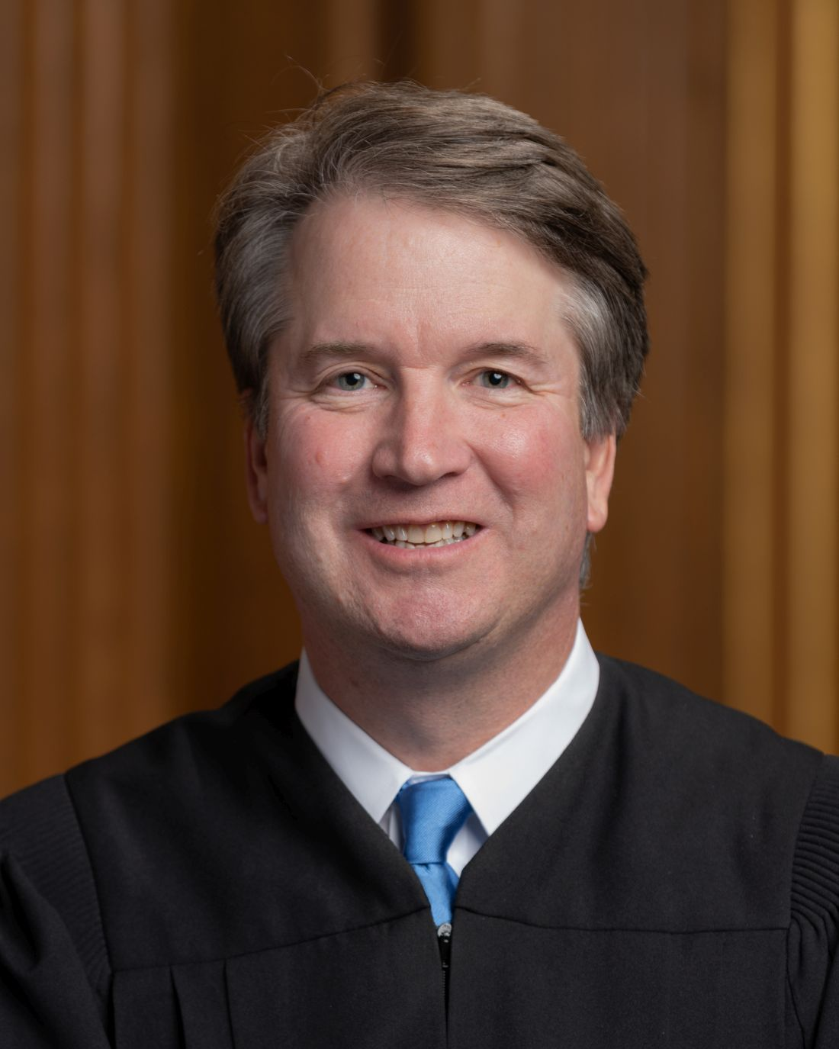
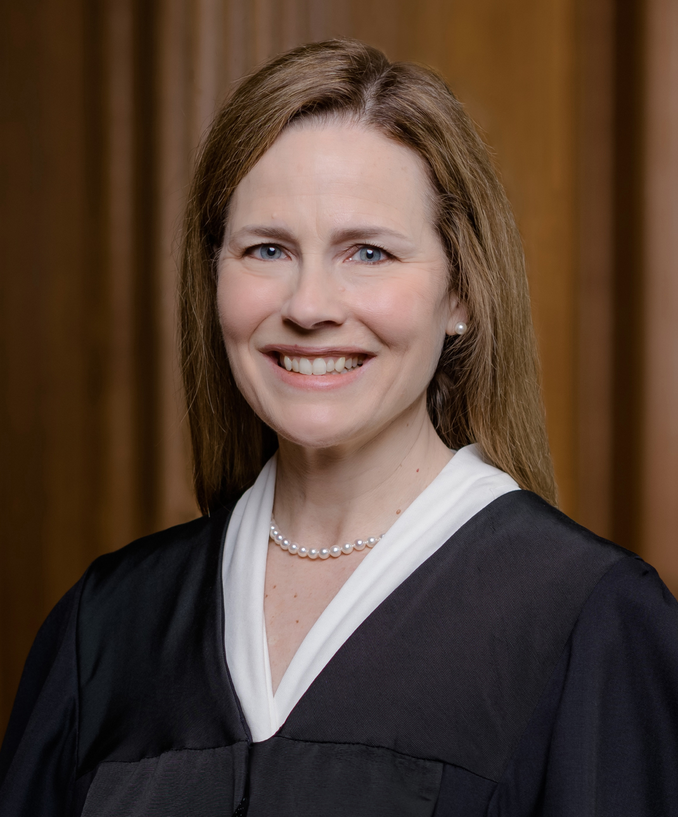
2. Trump Policies
Movement Conservative Policies
Justice Justice Justice
Neil Gorsuch Brett Amy Coney
Kavanaugh Barrett

Slide 29
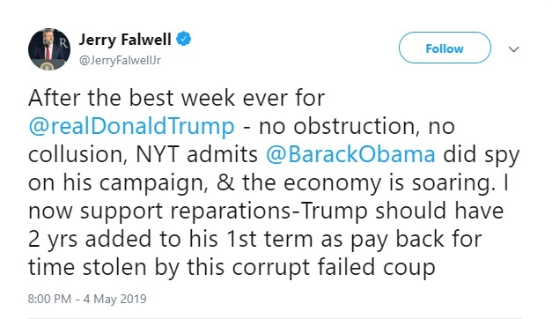
Evangelical Support
Franklin Graham
“Progressive?...That’s just another word for godless.”
May 2018

Slide 30
Immigration and Trade

Slide 31
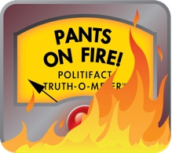
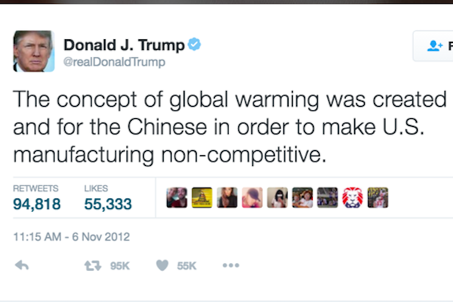
3.Trump Style: Twitter
Attack
Lying
Politifact on Trump
Washington Post Fact Checker
30,573 lies in four years
Trump vs. CDC, April 2020

Slide 32
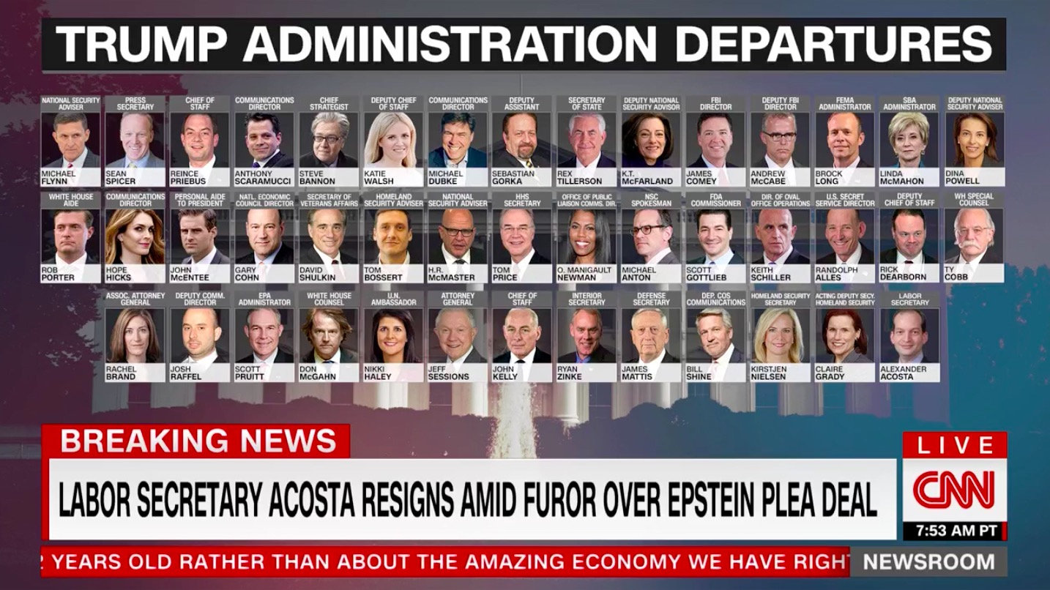
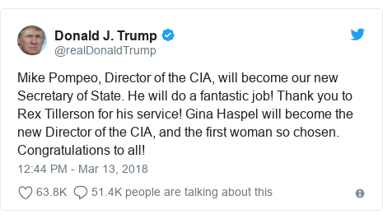
Management
Turnover in the Trump Administration

Slide 33
First Impeachment

Slide 34
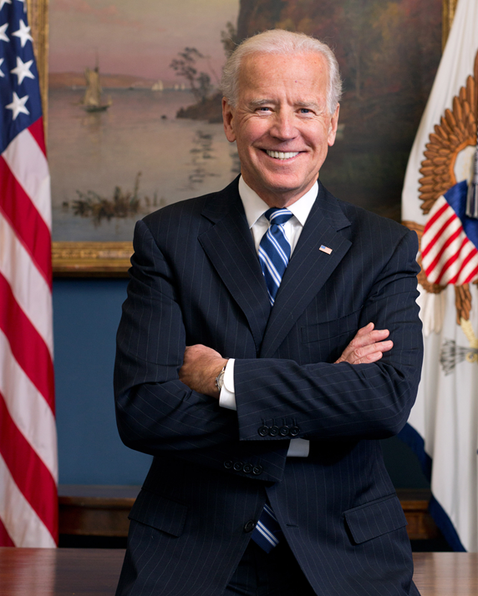
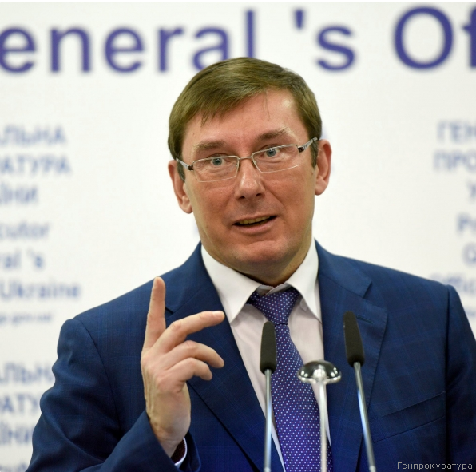
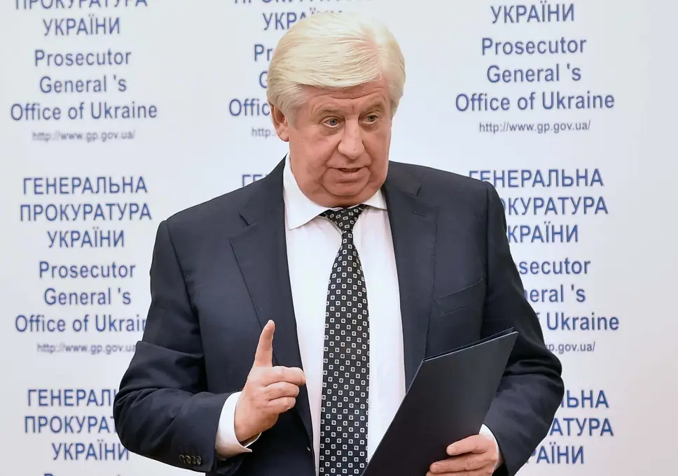
Allegations against VP Joe Biden Russian Disinformation Campaign (reference)
Viktor Shokin VP Joe Biden Yuri Lutsenko
Ukraine Chief Prosecutor Shokin Successor

Slide 35
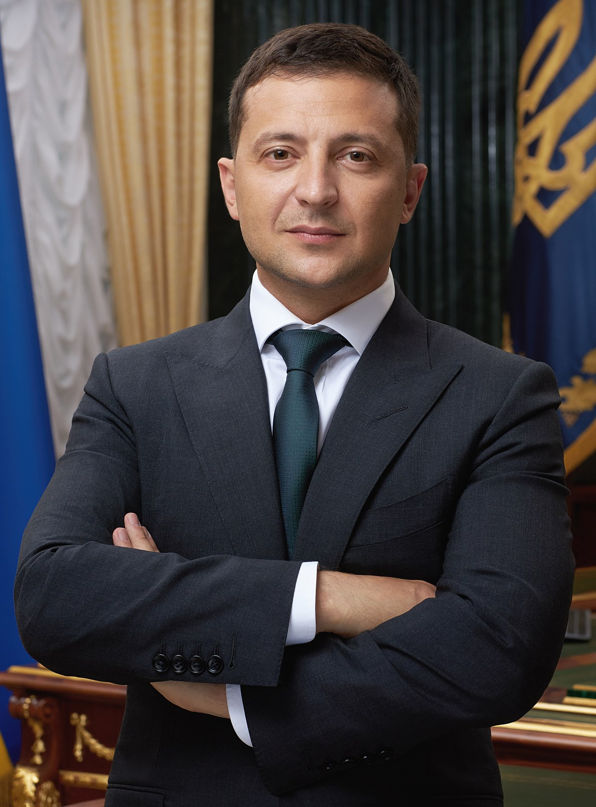
Trump and Ukraine
$391 million in US Aid to Ukraine
July 25, 2019 Phone Call
The Whistleblower Report
White House Transcript
Pres. Volodimir Zelensky
“…I would like you to do us a favor though… The other thing, There's a lot of talk about Biden's son,. that Biden stopped the prosecution and a lot of people want to find out about that so whatever you can do with the Attorney General would be great. Biden went around bragging that he stopped the prosecution so if you ·can look into it ... It sounds horrible to me.” (pages 3-4)

Slide 36
First Impeachment, 2019-2020
 | House (brings charges) | Senate (requires 2/3 for conviction)
First Impeachment | December 18, 2019 | February 5, 2020
Abuse of Power | 230-197 | 48-52 (Party Line vote)
Obstruction of Congress | 229-198 | 47- 53 (one Republican voted guilty, Mitt Romney (UT)

Slide 37
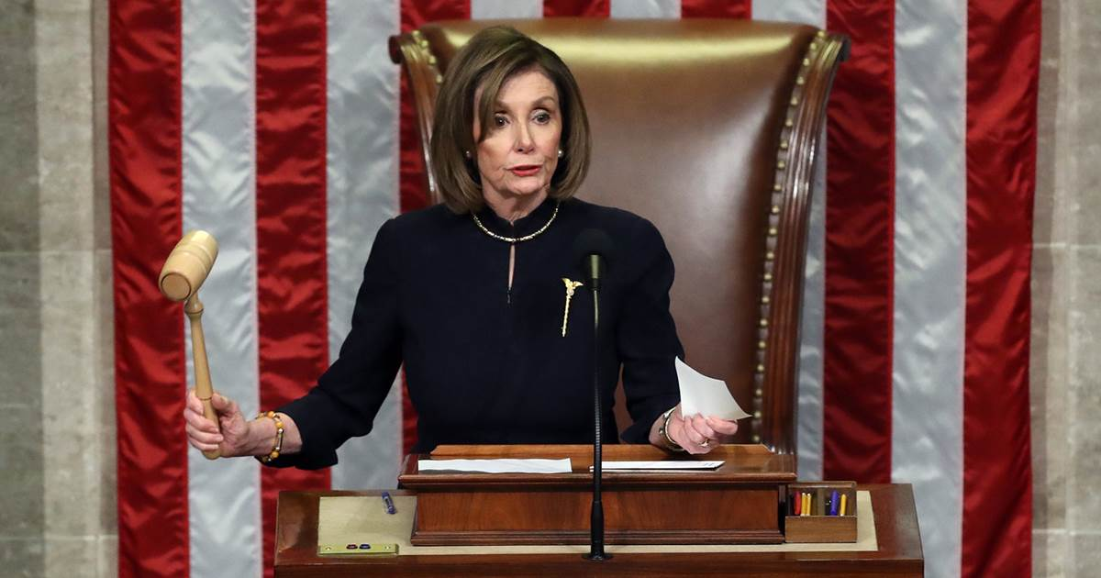
Trump Impeached December 18, 2019 (reference)
Articles of Impeachment against President Donald Trump
December 10, 2019
Vote on Article One: Abuse of Power (230-197)
December 18, 2019
Vote on Article Two:
Obstruction of Congress (229-198)
December 18, 2019

Slide 38
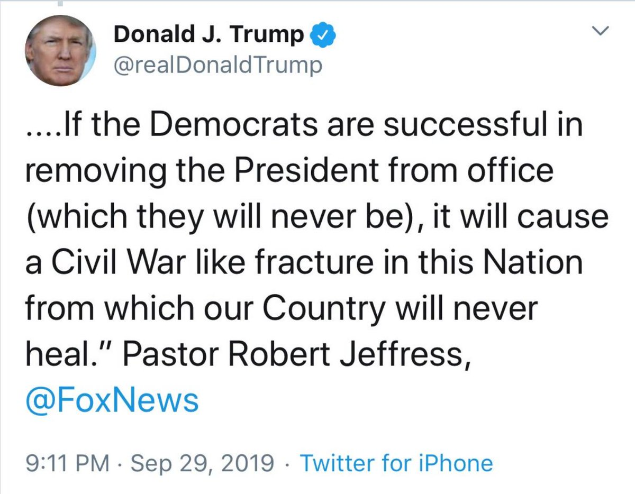
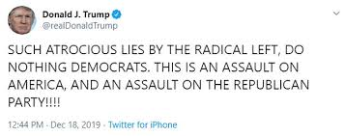
Trump Response
Refusal to allow witness testimony
Refusal to turn over documents

Slide 39
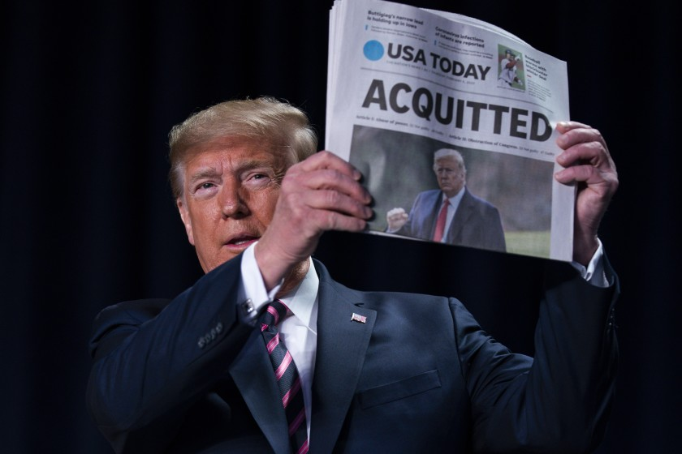
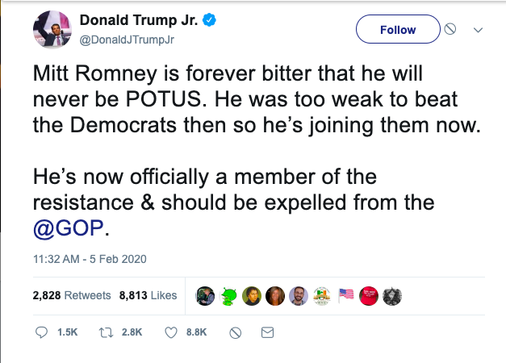
Senate Finds Trump Not Guilty
Party line votes except for Mitt Romney voting guilty on Abuse of Power charge

Slide 40
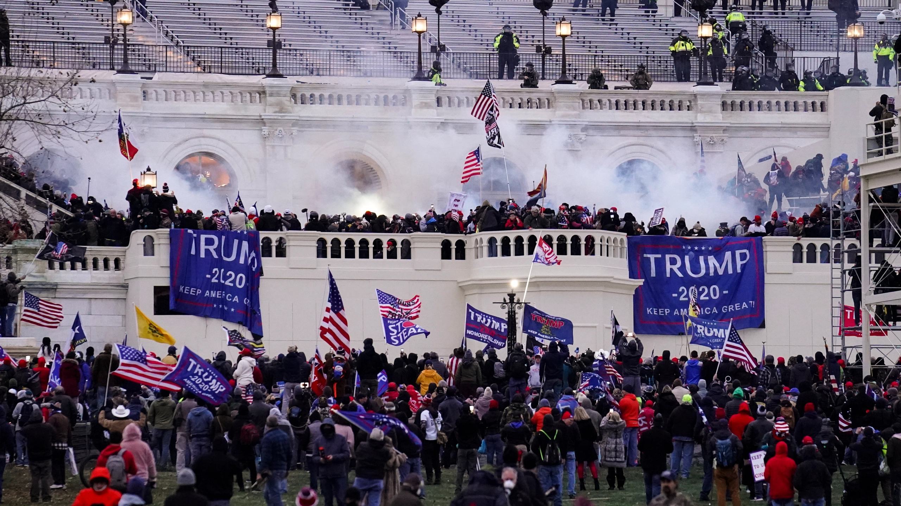
Second Impeachment: Incitement of Insurrection

Slide 41
Second Impeachment
 | House (brings charges) | Senate (requires 2/3 for conviction)
Second Impeachment | January 13, 2021 | February 13, 2021
Incitement of Insurrection | 232-197 Ten Republicans voted for charges | 57-43 Seven Republicans voted guilty (Richard Burr (NC), Bill Cassidy (LA), Susan Collins (ME), Lisa Murkowski (AK), Mitt Romney (UT), Ben Sasse (NE), Pat Toomay (PA))

Slide 43
Trump Job Approval 2021

Slide 44
2020 Election

Slide 45
President Biden and VP Kamala Harris

Slide 46
Objections to the Electoral Votes
Objections
In writing
Signed by one member of House and one of Senate
House and Senate meets separately to consider
Majority of both House and Senate required to reject an electoral vote
1969 and 2005 challenges and rejection of challenges by each chamber
Two slates of electors?
Or none?

Slide 47
January 6, 2021 Certification Day
Arizona Votes Challenged
Paul Gosar (AZ) and Ted Cruz (TX)
Objection overruled 303-121 and 6-93
Pennsylvania Votes Challenged
(Scott Perry (PA) and Josh Hawley (MO)
Objection Overruled 138-282 and 7-97

Slide 48
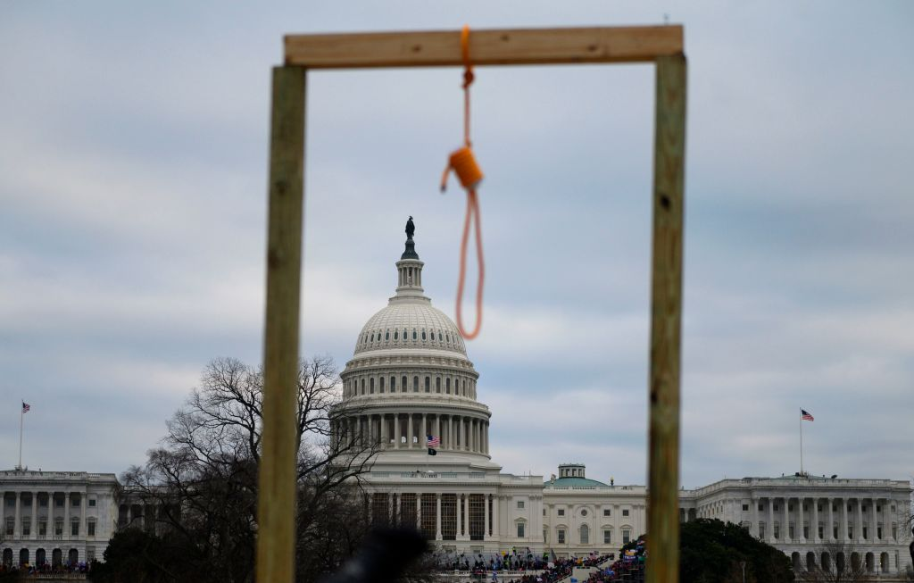
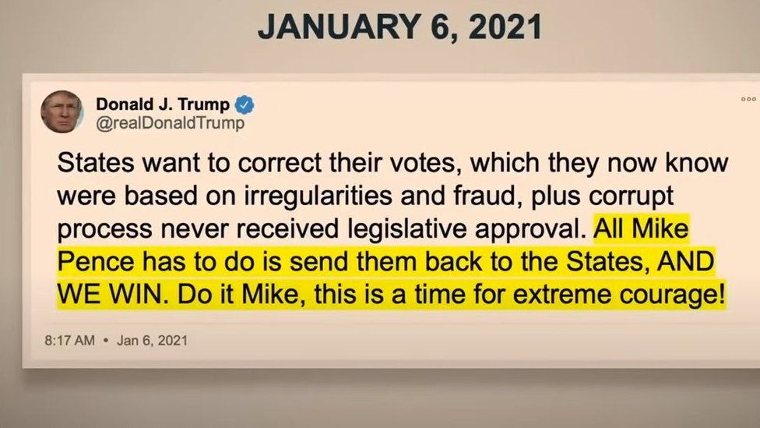
January 6, 202: Certification Day

Slide 49
The Big Lie Information on Investigations, Court Cases…

Slide 50
January 6, 2021

