Slide 1
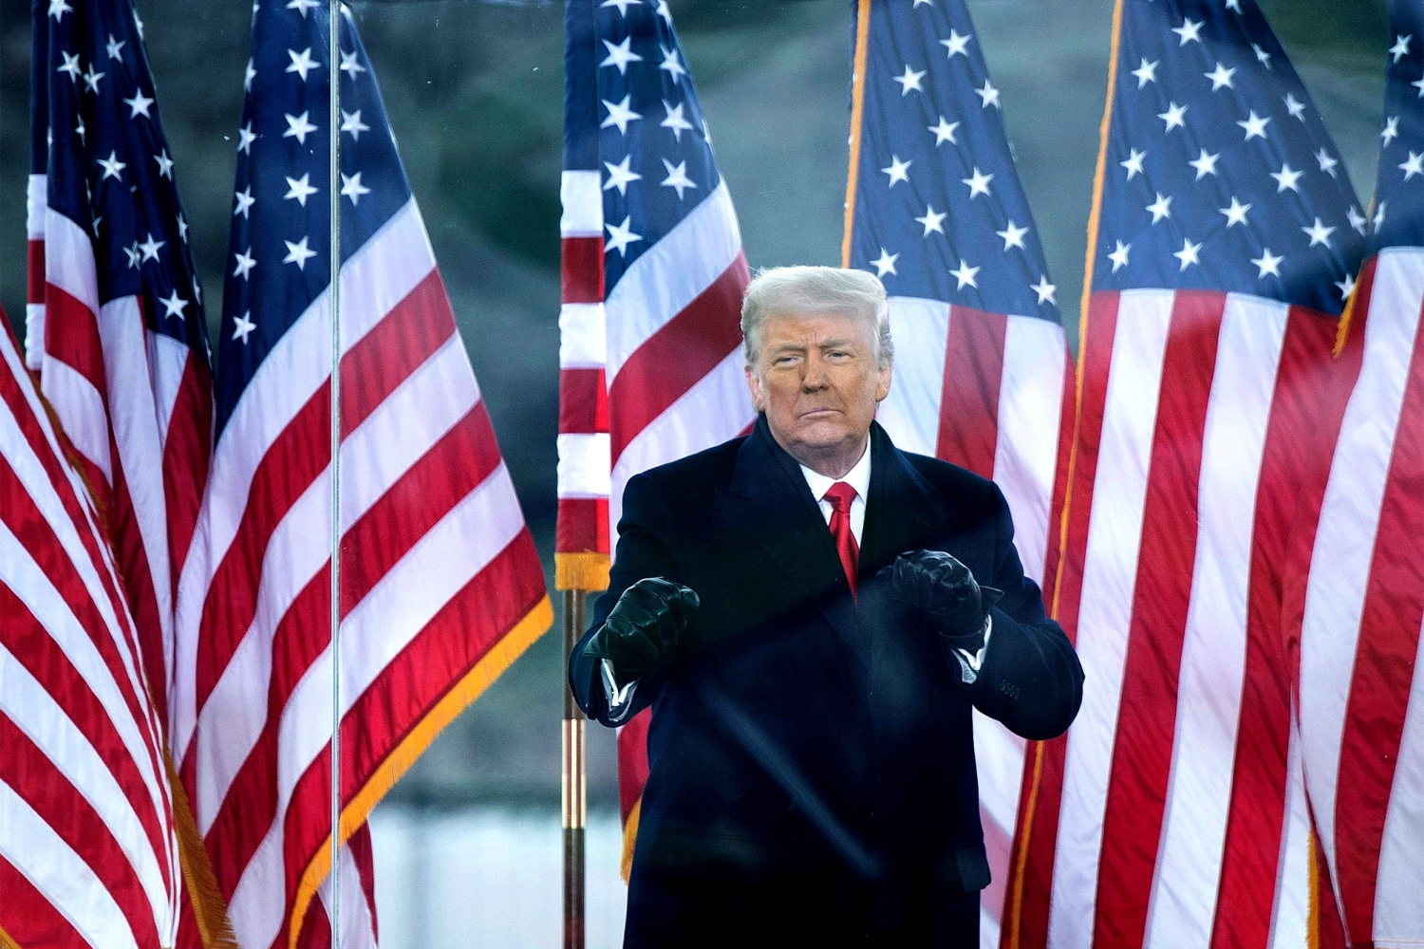
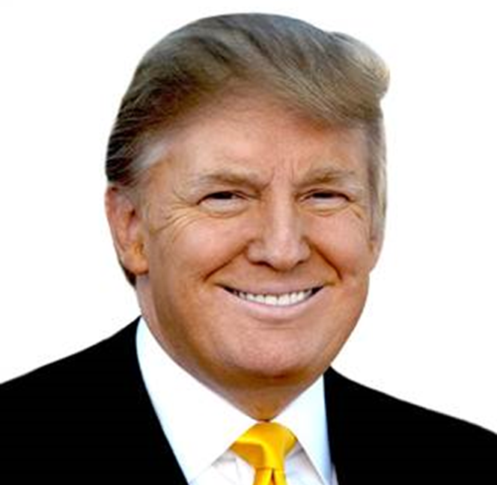
Trump

Slide 2
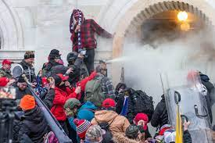
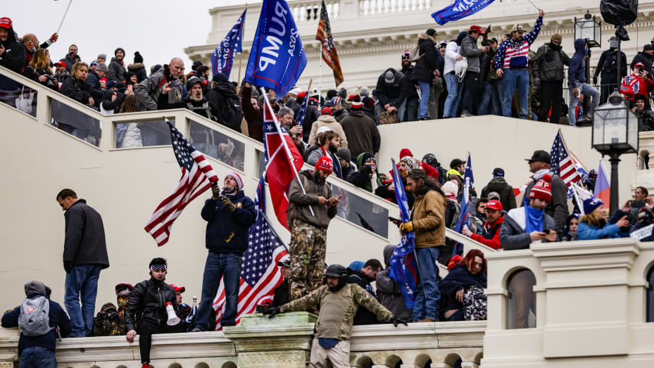
January 6, 2021

Slide 3
The Crisis in US Democracy Is Trump the demagogue the founders feared?
“…it has been fully confirmed by experience that they are daily misled into the most baneful measures and opinions by the false reports circulated by designing men, and which no one on the spot can refute.” ~Elbridge Gerry, May 31, 1787
The Records of the Federal Convention of 1787, ed. Max Farrand (New Haven: Yale University Press, 1911). Vol. 1.
https://oll.libertyfund.org/title/farrand-the-records-of-the-federal-convention-of-1787-vol-1#Farrand_0544-01_457

Slide 4
“…of those men who have overturned the liberties of republics, the greatest number have begun their career by paying an obsequious court to the people; commencing demagogues, and ending tyrants.”
Hamilton, Federalist No. 1
Avalon Project, https://avalon.law.yale.edu/18th_century/fed01.asp

Slide 5
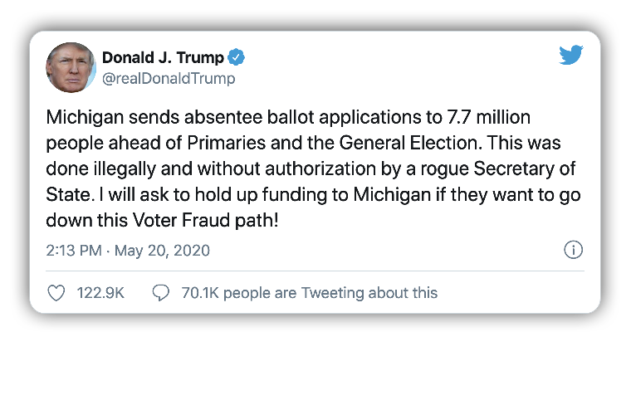
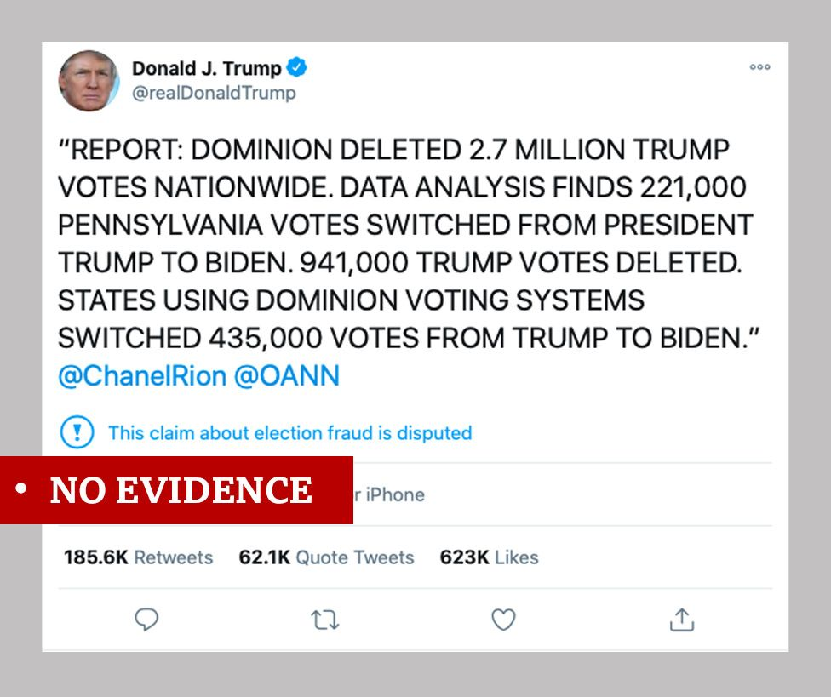
The Big Lie Information on Investigations, Court Cases… (Old Slide for reference)

Slide 6
What Comparative Politics Tells Us… (old slide for reference)
Party or leader Followers refuse to
claims only it/he accept opposition elected
can be trusted officials, reject facts;
(discredits independent news) only have faith and loyalty to leader
Party or leader
declares electoral Followers Followers lose
fraud where there believe the faith in electoral
is none election was system and the
stolen need for elections
Belief that since an End of free
election was stolen and fair
from them, they can elections;
justifiably steal the next one violence; collapse of democracy

Slide 7
Red and Blue and the Pandemic

Slide 8
Trump
Election of 2016
Policy
Trump Style
impeachments

Slide 9
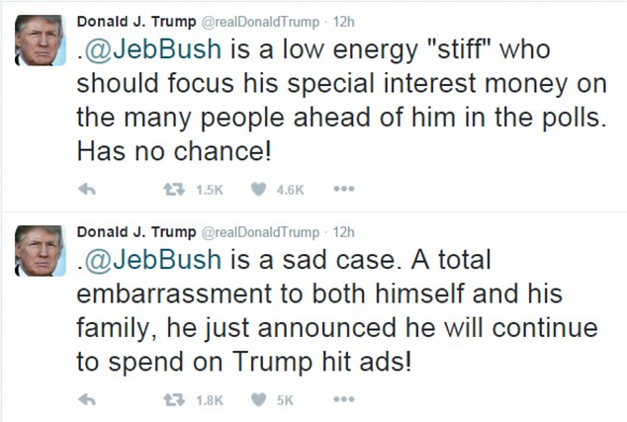
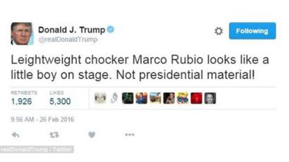
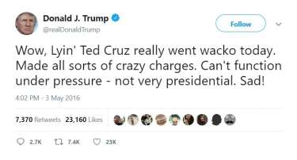
1. 2016 Election

Slide 10
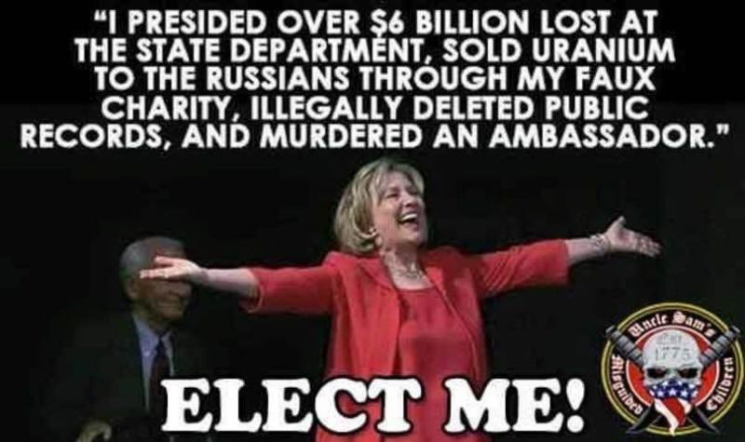
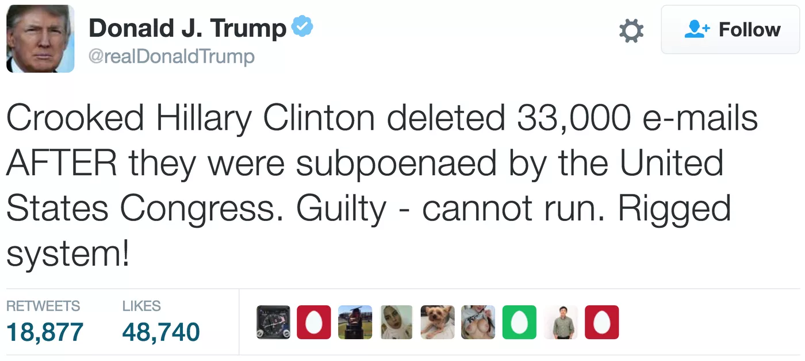
Clinton vs. Trump

Slide 11
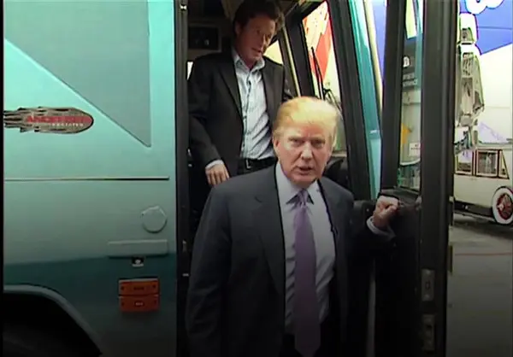
The Controversies
Access Hollywood Tape
(Trump brags about sexual assault)
Clinton Emails
(Investigated: Neither FBI nor Congress decides to take action)
Summary of the issue
State Department Inspector General Report on the Emails, May 2016
Comey Statement July 2016
Inspector General’s Report (June 2018)
The Actual Emails
Notes:
30,000 emails
110 had references to classified information
3 emails had classified information in them
All sent by other people to Clinton

Slide 12
2016 Election

Slide 13
2016 Election by County

Slide 14
2016 By the Numbers
Candidate | Popular Vote
Donald Trump | 62,980,160
Hillary Clinton | 65,845,063
Gary Johnson | 4,488,931
Jill Stein | 1,457,050
Evan McMullen | 728,830

Slide 15
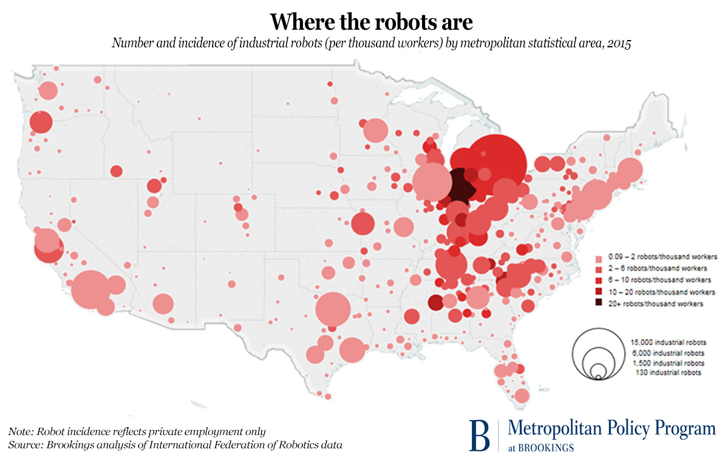
States that Voted for Obama and Trump
Florida
Michigan
Iowa
Ohio
Pennsylvania
Wisconsin

Slide 16
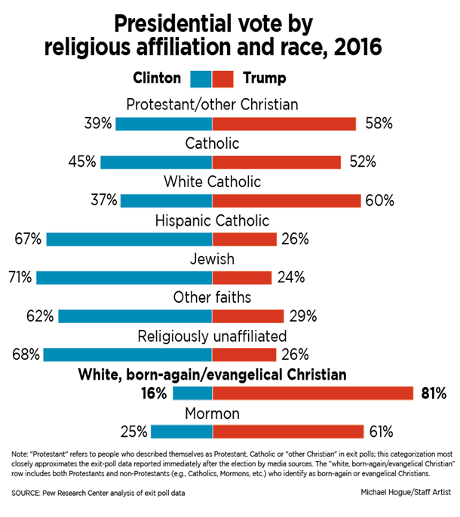
2016 Coalitions? (reference only)
Obama/
Clinton Coalition
Trump Coalition
Evangelicals
Non-College-Educated White Men
White Southerners
Blue Collar in North and Midwest
Anti-free trade
Anti-intervention
Nationalists
White
Christian
Rural/anti-elite
Tea Party
Non-white Women
New England
West Coast
College-Educated
African-Americans
Latino-American
Asian-Americans

Slide 17
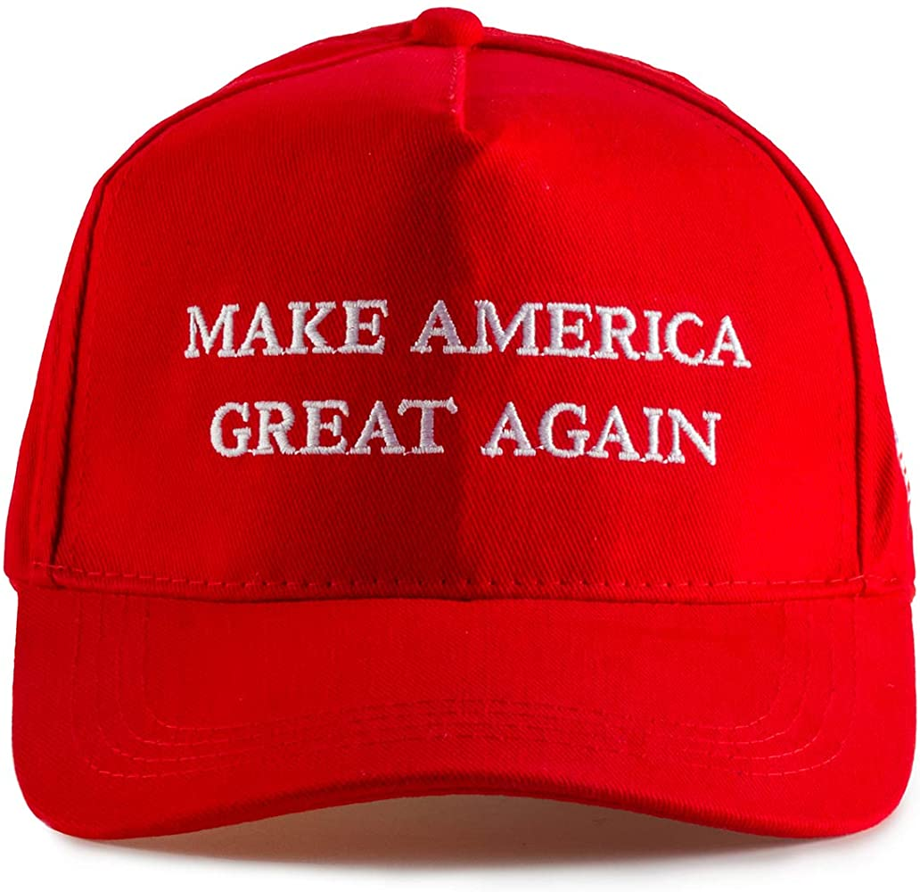
The Meaning of Trump (reference)
Anti-Establishment
Anti-Globalization
Three Billion New Capitalists – competition
Decline of Traditional US Manufacturing
US Education problems
Polarization
Republican Party Crisis
Demagoguery out of control
Conspiracy Theories
Social media and bullying
White Nationalism?
Christian Nationalism?

Slide 18
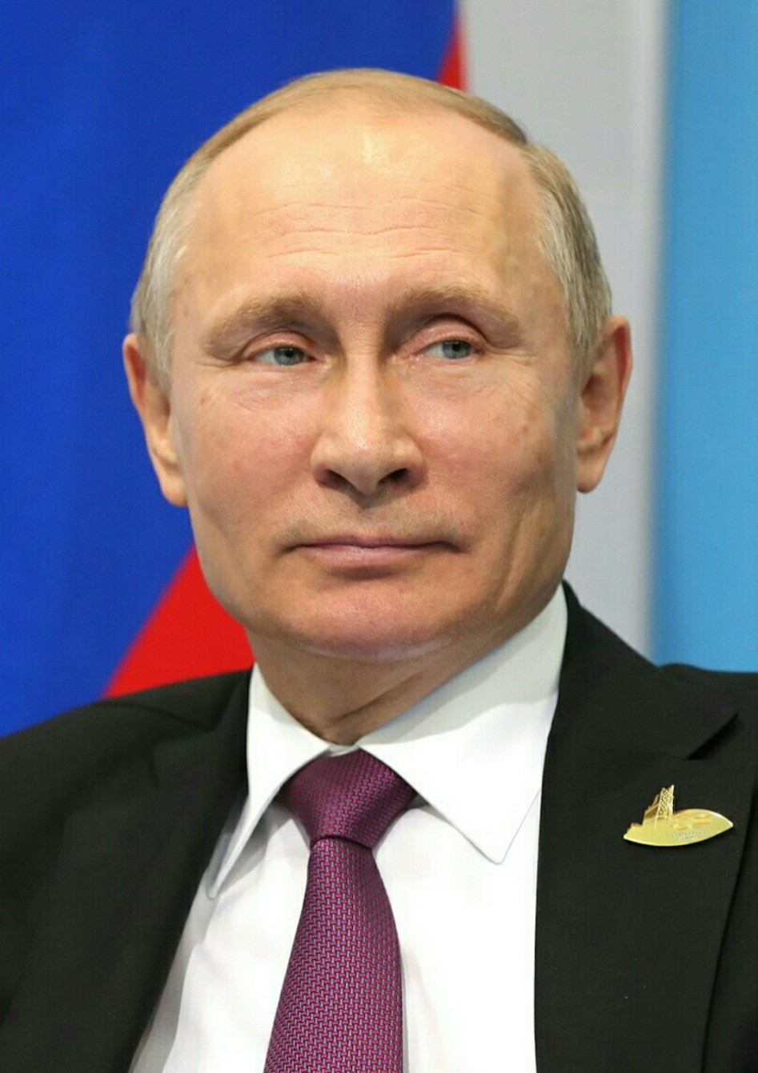
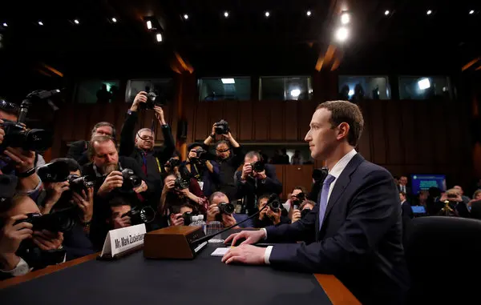
Social Media, Disinformation, and Russia
Russian Disinformation
Director of National Intelligence Report, January 2017
House Intelligence Committee Report, March 2018
Senate Intelligence Committee Reports
Senate Intelligence Committee Report April 2020
Putin Facebook CEO Zuckerberg

Slide 19
A Question
Democratic National Committee Hacked
Russian Intelligence and non-governmental groups
Wikileaks Releases Emails from Clinton Campaign
Trump Campaign?

Slide 20
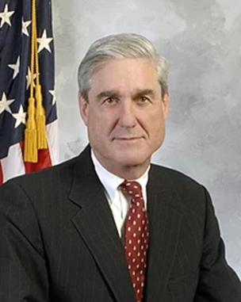
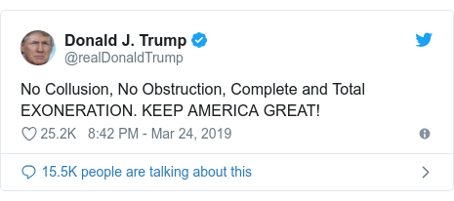
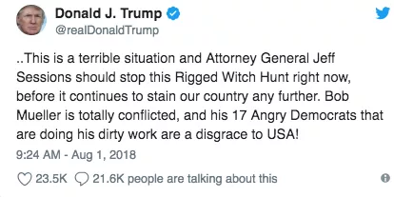
Mueller Report, April 18, 2019 Appointed May 2017
Special Counsel Robert Mueller

Slide 21
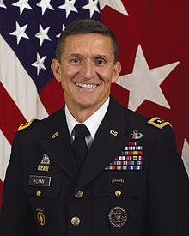
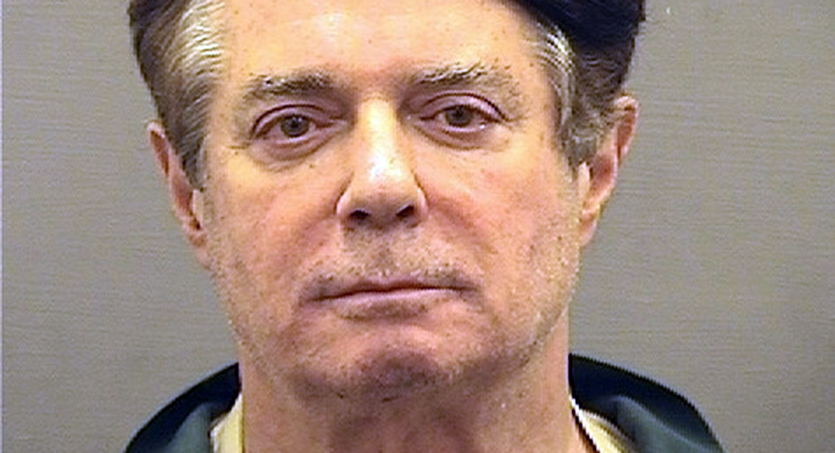
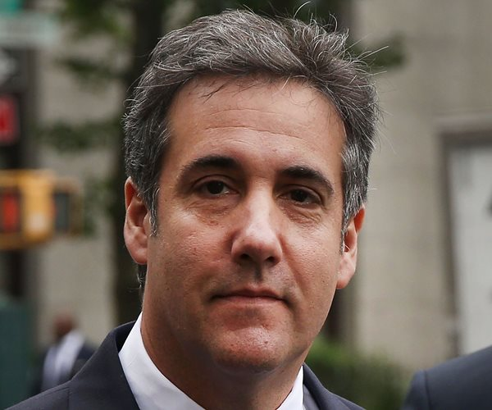
Convicted of Crimes Related to Russia Connections and financial fraud (reference)
Michael Paul Michael
Flynn Manafort Cohen
National Security Campaign Manager Personal Lawyer
Adviser

Slide 22
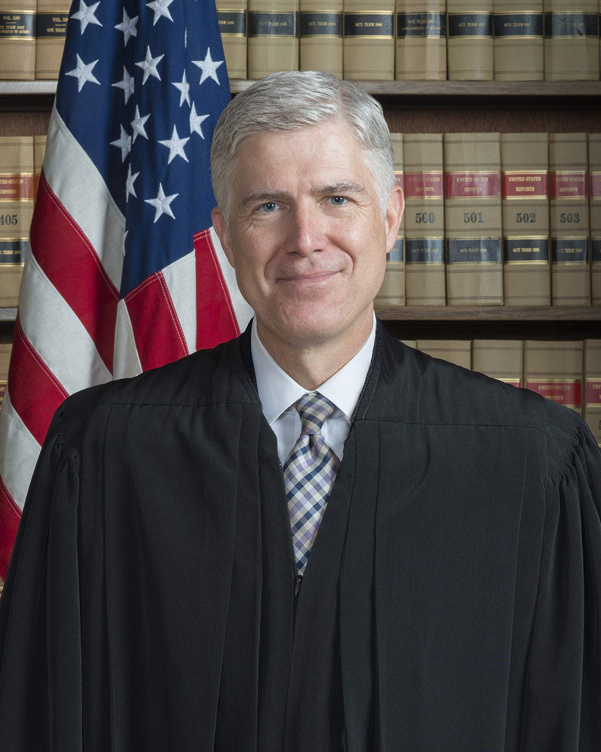
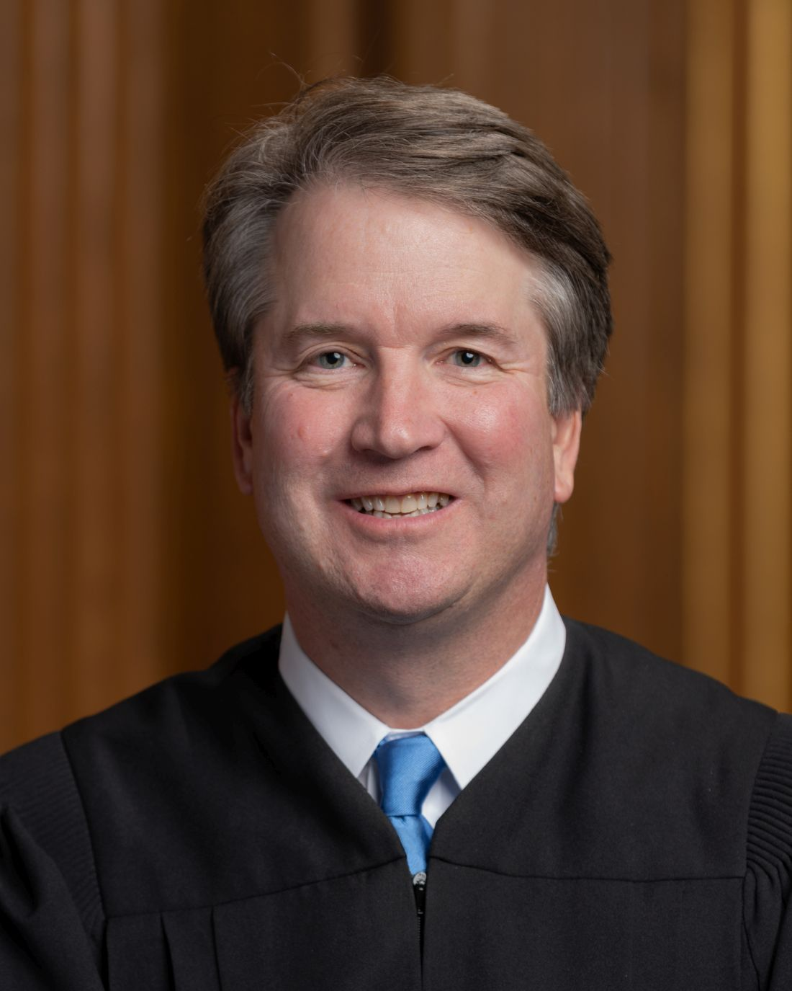
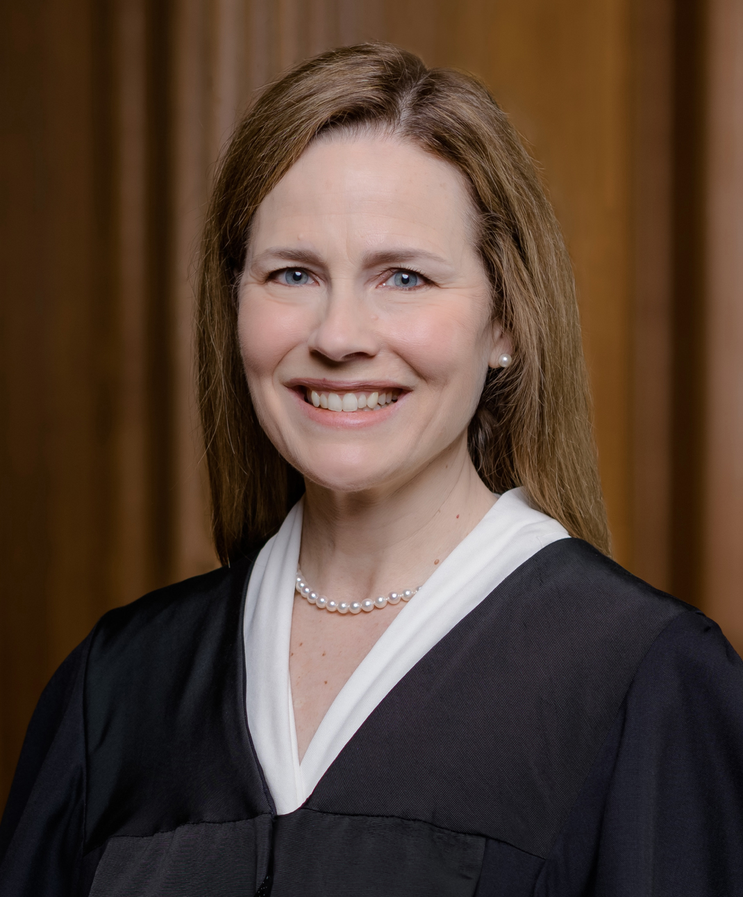
2. Trump Policies
Movement Conservative Policies
Justice Justice Justice
Neil Brett Amy Coney
Gorsuch Kavanaugh Barrett

Slide 23
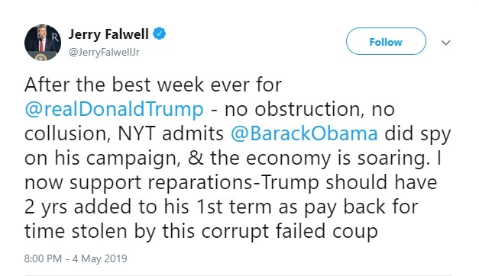
Evangelical Support
Franklin Graham
“Progressive?...That’s just another word for godless.”
May 2018

Slide 24
Immigration and Trade

Slide 25
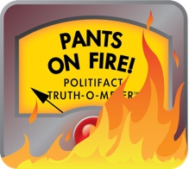
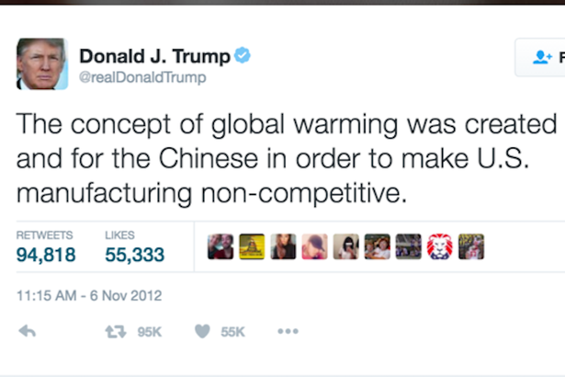
3.Trump Style: Twitter
Attack
Lying
Politifact on Trump
Washington Post Fact Checker
30,573 lies in four years
Trump vs. CDC, April 2020

Slide 26
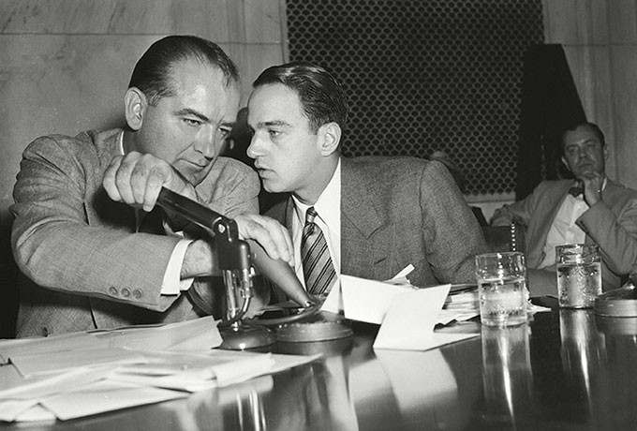
Demagoguery
Sen. Joseph McCarthy and Roy Cohn (Chief Counsel for the Senate Permanent Committee on Investigations)

Slide 27
Roy Cohn Style
Lie about everything
The more outlandish the better; never back down
No shame
Accuse people of the things that you yourself are doing
Facing investigation: use every legal trick to delay, complicate, raise the cost of investigation/prosecution
If sued, countersue until the end of time
Discredit all your enemies in every way possible
Scorched earth; better to destroy everything than admit guilt or lose

Slide 28
Trump and Cohn (1984)

Slide 29
4. Impeachment Number 1

Slide 30
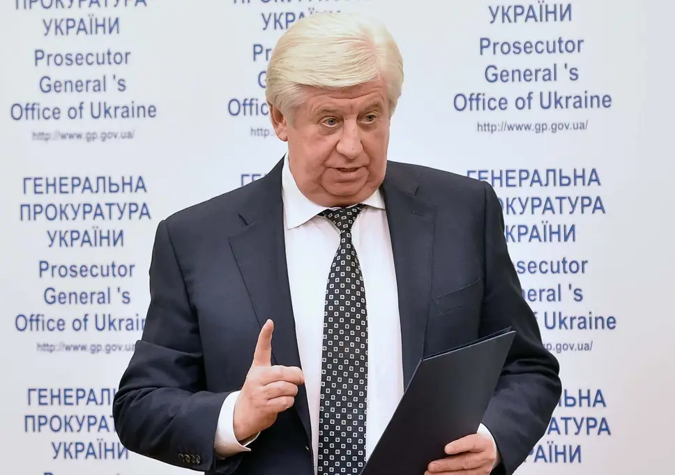
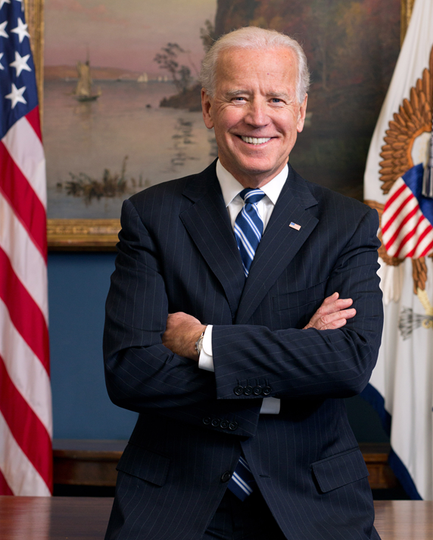
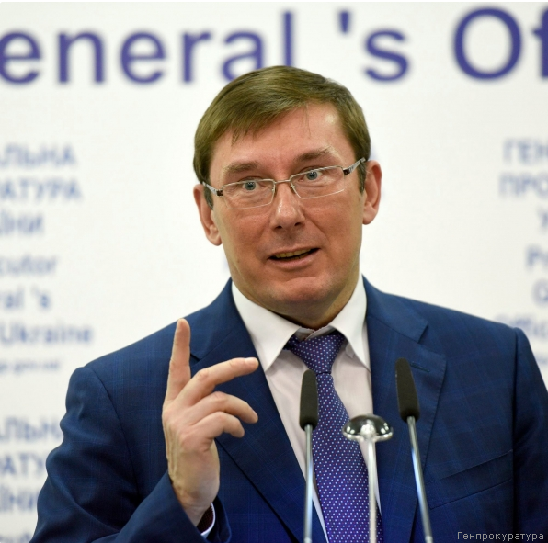
Allegations against VP Joe Biden Russian Disinformation Campaign (reference)
Viktor Shokin VP Joe Biden Yuri Lutsenko
Ukraine Chief Shokin Prosecutor Successor

Slide 31
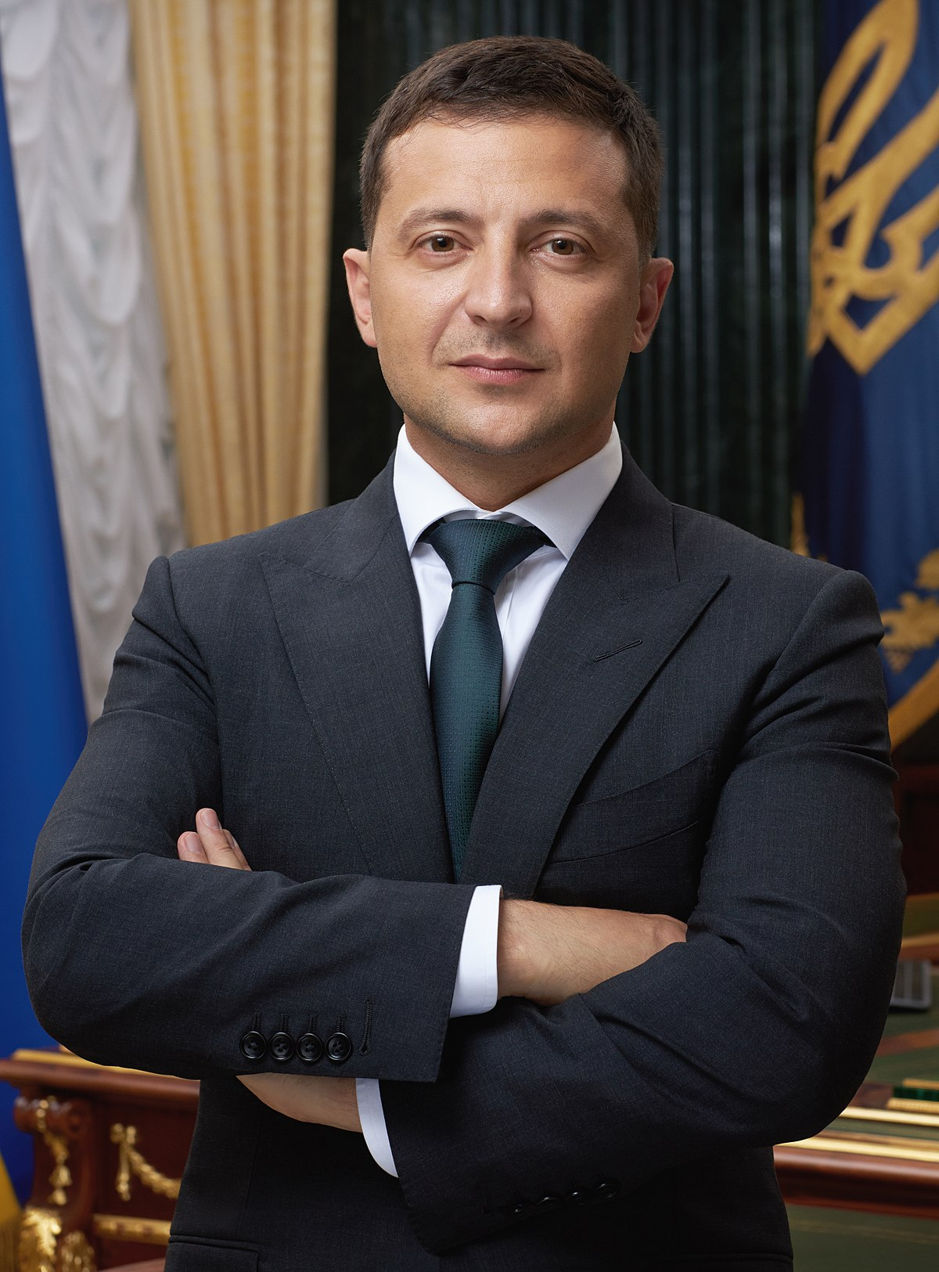
Trump and Ukraine
$391 million in US Aid to Ukraine
July 25, 2019 Phone Call
The Whistleblower Report
White House Transcript
Pres. Volodimir
Zelensky
“…I would like you to do us a favor though… The other thing, There's a lot of talk about Biden's son,. that Biden stopped the prosecution and a lot of people want to find out about that so whatever you can do with the Attorney General would be great. Biden went around bragging that he stopped the prosecution so if you ·can look into it ... It sounds horrible to me.” (pages 3-4)

Slide 32
First Impeachment, 2019-2020
 | House (brings charges) | Senate (requires 2/3 for conviction)
First Impeachment | December 18, 2019 | February 5, 2020
Abuse of Power | 230-197 | 48-52 (Party Line vote)
Obstruction of Congress | 229-198 | 47- 53 (one Republican voted guilty, Mitt Romney (UT)

Slide 33
Trump Impeached December 18, 2019 (reference)
Articles of Impeachment against President Donald Trump
December 10, 2019
Vote on Article One: Abuse of Power (230-197)
December 18, 2019
Vote on Article Two:
Obstruction of Congress (229-198)
December 18, 2019

Slide 34
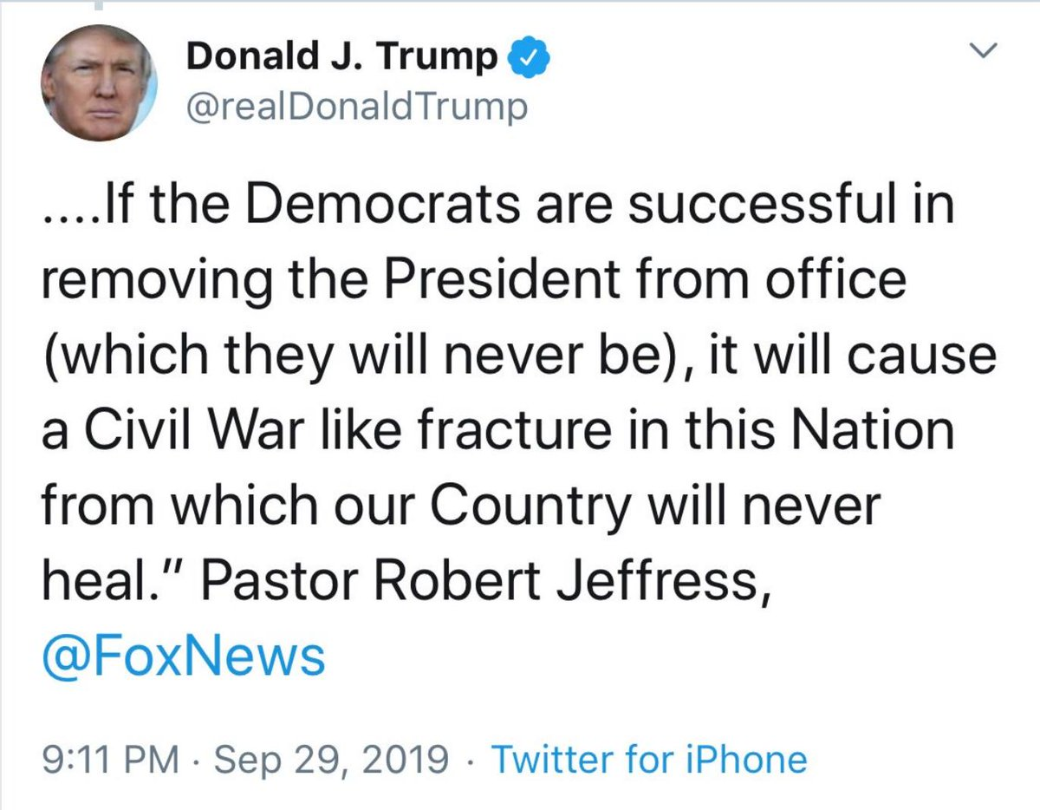
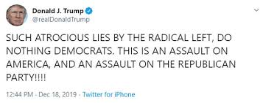
Trump Response
Refusal to allow witness testimony
Refusal to turn over documents

Slide 35
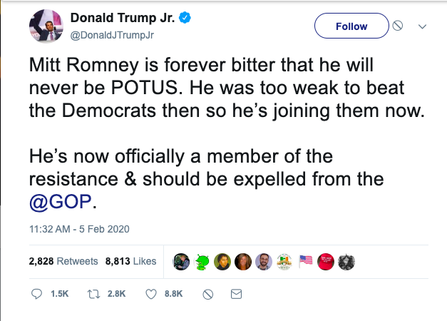
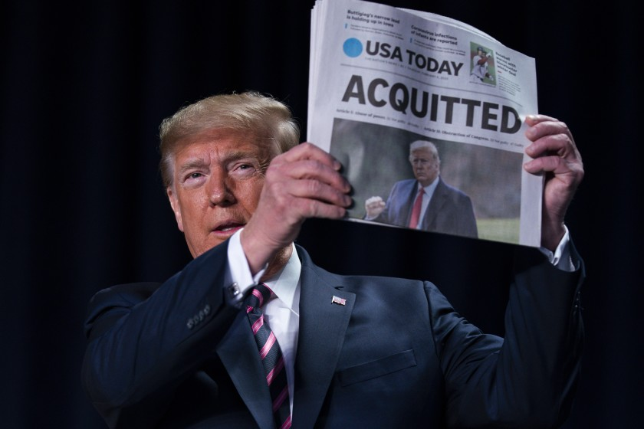
Senate Finds Trump Not Guilty
Party line votes except for Mitt Romney voting guilty on Abuse of Power charge

Slide 36
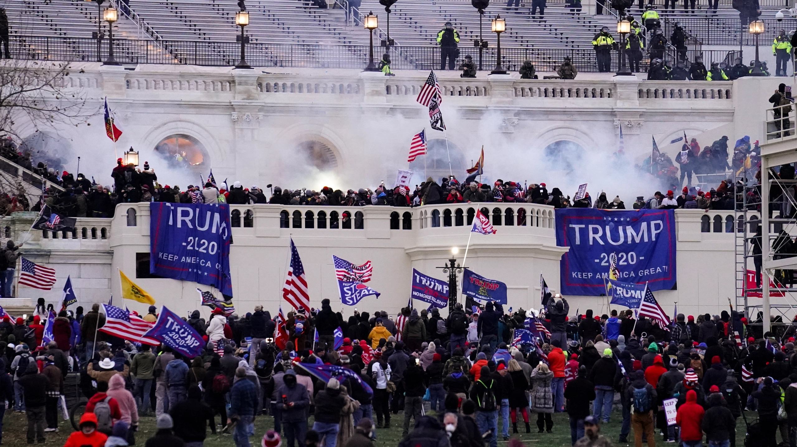
Second Impeachment: Incitement of Insurrection

Slide 37
Second Impeachment
 | House (brings charges) | Senate (requires 2/3 for conviction)
Second Impeachment | January 13, 2021 | February 13, 2021
Incitement of Insurrection | 232-197 Ten Republicans voted for charges | 57-43 Seven Republicans voted guilty (Richard Burr (NC), Bill Cassidy (LA), Susan Collins (ME), Lisa Murkowski (AK), Mitt Romney (UT), Ben Sasse (NE), Pat Toomay (PA))

Slide 39
Trump Job Approval 2021

Slide 40
2020 Election

Slide 41
President Biden and VP Kamala Harris

