Slide 1
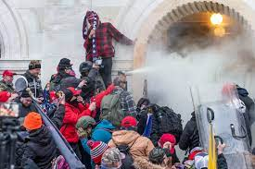
The Big Lie and January 6, 2021

Slide 2
What Comparative Politics Tells Us… (old slide for reference)
Party or leader Followers refuse to
claims only it/he accept opposition elected
can be trusted officials, reject facts;
(discredits independent news) only have faith and loyalty to leader
Party or leader
declares electoral Followers Followers lose
fraud where there believe the faith in electoral
is none election was system and the
stolen need for elections
Belief that since an End of free
election was stolen and fair
from them, they can elections;
justifiably steal the next one violence; collapse of democracy

Slide 3
“Demagogue”
Gains support by
Blaming elites
Blaming certain groups in society (scapegoats)
Blaming institutions
Claiming to defend All of “us” from “them”
Claiming that only I can be trusted
Creating “Alternative Reality Bubble” (Charlie Sykes)
Using disinformation campaign

Slide 4
Red and Blue and the Pandemic

Slide 5
Trump Indictments and Trial Dates (Reference)
March 4, 2024: Federal Trial on 2020 Election Interference
United States of America v. Donald Trump
March 25, 2024: NY Trial on Falsifying Business Records
People of the State of New York v. Donald Trump
May 20, 2024: Federal Trial on Mishandling Classified Documents
United States of America v. Donald Trump and Waltine Nauta
Georgia Election Interference Case: No date set yet
The State of Georgia v. Donald John Trump, Rudolph William Louis Giuliani… (19 people) 41 Counts

Slide 6
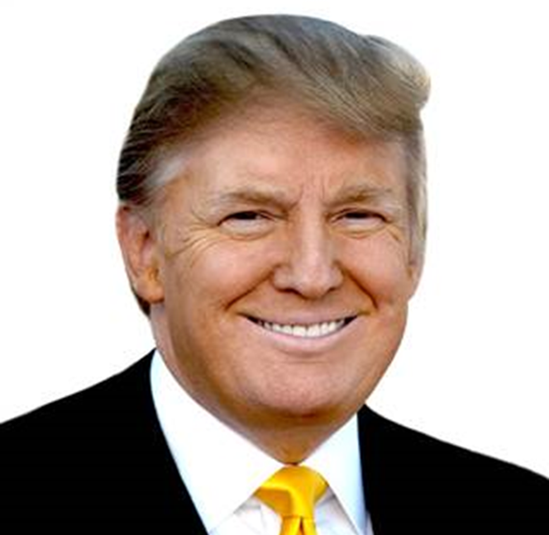
Trump
Election of 2016
Policy
Trump Style
impeachments

Slide 7
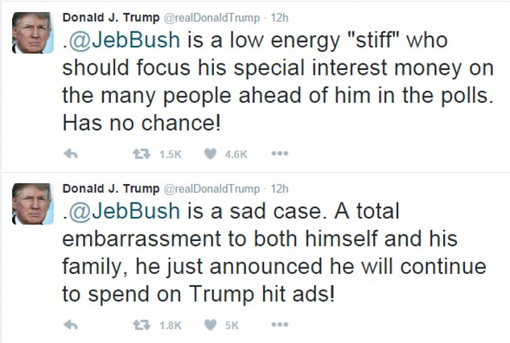
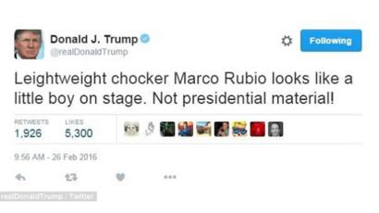
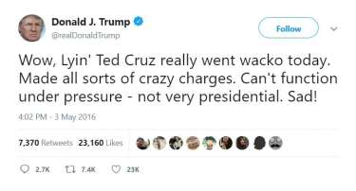
1. 2016 Election

Slide 8
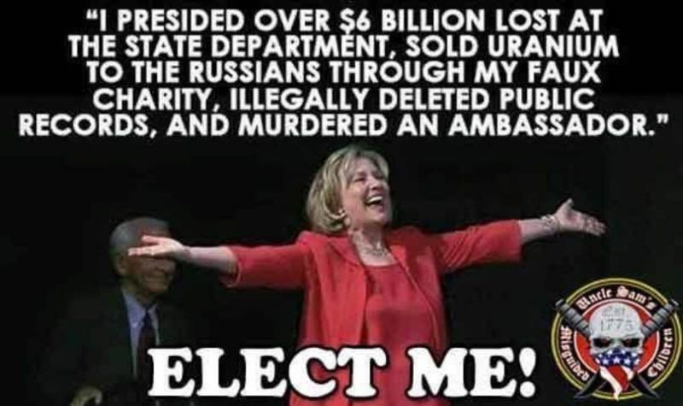
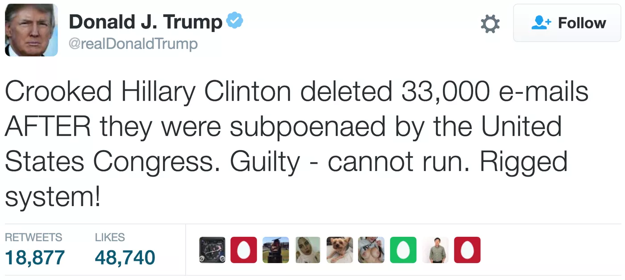
Clinton vs. Trump

Slide 9
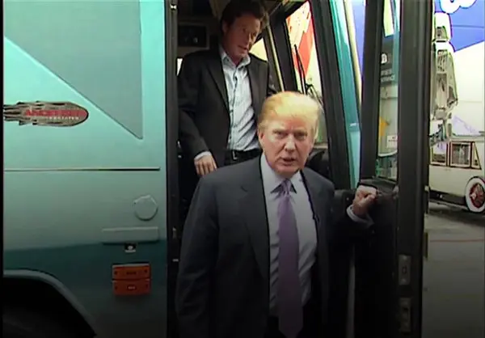
The Controversies
Access Hollywood Tape
(Trump brags about sexual assault)
Clinton Emails
(Investigated: Neither FBI nor Congress decides to take action)
Summary of the issue
State Department Inspector General Report on the Emails, May 2016
Comey Statement July 2016
Inspector General’s Report (June 2018)
The Actual Emails
Notes:
30,000 emails
110 had references to classified information
3 emails had classified information in them
All sent by other people to Clinton

Slide 10
2016 Election

Slide 11
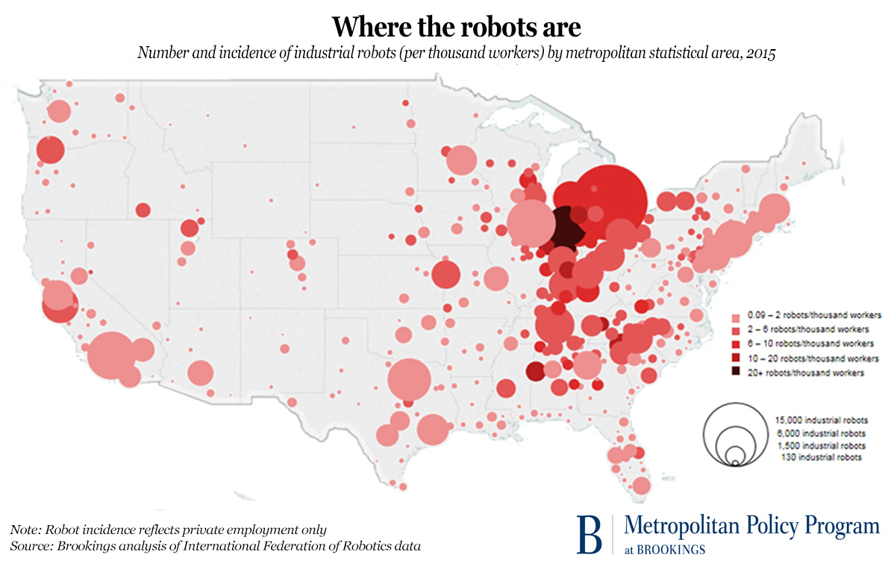
States that Voted for Obama and Trump
Florida
Michigan
Iowa
Ohio
Pennsylvania
Wisconsin

Slide 12
2016 By the Numbers (Reference)
Candidate | Popular Vote
Donald Trump | 62,980,160
Hillary Clinton | 65,845,063
Gary Johnson | 4,488,931
Jill Stein | 1,457,050
Evan McMullen | 728,830

Slide 13
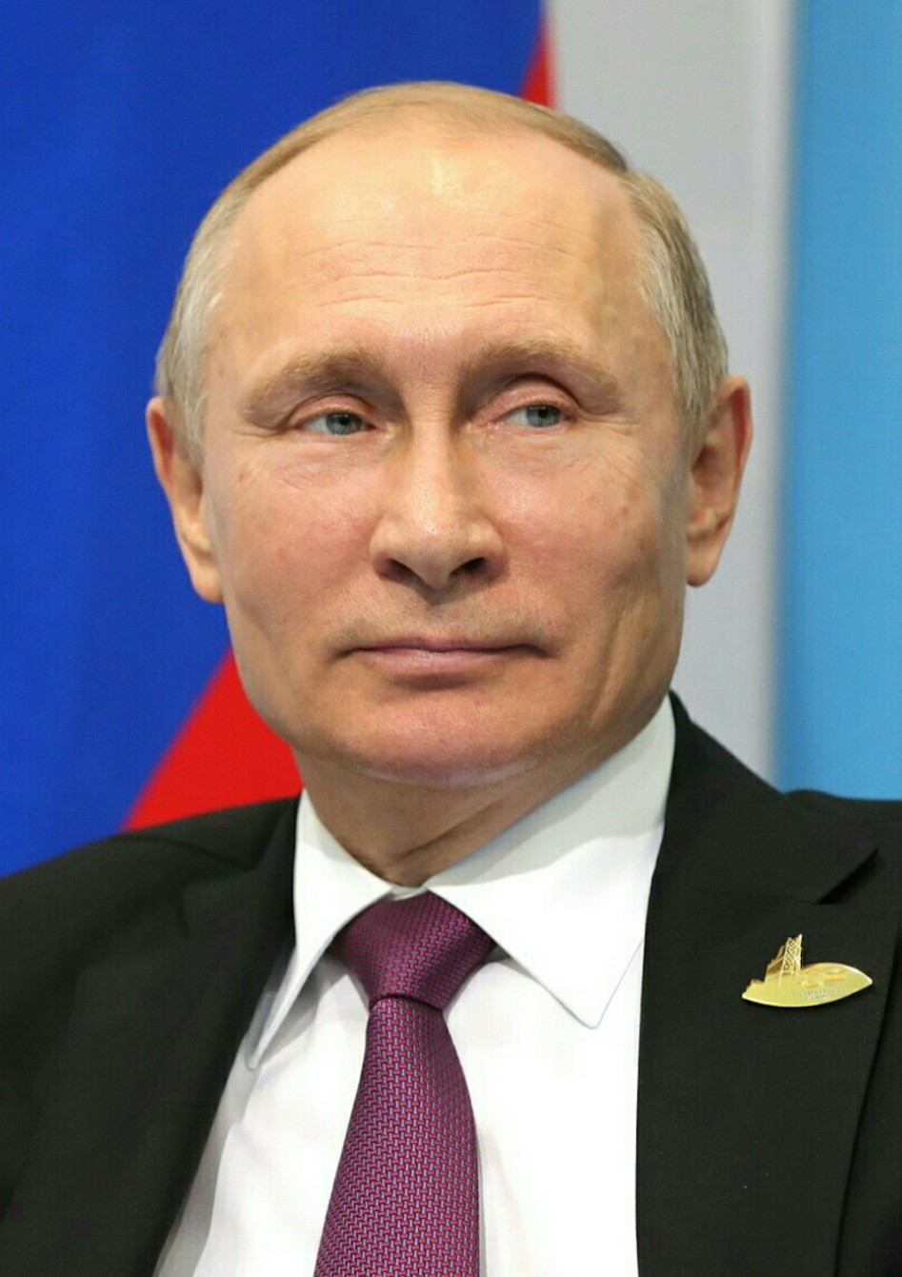
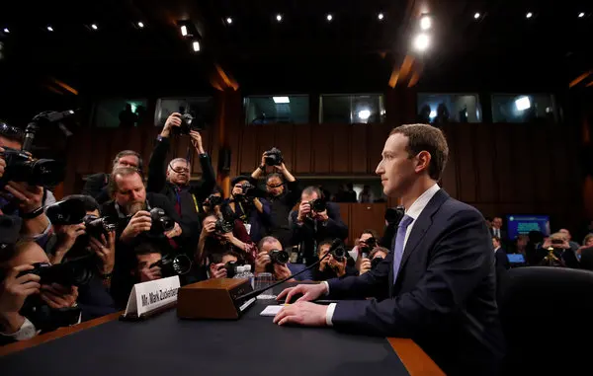
Social Media, Disinformation, and Russia (reference)
Russian Disinformation
Director of National Intelligence Report, January 2017
House Intelligence Committee Report, March 2018
Senate Intelligence Committee Reports
Senate Intelligence Committee Report April 2020
Putin Facebook CEO Zuckerberg

Slide 14
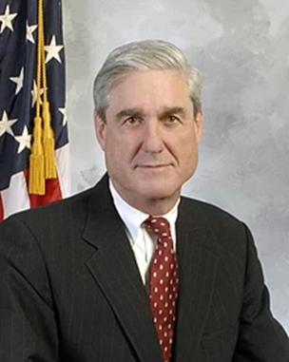
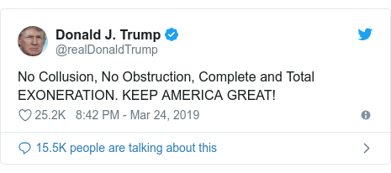
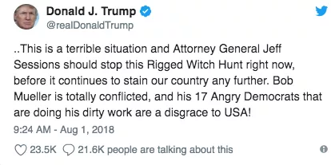
Mueller Report, April 18, 2019 Appointed May 2017
Special Counsel Robert Mueller

Slide 15
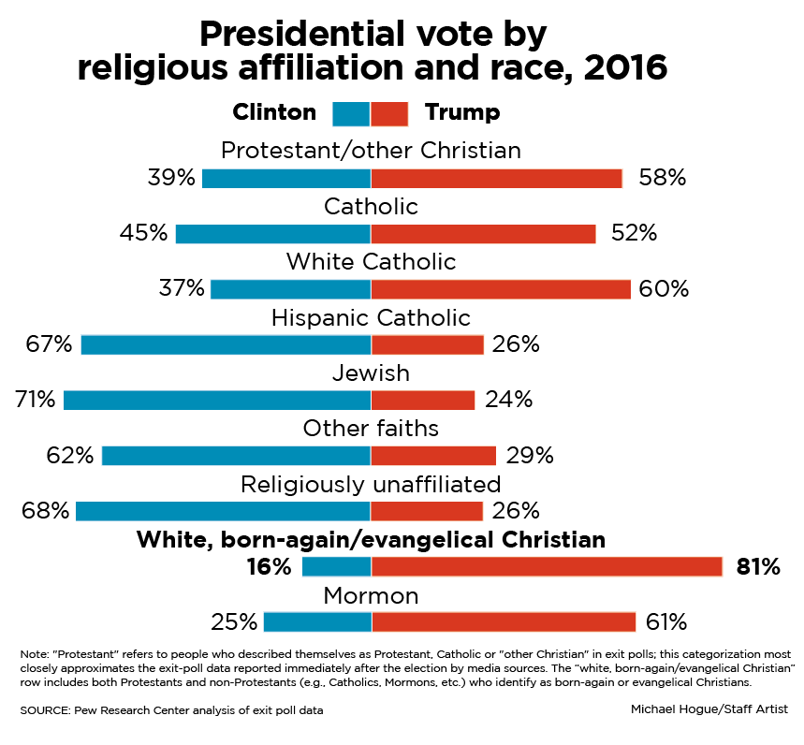
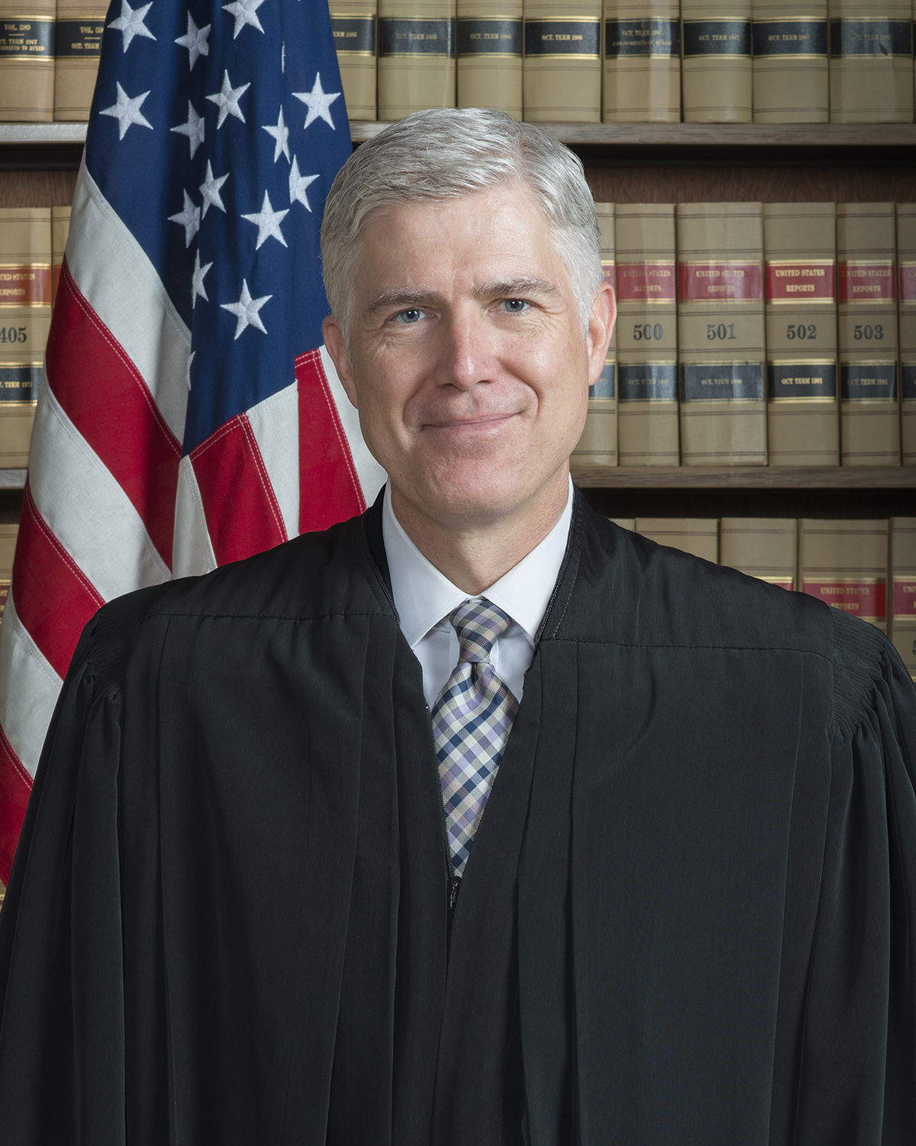
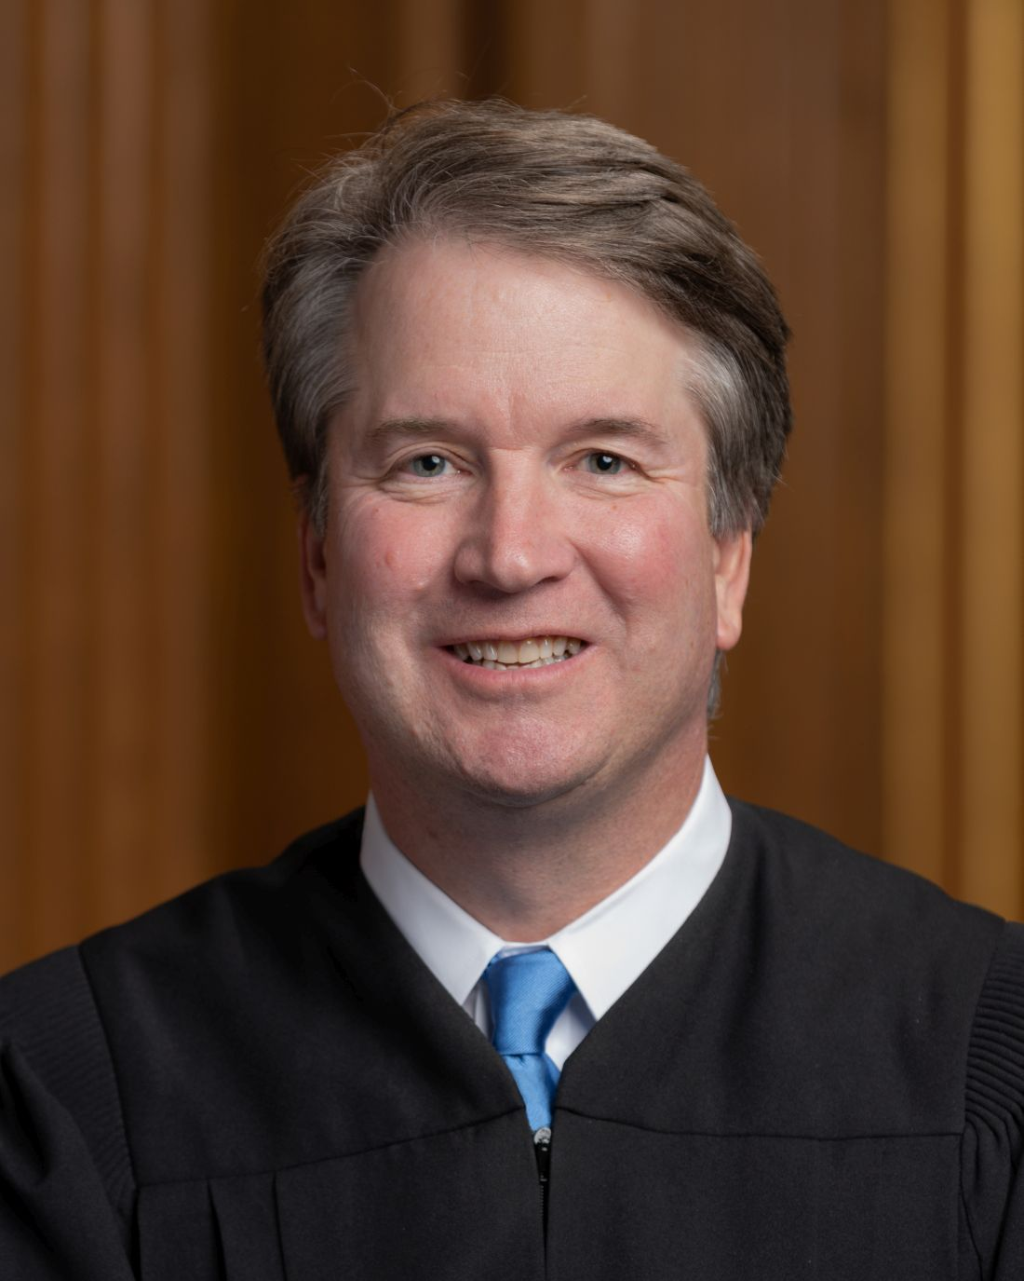
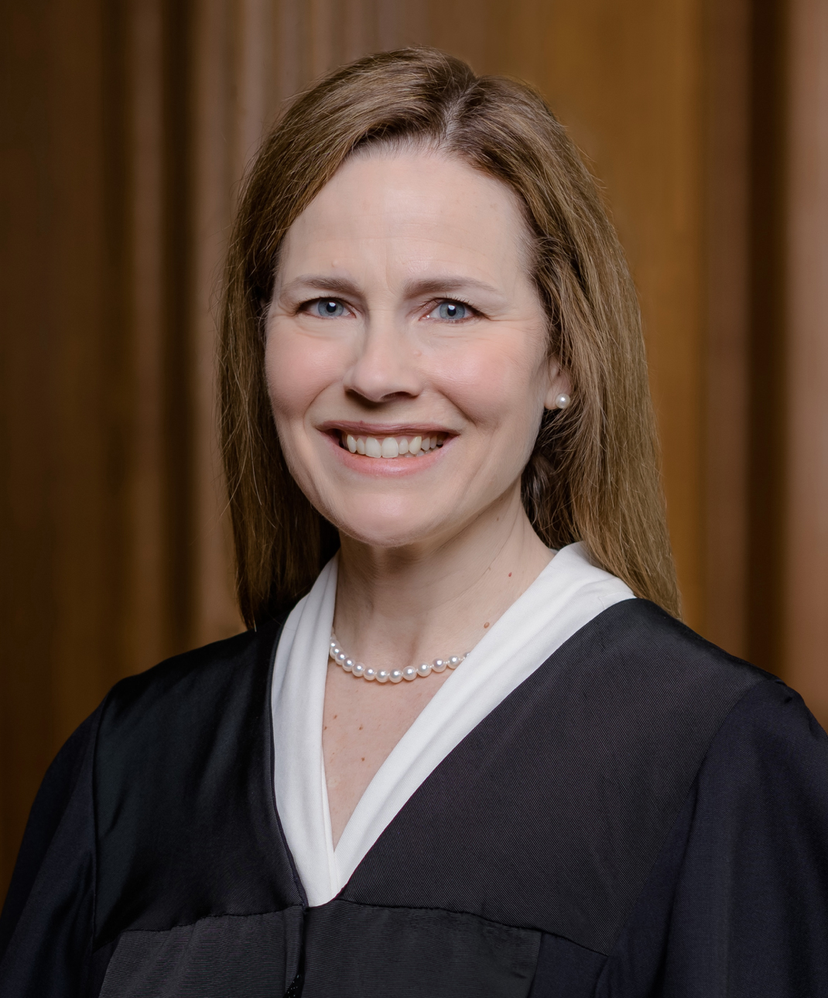
2. Trump Policies
Movement Conservative Policies
Justice Justice Justice
Neil Brett Amy Coney
Gorsuch Kavanaugh Barrett

Slide 16
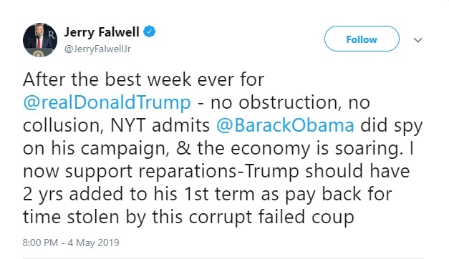
Evangelical Support
Franklin Graham
“Progressive?...That’s just another word for godless.”
May 2018

Slide 17
Immigration and Trade

Slide 18
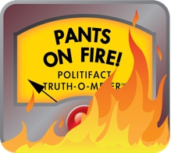
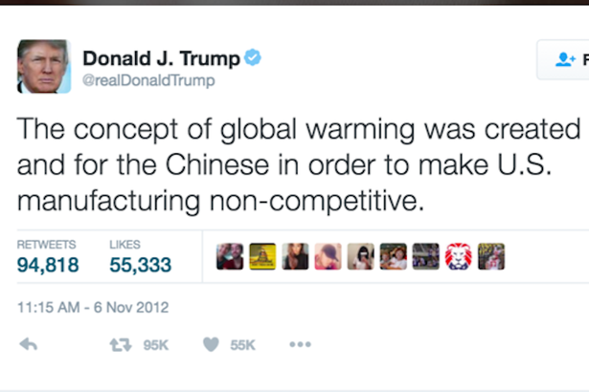
3.Trump Style: Twitter
Attack
Lying
Politifact on Trump
Washington Post Fact Checker
30,573 lies in four years
Trump vs. CDC, April 2020

Slide 19
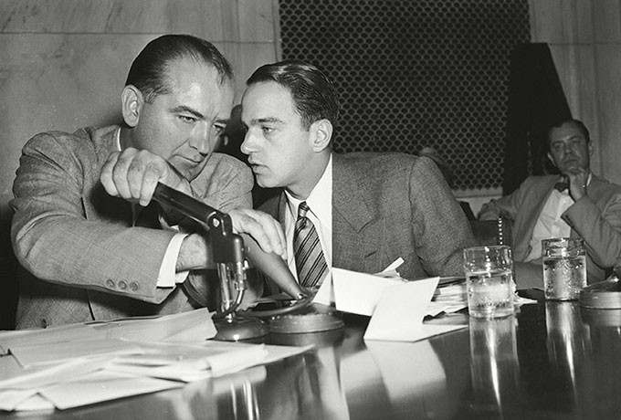
Demagoguery
Sen. Joseph McCarthy and Roy Cohn (Chief Counsel for the Senate Permanent Committee on Investigations)

Slide 20
Roy Cohn Style
Lie about everything
The more outlandish the better; never back down
No shame
Accuse people of the things that you yourself are doing
Facing investigation: use every legal trick to delay, complicate, raise the cost of investigation/prosecution
If sued, countersue until the end of time
Discredit all your enemies in every way possible
Scorched earth; better to destroy everything than admit guilt or lose

Slide 21
Trump and Cohn (1984)

Slide 22
4. Impeachment Number 1
Notes:
Trump was impeached twice. In both cases, the impeachment was mostly along party lines.

Slide 23
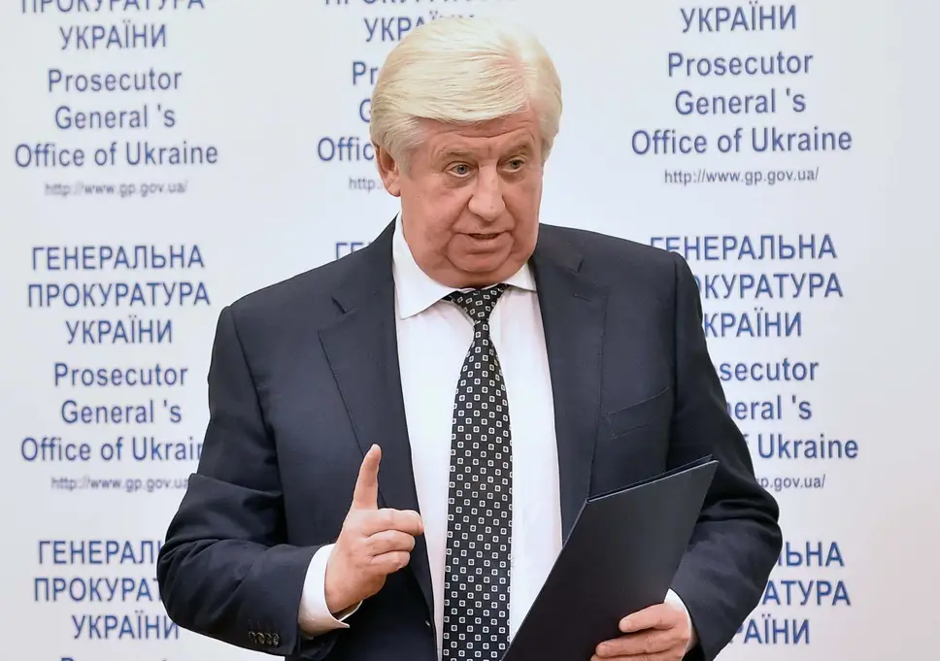
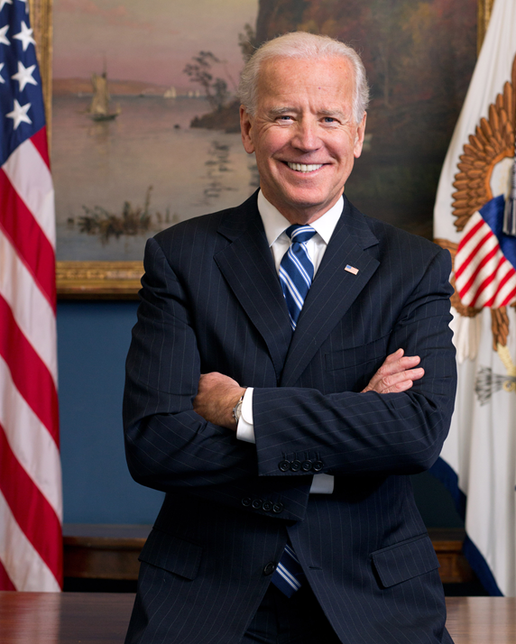
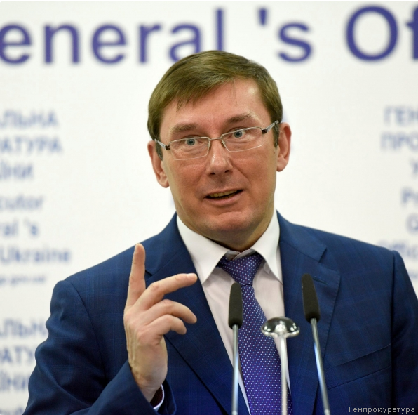
Allegations against VP Joe Biden Russian Disinformation Campaign (reference)
Viktor Shokin VP Joe Biden Yuri Lutsenko
Ukraine Chief Shokin Prosecutor Successor
Notes:
Disinformation about Joe Biden all over the internet said that he had threatened to withhold aid to Ukraine if Ukraine investigated his son’s dealings with Ukrainian companies (Hunter Biden and a company called Burisma). The reality is that during the Obama administration Ukraine had been told to end corruption or it wouldn’t get aid from the US and Europe. Victor Shokin was the Ukrainian official who was supposed to investigate corruption. Notice I say “supposed to.” He didn’t investigate it. Biden was the Obama administration's Ukraine go to guy on Ukraine and he did tell Ukraine to fire Shokin, but there is no evidence it was to protect Burisma and Hunter Biden. There were no investigations into that yet. But after Ukraine fired Shokin, the new Chief Prosecutor – Lutsenko – did investigate Hunter Biden and Burisma and found nothing. So, in the real world, the firing of Shokin led to the investigation. In the alternate world, the firing of Shokin ended an investigation. The alternate world didn’t happen in this corner of the multiverse; however, most Republicans believe it did.

Slide 24
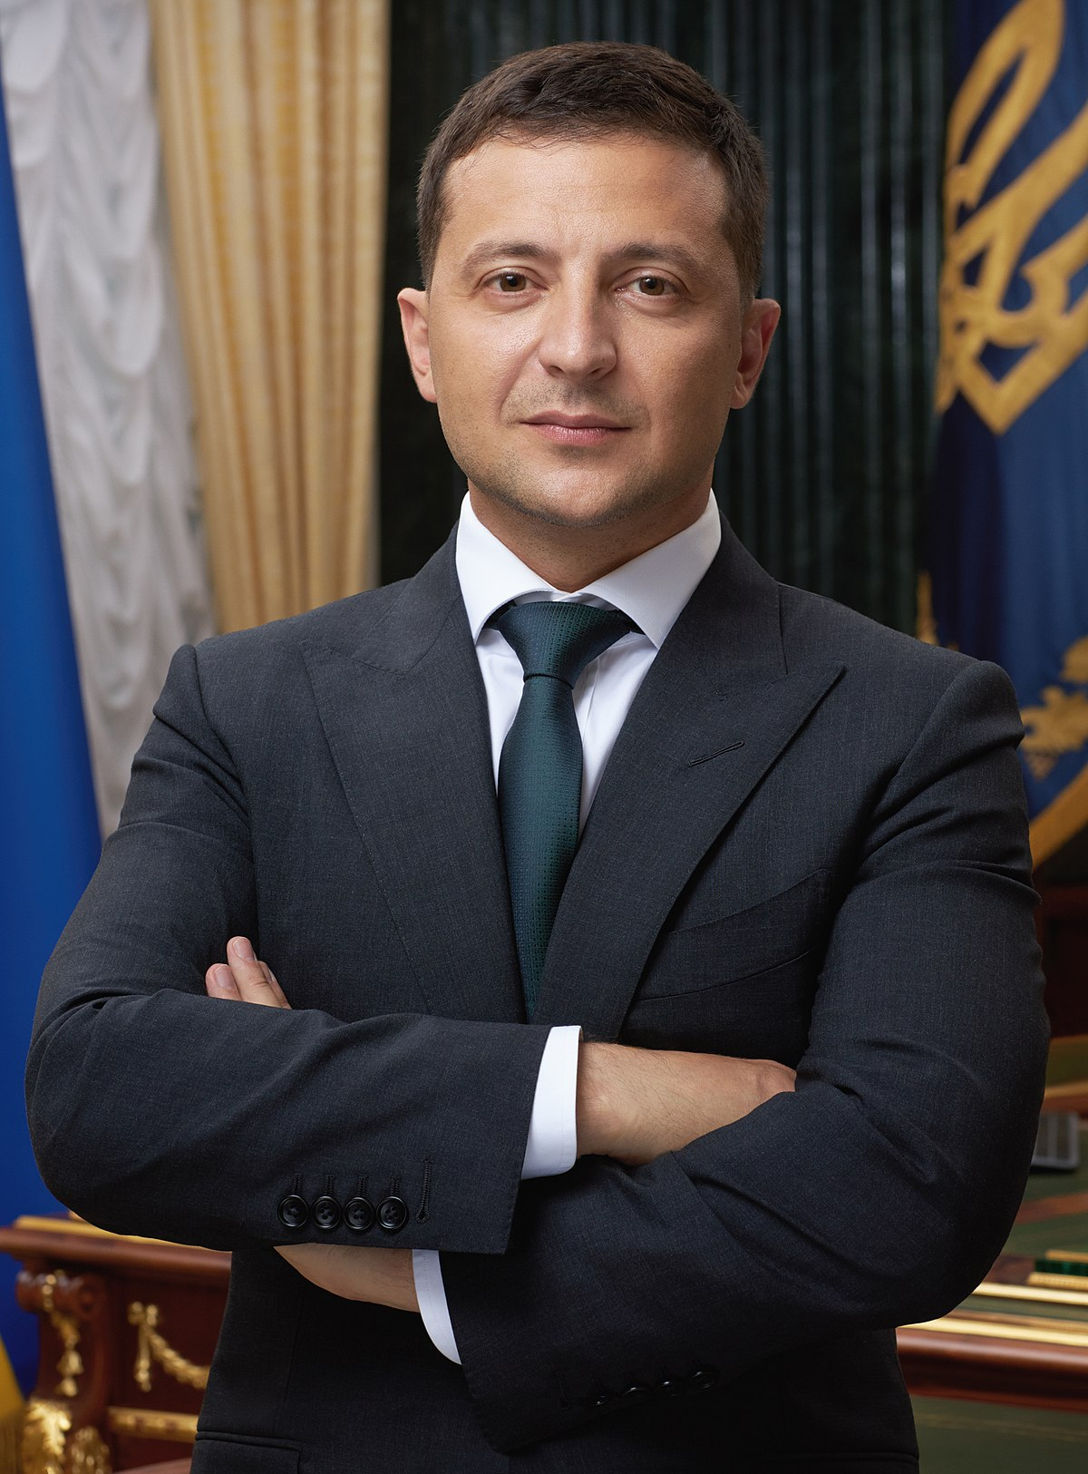
Trump and Ukraine
$391 million in US Aid to Ukraine
July 25, 2019 Phone Call
The Whistleblower Report
White House Transcript
Timeline of Events
Pres. Volodimir
Zelensky
“…I would like you to do us a favor though… The other thing, There's a lot of talk about Biden's son,. that Biden stopped the prosecution and a lot of people want to find out about that so whatever you can do with the Attorney General would be great. Biden went around bragging that he stopped the prosecution so if you ·can look into it ... It sounds horrible to me.” (pages 3-4)
Notes:
In the first impeachment, the key details:
The US promised $391 million dollars in aid to Ukraine. Foreign aid is given to other countries as part of specific laws which grant aid to other nations. The point here is that when the US passes a law that says a nation will get foreign aid, then the money is not a suggestion or a desire, it is the law of the US.
That means that it is subject to the Congressional Budget and Impoundment Control Act of 1974 (a piece of legislation which you all know and love). That money must be spent by the end of the fiscal year or the executive branch is in violation of the law.
Trump stopped the flow of money to Ukraine on July 3 and 12, 2019 (through orders to the Office of Management and Budget).
During July, US officials told President Zelensky of Ukraine that he needed to open an investigation into Joe Biden or announce an investigation into Joe Biden if he wants the aid to keep flowing, an investigation, in part, into the issues mentioned in the previous slide.
July 25: In a phone call to Zelensky Trump explained that he needed Zelensky to do him a favor…See the quote in the slide, or read the transcript, or read the whistleblower report. The phone call was recorded.
In short, on tape President Trump tried to extort a foreign leader whose country had been invaded by Russia: Announce that you are investigating my political rival for corruption or else I will end US aid to Ukraine.
Holy &$#%
The US has whistleblower laws which allow officials who think they have seen an illegal act in their department or agency to report it to a specific official in that agency. A CIA officer files a whistleblower report.
Congress finds out about the suspension of aid because Ukraine begins asking officials in several agencies about it: Why have you blocked aid to Ukraine? Congress informs the administration that blocking this aid is probably illegal.
Mid September: the aid is released because on September 30 the fiscal year ends and if the aid had not been released by then, the administration would be in violation of the law.
Congress begins investigating this. They get a transcript of the Trump-Zelensky conversation. Eventually, the transcript is released to the public.
Trump says the transcript exonerates him because it shows the call was “perfect.”

Slide 25
First Impeachment, 2019-2020 (Reference)
 | House (brings charges) | Senate (requires 2/3 for conviction)
First Impeachment | December 18, 2019 | February 5, 2020
Abuse of Power | 230-197 | 48-52 (Party Line vote)
Obstruction of Congress | 229-198 | 47- 53 (one Republican voted guilty, Mitt Romney (UT)
Notes:
Here are the charges, links to the charges, and the votes.

Slide 26
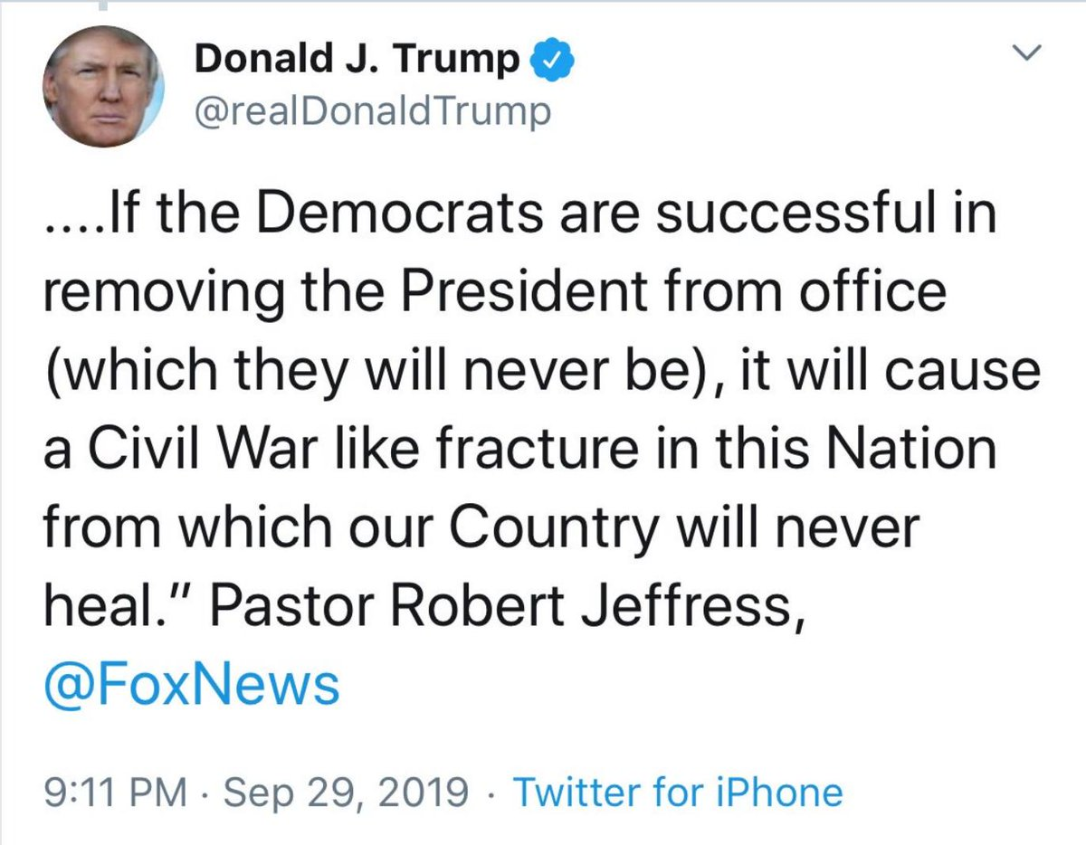
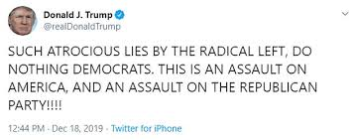
Trump Response
Refusal to allow witness testimony
Refusal to turn over documents
Notes:
Trump’s response: angry tweets.

Slide 27
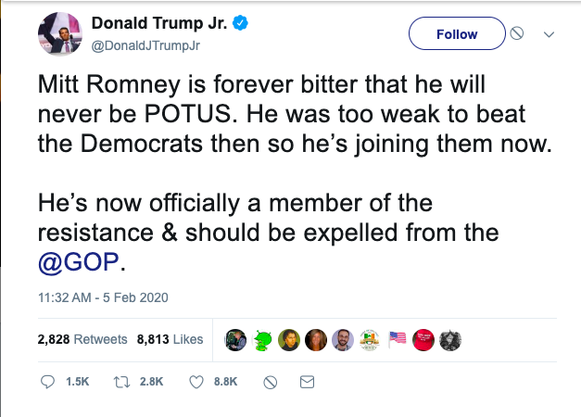
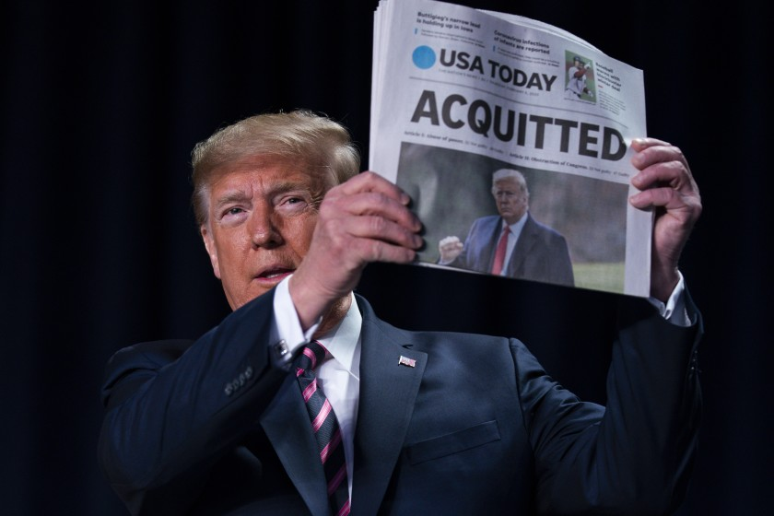
Senate Finds Trump Not Guilty
Party line votes except for Mitt Romney voting guilty on Abuse of Power charge
Notes:
Trump is found not guilty in the Senate. Like the House impeachment vote, it is mostly on partisan lines.

Slide 28
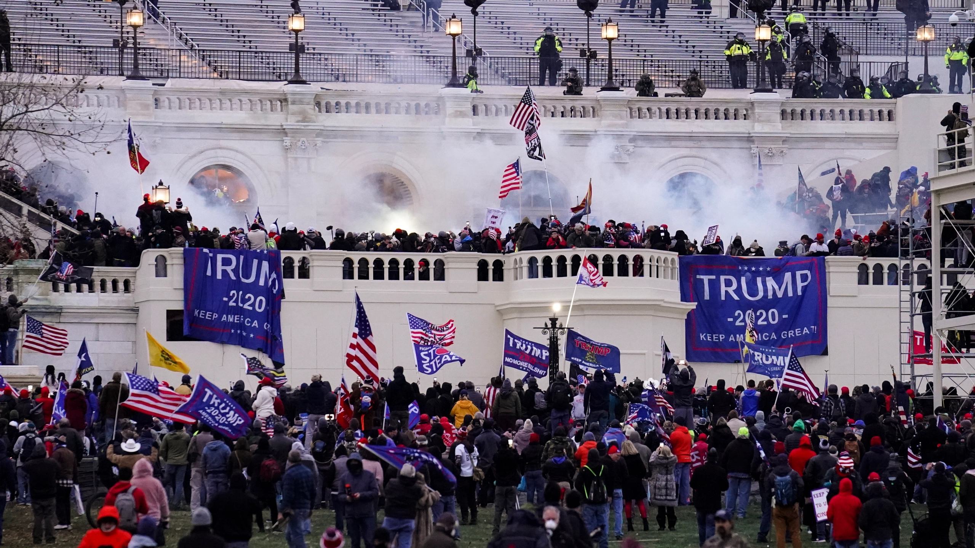
Second Impeachment: Incitement of Insurrection
Notes:
Second impeachment is over January 6 and charges that Trump encouraged an insurrection against the US government.

Slide 29
Second Impeachment (Reference)
 | House (brings charges) | Senate (requires 2/3 for conviction)
Second Impeachment | January 13, 2021 | February 13, 2021
Incitement of Insurrection | 232-197 Ten Republicans voted for charges | 57-43 Seven Republicans voted guilty (Richard Burr (NC), Bill Cassidy (LA), Susan Collins (ME), Lisa Murkowski (AK), Mitt Romney (UT), Ben Sasse (NE), Pat Toomay (PA))
Notes:
The Vote. You might ask: why would they even bother impeaching him when he was leaving office anyway. First, Trump tried to stay in office (that was what January 6 was about). But even after he did leave office on January 20, why bother having the Senate vote? One of the punishments in a conviction of this type can be barring someone from ever holding federal office, which would prevent Trump from running for president again. Also, if impeached and convicted for encouraging an insurrection, Section 3 of the 14th Amendment could come into play. It bars anyone involved in an insurrection from holding federal office:
“Section 3
No person shall be a Senator or Representative in Congress, or elector of President and Vice-President, or hold any office, civil or military, under the United States, or under any State, who, having previously taken an oath, as a member of Congress, or as an officer of the United States, or as a member of any State legislature, or as an executive or judicial officer of any State, to support the Constitution of the United States, shall have engaged in insurrection or rebellion against the same, or given aid or comfort to the enemies thereof. But Congress may by a vote of two-thirds of each House, remove such disability.”

Slide 30
Notes:
Trump’s approval ratings during his term in office. Notice the big drop after January 6.

Slide 31
Trump Job Approval 2021
Notes:
His job approval ratings.

Slide 32
2020 Election
Notes:
The 2020 election. Biden takes back Michigan, Pennsylvania, and Wisconsin which Trump had won in 2016. And he takes Georgia and Arizona. These were upsets to a certain extent.

Slide 33
President Biden and VP Kamala Harris
Notes:
The new team after the 2020 election.

