Slide 1
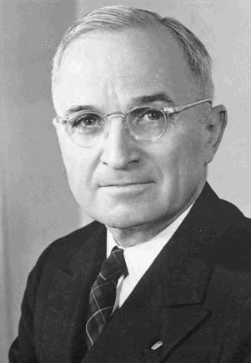
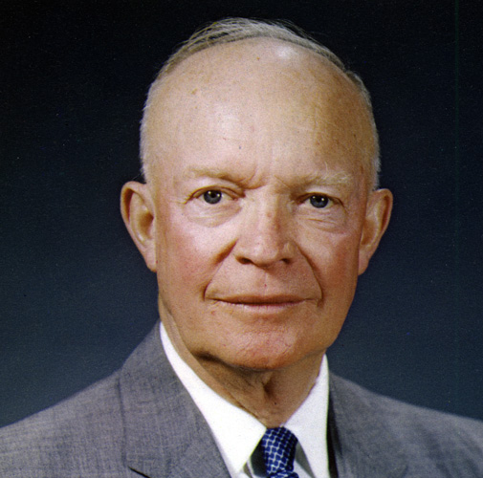


Truman, Ike, JFK
Part Three
Truman Eisenhower Kennedy

Slide 2
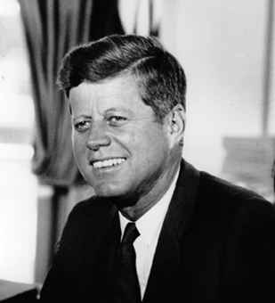
JFK
Informal Management
Notes:
2

Slide 3
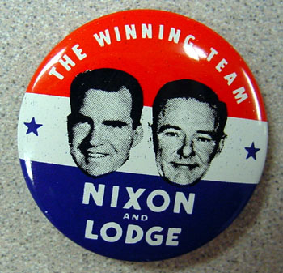
Republican Nominee
Notes:
3

Slide 4
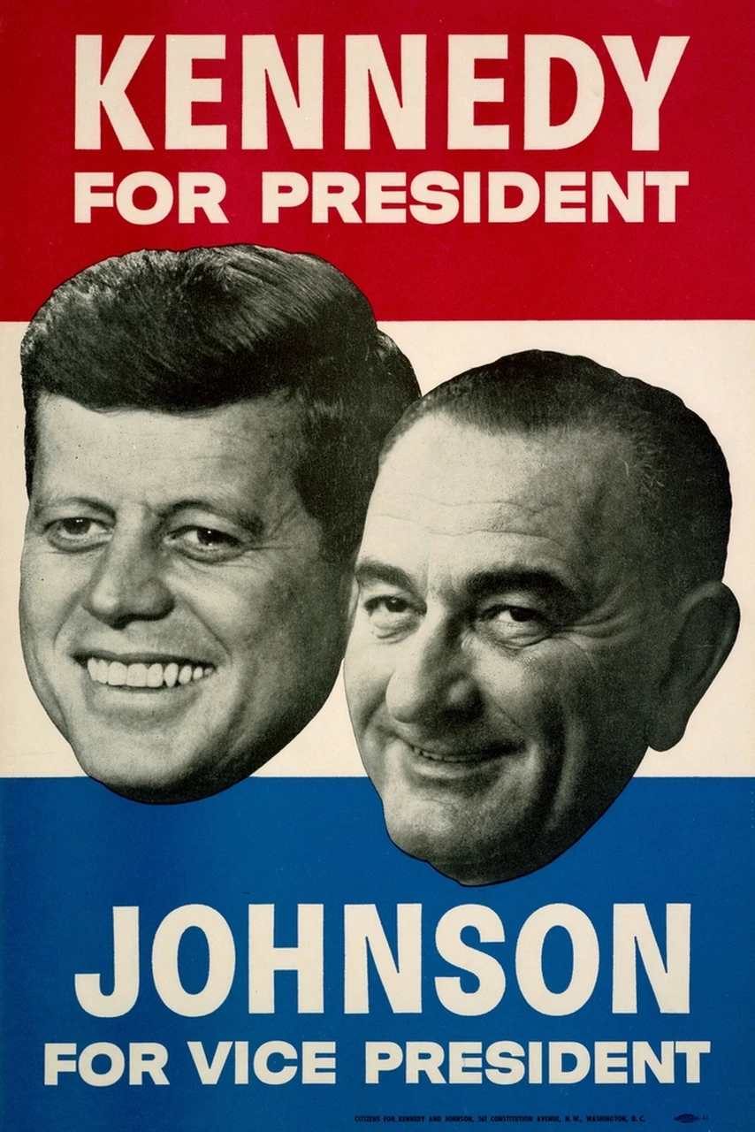

Slide 5
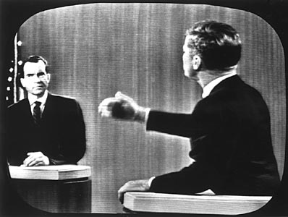
Debates: Nixon’s Uneasy
Notes:
5

Slide 6
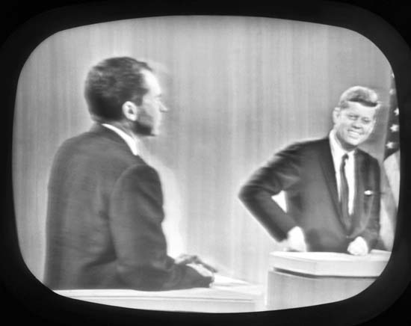
JFK’s Relaxed
Notes:
6

Slide 7
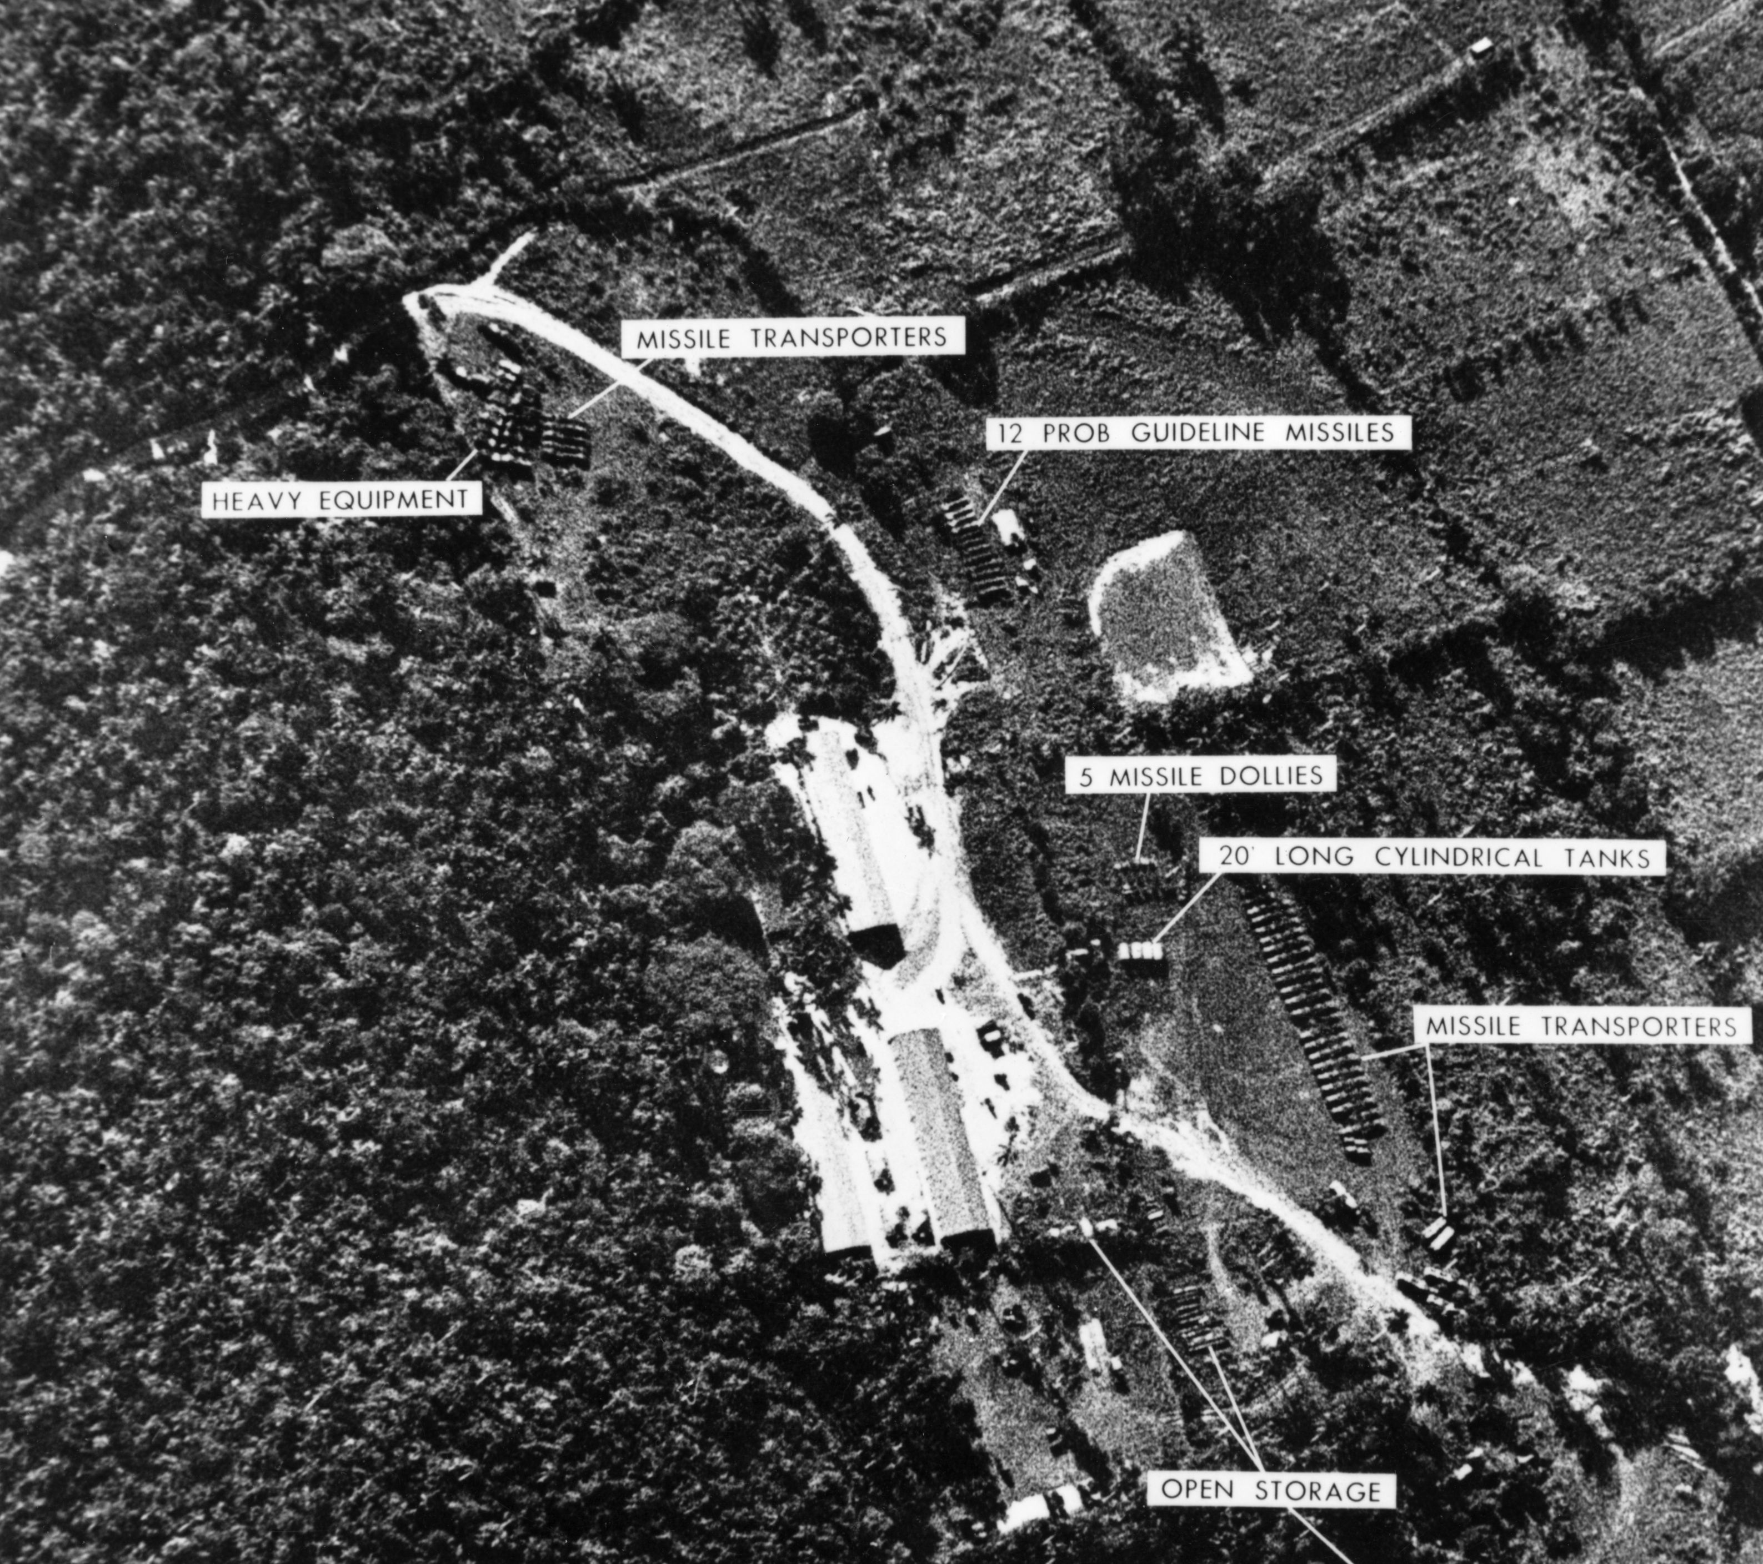
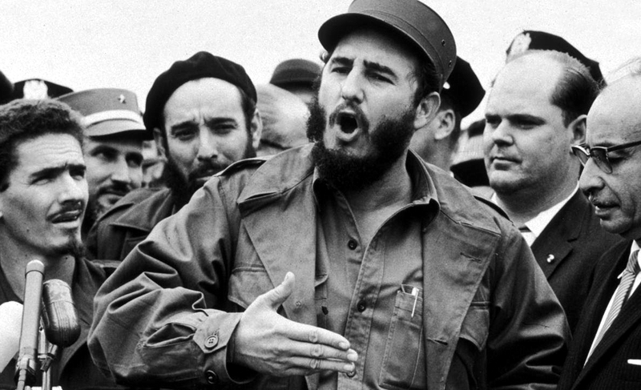
Kennedy and Cuba
Bay of Pigs
April 1961
Cuban Missile Crisis October 1962

Slide 8
Dual Roles of Cabinet Officers
President’s Key Adviser on an Issue
vs.
Senior Official of a Department of Agency
Notes:
8

Slide 9
Types of Presidential Advisers
Experts
Independent Political Figures
Friends
Notes:
9

Slide 10
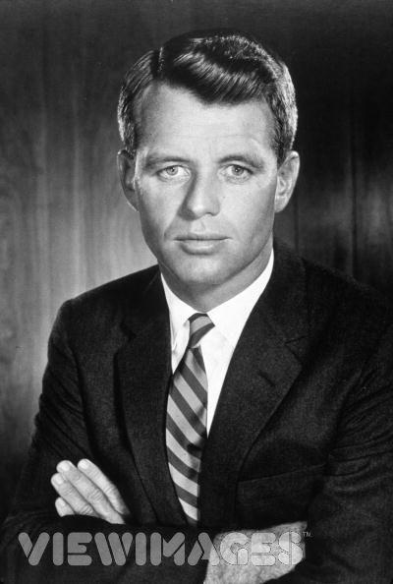
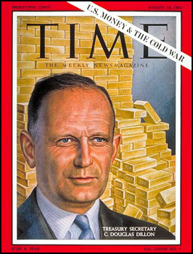
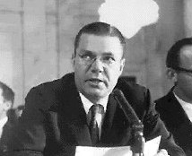
JFK Advisers
Robert Kennedy Douglas Dillon Robert McNamara
Attorney General Sec. Treasury Sec. Defense
Friend Independent Expert
political figure
Notes:
10

Slide 11
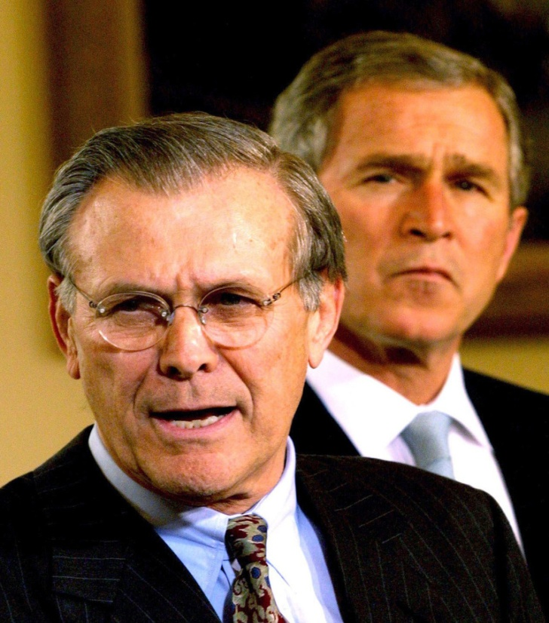
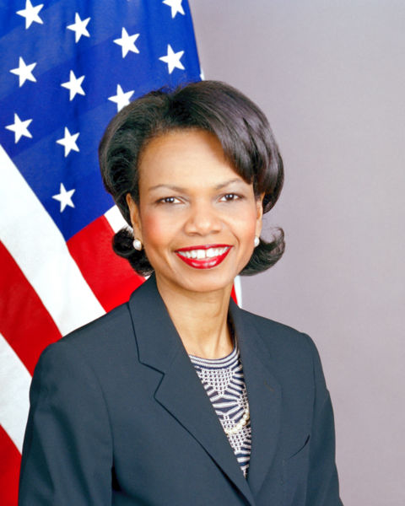
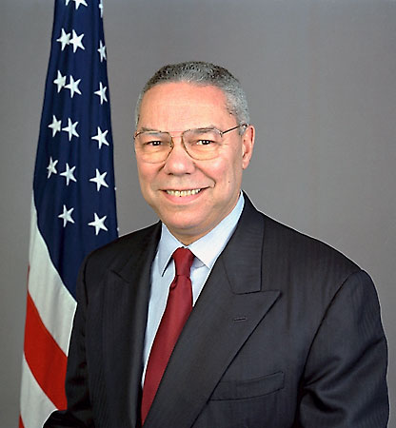
Bush 43 Advisers
Condoleezza Rice Colin Powell Donald Rumsfeld
Nat’l Security Adv Sec. of State Sec of Defense
Friend Independent Expert
political figure
Notes:
11

Slide 12
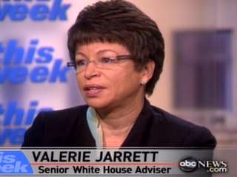
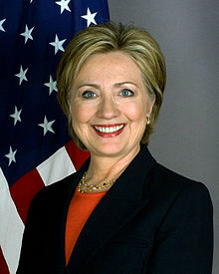
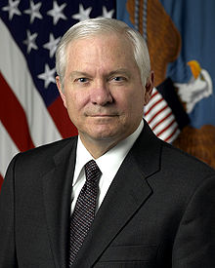
Obama Advisers
Valerie Jarrett Hillary Clinton Robert Gates
Senior Adviser Sec. State Sec. Defense Friend Independent Expert
political figure

Slide 13
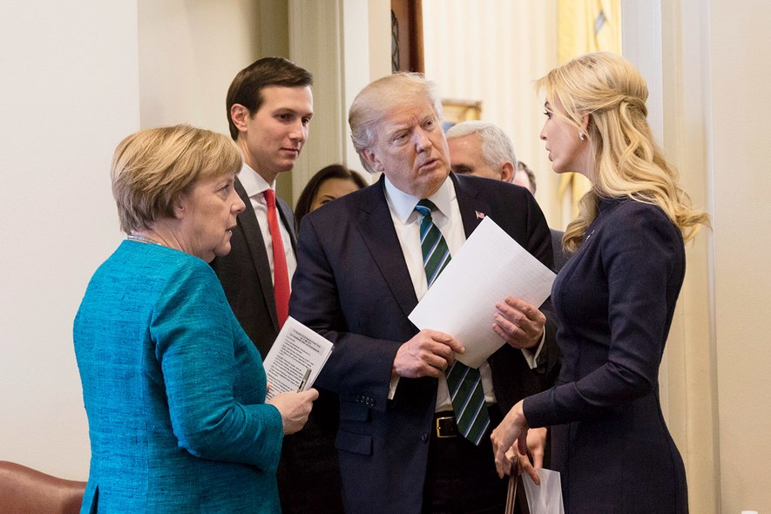
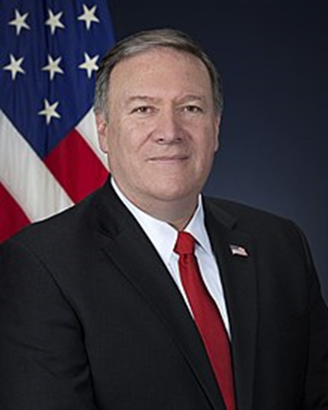
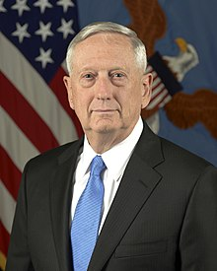
Trump Advisers
Ivanka Trump Mike Pompeo Jim Mattis
Jared Kushner Sec. State Sec. Defense
Friends Independent Expert
political figure

Slide 14
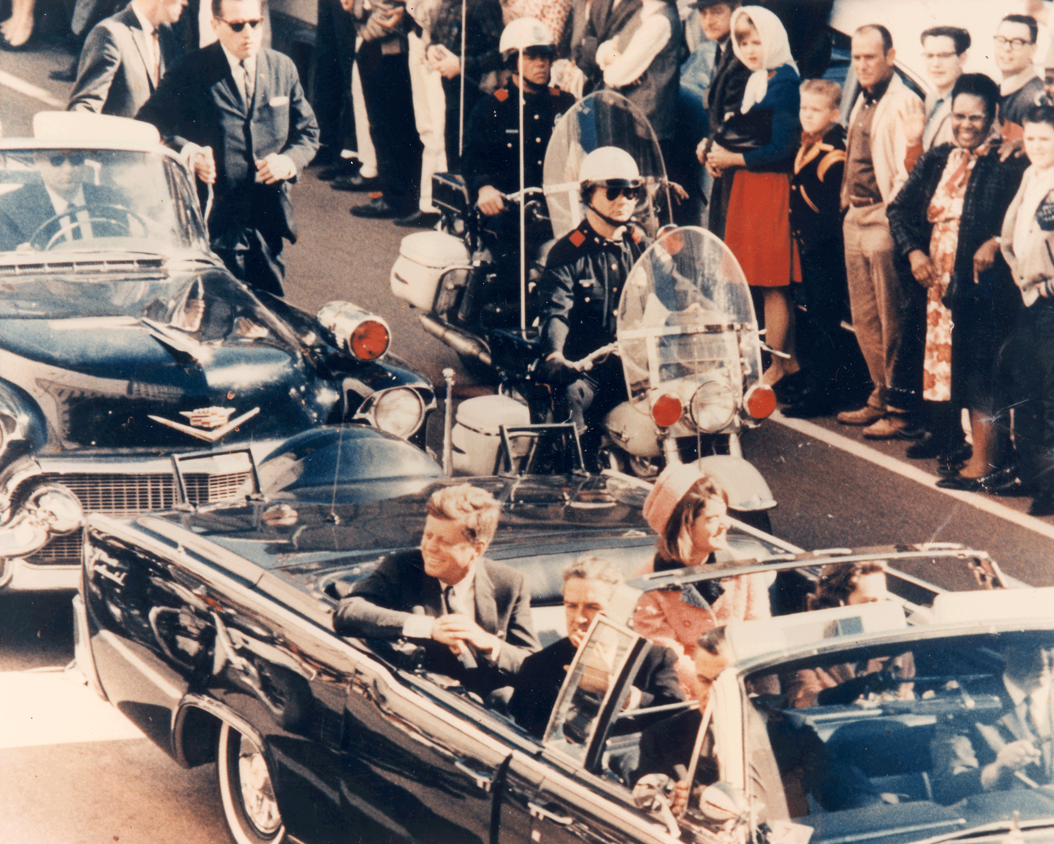
Dallas 11/22/1963
Notes:
14

Slide 15
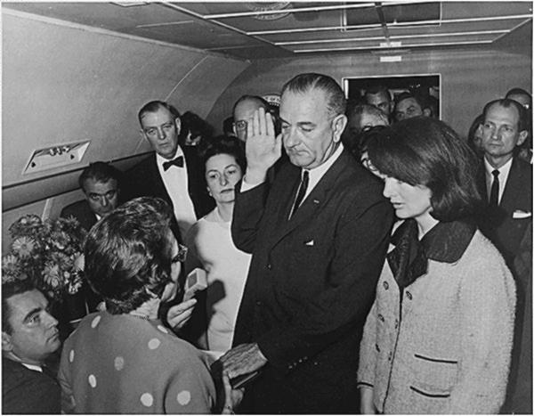
LBJ Taking the Oath of Office
Notes:
15

