Slide 1
Truman, Ike, JFK Part One FDR Changed everything: Now what?
Truman Eisenhower Kennedy

Slide 2
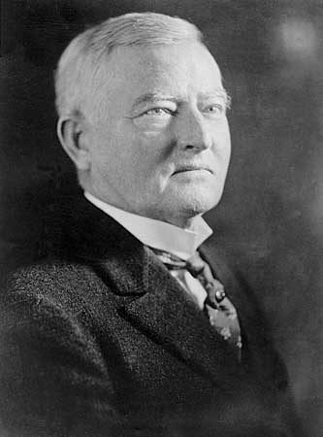
FDR VPs
John Nance Garner 1933-41
Henry Wallace
1941-45

Slide 3
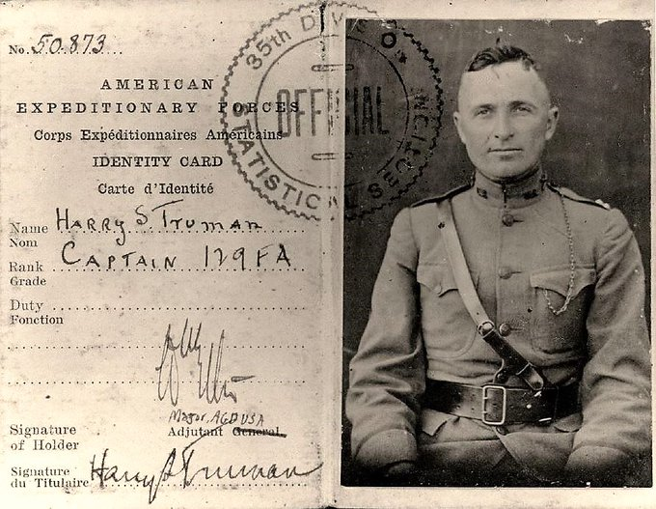
Harry Truman

Slide 4
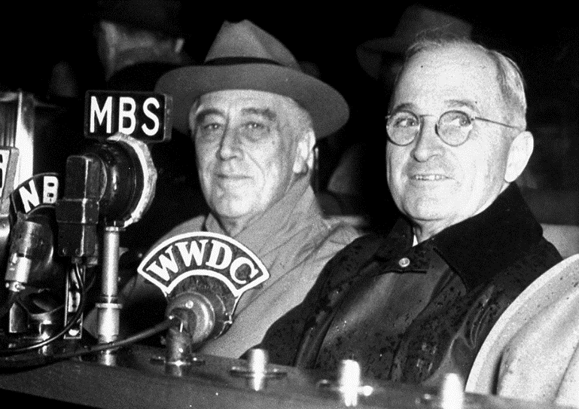
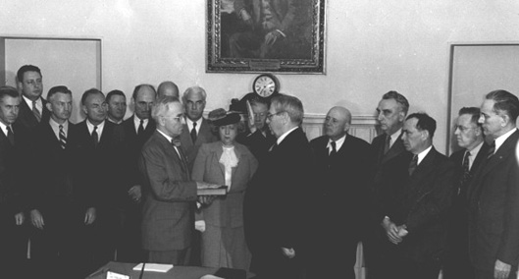
FDR and Truman
Vice Pres President
January 20, 1945 April 12, 1945

Slide 5
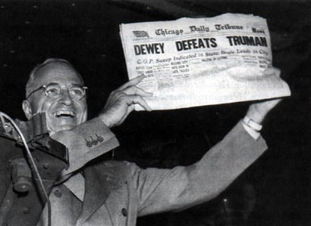
Harry Truman Election Day 1948

Slide 6
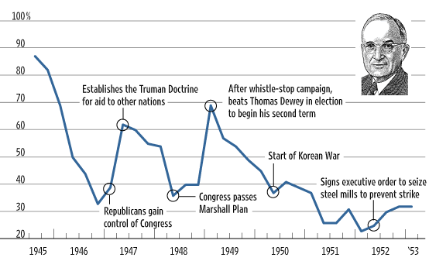
Truman Approval Ratings
Sources: Gallup, AP, WSJ.com research. From: Wall Street Journal.com: http://online.wsj.com/public/resources/documents/info-presapp0605-31.html

Slide 7
A Different Era?
Bipartisanship
Vs.
Demagoguery

Slide 8
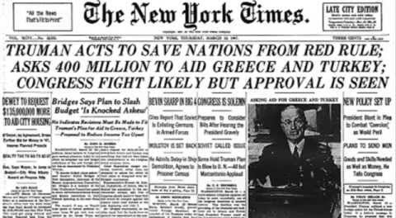
Leadership
“Truman Doctrine” speech, March 1947

Slide 9
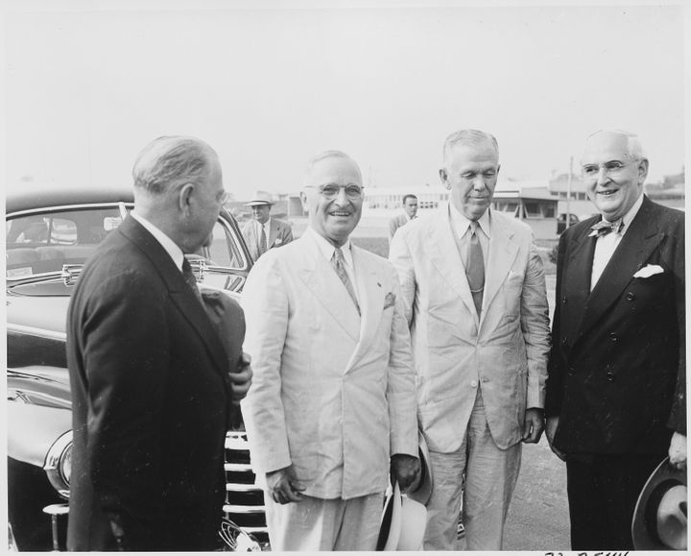
Bipartisanship
Truman and Senator Arthur Vandenberg (R-MI)
Right to Left: US Amb to UN Warren Austin, Truman, Secretary of State George Marshall, Vandenberg

Slide 10
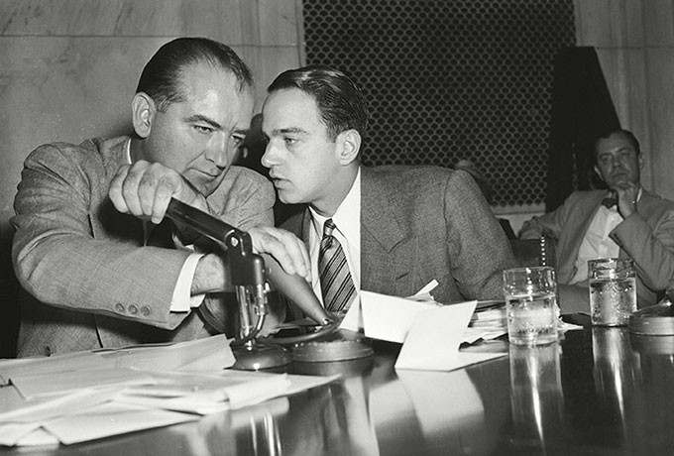
Demagoguery
Sen. Joseph McCarthy and Roy Cohn (Chief Counsel for the Senate Permanent Committee on Investigations)

Slide 11
Trump and Cohn (1984)

Slide 12
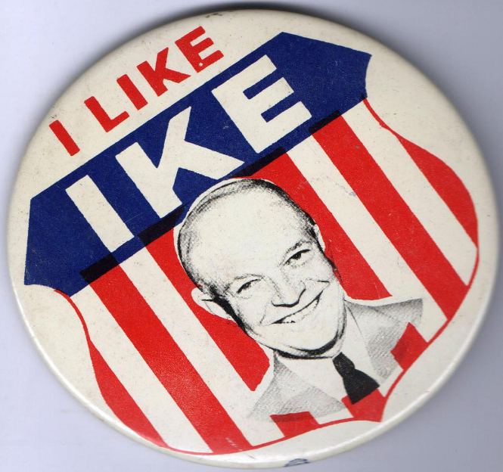
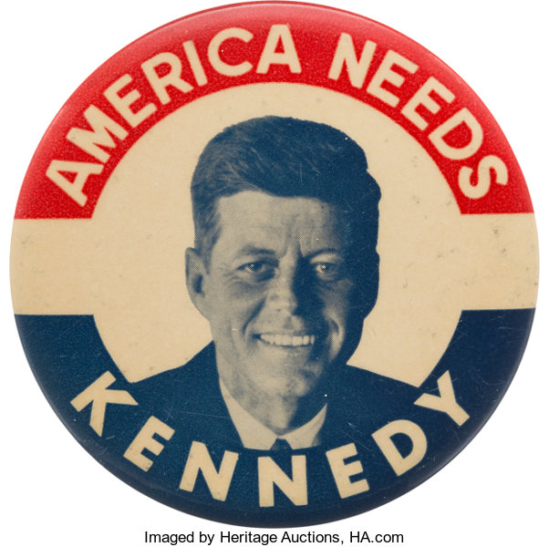
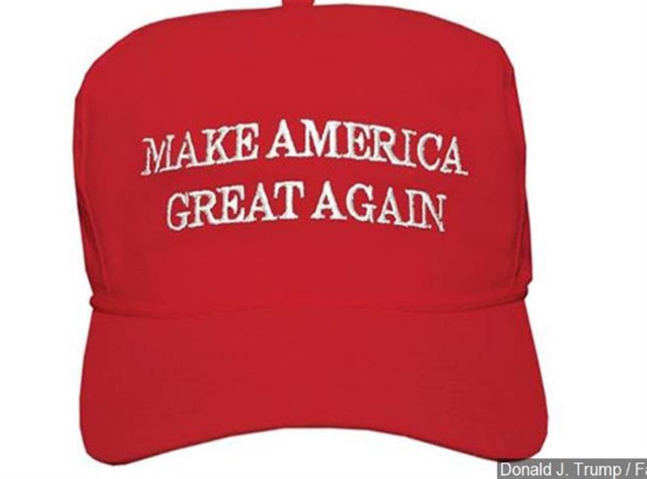
Two Developments
22nd Amendment (1951)
Candidate-centered Politics
Eisenhower JFK Trump

Slide 13
End Part One

