Slide 1
Facts
Evidence
Context
Lies

Slide 2
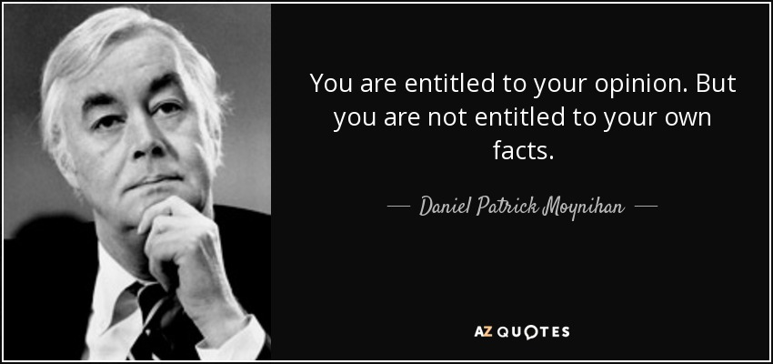
Senator Daniel Patrick Moynihan

Slide 3
“Alternative Facts”
Trump’s 2016 Victory

Slide 4
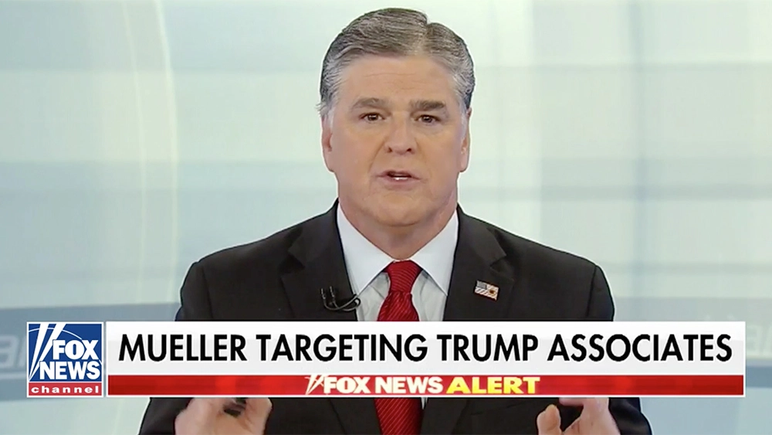
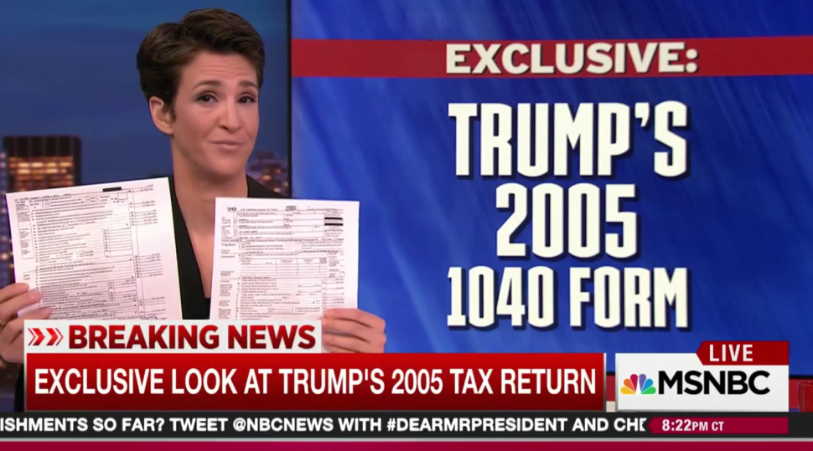
Social Media or TV as Our Source of News/Information
Reality Bubble/Echo Chambers
Opinion vs. Fact
Fox MSNBC

Slide 5
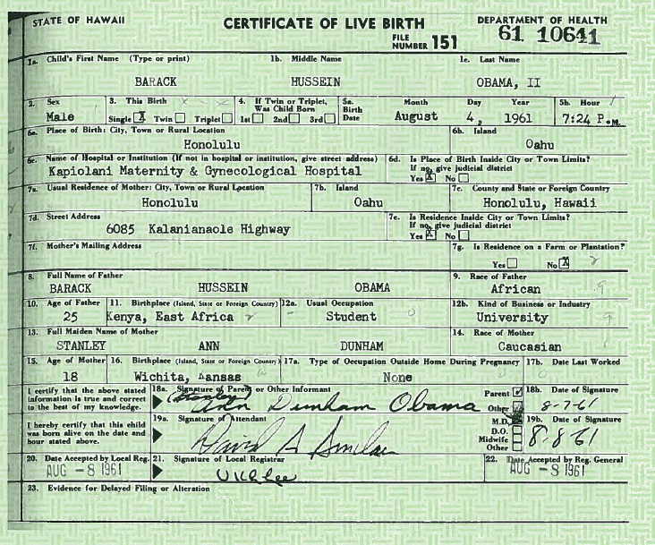
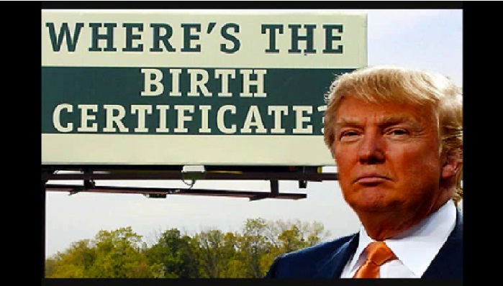
The Attention Economy
Clicks/Followers/Views
Conspiracy Sells
The “Birthers”
The Facts

Slide 6
Context, Evidence vs. Demagoguery, Trolling?
Traitor?
Serious drug problem in college
Nearly flunked out of college
Secret meetings with Chinese Communist Party Members
Received envelope filled with cash from an organization with ties to the Chinese Communist Party
Chinese and North Korean flags in his office
Advised members of the Chinese Communist Party
Under investigation by US government officials several times

Slide 7
Flags in the Office 1

Slide 8
Flags in the Office 2

Slide 9
Dig for Facts Liars Are Hoping You Won’t
Fact Check.Org From the Annenberg Center at the University of Pennsylvania
PolitiFact.com From several newspapers
The Fact Checker From the Washington Post
Snopes.com (fact checking and debunking urban legends and internet hoaxes that are often about politics)

