Slide 1
Facts
Evidence
Context
Lies

Slide 2
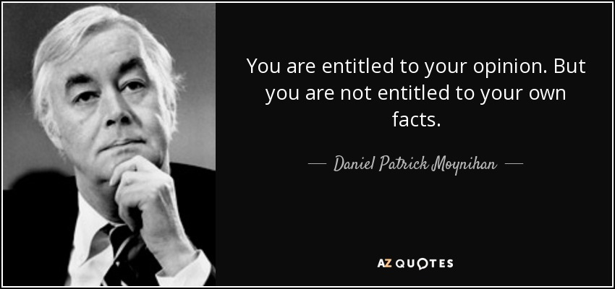
Senator Daniel Patrick Moynihan

Slide 3
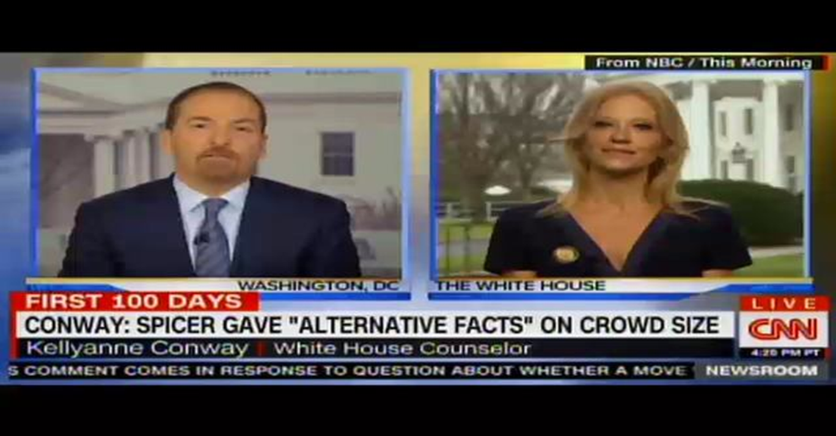
“Alternative Facts”
Trump’s 2016 Victory

Slide 4
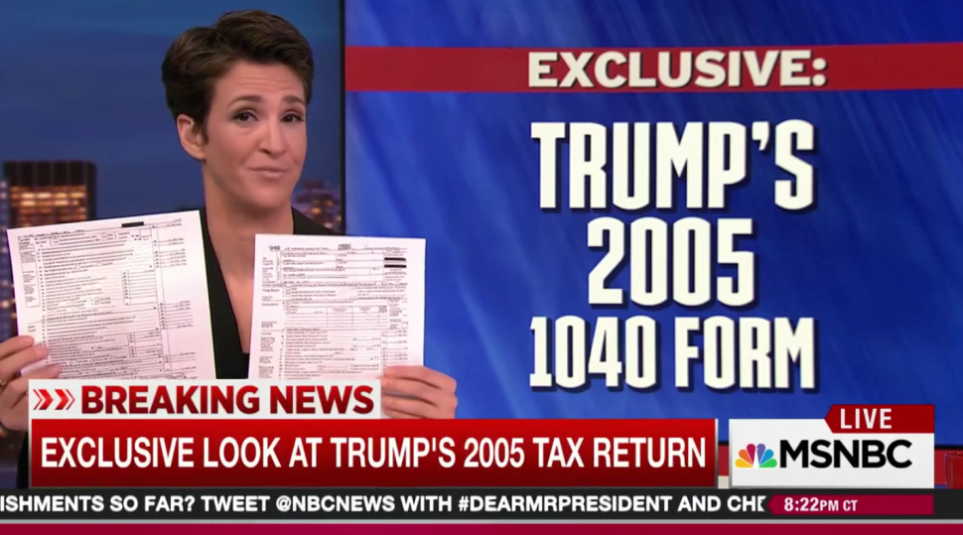
Social Media or TV as Our Source of News/Information
Spin
Reality Bubble/Echo Chambers
Opinion vs. Fact
Fox MSNBC

Slide 5
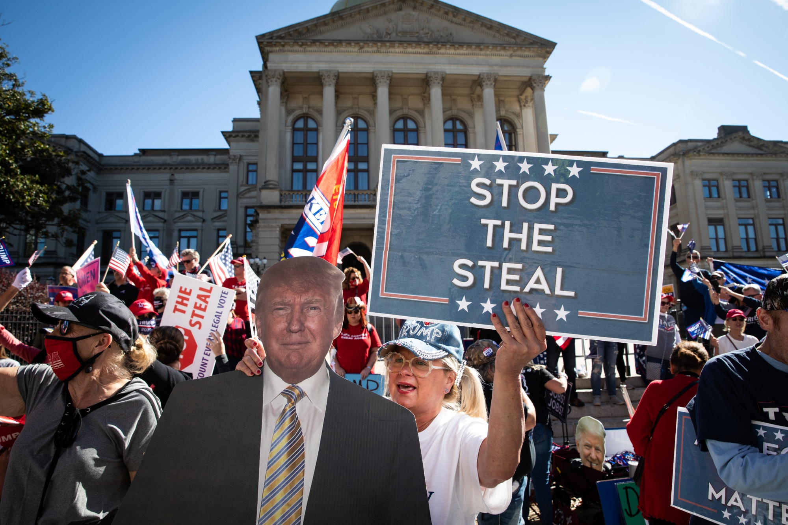
But not just spin… Post- Fact World?
Disinformation
Misinformation
Internet
Propaganda
The “Big Lie”
“Truth Decay”
(Rand Corporation Research Project)

Slide 6
No… A Problem with Social Media

Slide 7
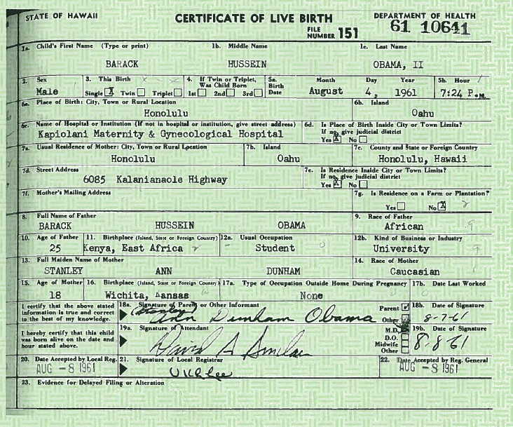
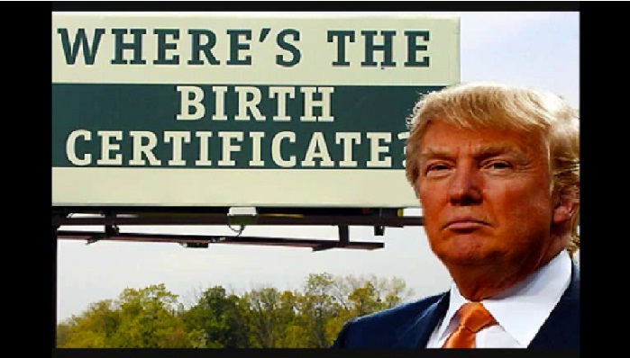
A Motivation… The Attention Economy
Clicks/Followers/Views
Conspiracy Sells
9/11 “Truthers” Debunked
The “Birthers”: The Facts

Slide 8
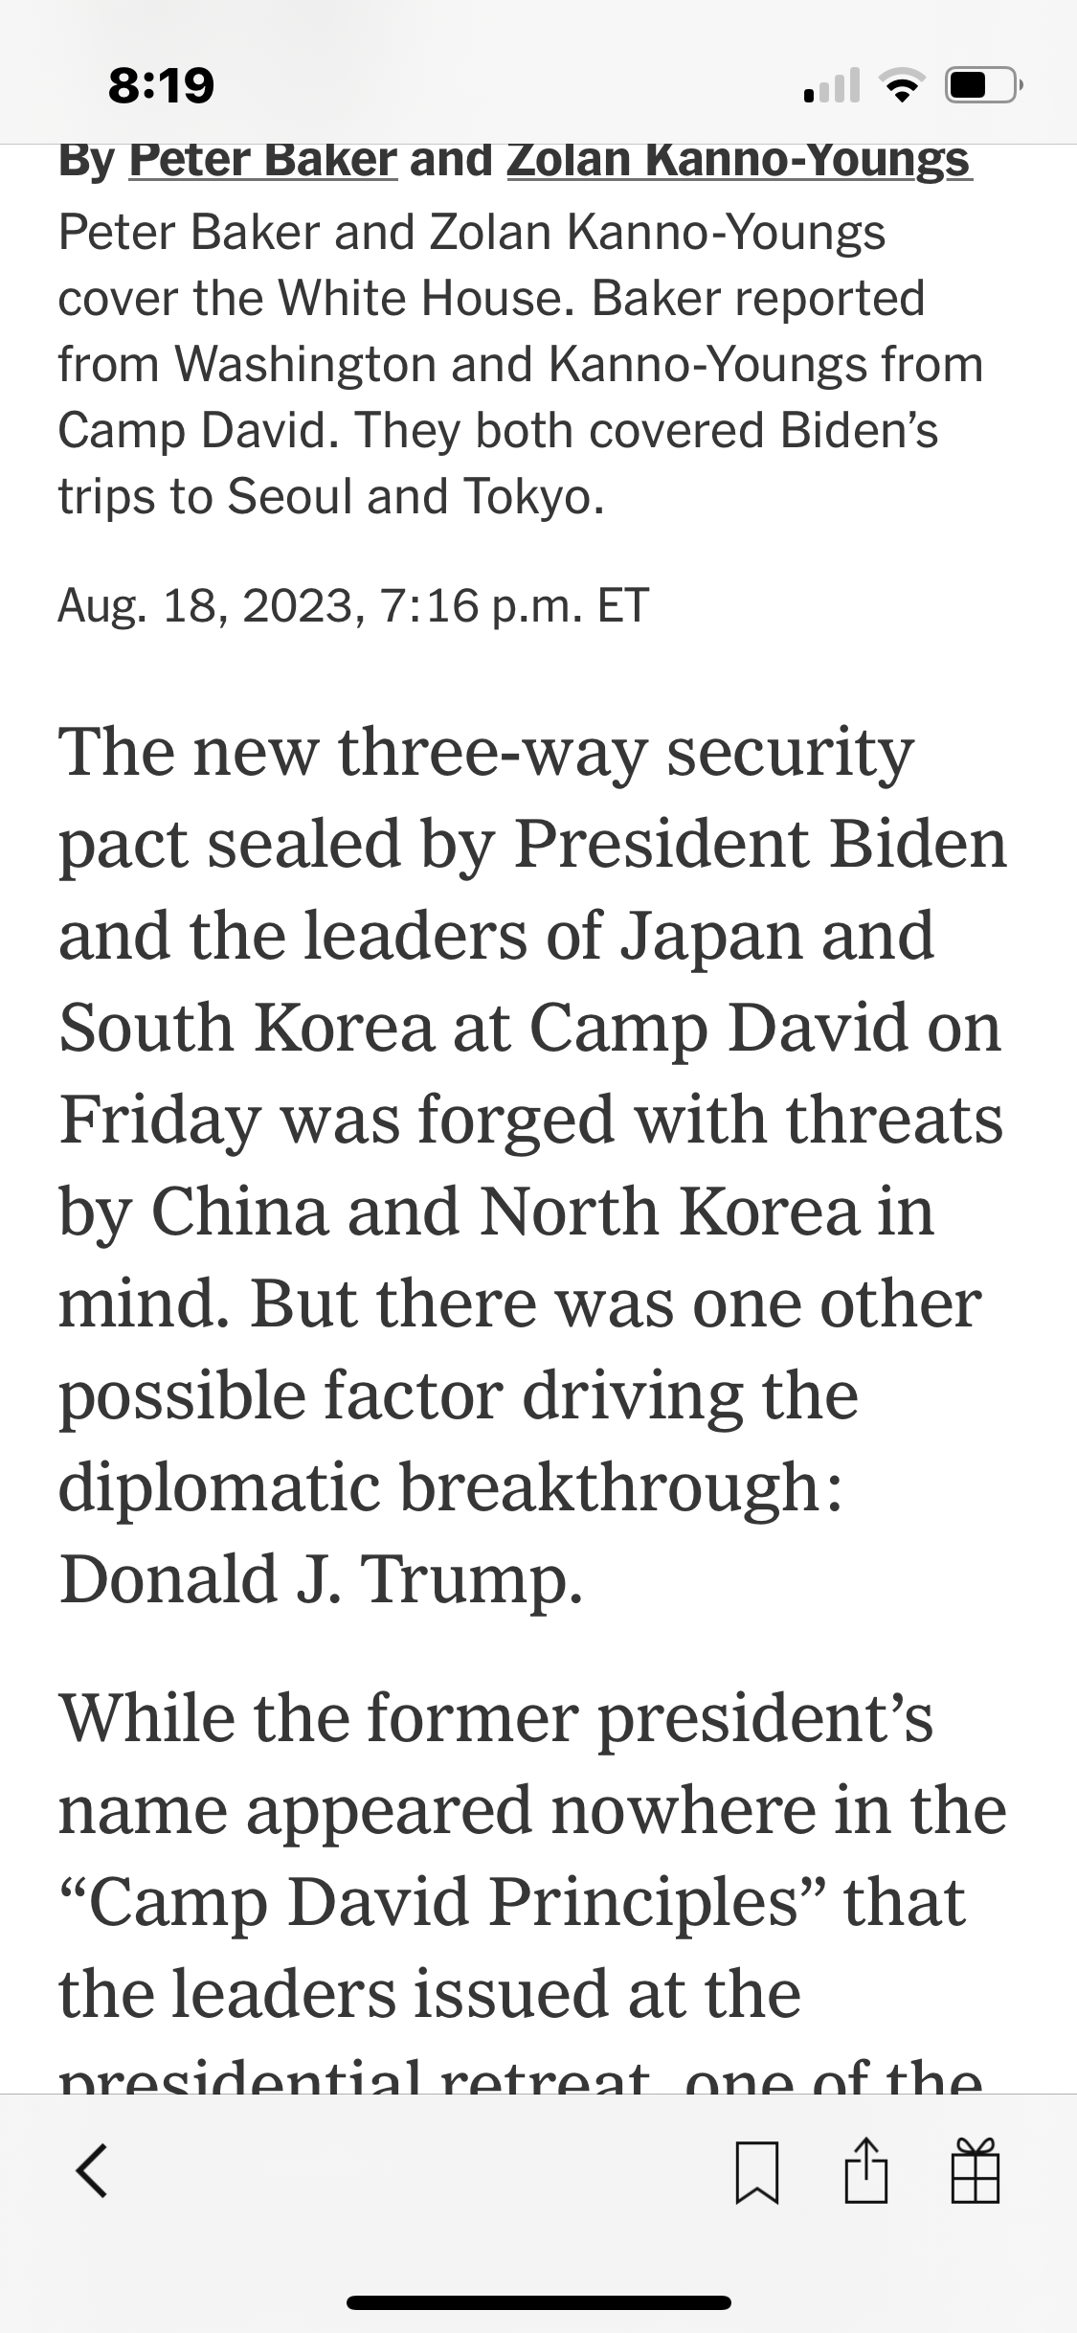
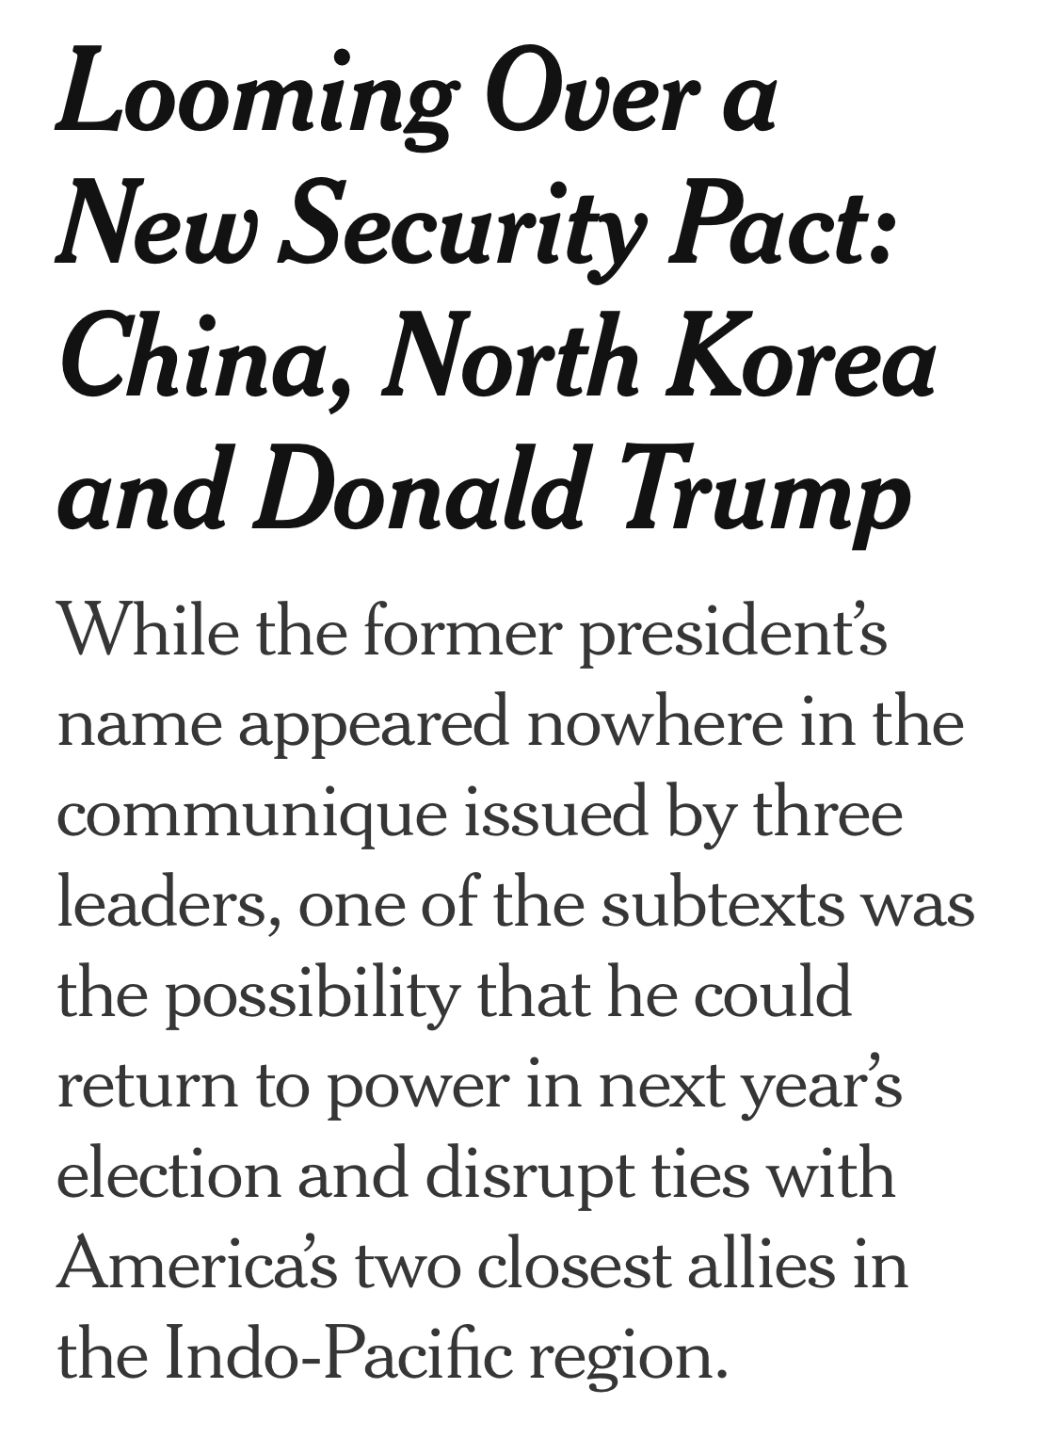
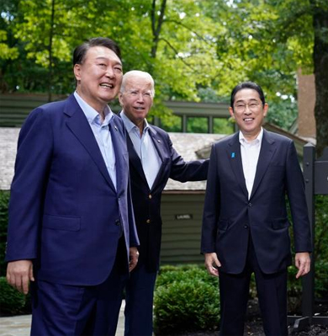
How Donald Trump Dominates the Attention Economy…
New York Times Reporting on Japan, South Korea, US Summit, August 18, 2023

Slide 9
Do you trust this person?
These statements are all true…
Serious drug problem in college
Nearly flunked out of college
Secret meetings with Chinese Communist Party Members
Received envelope filled with cash from an organization with ties to the Chinese Communist Party
Chinese and North Korean flags in his office
Advised members of the Chinese Communist Party
Under investigation by US government officials several times

Slide 10
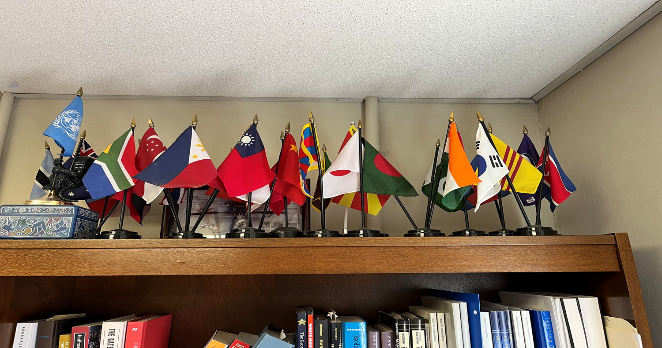
Fact Check: Flags in the Office 1

Slide 11
Flags in the Office 2

Slide 12
Dig for Facts Liars Are Hoping You Won’t
Fact Check.Org From the Annenberg Center at the University of Pennsylvania
PolitiFact.com From several newspapers
The Fact Checker From the Washington Post
Snopes.com (fact checking and debunking urban legends and internet hoaxes that are often about politics)

Slide 13
The Model of Democracy
Party philosophy, policies, character, and
Record of candidate A
Voter compares Choice
Party philosophy, policies, character, and
Record of candidate B

Slide 14
Add Spin, Propaganda, Disinformation…
Party philosophy, policies, and
Record of candidate A
Distorted Record *Policy of A (lifesaving)
*Character of A (angelic)
*Policy of B (dangerous)
*Character of B (demonic)
Voter compares Choice
*no historical context
*little knowledge of government
*has not paid attention to events
Distorted Record *Policy of B (lifesaving)
Party philosophy, policies, and *Character of B (angelic)
Record of Candidate B *Policy of A (dangerous)
*Character of A (demonic)

Slide 15
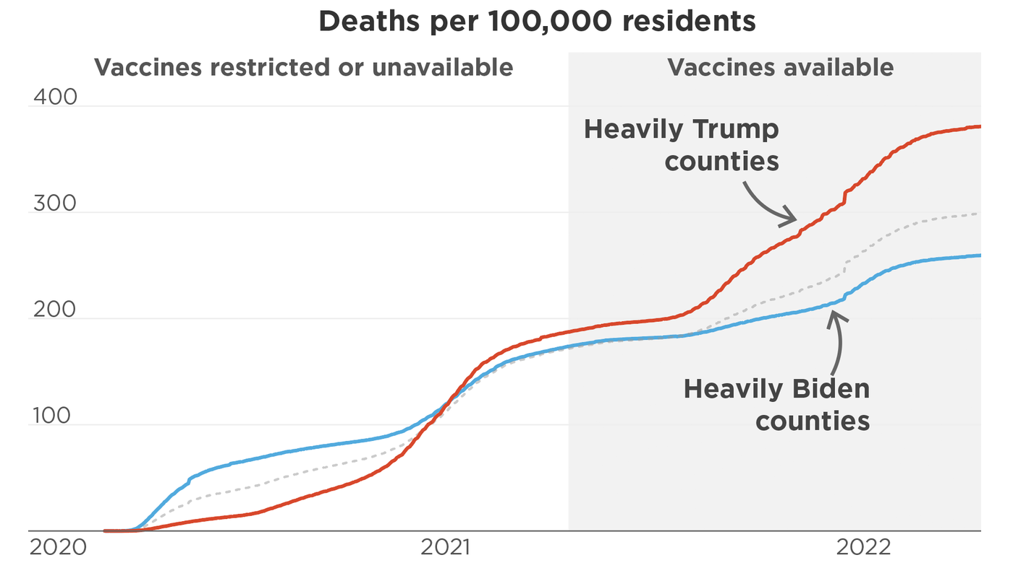
Disinformation Kills
COVID: Red vs. Blue States

Slide 16
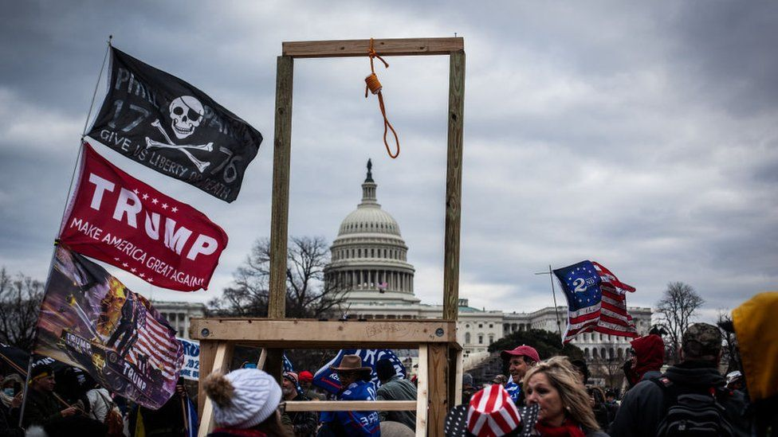
January 6, 2021

