Slide 1
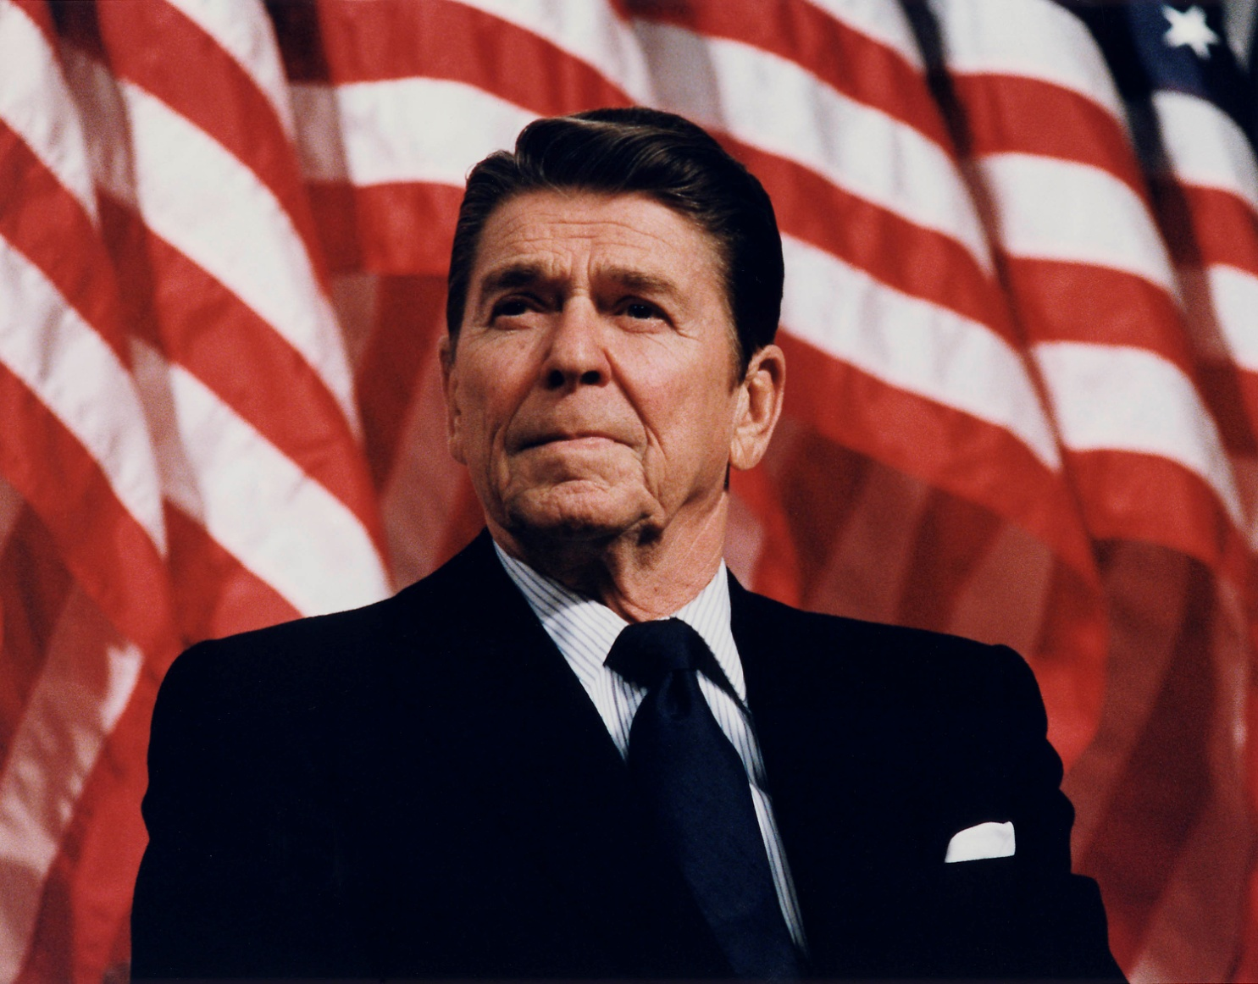
Ronald Reagan

Slide 2
Also Ronald Reagan

Slide 3
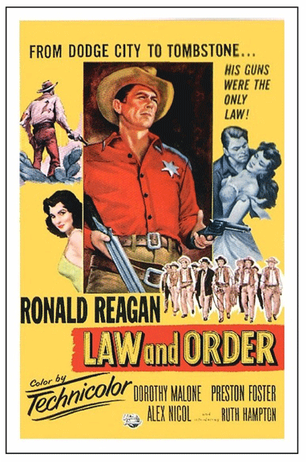
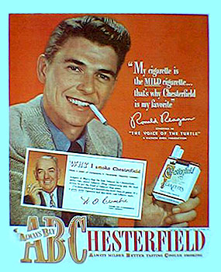
Before National Politics
Goldwater speech 1964

Slide 4
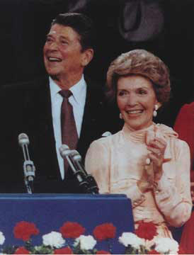
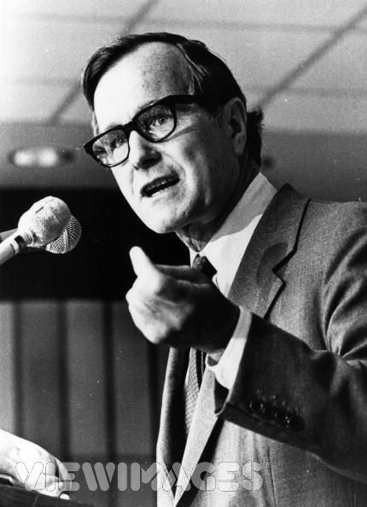
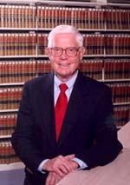
The Republican Nomination
Ron and Nancy GHW Bush John Anderson

Slide 5
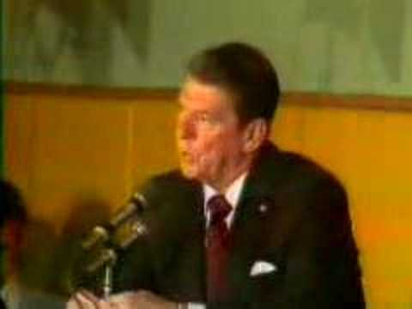
Capturing the Nomination
New Hampshire debate 1980:
The Line

Slide 6
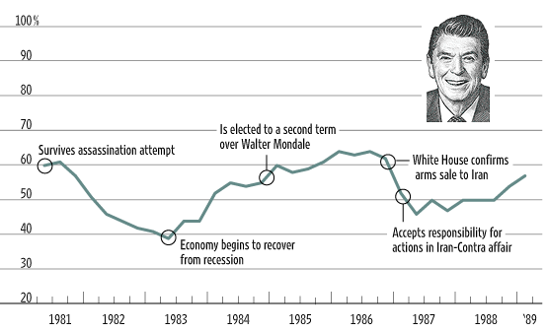
Reagan Public Approval Ratings

Slide 7
Reagan’s Clarity
Reduce the size of government;
Government is the problem, not the solution
Strong Defense
Cut taxes
Cut Spending
Balance the Budget

Slide 8
Economic Philosophy
Modern Liberalism
Keynesian Economics
“Demand Side” Economics
New Deal
Reagan Conservatism
Chicago School
“Supply Side” Economics
“Reaganomics”
The Reagan Revolution

Slide 9
An Analysis of the President’s Budgetary Proposals for Fiscal Year 2011: http://www.cbo.gov/ftpdocs/112xx/doc11280/03-24-apb.pdf

Slide 10
Realignment
New Deal Coalition
Democratic South
African-Americans
Union members
Urban North
Immigrant/newer ethnic groups
Farmers
Reagan Coalition
Midwest small towns
Wealthiest Americans
Hawks on foreign policy
Blue Collar in North and Midwest (union and non-union)
White Southerners
Evangelicals
Yuppies

Slide 11
Effect of Reagan on US Political Culture
Left Right
Left-right defined as accepted level of government intervention in the economy:
right = less intervention
left = more intervention
US
Pre-1981;
New Deal
and Great
Society
era
Reagan era

Slide 12
Presidential Power and Persuasion
LBJ Model
Pres Congress People

Slide 13
Presidential Power and Persuasion
Reagan Model
Pres People Congress

Slide 14
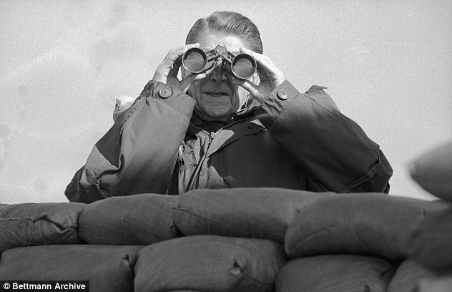
Reagan Media Strategy I
Bully Pulpit
Stage Events in Controlled Settings
Korean DMZ

Slide 15
The Ultimate Example
Berlin 1987
(Start from about
10 minutes in to
get the big sound bite;
ends at about 12:15)
“Mr. Gorbachev,
tear down this wall…”

Slide 16
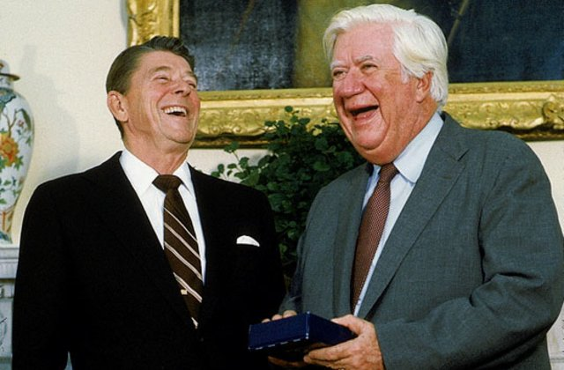
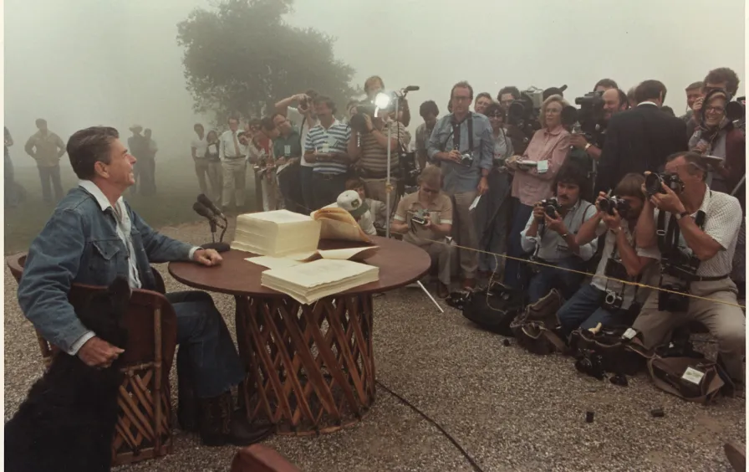
Media Strategy II
Feed the Media
Consistency of Message
Selling the President
Reagan and House Speaker Tip O’Neill

Slide 17
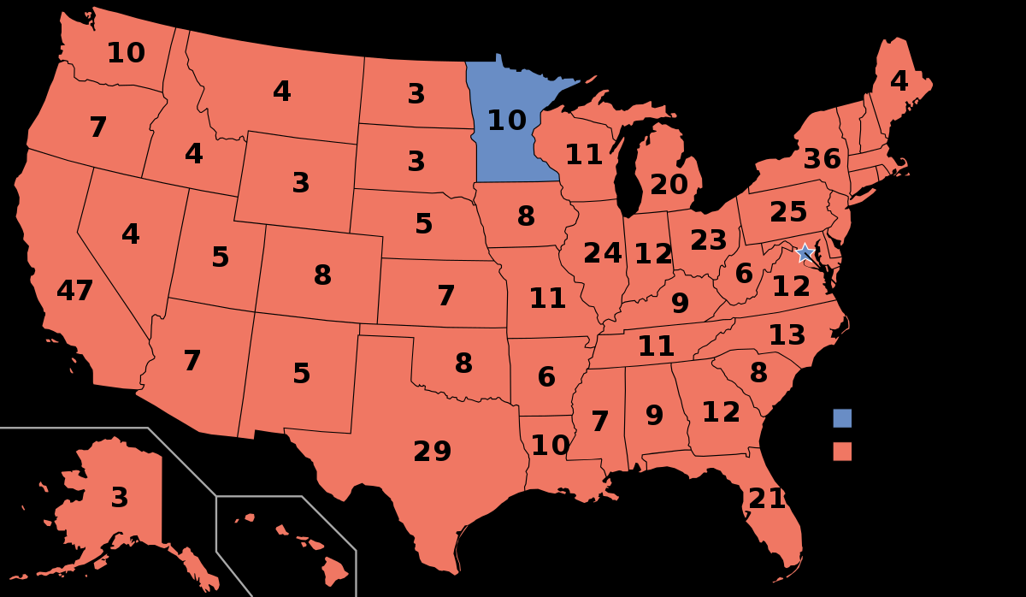
Media Strategy III
Popularity is Power 525-13

Slide 18
Teflon President

Slide 19
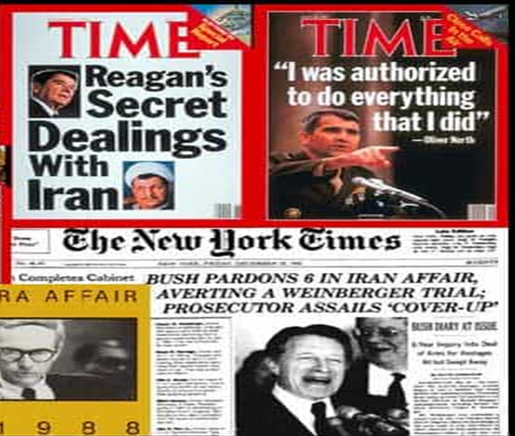
Iran Contra
Comparison to other scandals
When Congress tries to restrain presidential actions
Ignore Congress

Slide 20
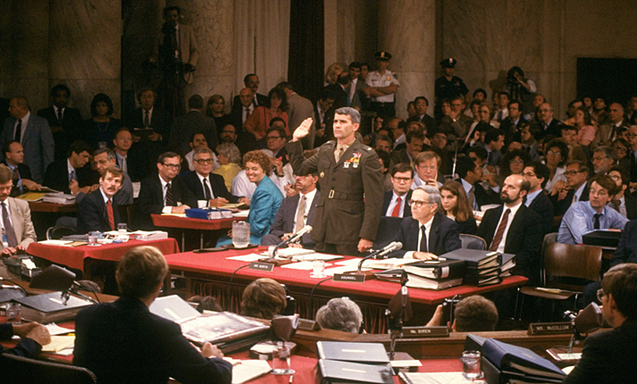
Scandal or Constitutional Crisis (or both)
Tower Commission Report 1987
Report of the Independent Counsel 1993
Oliver North at
Senate Hearings
1987

Slide 21
The Iran Contra Scandal (reference only)
Contras
Private US $
Foreign Gov’t $
$$$
Hostages
weapons
weapons
Swiss bank
accounts;
controlled
by North
Iran
US
Israel

