Slide 1
Barack Obama

Slide 2
Obama-Biden 2008

Slide 3
McCain-Palin

Slide 4
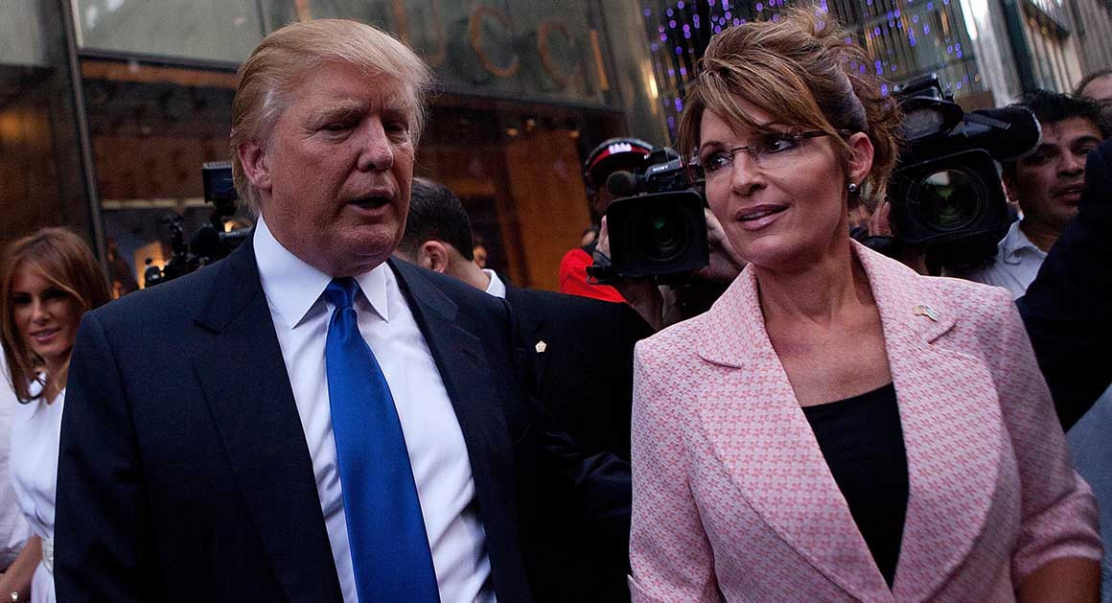
Palin as Precursor to Trump
Why Lie? (During Campaign)
The Death Panels (After 2008)

Slide 5
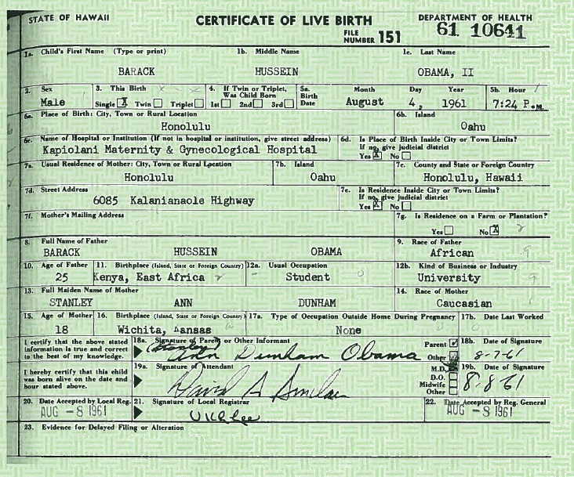
The Birthers
The Facts

Slide 6
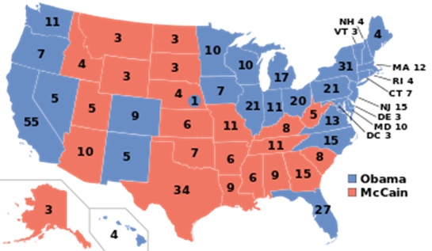
2008 Results
Obama 365
McCain 173

Slide 7
The Great Recession

Slide 8
Bush and Obama: Keynesian Response

Slide 9
Priorities: Health Care
White House Health care page
Patient Protection and Affordable Care Act
Introduced Sep 17, 2009
Passed House Oct 08, 2009
Passed Senate with Changes Dec 24, 2009
Passed Senate Mar 21, 2010
Signed by the President Mar 23, 2010

Slide 10
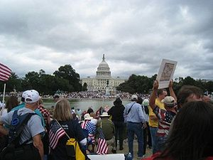
Tea Party Movement

Slide 11
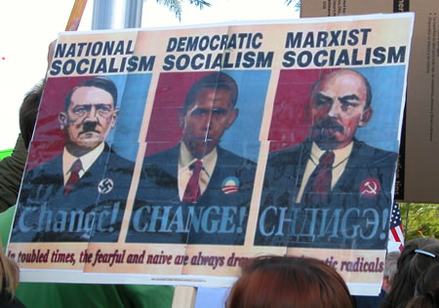
The Fringe

Slide 12
Senate Elections
Year | Democrats | Republicans | Independent
2008 (111th) | 57 | 41 | 2 (allied with Democrats)
2010 (112th) | 51 | 47 | 2 (allied with Democrats)
2012 (113th) | 53 | 45 | 2 (allied with Democrats)
2014 (114th) | 44 | 54 | 2 (allied with Democrats)

Slide 13
House Elections
Year | Democrats | Republicans
2008 (111th) | 257 | 178
2010 (112th) | 193 | 242
2012 (113th) | 201 | 234
2014 (114th) | 188 | 247

Slide 14
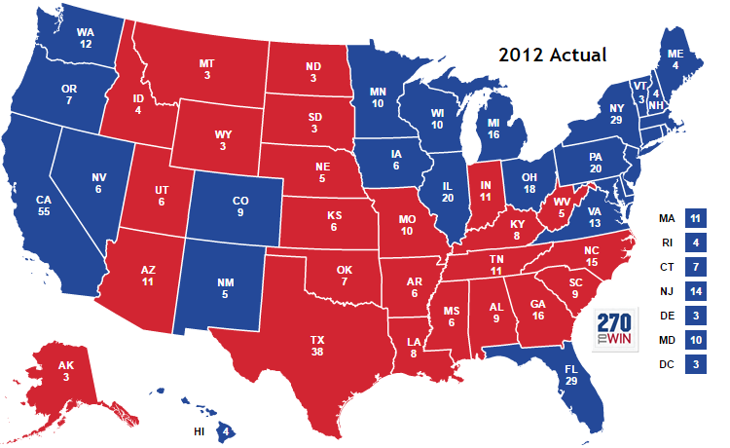
2012
Obama 332
Romney 206
Notes:
.

Slide 15
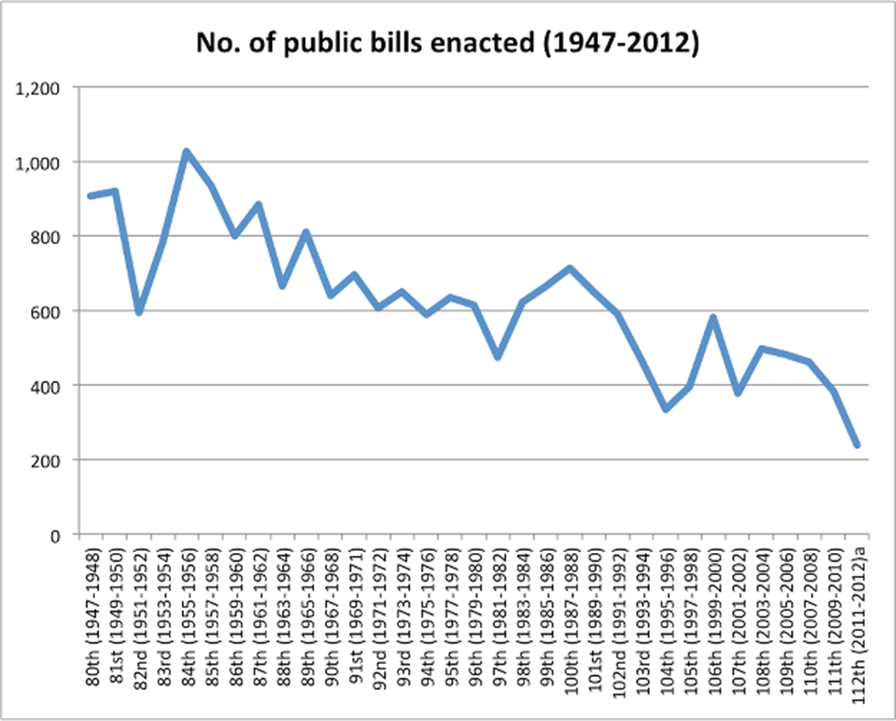
Republican Strategy
Stop Obama’s legislative agenda

Slide 16
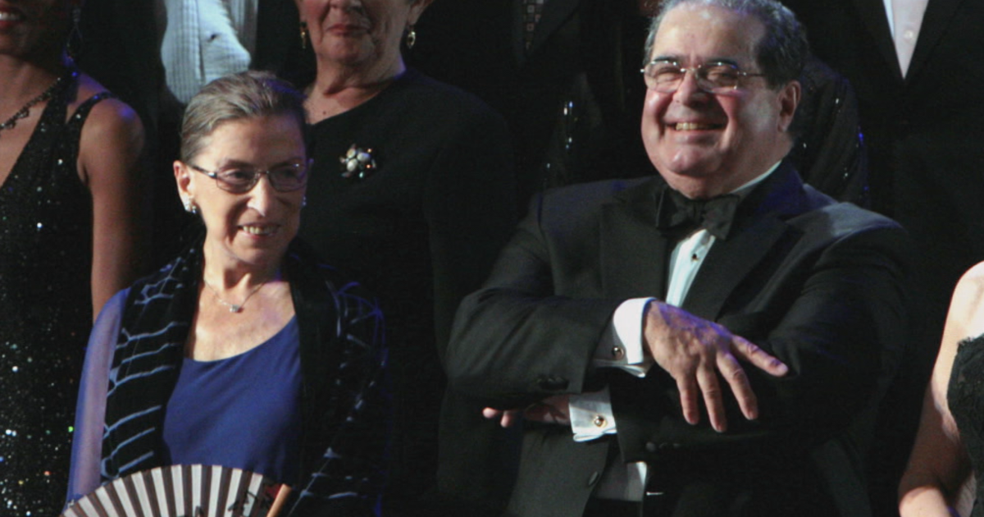
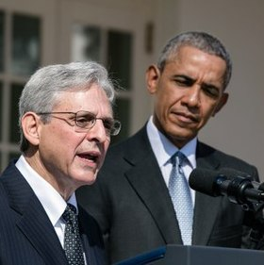
Merrick Garland
Ginsburg and Scalia Merrick Garland

Slide 17
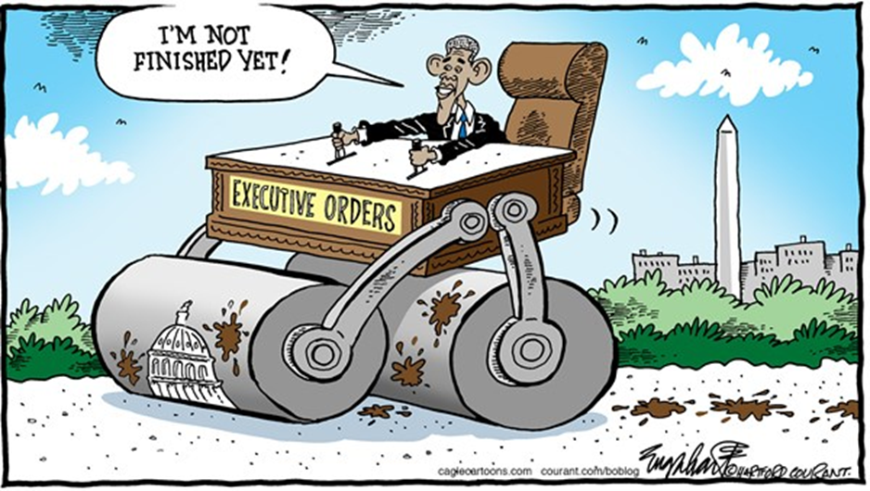
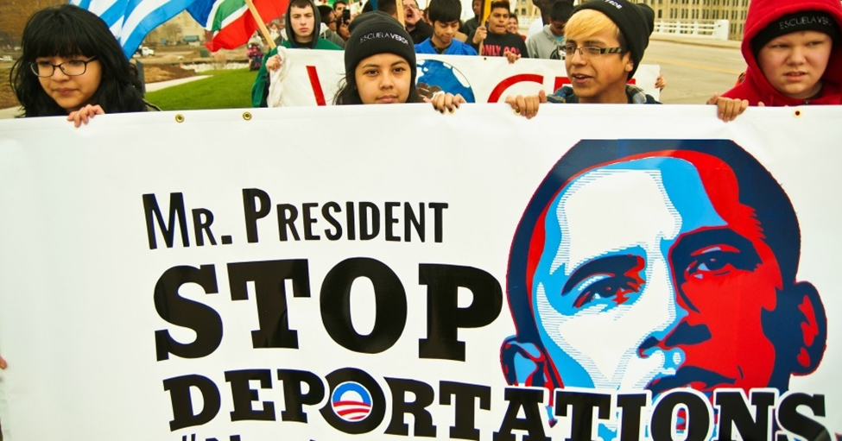
Obama Strategy
Executive power
Immigration

Slide 18
Obama, DREAM Act, and DACA Development, Relief, and Education for Alien Minors
2011 DREAM Act
Obama statement on DACA June 2012
DAPA November 2014
September 2017: Trump announces end to DACA
Court Cases on DACA
Supreme Court and DACA
DACA as of June 2021

