Slide 1
Richard M. Nixon

Slide 2
Nixon Years
Electoral Realignment
Nixon’s Administrative Presidency (Decision making)
Problems with Nixon’s Style
Watergate (next slideshow)

Slide 3
1. Electoral Realignment End of New Deal Coalition?
IN
African-Americans
Union members
Urban North
Immigrant/newer ethnic groups
Farmers
OUT
Democratic South

Slide 4
The South Defects
Civil Rights Achievements and failures
Expansion of Federal Power
Viet Nam

Slide 5
1880: James Garfield (R) Victory South is Democratic

Slide 6
1900: William McKinley (R) Victory South is Democratic

Slide 7
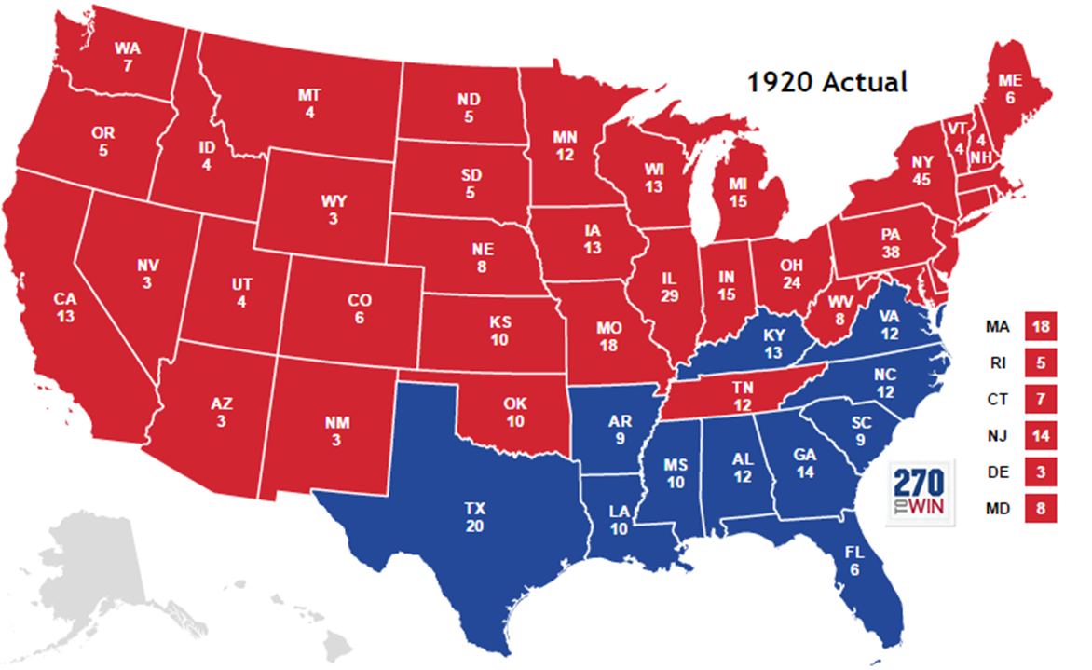
1920: Warren Harding (R) Victory South is Democratic
404-127 EV over James Cox/FDR

Slide 8
1932: FDR (D) Victory South is Democratic

Slide 9
1948: Truman (D) Victory South is Democratic; 39 EV for Strom Thurmond (D) running to re-segregate the US armed forces

Slide 10
1952: Eisenhower (R) Victory South is Democratic

Slide 11
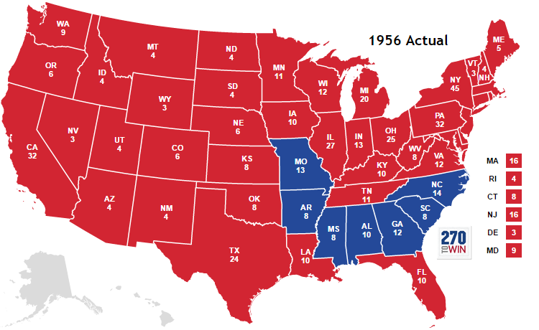
1956 Eisenhower Again South is Democratic
South Still Doesn’t Like Ike

Slide 12
1960: JFK over Nixon South is Democratic

Slide 13
1964: LBJ Southern states go for Goldwater

Slide 14
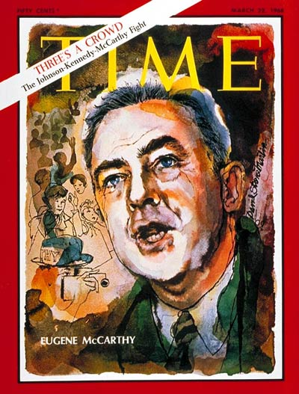
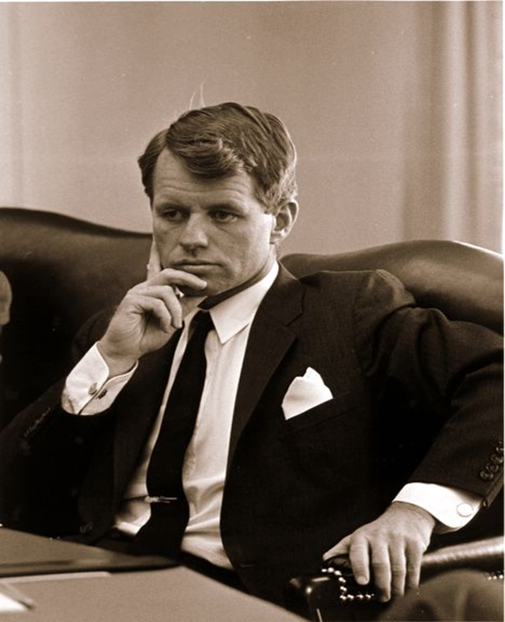
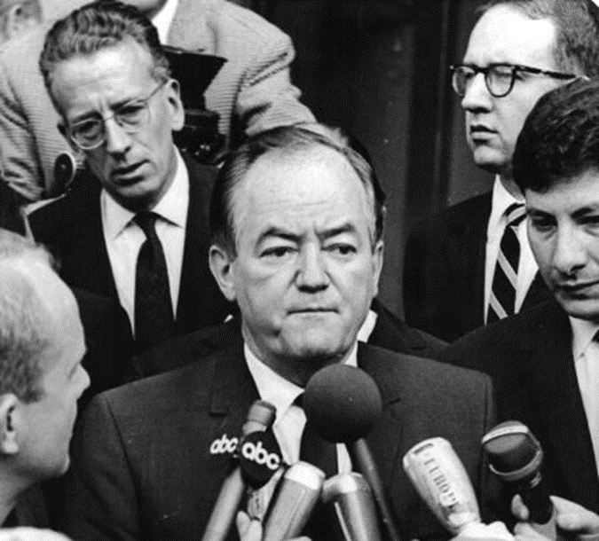
1968 Democratic Race
Sen. Gene RFK VP Hubert
McCarthy Humphrey

Slide 15
1968 Democratic Convention

Slide 16
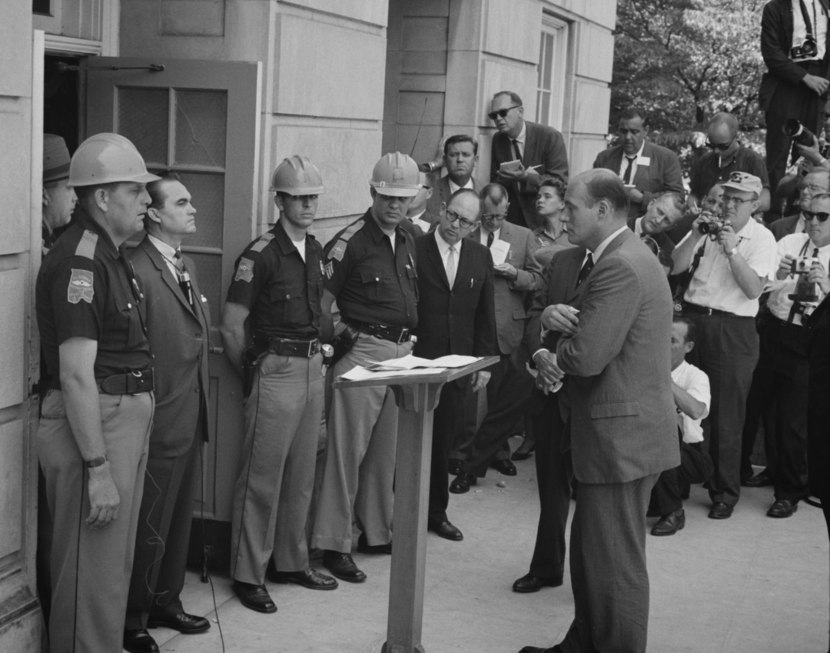
George Wallace

Slide 17
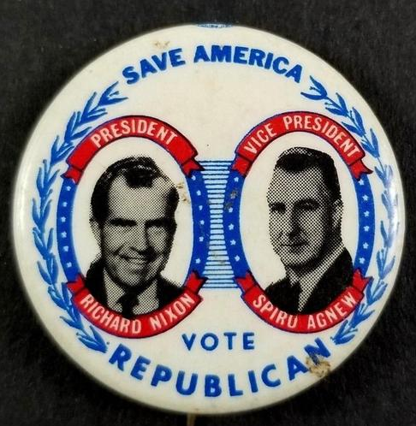
Nixon/Agnew
Quiet Americans
Silent Majority
Southern Strategy
Law and Order

Slide 18
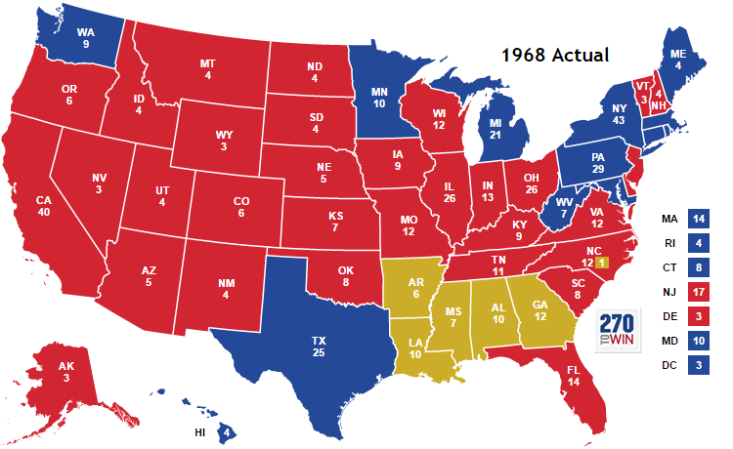
1968 Nixon (R) over Humphrey (D)
And Wallace

Slide 19
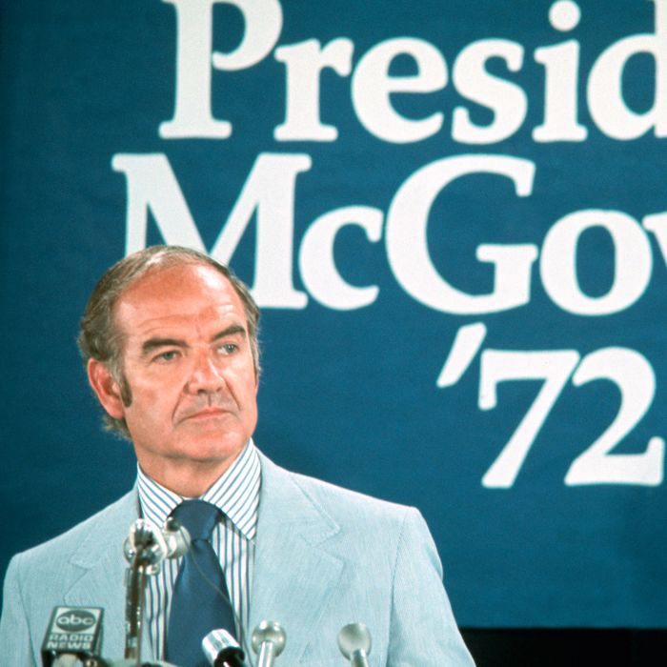
1972 Nixon over George McGovern

Slide 20
2. RN’s Administrative Presidency
White House
Appointee
Career

Slide 21
John Ehrlichman: Domestic Council

Slide 22
Henry Kissinger: NSC Staff

Slide 23
H. R. Haldeman: Chief of Staff

Slide 24
Problem with Nixon’s Style
Cabinet Government?
Isolation
Feeding Nixon’s Flaws

Slide 25
1. Cabinet Government?
William Rogers
Secretary of State 1969-1973
George Romney
Secretary of HUD
1969-1973

Slide 26
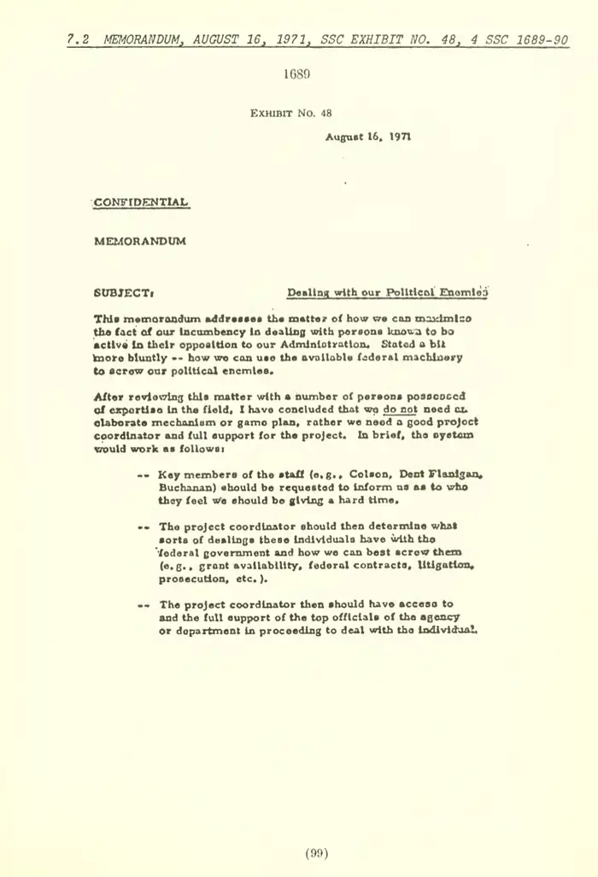
2. Isolation
Line vs. Staff
Nixon’s Enemies List
Read quote from
the first paragraph

Slide 27
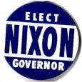
3. Feeding Nixon’s Flaws
“Checker’s” Speech

Slide 28
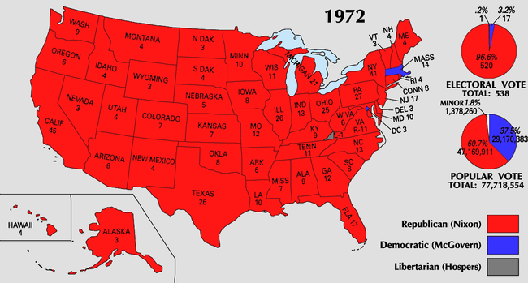
Nixon’s Success and a 49 State Victory in 1972
Ending the Vietnam War
Détente with USSR
Opening to China
EPA
Great Society
spending

