Slide 1
POLI 308 US Presidency

Slide 2
What We Think We Know and How We Think We Know It
Approaches to the Presidency
Presidential Domination
Cycles of Presidential Power

Slide 3
1. Three Approaches to the Presidency
Historical
Institutional
Character

Slide 4
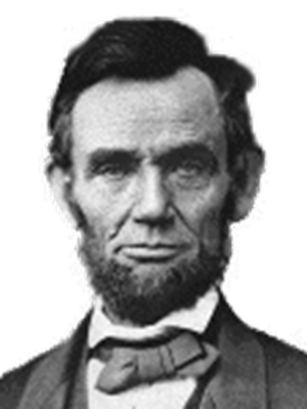
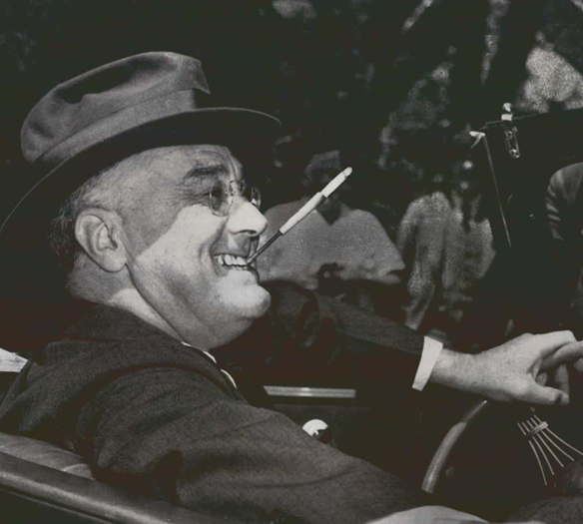
A. Historical Approach
Lincoln Franklin Roosevelt
Presidents become powerful when we need them to be powerful: Crisis

Slide 5
B. Institutional
US Constitution
Executive
Legislative
Judicial

Slide 6
Career vs. Appointee Basic Management Dilemma
Transition 2020-21
Career
TRUMP
BIDEN

Slide 7
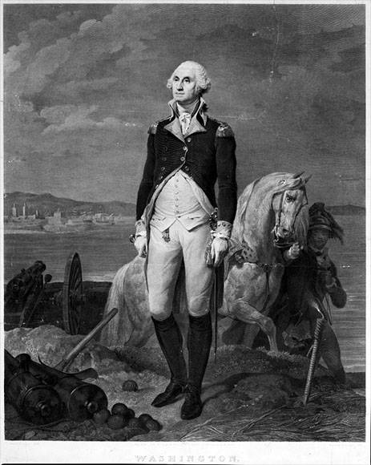
C. Character: The Good

Slide 8
Character: The Bad

Slide 9
Character: The Ridiculous?

Slide 10
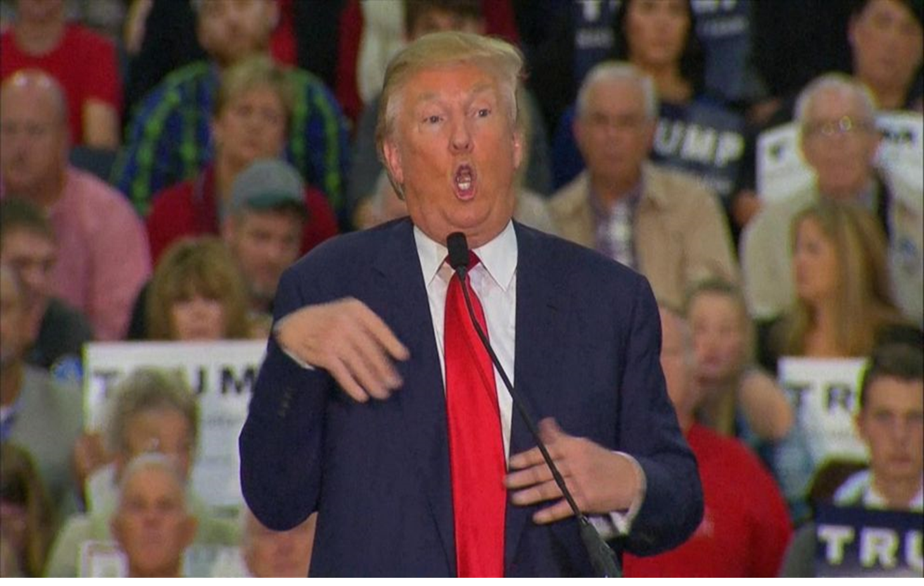
Character: The Difficult to Explain
Candidate Trump mocking a disabled reporter: November 2015

Slide 11
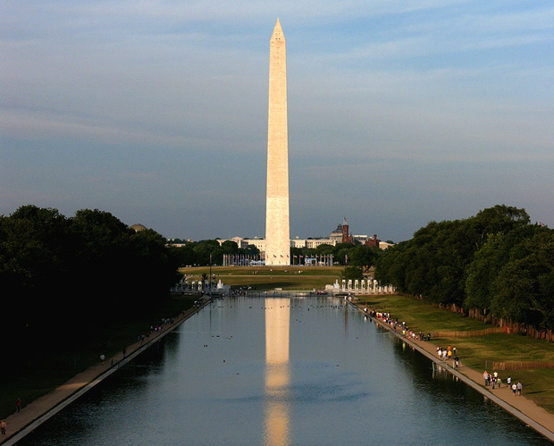
2. Presidential Domination

Slide 12
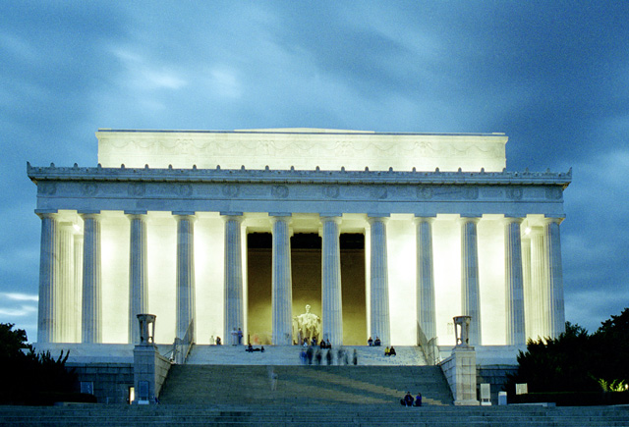
Lincoln Memorial

Slide 13
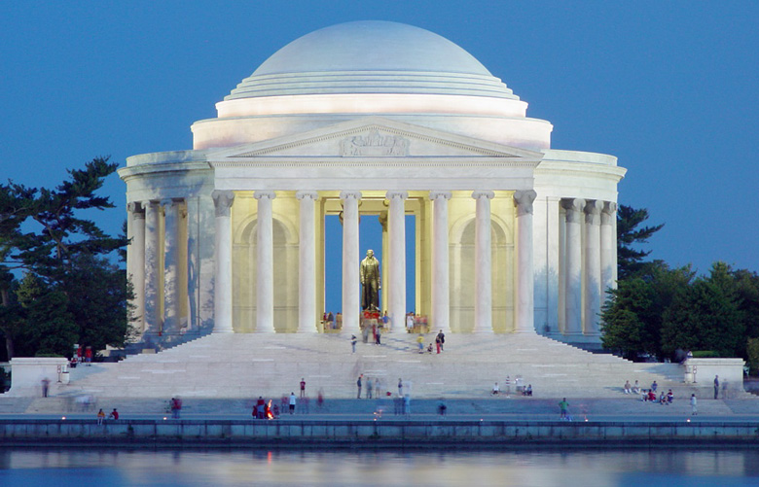
Jefferson Memorial

Slide 14
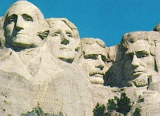
Mt. Rushmore

Slide 15
FDR Memorial

Slide 16
Speaker of the House Monument?

Slide 17
3. Cycles of Presidential Power
LBJ/Nixon Reagan Bush 43
Carter/Ford Bush 41/Clinton

Slide 18
Enough Intro…

Slide 19
Creating the Executive

Slide 20
Creating the Executive
Articles of Confederation
US Constitution
The Federalist Papers
Anti-Federalist Papers

Slide 21
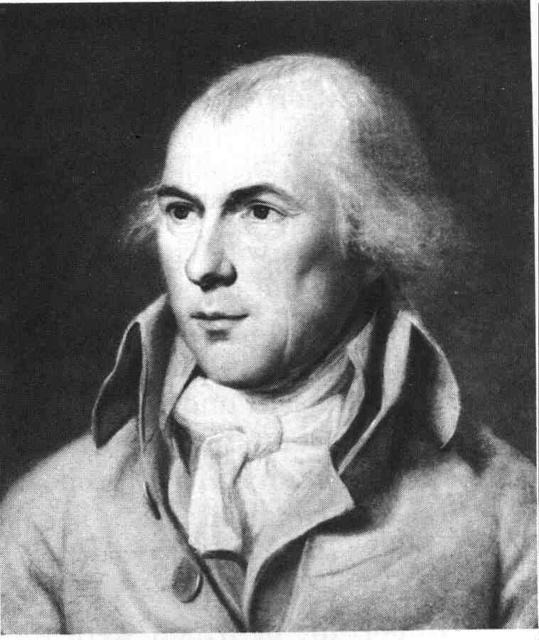
Early Debates on the Executive
Hamilton Madison
Presidential power checks and balances
UNITY PREVENT TYRANNY

Slide 22
Design of the US Government
Articles of Confederation
US Constitution
Executive
Legislative
Judicial

Slide 23
Institutional Powers
Article One:
Congressional Powers
Declare War
Raise and support armed forces
Regulate armed forces
Senate: approve executive branch officials
Senate: advise and consent on treaties
Tax and Spend money
Article Two:
Executive Powers
Make treaties
Appoint officials and ambassadors
Commander-in-chief of armed forces
Notes:
23

Slide 24
Two Presidencies?
Domestic Affairs vs. Foreign Affairs
US vs. Curtiss Wright (1936)
“The powers to declare and wage war, to conclude peace, to make treaties, to maintain diplomatic relations with other sovereignties, if they had never been mentioned in the Constitution, would have vested in the federal government…Not only, as we have shown, is the federal power over external affairs in origin and essential character different from that over internal affairs… In this vast external realm, with its important, complicated, delicate and manifold problems, the President alone has the power to speak or listen as a representative of the nation.”

Slide 25
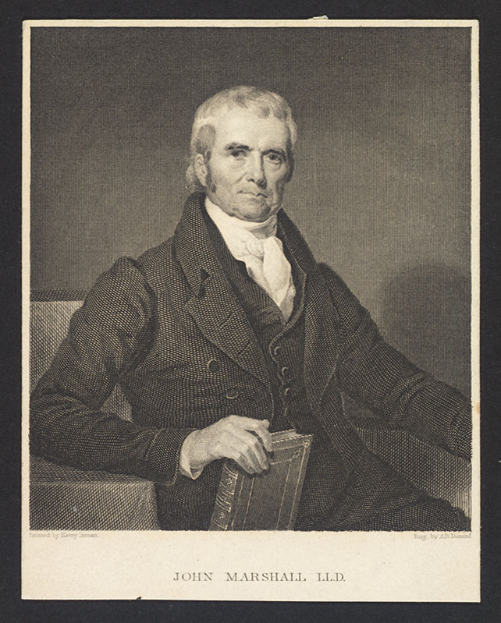
Supreme Court
Judicial Review
Marbury V. Madison 1803
John Marshall,
Chief Justice
1801-1835

Slide 26
Executive Orders By President since FDR
Lincoln’s Emancipation Proclamation 9/22/62
FDR’s Orders 1937
Carter creates FEMA 7/20/79
Bush creates HSC and OHS 10/8/01
Bush Military Order on Unlawful Enemy Combatants 11/13/01
Biden Securing Access to Reproductive and Other Healthcare Services

Slide 27
ALABAMA ASSOCIATION OF REALTORS, ET AL. v. DEPARTMENT OF HEALTH AND HUMAN SERVICES, ET AL. [August 26, 2021]
The Director of the Centers for Disease Control and Prevention (CDC) has imposed a nationwide moratorium on evictions…86 Fed. Reg. 43244 (2021)…
The Alabama Association of Realtors…obtained a judgment from the U. S. District Court for the District of Columbia vacating the moratorium on the ground that it is unlawful….
The District Court produced a comprehensive opinion concluding that the statute on which the CDC relies does not grant it the authority it claims….It would be one thing if Congress had specifically authorized the action that the CDC has taken. But that has not happened.

Slide 28
Obama, DREAM Act, and DACA Development, Relief, and Education for Alien Minors
2011 DREAM Act
Obama statement on DACA June 2012
DAPA November 2014
September 2017: Trump announces end to DACA
Court Cases on DACA
Supreme Court and DACA

