Slide 1
LBJ

Slide 2
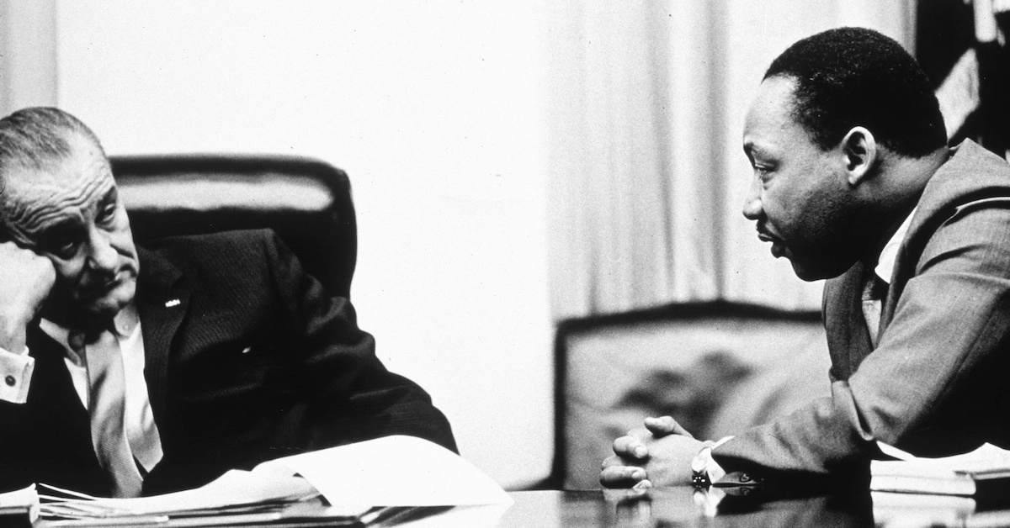
LBJ and Civil Rights
Civil Rights Act of 1964
Voting Rights Act of 1965

Slide 3
LBJ and Viet Nam

Slide 4
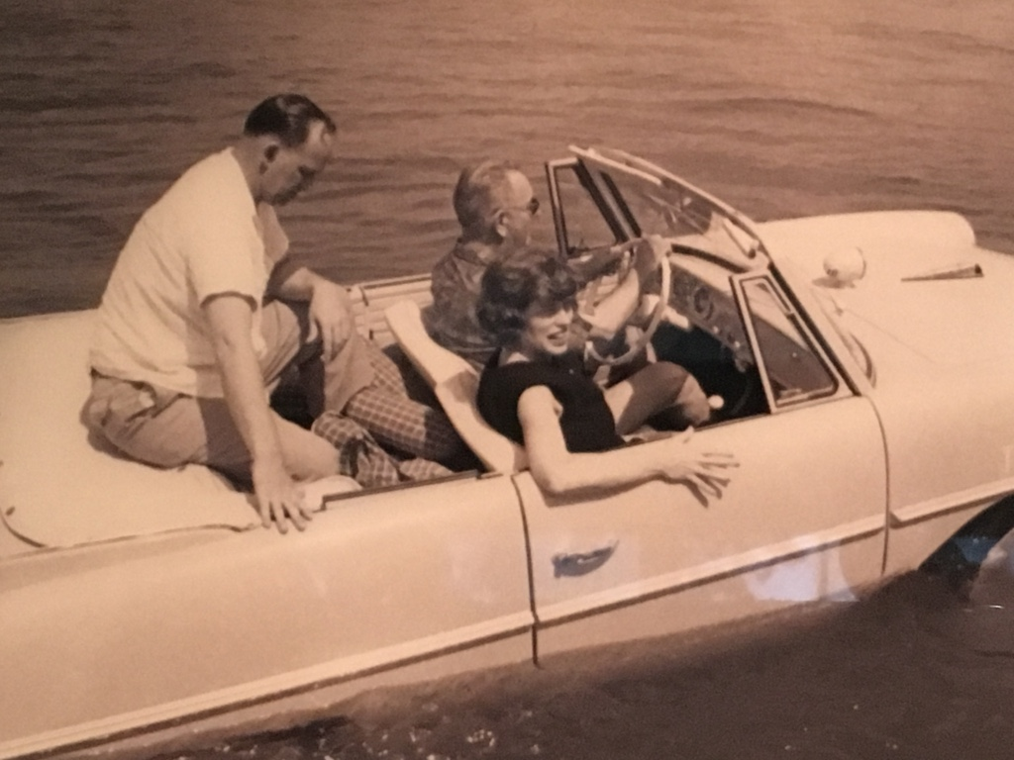
Fun with the President

Slide 5
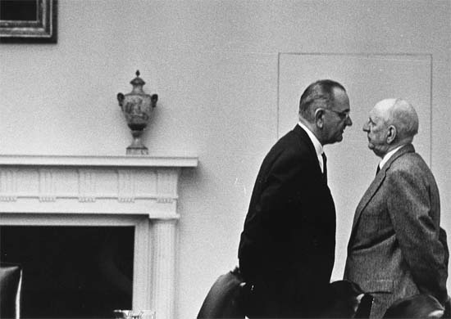
The Johnson Treatment

Slide 6
Presidential Power
Presidential Power is “Persuasion”
Persuasion is bargaining
Richard Neustadt, Presidential Power

Slide 7
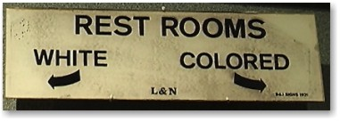
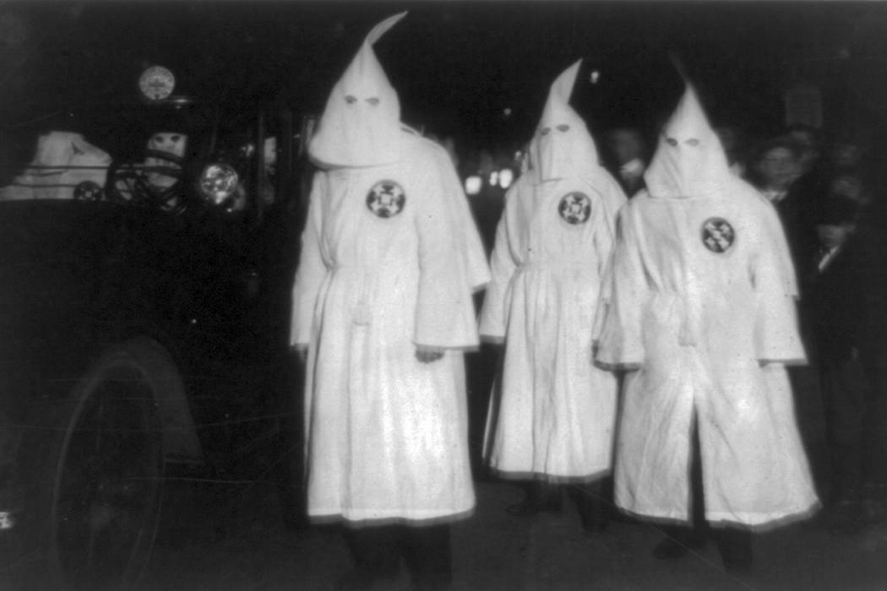
The South before Civil Rights

Slide 8
August 1963

Slide 9
LBJ’s Challenge
Persuasion in Pluralist Society
Coalitions
Timing and persuasion

Slide 10
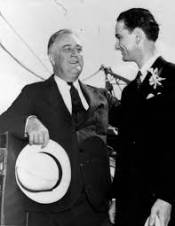
1. Persuasion and Coalitions
New Deal Coalition
Democratic South
African-Americans
Union members
Urban North
Farmers
Immigrant/new ethnic groups

Slide 11
1948 Presidential Election

Slide 12
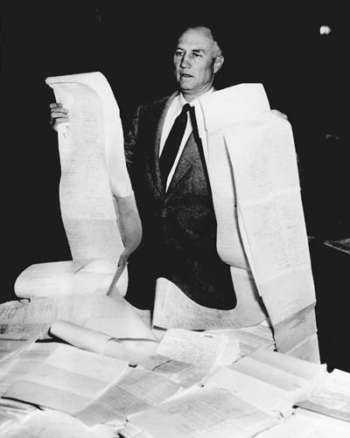
Strom Thurmond in 1957
Senate Rule 22
(Filibuster)
Cloture (60 votes)
24 hours 18 minutes

Slide 13
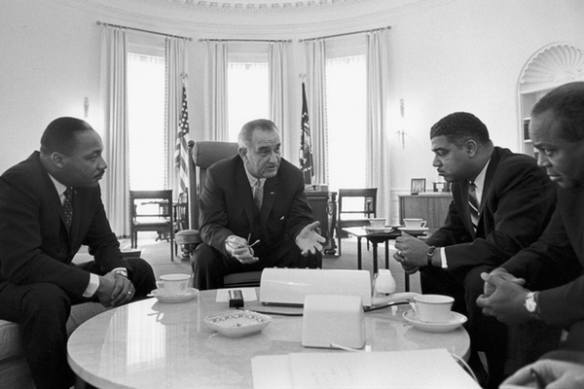
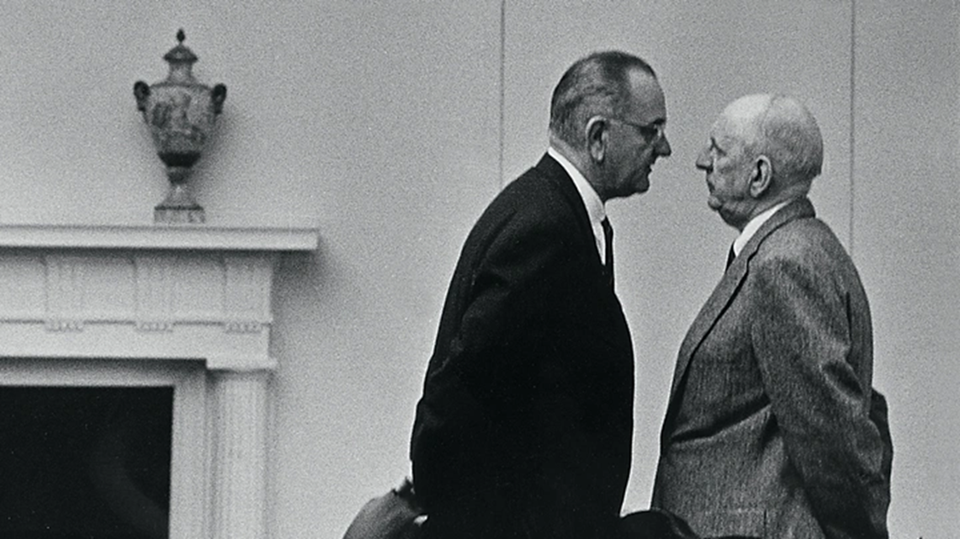
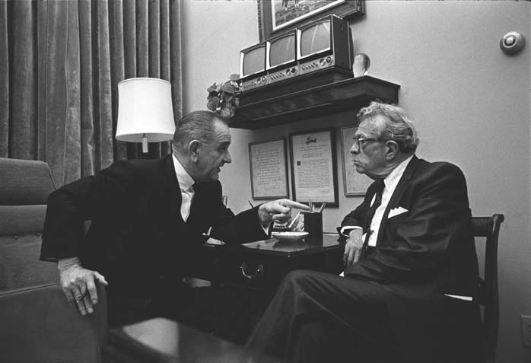
Working Every Side
LBJ and… MLK
Richard Russell
Everett Dirksen

Slide 14
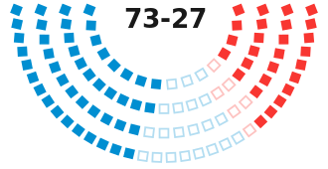
Senate Vote on Civil Rights Act June 19, 1964
Yea Nay
Democrats 46 21
Republicans 27 6
Democratic Nay
AL, AR, FL, GA,
LA, MS, NC, SC,
TN, VA

Slide 15
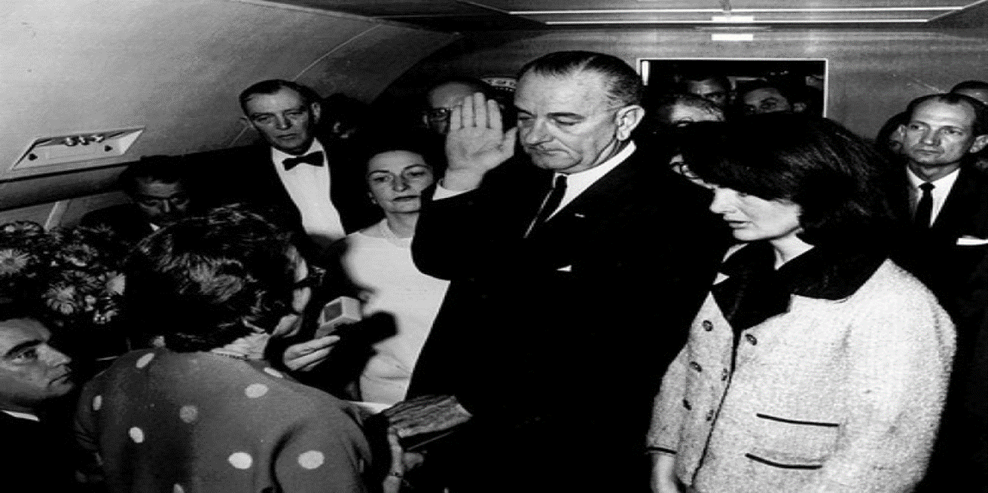
2. Timing

Slide 16
LBJ Speech to Joint Session of Congress November 27, 1963

Slide 17
1964 Election

Slide 18
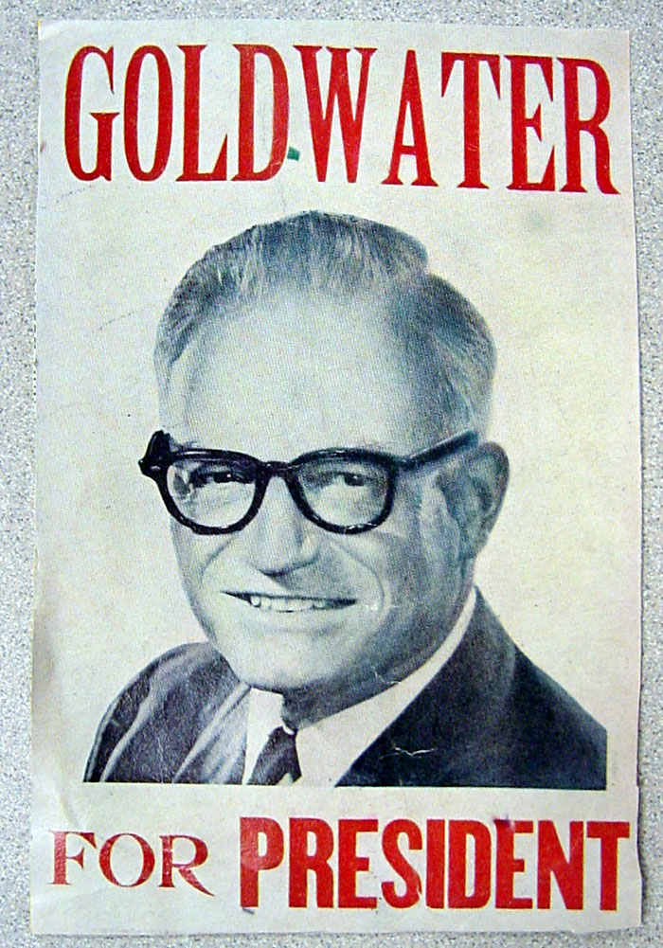
LBJ vs. Barry Goldwater
Daisy Ad
Reagan speech
for Goldwater
LBJ Ad “Klan
supports Gold.”
1964 results

Slide 19
Charting Presidential Power
P Political Capital
O
W
E
R
Elect. 1 2 3 Reelect 5 6 7 8
Time

Slide 20
LBJ Double Honeymoon
P
O JFK Crisis
W 1964 Election
E
R
11/63 11/64 3 4 1968
Time
Notes:
20

Slide 21
Selma and VRA 1965
Bloody Sunday March 7, 1965
LBJ before a Joint Session of Congress, March 15, 1965

Slide 22
Great Society
Increased Federal government power at the expense of state power
Increased Federal government role in the economy
Committed Federal government and state governments to more spending

Slide 23
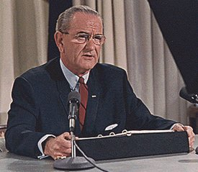
Viet Nam
Goodbye

Slide 24
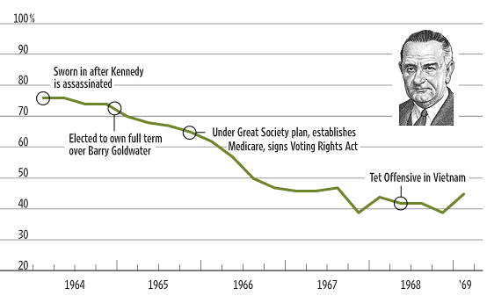
LBJ Public Opinion

