Slide 1
POLI 308 US Presidency

Slide 2
First Week of June 2020
Monday: President Trump suggests the use of the US military to deal with protests
Insurrection Act
CRS Report on use of troops domestically (during disasters)
Tuesday: Armed security personnel, who refuse to identify themselves, guard White House
Wednesday: Sec. of Defense disagrees on use of US military for domestic situation

Slide 4
Basics Ideas in Studying the Presidency: Big Frameworks
Three Approaches to the Presidency
Presidential Domination
Cycles of Presidential Power

Slide 5
1. Three Approaches to the Presidency
Historical
Institutional
Character

Slide 6
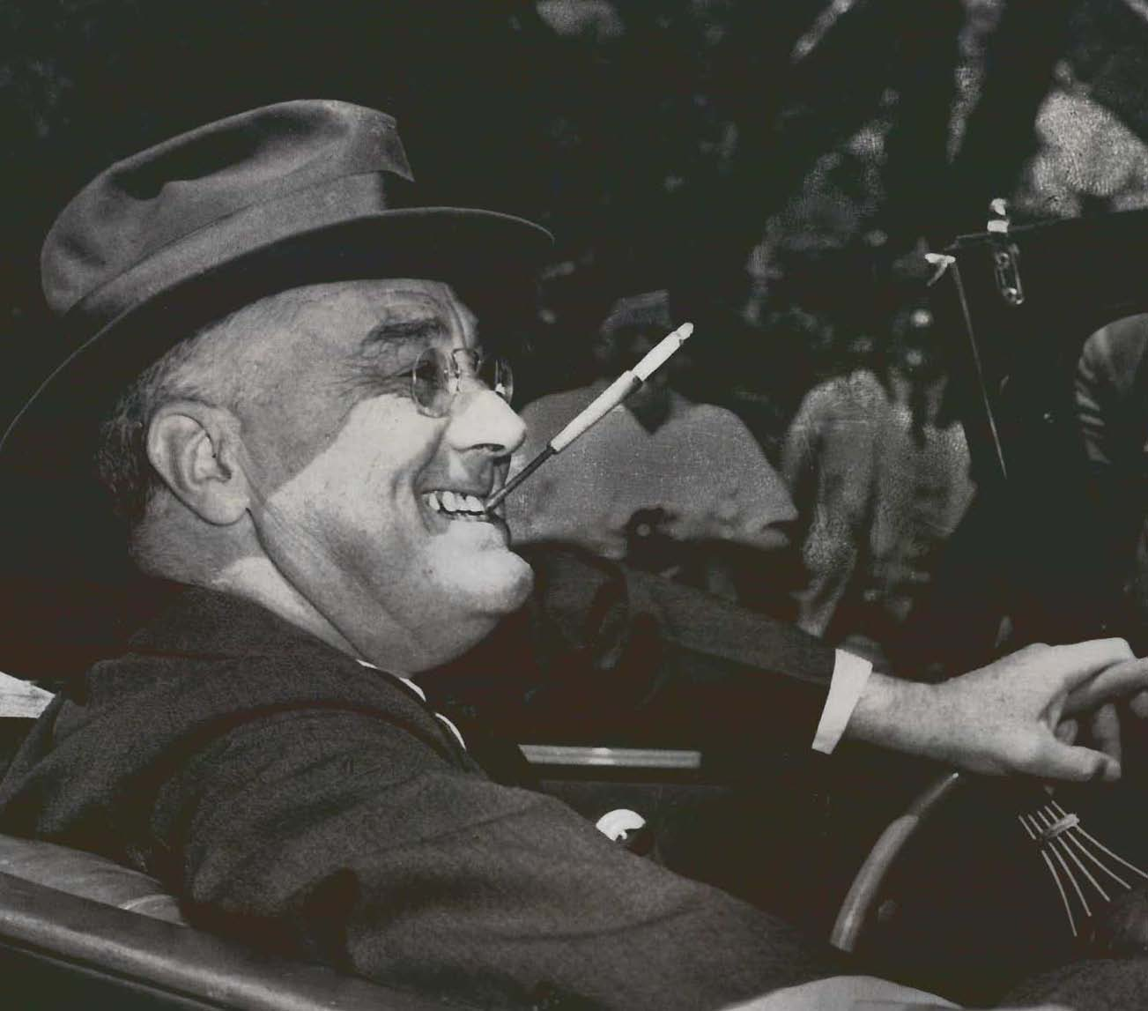
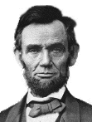
Historical: Presidential Power

Slide 7
Institutional
US Constitution
Executive
Legislative
Judicial

Slide 8
Career vs. Appointee Basic Management Dilemma
Transition 2016-17
Career
OBAMA
TRUMP

Slide 9
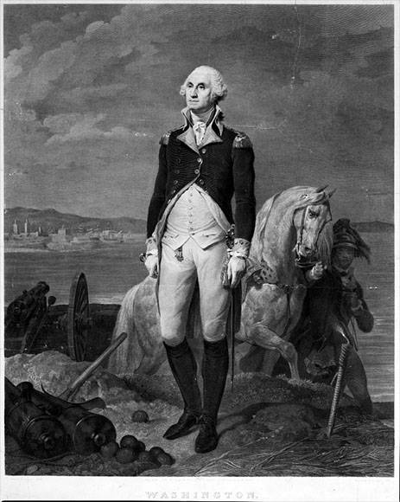
Character: The Good

Slide 10
Character: The Bad

Slide 11
Character: The Ridiculous

Slide 12
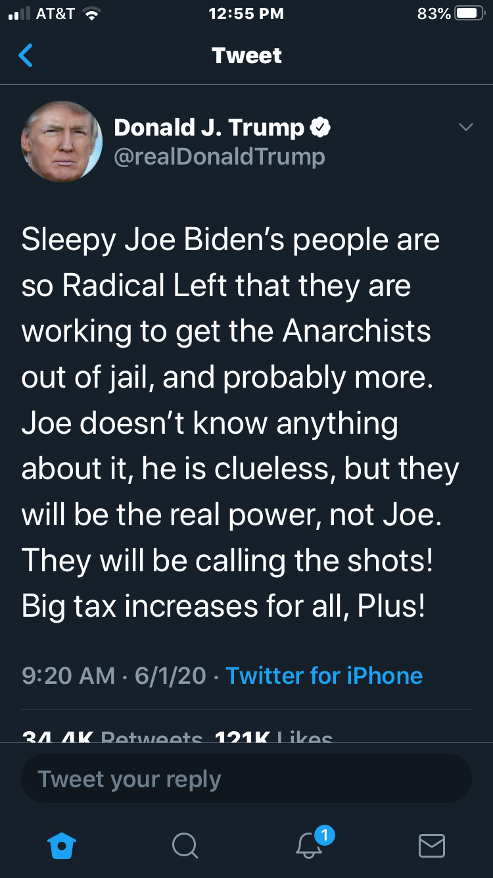
The Bizarre

Slide 13
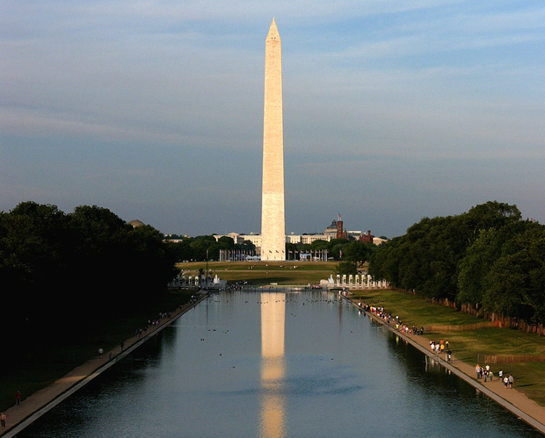
2. Presidential Domination

Slide 14
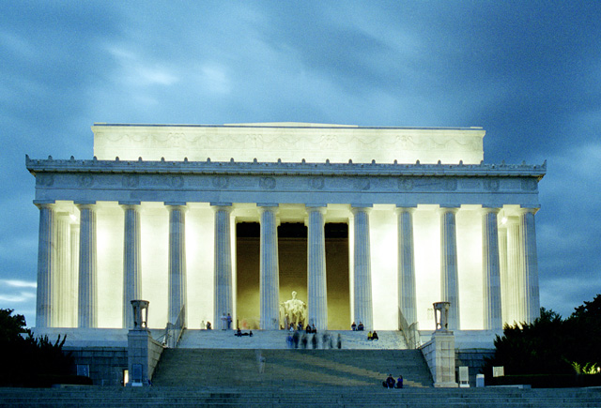
Lincoln Memorial

Slide 15
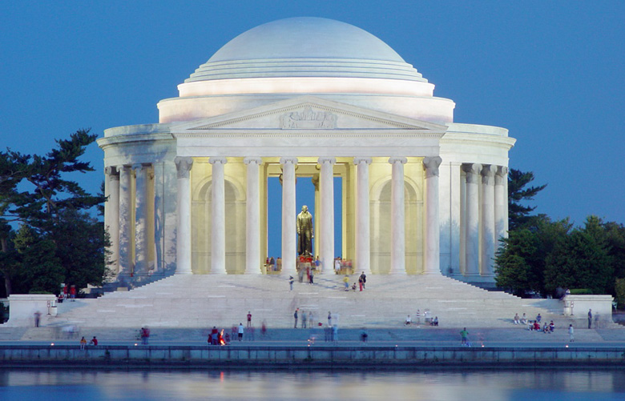
Jefferson Memorial

Slide 16
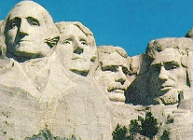
Mt. Rushmore

Slide 17
FDR Memorial

Slide 18
Speaker of the House Monument?

Slide 19
3. Cycles of Presidential Power
LBJ/Nixon Reagan Bush 43
Carter/Ford Bush 41/Clinton

