Slide 1
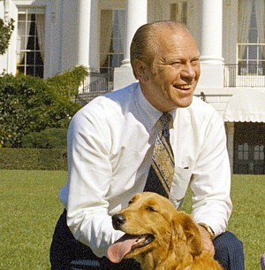
Gerald Ford and Jimmy Carter

Slide 2
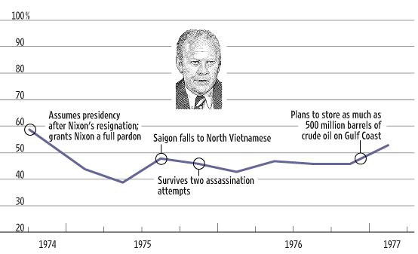
Ford Approval Ratings

Slide 3
Carter Approval Ratings

Slide 4
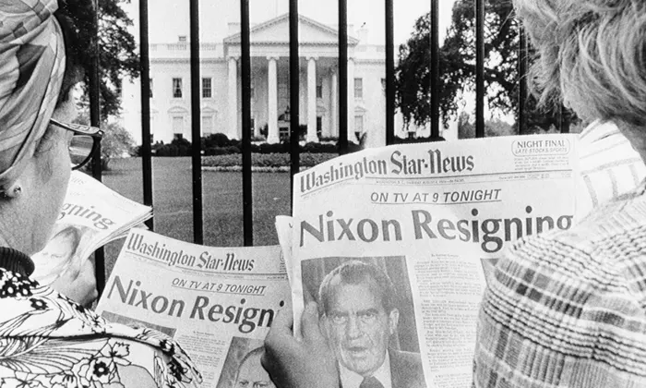
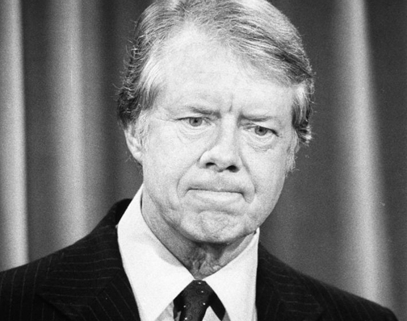
“No-Win Presidency”
Crisis of the Presidency
Presidency and the People
Presidency and Media
Congressional Power
To Weaken the Presidency

Slide 5
Crisis of the Presidency
“Imperial Presidency”
Arthur Schlesinger book
Lying
“credibility gap”

Slide 6
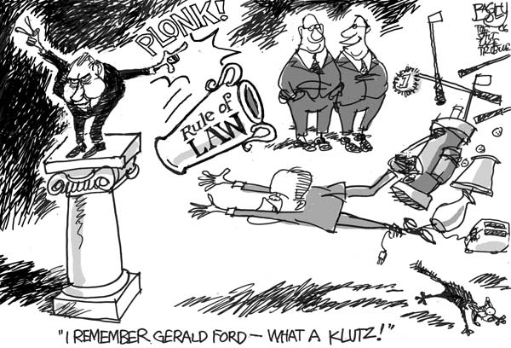
The President and the People From Daryl Cagle’s Political Cartoonists Index:http://www.cagle.com/news/GeraldFord/images/bagley.jpg

Slide 7
President and Media

Slide 8
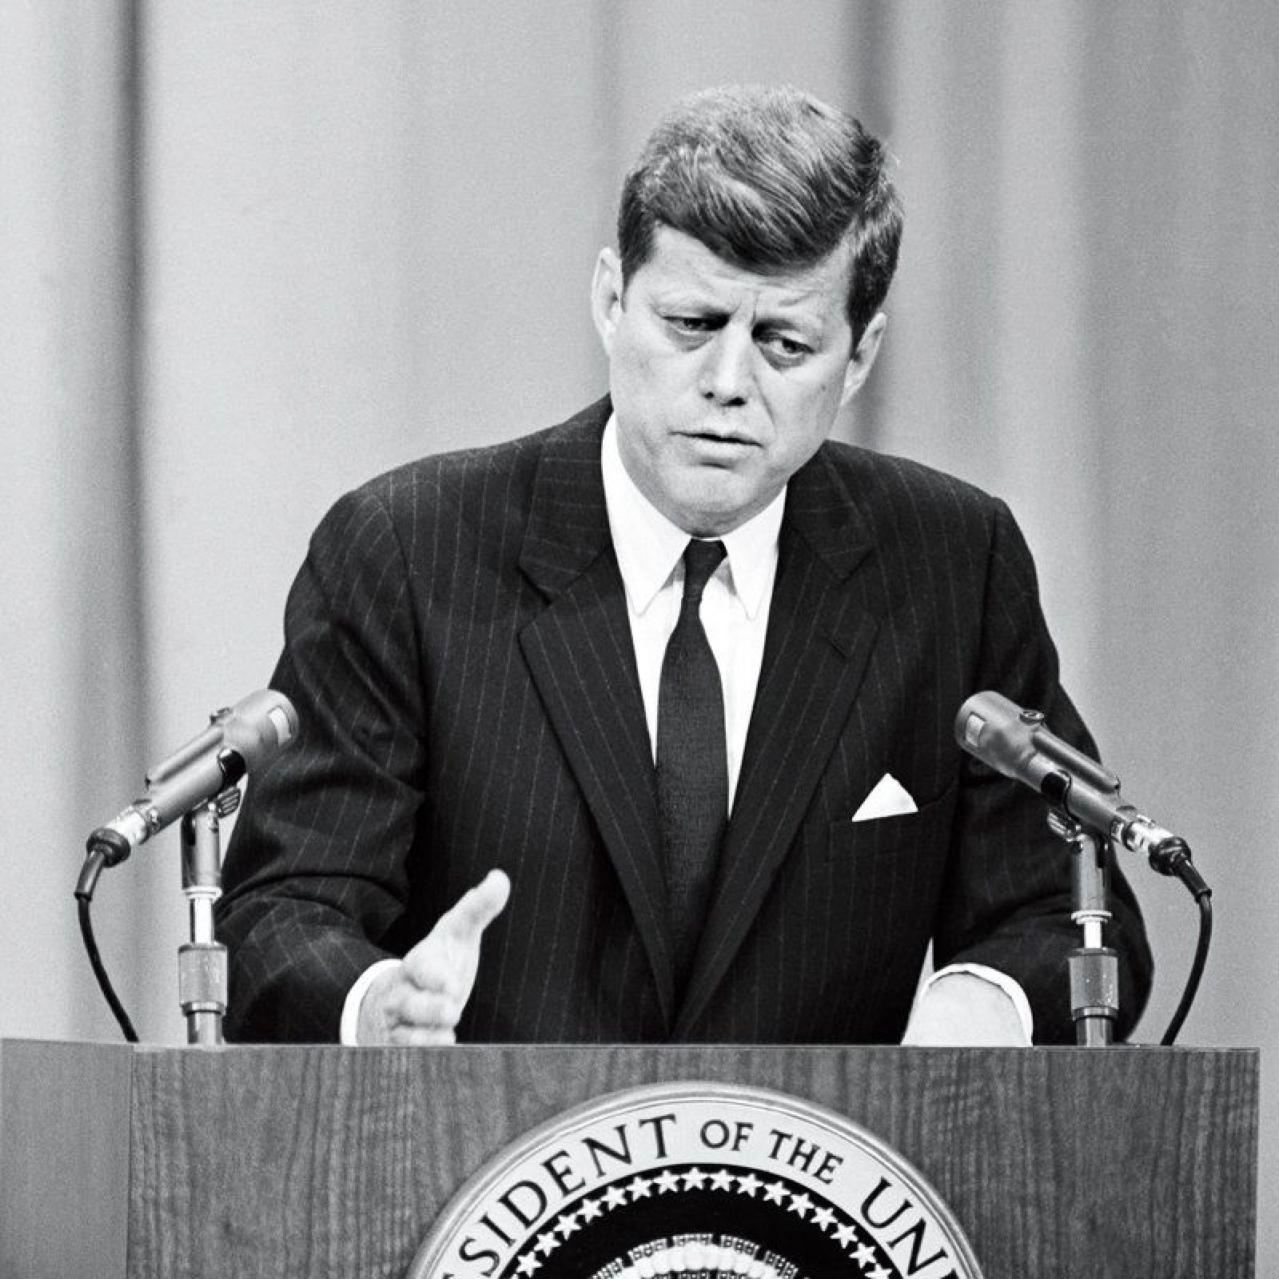
Press Keeping a President’s Secrets?

Slide 9
Congressional Power: Foreign Policy
War Powers Resolution 1973 (PL 93-148) (from Federation of American Scientists , see Appendix 3)
Clark Amendment to Arms Export Control Act 1976
(see next slide for Clark)

Slide 10
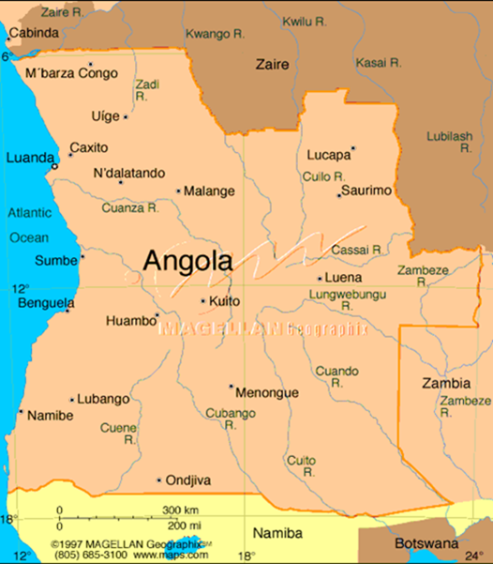
Congress and Foreign Policy (cntinued)
2. Clark Amendment to Arms Export Control Act 1976

Slide 11
Congressional Power: Domestic Politics
Congressional Budget and Impoundment Control Act 1974
Impoundment
Government Accountability Office (GAO)
Congressional Budget Office (CBO)
Office of Technology Assessment (OTA)
Congressional Research Service (CRS)
CRS reports on national security from Federation of American Scientists
CRS Reports on other areas, try EveryCRSReport.com and here, and here and here

Slide 12
Carter vs. Ford

Slide 13
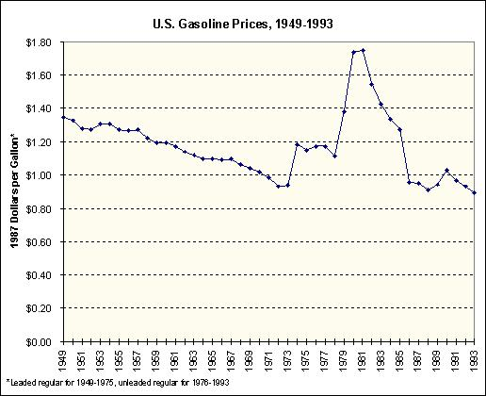
Energy
Source: Office of Trade and Economic Development, Washington state. Available at: http://www.cted.wa.gov/energy/archive/FILES/PRFL/docs/key09/k09page.htm

Slide 14
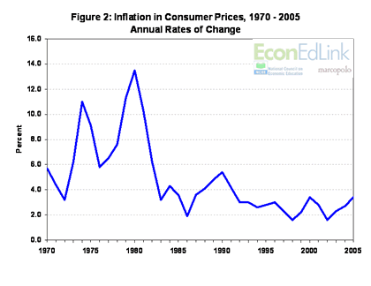
Inflation
A Case Study: The March Inflation Rate - April 19, 2006. Source: Econed.org, available at http://www.econedlink.org/lessons/index.cfm?lesson=EM685&page=teacher

Slide 15
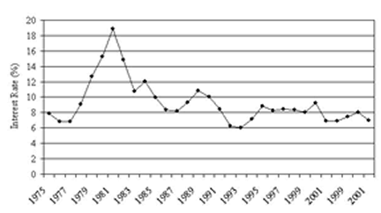
Interest Rates
Source: Christopher D. Merrett, The Future of Rural Communities in a Global Economy, University of Iowa Center for International Finance and Development. Available at: http://www.uiowa.edu/ifdebook/issues/globalization/perspectives/merrett.shtml

Slide 16
Carter’s “Crisis of Confidence” speech
July 1979 speech
‘Often you see paralysis and stagnation and drift. You don't like it, and neither do I. What can we do?...
One of the visitors to Camp David last week put it this way: “…The strength we need will not come from the White House, but from every house in America." ‘

Slide 17
November 4, 1979

